Slide 1
Aggregates in SQL
SQL Day 3 class

Slide 2
Introduction
Aggregation functions in SQL allows us to gain quantitative insight quickly
Sums, averages, minimums, maximums, and other transformations.
Strings can also be grouped and aggregated for building strings. In this lesson, we will look at common aggregations in SQL.

Slide 3
Learning Objectives
By the end of this lesson, you will be able to:
Calculate the average of a numerical value for a group.
Determine the minimum and maximum numerical value for a group.
Count the number of values and unique values for a field.
Aggregate strings into a delimited list.

Slide 4
Agenda
What is an Aggregate?
Define Min, Max, and AVG Functions
Exercise 1

Slide 5
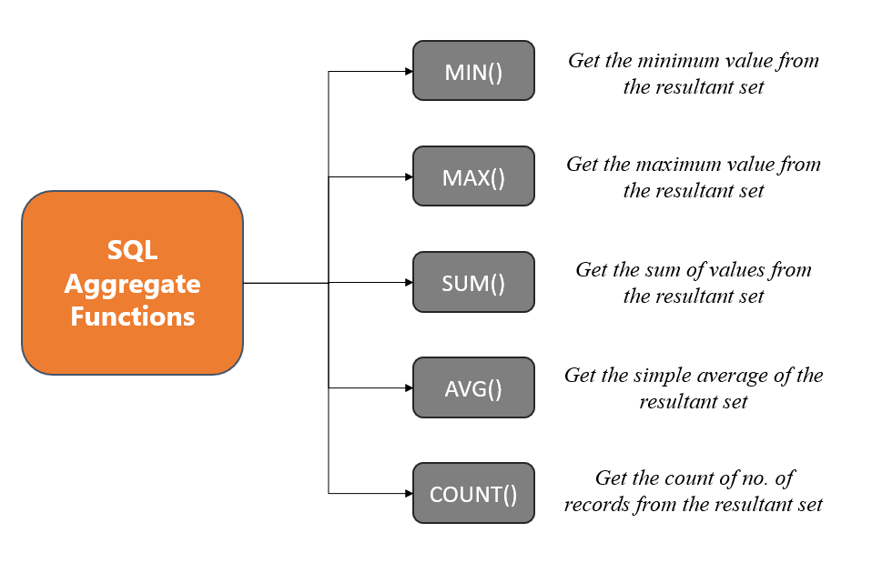
What is an aggregate?
Aggregation is the process of combining a set of values into a single value

Slide 6
Example 1
Suppose we want total dollar values for purchase orders, orders, or invoices. We can use aggregates to calculate:
The sums of multiple purchase orders and overall
Minimum and maximum values for those purchase orders or invoices

Slide 7
Example 2
Suppose we are teachers with students' assignment grades in a table. We can use aggregates to tell us:
What students are at the top and which are at the bottom
What the average grade is
How many assignments were submitted
How many unique students are enrolled in our class

Slide 8
Agenda
What is an Aggregate?
Define Min, Max, and AVG Functions
Exercise 1

Slide 9
Aggregate Functions
What is an Aggregate function?
Remember a SQL function is a reusable block of SQL code that can be called/invoked to perform a specific task in a database
Aggregate functions - Perform a calculation on a set of values and return a single value
Examples: COUNT(), MAX(), AVG()

Slide 10
Minimum Function
The MIN() function in SQL is an aggregate function that allows you to find the minimum value from a set of records or values in a particular column of a table.
The basic syntax is:
SELECT MIN(column_name) FROM table_name

Slide 11
Maximum Function
The MAX() function in SQL is an aggregate function that allows you to find the maximum value from a set of records or values in a particular column of a table.
The basic syntax is:
SELECT MAX(column_name) FROM table_name;

Slide 12
Average Function
The AVG() function in SQL is an aggregate function that allows you to calculate the average value from a numeric column in a table.
The basic syntax is:
SELECT AVG(column_name) FROM table_name;

Slide 13
Key Points
Can be used with numeric, character, and date/time data types
Ignores NULL values when calculating the minimum value.
Can be used with WHERE and GROUP BY to find minimums of subsets of rows
Can also be combined with the DISTINCT keyword if you only want unique values considered:
SELECT MIN(DISTINCT column_name) FROM table_name;

Slide 14
Agenda
What is an Aggregate?
Define Min, Max, and AVG Functions
Exercise 1

Slide 15
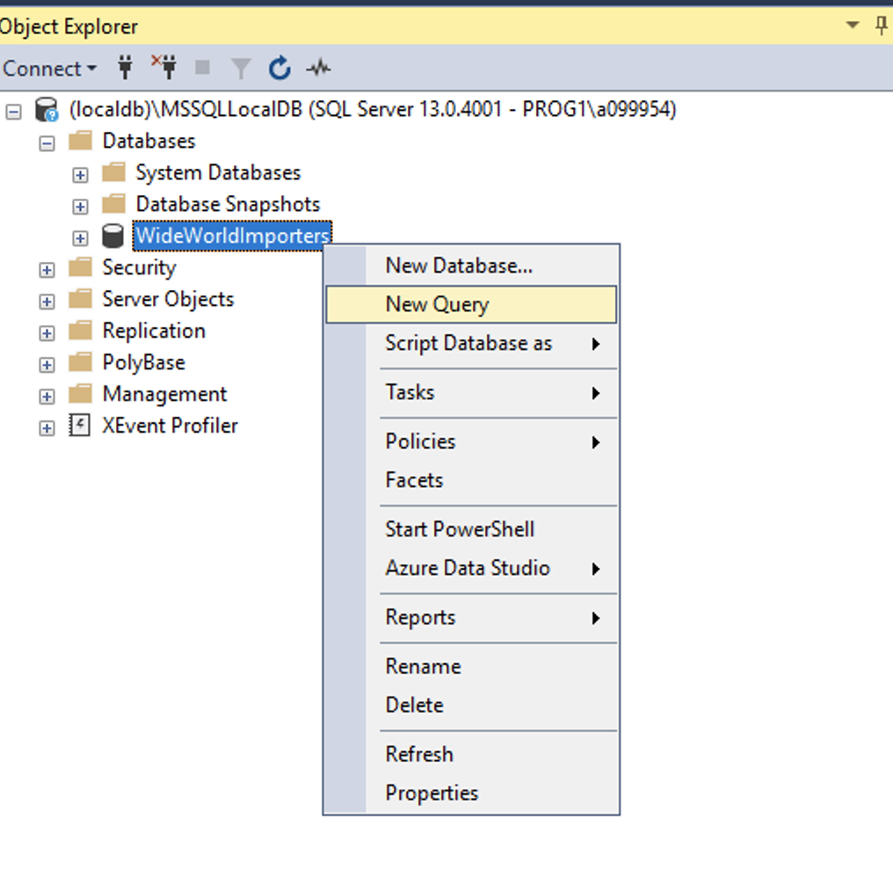
Exercise
Using the World Wide Importers Database
Please open up SSMS
Connect to localhost
(localdb)\MSSQLLocalDB
Right click on WorldWideImporters
Select new query

Slide 16
Exercise 1
Situation:
The warehouse manager wondered if we could assist in tracking their cold room temperatures.
They want to know the minimum, maximum, and average temperature for the cold room.
Take 5 – 10 Minutes
Raise your hand when you have finished

Slide 17
Exercise 1
Answer
SELECT MIN(Temperature),
MAX(Temperature),
AVG(Temperature)
FROM Warehouse.ColdRoomTemperatures
Min Value | Max Value | Average Value
3.00 | 4.70 | 3.750000

Slide 18
Questions?

