Slide 1
Aggregates in SQL
SQL Day 3 class

Slide 2
Introduction
Aggregation functions in SQL allows us to gain quantitative insight quickly
Sums, averages, minimums, maximums, and other transformations.
Strings can also be grouped and aggregated for building strings. In this lesson, we will look at common aggregations in SQL.

Slide 3
Learning Objectives
By the end of this lesson, you will be able to:
Calculate the average of a numerical value for a group.
Determine the minimum and maximum numerical value for a group.
Count the number of values and unique values for a field.
Aggregate strings into a delimited list.

Slide 4
Agenda
What is an Aggregate?
Define Function

Slide 5
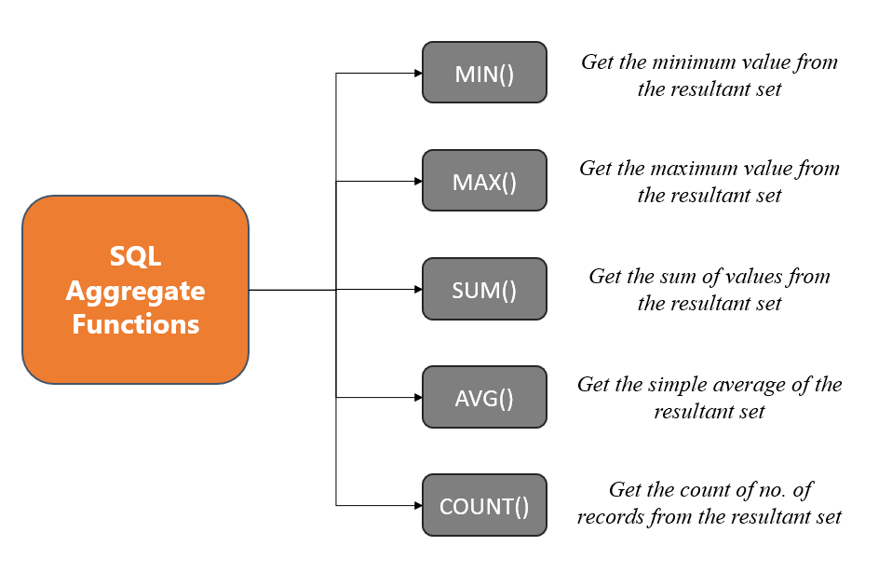
What is an aggregate?
Aggregation is the process of combining a set of values into a single value

Slide 6
Example 1
Suppose we want total dollar values for purchase orders, orders, or invoices. We can use aggregates to calculate:
The sums of multiple purchase orders and overall
Minimum and maximum values for those purchase orders or invoices

Slide 7
Example 2
Suppose we are teachers with students' assignment grades in a table. We can use aggregates to tell us:
What students are at the top and which are at the bottom
What the average grade is
How many assignments were submitted
How many unique students are enrolled in our class

Slide 8
Agenda
What is an Aggregate?
Define Function

Slide 9
Function 1
Min Function
This returns the smallest value in a given column.

Slide 10
Function 2
MAX Function
This returns the largest value in a given column.

Slide 11
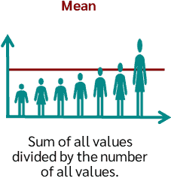
Function 3
Average Function
This returns the mean value in a given column.
Notes:
Give us your speaking points

Slide 12
Agenda
What is an Aggregate?
Define Function
SQL Context

Slide 13
SQL Statement
The Syntax for the functions described:
SELECT MIN(Column_name),
MAX(Column_name),
AVG(Column_name)
FROM Table_name

Slide 14
Agenda
What is an Aggregate?
Define Function
SQL Context
Exercise 1

Slide 15
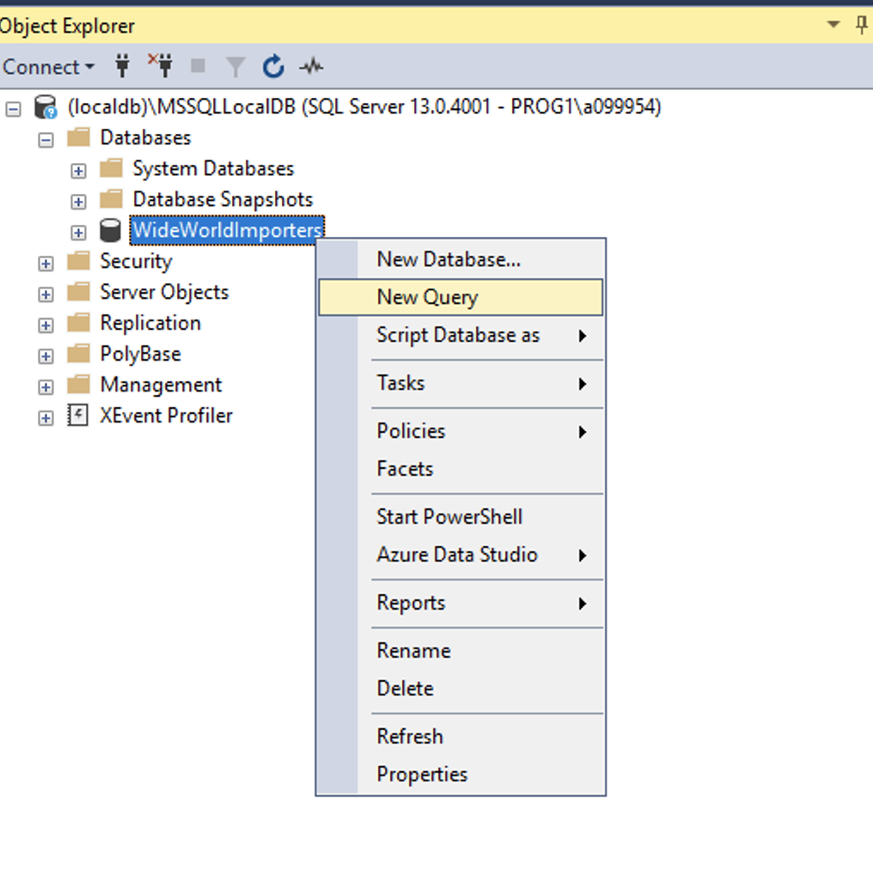
Exercise
We will be using the World Wide Importers Database
Please open up SSMS
Connect to localhost
(localdb)\MSSQLLocalDB
Right click on WorldWideImporters
Select new query

Slide 16
Exercise 1
Situation:
The warehouse manager wondered if we could assist in tracking their cold room temperatures.
They want to know the minimum, maximum, and average temperature for the cold room.
Take 5 – 10 Minutes
Raise your hand when you have finished

Slide 17
Exercise 1
Answer
SELECT MIN(Temperature),
MAX(Temperature),
AVG(Temperature) FROM Warehouse.ColdRoomTemperatures
(No column name) | (No column name) | (No column name)
3.00 | 4.70 | 3.750000

Slide 18
Questions?

