Slide 1
Touch interface with three.js

Slide 2
Use jQuery as much as possible
To simplify coding

Slide 3
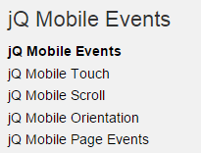
Questions
http://hammerjs.github.io/
Web audio api works?
Button.click() counterpart?
Localstorage works?
Yes (25int)
Orientation test?!
http://stackoverflow.com/questions/17068877/jquery-click-event-for-tablets-and-touch-screen-phones
http://www.w3schools.com/jquerymobile/jquerymobile_events_intro.asp

Slide 4
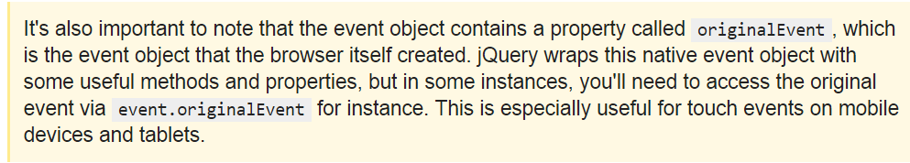
originalEvent:
http://stackoverflow.com/questions/16674963/event-originalevent-jquery

Slide 5
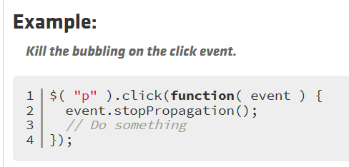
https://api.jquery.com/event.stoppropagation/
http://stackoverflow.com/questions/10082031/why-use-jquery-on-instead-of-click

