Slide 1
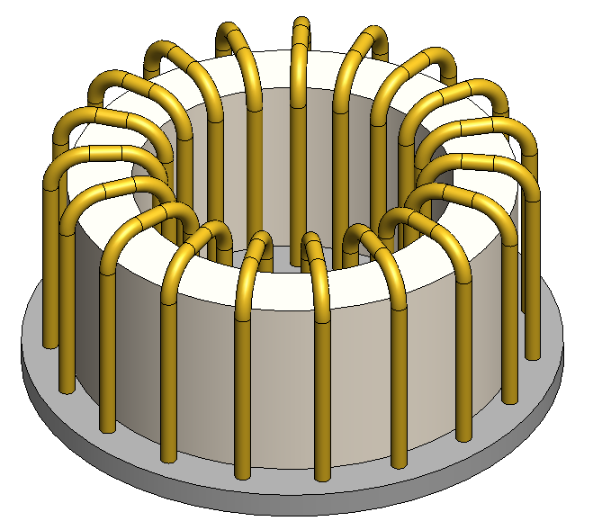
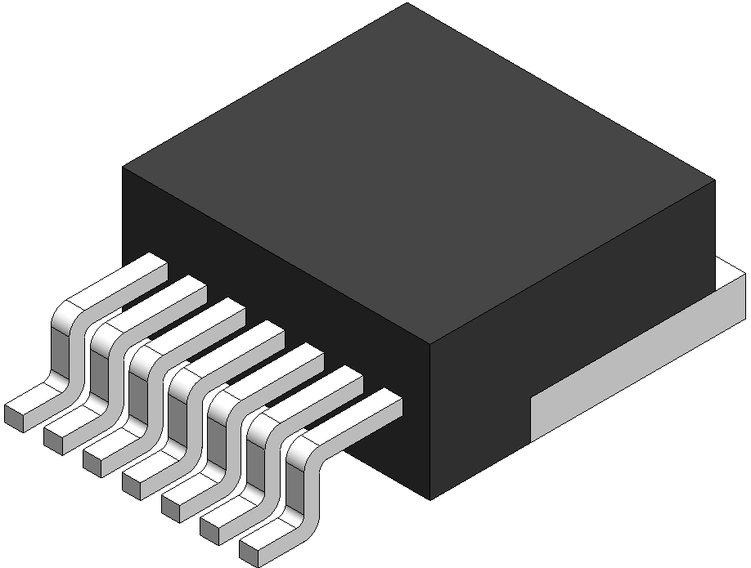
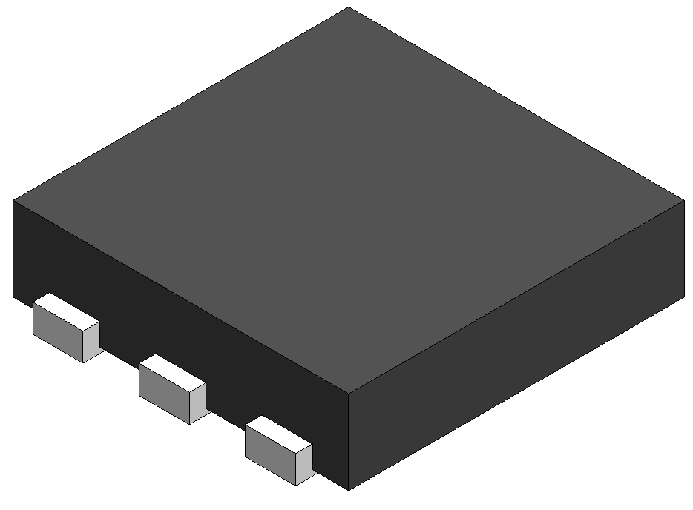
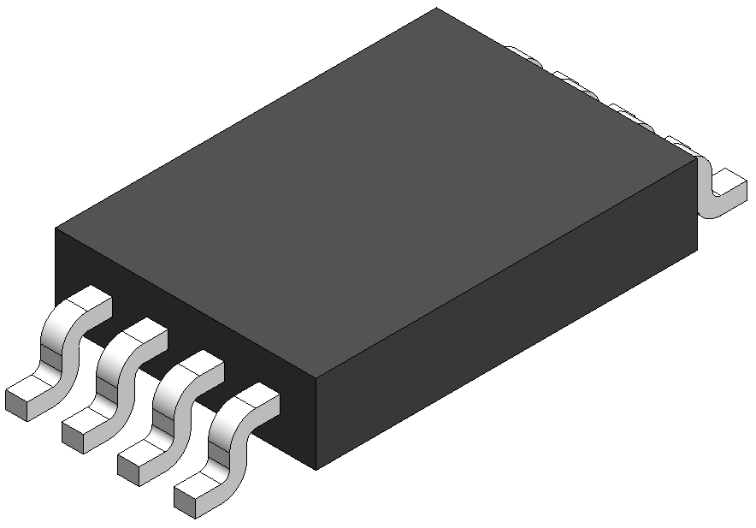
1x Common Mode Choke SCF47X-200-S1R8B011JH From Kemet
3x FET
IMBG65R048M1HXTMA1
From Infineon
2x Transformers
CAT6243
from Onsemi
2x Inductors
DMN3020UTS
From Diodes Inc

Slide 2
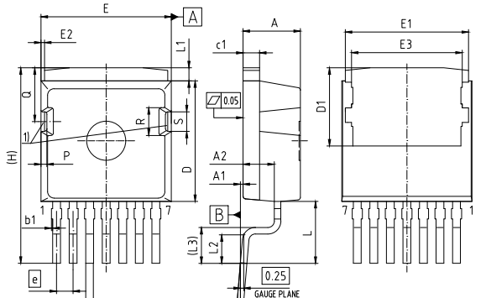
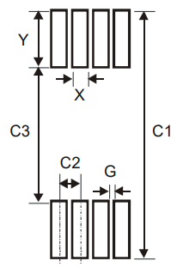
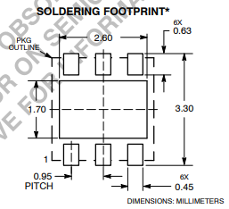
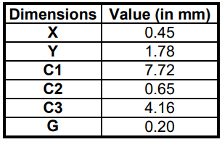
3x FET
IMBG65R048M1HXTMA1
From Infineon
2x Transformers
CAT6243
from Onsemi
2x Inductors
DMN3020UTS
From Diodes Inc

Slide 3
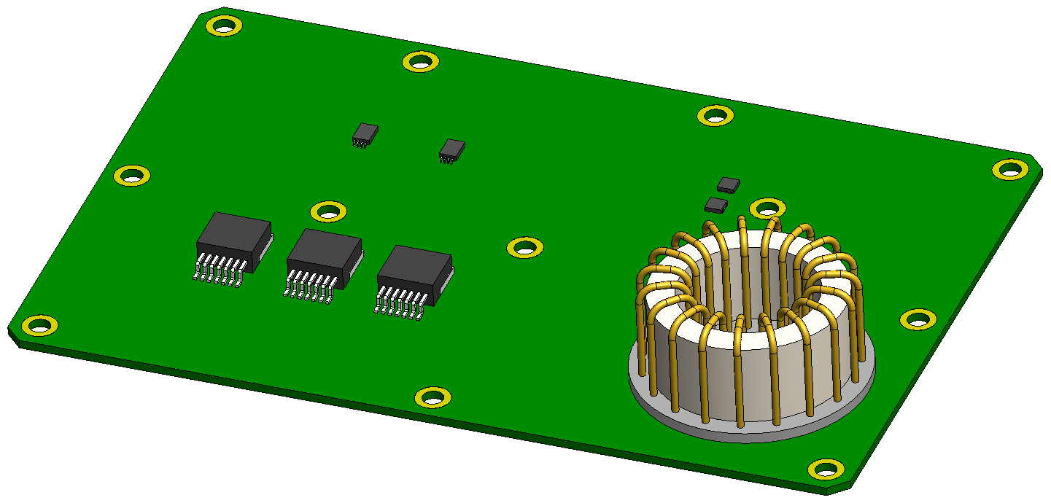

Slide 4
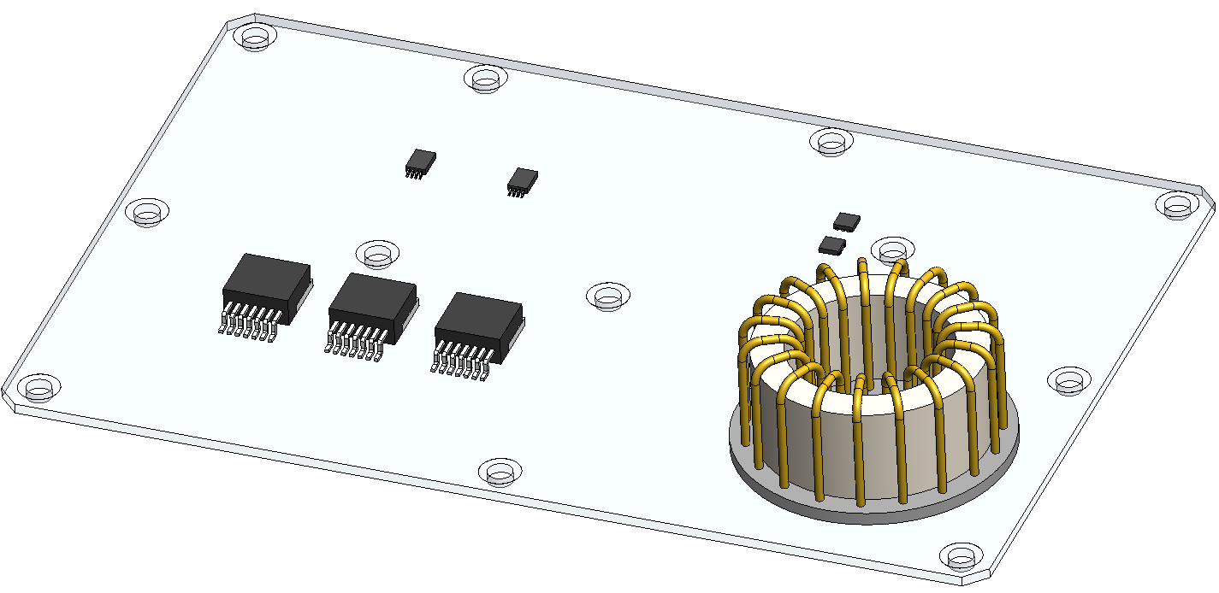

Slide 5
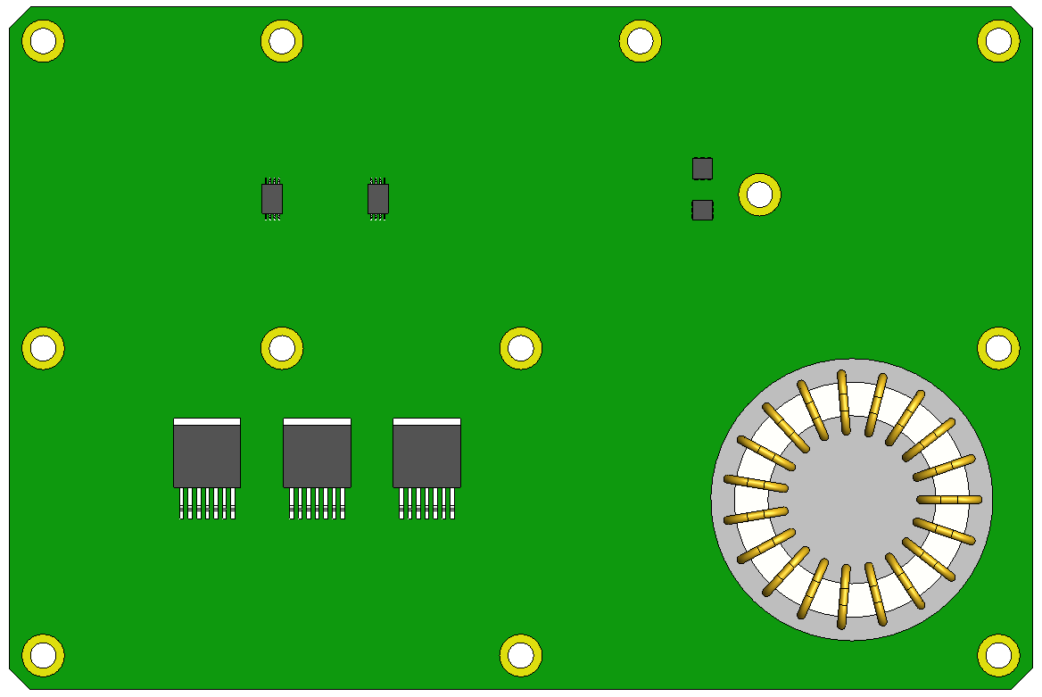

Slide 6
2oz Copper
VT-5A2
2oz Copper
VT-5A2
Al-Clad Base

Slide 7
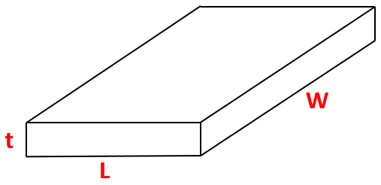

Slide 8
Cu Layer
Cu Layer
Cu Layer
VT-5A2 Layer
VT-5A2 Layer
Al-Clad Base

Slide 9
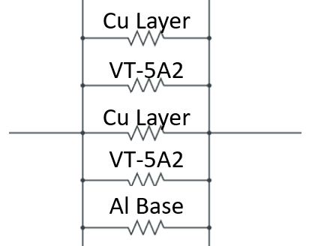

Slide 10
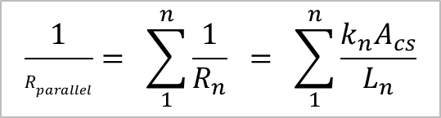
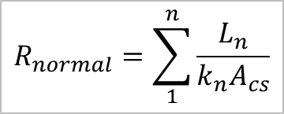
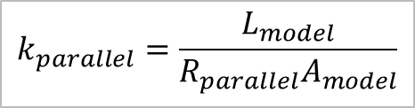

$$R_{normal}=\sum_{1}^{n}{\frac{L_{n}}{k_{n}A_{cs}}}$$
$$\frac{1}{R_{parallel}}= \sum_{1}^{n}{\frac{1}{R_{n}}} = \sum_{1}^{n}{\frac{k_{n}A_{cs}}{L_{n}}}$$
$$k_{normal}=\frac{L_{model}}{R_{normal}A_{model}}$$
$$k_{parallel}=\frac{L_{model}}{R_{parallel}A_{model}}$$

Slide 11
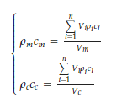

Slide 12
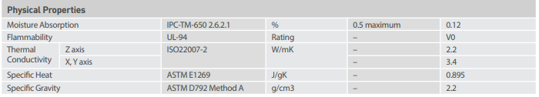

Slide 13
