Slide 1
Data Mining:
Concepts and Techniques
— Chapter 2 —
Jiawei Han, Micheline Kamber, and Jian Pei
University of Illinois at Urbana-Champaign
Simon Fraser University
©2011 Han, Kamber, and Pei. All rights reserved.

Slide 2
Chapter 2: Getting to Know Your Data
Data Objects and Attribute Types
Basic Statistical Descriptions of Data
Data Visualization
Measuring Data Similarity and Dissimilarity
Summary

Slide 3
Data Objects
Data sets are made up of data objects.
A data object represents an entity.
Examples:
  sales database: customers, store items, sales
  medical database: patients, treatments
  university database: students, professors, courses
Also called samples , examples, instances, data points, objects, tuples.
Data objects are described by attributes.
Database rows -> data objects; columns ->attributes.

Slide 4
Attributes
Attribute (or dimensions, features, variables): a data field, representing a characteristic or feature of a data object.
  E.g., customer _ID, name, address
Types:
  Nominal
  Binary
  Numeric: quantitative
    Interval-scaled
    Ratio-scaled

Slide 5
Attribute Types
Nominal: categories, states, or “names of things”
  Hair_color = {auburn, black, blond, brown, grey, red, white}
  marital status, occupation, ID numbers, zip codes
Binary
  Nominal attribute with only 2 states (0 and 1)
  Symmetric binary: both outcomes equally important
    e.g., gender
  Asymmetric binary: outcomes not equally important.
    e.g., medical test (positive vs. negative)
    Convention: assign 1 to most important outcome (e.g., HIV positive)
Ordinal
  Values have a meaningful order (ranking) but magnitude between successive values is not known.
  Size = {small, medium, large}, grades, army rankings

Slide 6
Numeric Attribute Types
Quantity (integer or real-valued)
Interval
    Measured on a scale of equal-sized units
    Values have order
      E.g., temperature in C˚or F˚, calendar dates
    No true zero-point
Ratio
    Inherent zero-point
    We can speak of values as being an order of magnitude larger than the unit of measurement (10 K˚ is twice as high as 5 K˚).
      e.g., temperature in Kelvin, length, counts, monetary quantities

Slide 7
Discrete vs. Continuous Attributes
Discrete Attribute
  Has only a finite or countably infinite set of values
    E.g., zip codes, profession, or the set of words in a collection of documents
  Sometimes, represented as integer variables
  Note: Binary attributes are a special case of discrete attributes
Continuous Attribute
  Has real numbers as attribute values
    E.g., temperature, height, or weight
  Practically, real values can only be measured and represented using a finite number of digits
  Continuous attributes are typically represented as floating-point variables

Slide 8
Chapter 2: Getting to Know Your Data
Data Objects and Attribute Types
Basic Statistical Descriptions of Data
Data Visualization
Measuring Data Similarity and Dissimilarity
Summary

Slide 9
Basic Statistical Descriptions of Data
Motivation:
  Gives an overall picture of the data.
  Identifies the properties of the data and highlight which data values should be treated as noise or outliers.
Three areas of basic statistical descriptions:
  Central tendency
    Given an attribute where do most of its values fall?
  Dispersion
    How are the data spread out?
  Graphical representation

Slide 10
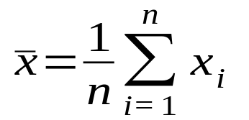
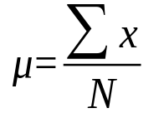
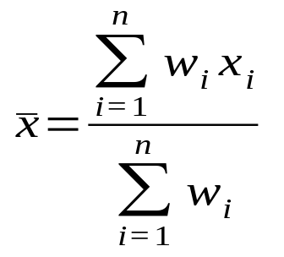
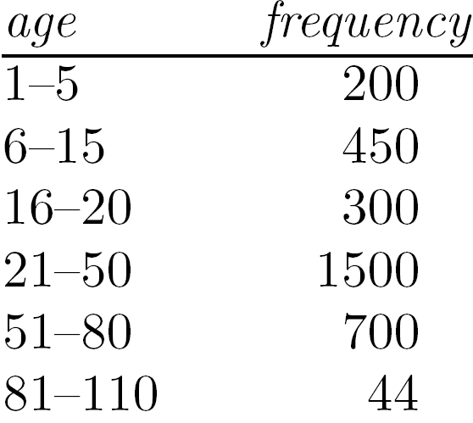
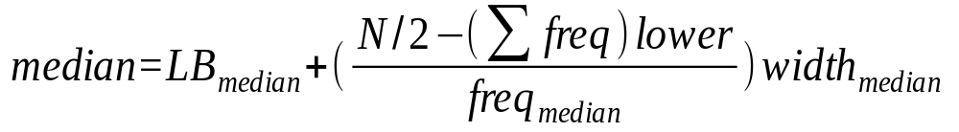
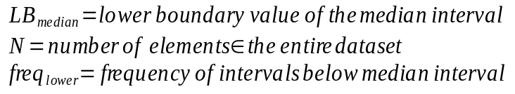
Measuring the Central Tendency
Mean (algebraic measure) (sample vs. population):
  Note: n is sample size and N is population size.
  Weighted arithmetic mean:
  Trimmed mean: chopping extreme values
Median:
  Middle value if odd number of values, or average of the middle two values otherwise
  Estimated by interpolation (for grouped data):

Slide 11
Measuring the Central Tendency
Mode
  Value that occurs most frequently in the data
  Unimodal, bimodal, trimodal
  Empirical relation (for unimodal, moderately asymmetric data):

Slide 12
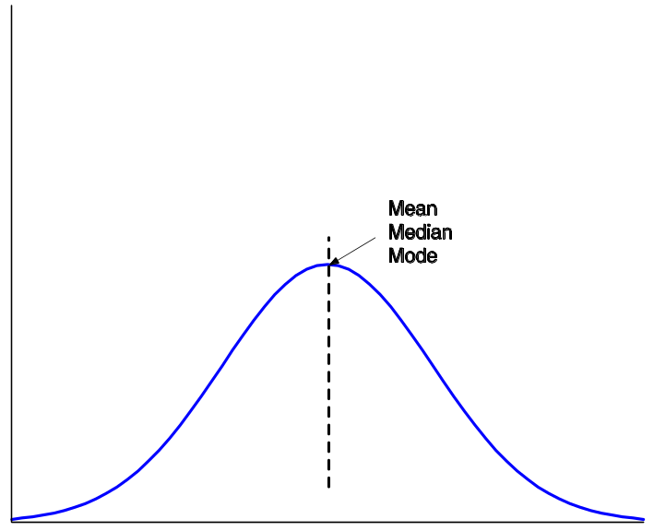


Symmetric vs. Skewed Data
Symmetric data distribution:
  Mean, median and mode are all at the same center value
Positively skewed data
  Mode is smaller than median
Negatively skewed data
  Mode is greater than median
symmetric
positively skewed
negatively skewed
Data Mining: Concepts and Techniques

Slide 13
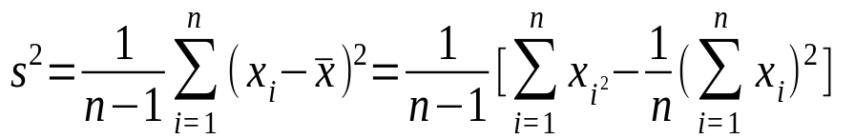
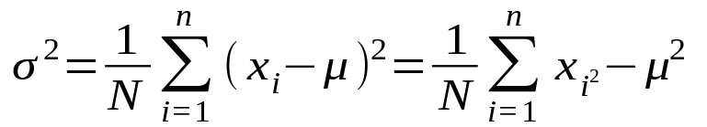
Measuring the Dispersion of Data
Quartiles, outliers and boxplots
  Quartiles: Q₁ (25th percentile), Q₃ (75th percentile)
  Inter-quartile range: IQR = Q₃ – Q₁
  Five number summary: min, Q₁, median, Q₃, max
  Boxplot: ends of the box are the quartiles; median is marked; add whiskers, and plot outliers individually
  Outlier: usually, a value higher/lower than 1.5 x IQR
Variance and standard deviation (sample: s, population: σ)
  Variance: (algebraic, scalable computation)
  Standard deviation s (or σ) is the square root of variance s² ⁽or σ²⁾
OpenIntroStatistics slides:
Ch. 1 Sec. 6 Examining numerical data

Slide 14
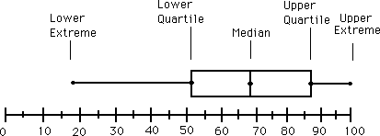
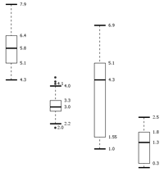
Boxplot Analysis
Five-number summary of a distribution
  Minimum, Q1, Median, Q3, Maximum
Boxplot
  Data is represented with a box
  The ends of the box are at the first and third quartiles, i.e., the height of the box is IQR
  The median is marked by a line within the box
  Whiskers: two lines outside the box extended to Minimum and Maximum
  Outliers: points beyond a specified outlier threshold, plotted individually

Slide 15
Graphic Displays of Basic Statistical Descriptions
Boxplot: graphic display of five-number summary
Histogram: x-axis are values, y-axis repres. frequencies
Quantile plot: each value x_{i} is paired with f_{i} indicating that approximately 100 f_{i} % of data are ≤ x_{i}
Quantile-quantile (q-q) plot: graphs the quantiles of one univariant distribution against the corresponding quantiles of another
Scatter plot: each pair of values is a pair of coordinates and plotted as points in the plane

Slide 16
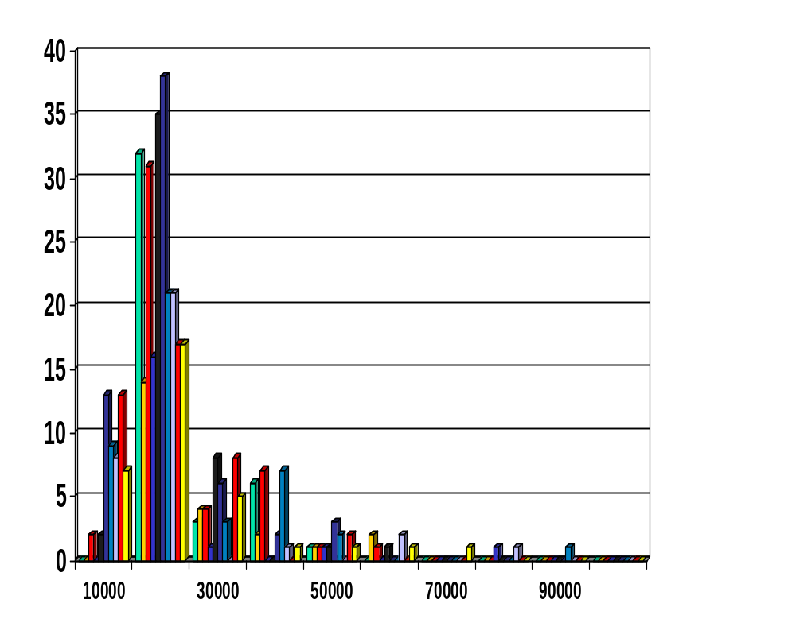
Histogram Analysis
Histogram: Graph display of tabulated frequencies, shown as bars
It shows what proportion of cases fall into each of several categories
Differs from a bar chart in that it is the area of the bar that denotes the value, not the height as in bar charts, a crucial distinction when the categories are not of uniform width
The categories are usually specified as non-overlapping intervals of some variable. The categories (bars) must be adjacent

Slide 17
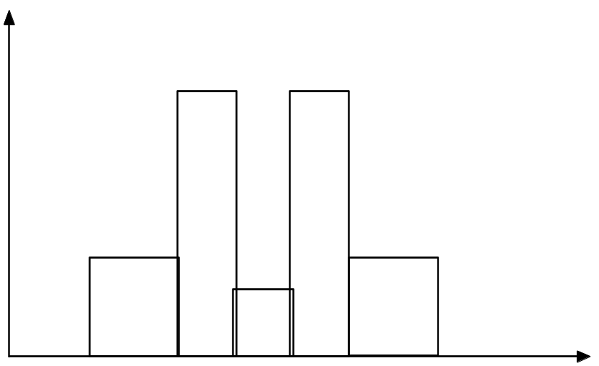
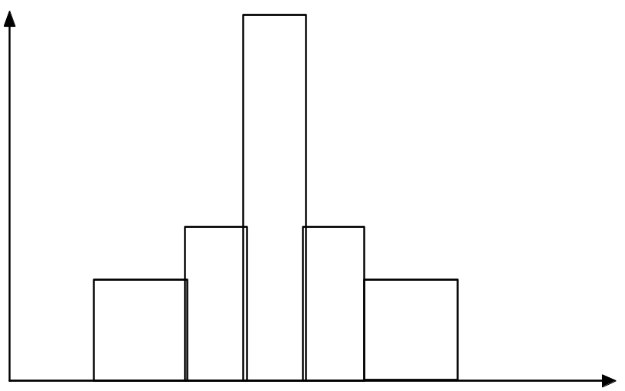
Histograms Often Tell More than Boxplots
The two histograms shown in the left may have the same boxplot representation
  The same values for: min, Q1, median, Q3, max
But they have rather different data distributions

Slide 18
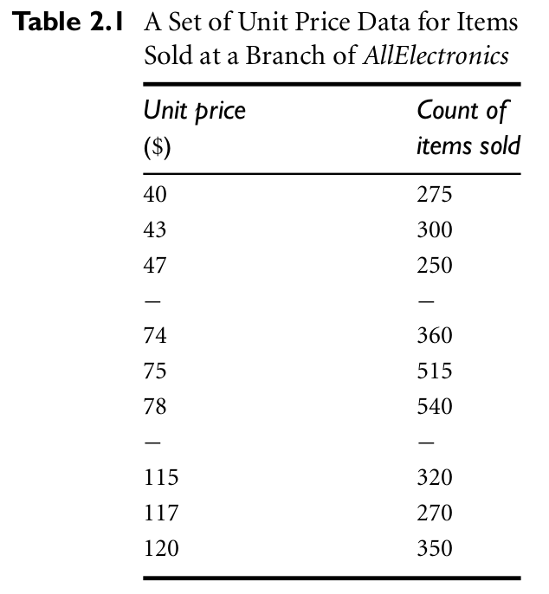
Quantile Plot
Displays all of the data (allowing the user to assess both the overall behavior and unusual occurrences)
Data Mining: Concepts and Techniques

Slide 19
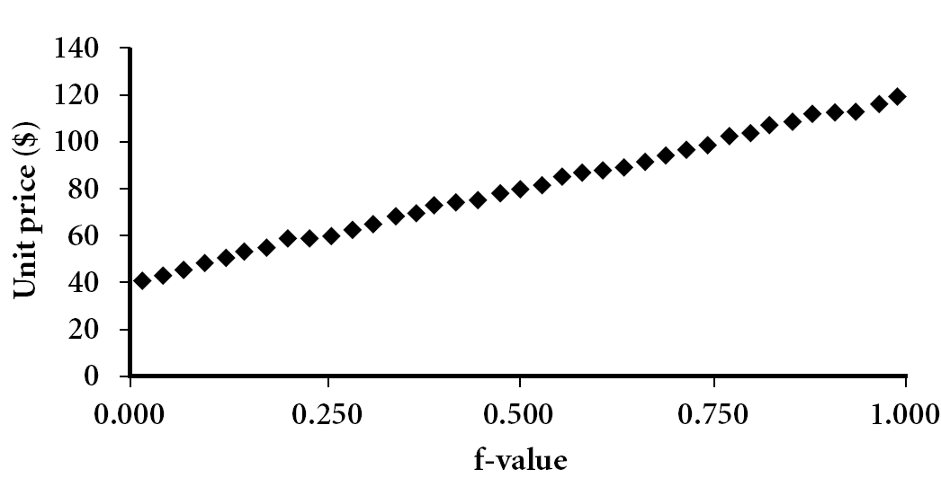
Quantile Plot
Displays all of the data (allowing the user to assess both the overall behavior and unusual occurrences)
Plots quantile information
  For a data x_{i} data sorted in increasing order, f_{i} indicates that approximately 100 f_{i}% of the data are below or equal to the value x_{i}
Data Mining: Concepts and Techniques

Slide 20
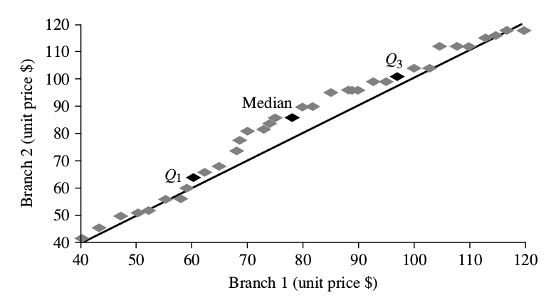
Quantile-Quantile (Q-Q) Plot
Graphs the quantiles of one univariate distribution against the corresponding quantiles of another
View: Is there is a shift in going from one distribution to another?
Example shows unit price of items sold at Branch 1 vs. Branch 2 for each quantile. Unit prices of items sold at Branch 1 tend to be lower than those at Branch 2.
Notes:
Note: We need to label the dark plotted points as Q1, Median, Q3 – that would help in understanding this graph.
Tell audience: There is a shift in distribution of branch 1 WRT branch 2 in that the unit prices of items sold at branch 1 tend to be lower than those at branch 2.

Slide 21
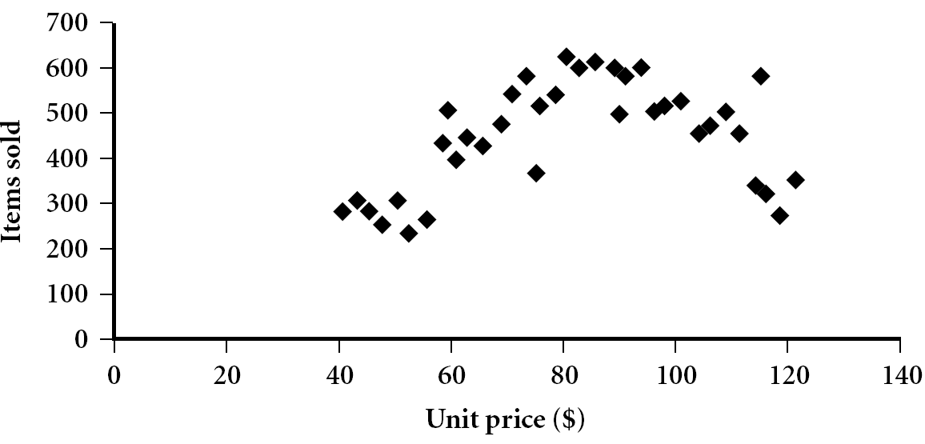
Scatter plot
Provides a first look at bivariate data to see clusters of points, outliers, etc
Each pair of values is treated as a pair of coordinates and plotted as points in the plane

Slide 22


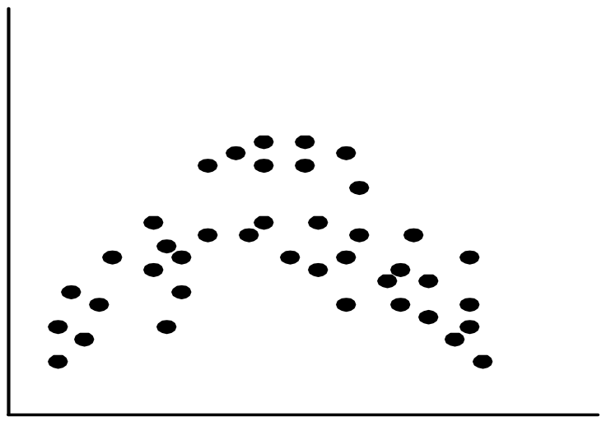
Positively and Negatively Correlated Data
The left half fragment is positively correlated
The right half is negative correlated

Slide 23


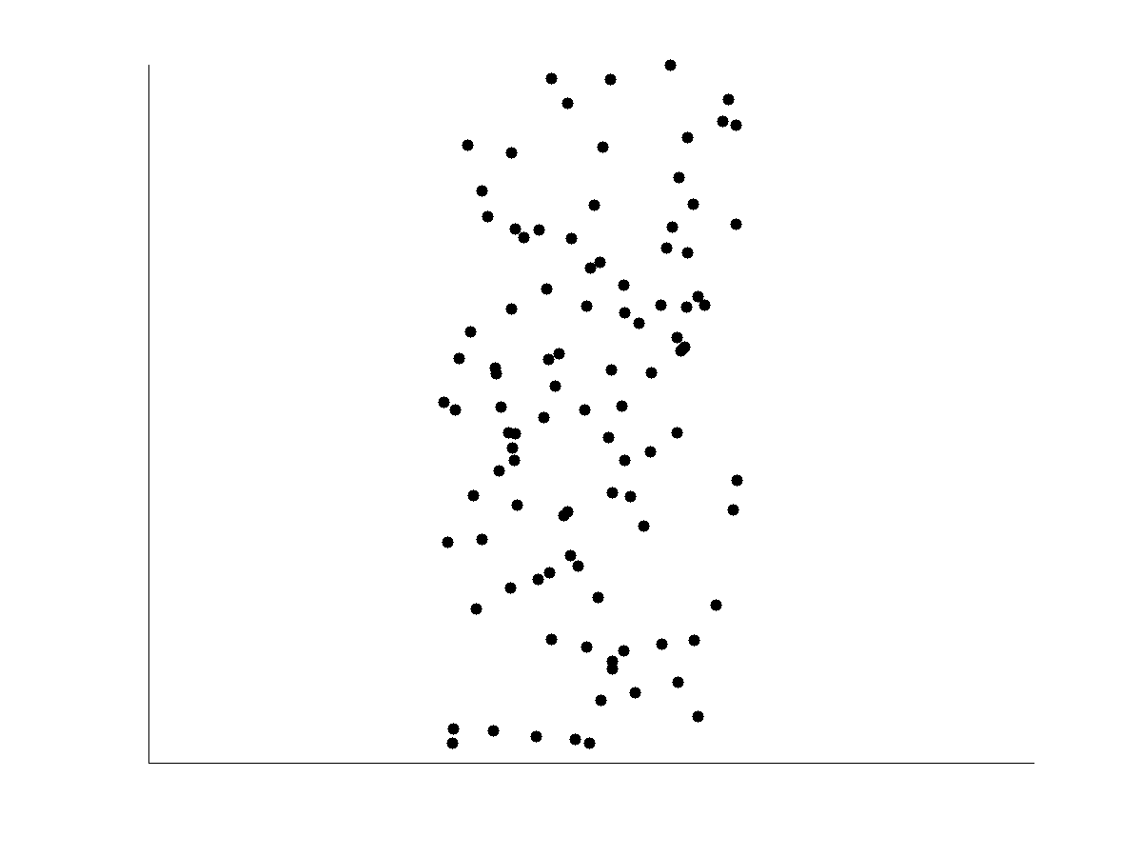
Uncorrelated Data

Slide 24
Chapter 2: Getting to Know Your Data
Data Objects and Attribute Types
Basic Statistical Descriptions of Data
Data Visualization
Measuring Data Similarity and Dissimilarity
Summary

Slide 25
Similarity and Dissimilarity
Similarity
  Numerical measure of how alike two data objects are
  Value is higher when objects are more alike
  Often falls in the range [0,1]
Dissimilarity (e.g., distance)
  Numerical measure of how different two data objects are
  Lower when objects are more alike
  Minimum dissimilarity is often 0
  Upper limit varies
Proximity refers to a similarity or dissimilarity

Slide 26
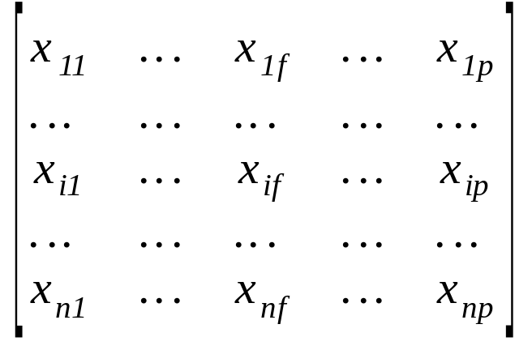
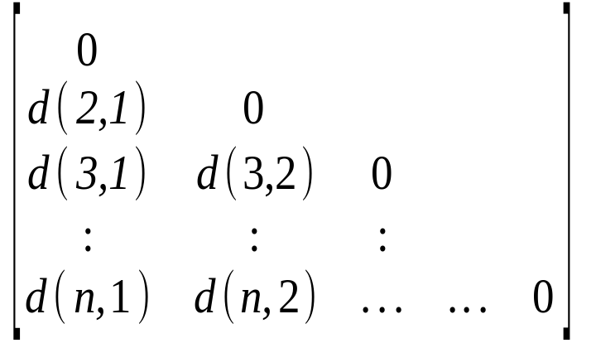
Data Matrix and Dissimilarity Matrix
Data matrix
  n data points with p dimensions
  Two modes
  n x p entries
Dissimilarity matrix
  n data points, but registers only the distance
  A triangular matrix
  Single mode
  n x n entries

Slide 27


Proximity Measure for Nominal Attributes
Can take 2 or more states, e.g., red, yellow, blue, green (generalization of a binary attribute)
Simple matching method:
  m: # of matches, p: total # of variables
Alternatively, similarity can be computed as:

Slide 28
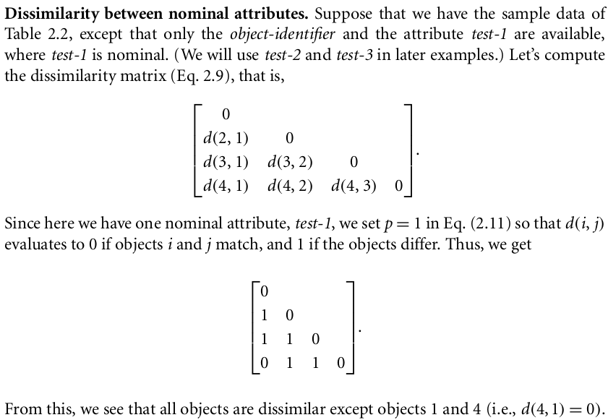
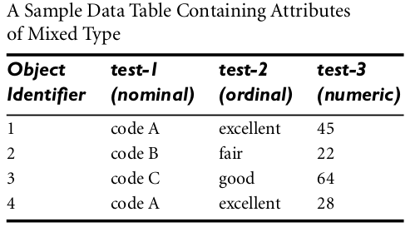
Proximity Measure for Nominal Attributes, Example

Slide 29
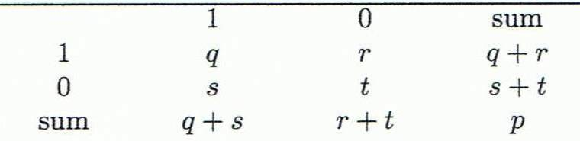
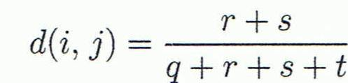
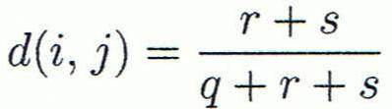

Proximity Measure for Binary Attributes
A contingency table for binary data
Distance measure for symmetric binary variables:
Distance measure for asymmetric binary variables (negative matches are ignored):
Jaccard coefficient (similarity measure for asymmetric binary variables):
Object j
Object i

Slide 30

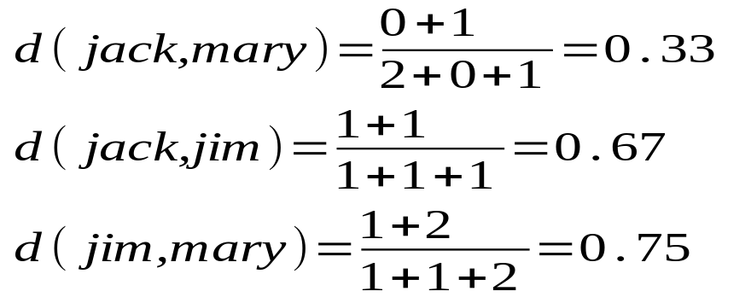
Dissimilarity between Binary Variables
Example
  Gender is a symmetric attribute
  The remaining attributes are asymmetric binary
  Let the values Y and P be 1, and the value N 0
  Distance based only on the asymmetric attributes:

Slide 31
Distance on Numeric Data: Minkowski Distance
Minkowski distance: A popular distance measure
  where i = (x_{i1}, x_{i2}, …, x_{ip}) and j = (x_{j1}, x_{j2}, …, x_{jp}) are two p-dimensional data objects, and h is the order (the distance so defined is also called L-h norm)
Properties
  d(i, j) > 0 if i ≠ j, and d(i, i) = 0 (Positive definiteness)
  d(i, j) = d(j, i) (Symmetry)
  d(i, j) ≤ d(i, k) + d(k, j) (Triangle Inequality)
A distance that satisfies these properties is a metric

Slide 32

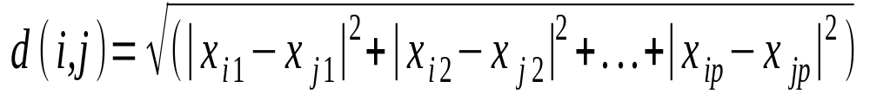
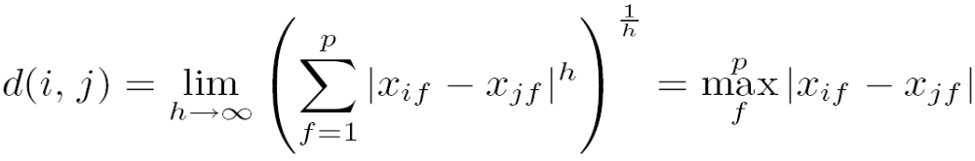
Special Cases of Minkowski Distance
h = 1: Manhattan (city block, L₁ norm) distance
  E.g., the Hamming distance: the number of bits that are different between two binary vectors
h = 2: (L₂ norm) Euclidean distance
h → ∞. “supremum” (L_{max} norm, L∞ norm) distance.
  This is the maximum difference between any component (attribute) of the vectors

Slide 33
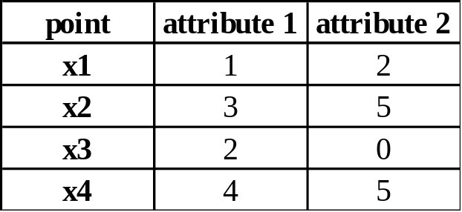
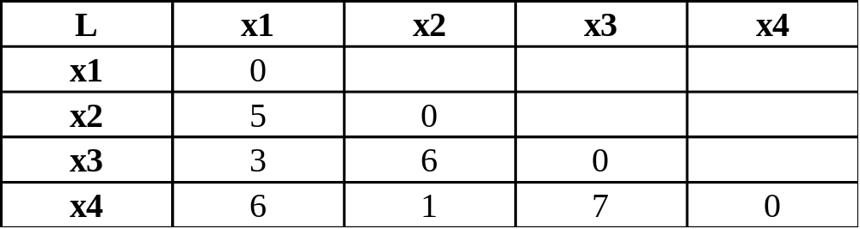
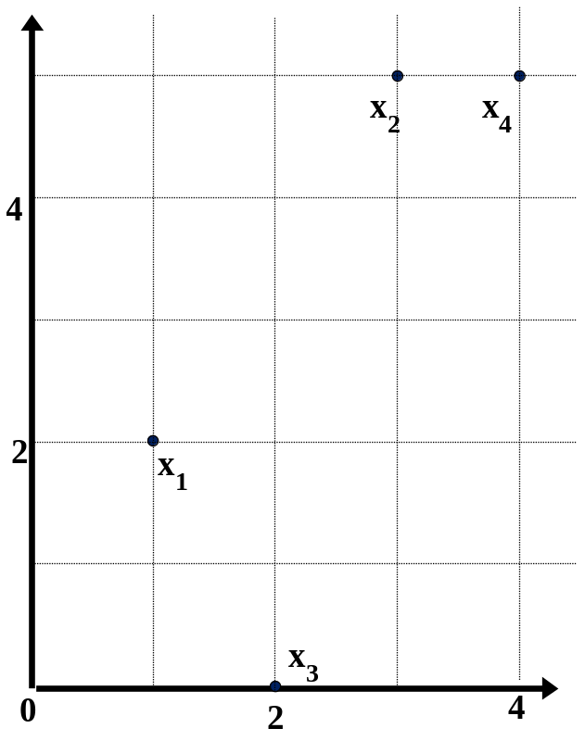
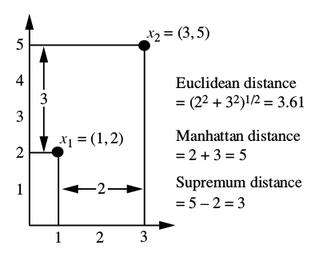
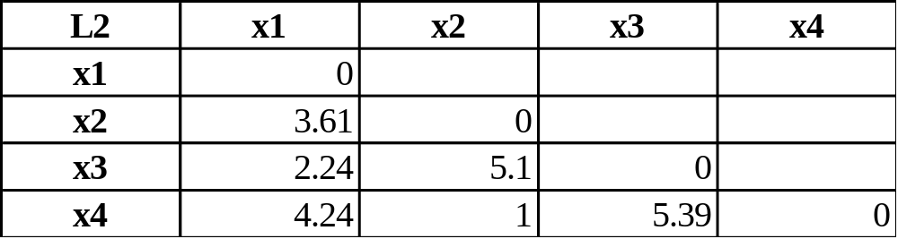
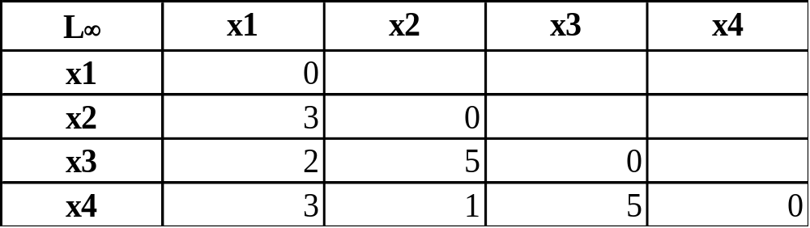
Example: Minkowski Distance
Dissimilarity Matrices
Manhattan (L₁)
Euclidean (L₂)
Supremum

Slide 34
Ordinal Variables
An ordinal variable can be discrete or continuous:
  A size discrete attribute:
    small, medium, large
  A continuous temperature attribute
    may be discretized by splitting it into intervals
    e.g., intervals -30 to -10; -10 to 10 and 10 to 30 represent cold, moderate and warm temperatures
Order is important, e.g., ranking between values

Slide 35
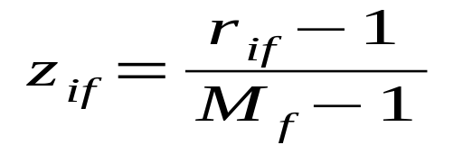
Ordinal Variables
Treated as follows for dissimilarity computations (let f be an ordinal attribute):
  Let f has M_{f} ordinal states
  Map each ordinal value to a rank, r_{f} Є {1,..,M_{f}}
  Replace each x_{if} (attribute f of object i) by its corresponding rank, r_{if} Є {1,..,M_{f}}
  Normalization required:
    Each nominal attribute may have different number of states
    Normalize by mapping the range of each variable onto [0, 1]
    Replace r_{if} by:
    Using z_{if,} dissimilarity can then be computed using distance measures for numeric attributes

Slide 36
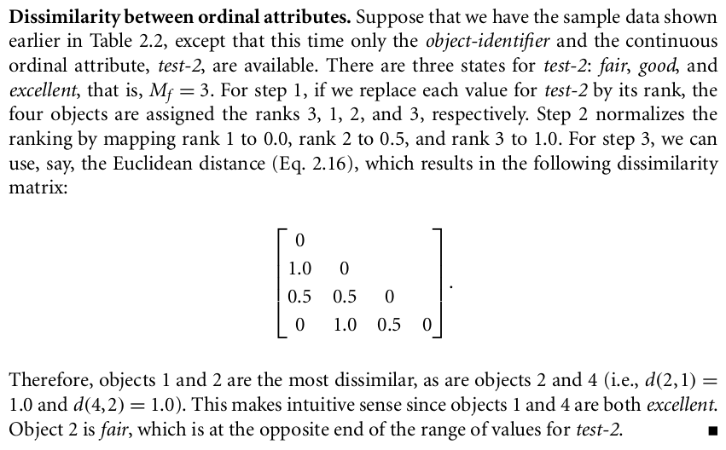
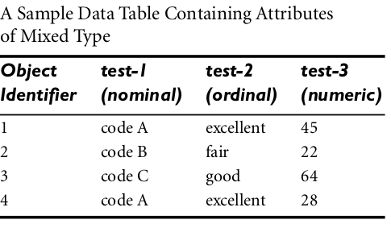
Ordinal Variables, Example

Slide 37
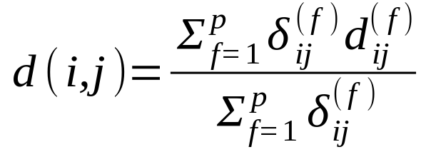
Attributes of Mixed Type
A database may contain all attribute types
  Nominal, symmetric binary, asymmetric binary, numeric, ordinal
One may use a weighted formula to combine their effects
  δ _{ij}^{(f)}=0 if attribute value for i or j is missing; or attribute f is asymmetric with both values of 0
  Distance contribution of f, d_{ij}^{(f)} = 0 if x_{if} = x_{jf} , or d_{ij}^{(f)} = 1 otherwise
  f is numeric: use the normalized distance
  f is ordinal
    Compute ranks r_{if} and
    Treat z_{if} as interval-scaled
Note that all the attributes are normalized so that the values map to the interval [0,1]

Slide 38
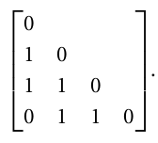
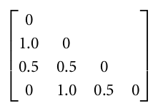
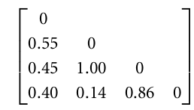
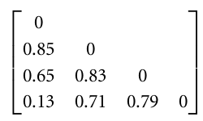
Attributes of Mixed Type, Example
Dissimilarity between attributes of mixed type
Dissimilarity matrices for attribute test-1, test-2 and test-3:
The indicator δ_{ij}^{(f)}=1 for each of three attributes; the resulting dissimilarity matrix is:

Slide 39
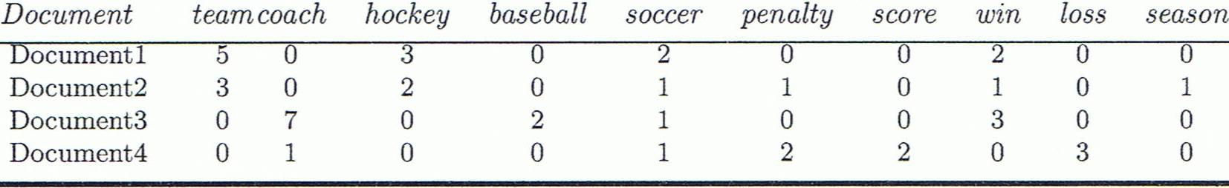
Document Similarity
A document can be represented by thousands of attributes, each recording the frequency of a particular word (such as keywords) or phrase in the document.
How do we compare two documents?
  The term frequency (tf_{t,d}): number of times that term t occurs in document d
  But it’s not a sure indicator of similarity!
    The similarity does not increase proportionally with tf!

Slide 40
Documents as vectors
Terms are axes of the space
So we have a |V|-dimensional vector space
Documents are points or vectors in this space
Very high-dimensional: tens of millions of dimensions when you apply this to a web search engine
These are very sparse vectors - most entries are zero.
How the distance between two points (distance between the end points of the two vectors) is being computed?
Euclidean distance?
Euclidean distance is a bad idea . . .
. . . because Euclidean distance is large for vectors of different lengths

Slide 41

Why distance is a bad idea
The Euclidean distance between vector q and vector d₂ is large even though the distribution of terms in those vectors are very similar.
Thought experiment: take a document d and append it to itself. Call this document d′.
“Semantically” d and d′ have the same content
The Euclidean distance between the two documents can be quite large

Slide 42

Use angle instead of distance
The angle between the two documents is 0, corresponding to maximal similarity.
From angles to cosines
Cosine is a monotonically decreasing function for the interval [0º, 180º]

Slide 43
Cosine Similarity
Cosine measure: If d₁ and d₂ are two vectors (e.g., term-frequency vectors), then
cos(d₁, d₂) = (d₁ • d₂) /||d₁|| ||d₂|| ,
  where • indicates vector dot product, ||d||: the length of vector d

Slide 44
Example: Cosine Similarity
cos(d₁, d₂) = (d₁ • d₂) /||d₁|| ||d₂|| ,
  where • indicates vector dot product, ||d|: the length of vector d
Ex: Find the similarity between documents 1 and 2.
  d₁ = (5, 0, 3, 0, 2, 0, 0, 2, 0, 0)
  d₂ = (3, 0, 2, 0, 1, 1, 0, 1, 0, 1)
  d₁•d₂ = 5*3+0*0+3*2+0*0+2*1+0*1+0*1+2*1+0*0+0*1 = 25
  ||d₁||= (5*5+0*0+3*3+0*0+2*2+0*0+0*0+2*2+0*0+0*0)^{0.5}=(42)^{0.5} = 6.481
  ||d₂||= (3*3+0*0+2*2+0*0+1*1+1*1+0*0+1*1+0*0+1*1)^{0.5}=(17)^{0.5} = 4.12
  cos(d₁, d₂ ) = 0.94
cos(d₁, d₃ ) = 0.156
cos(d₁, d₄ ) = 0.071
cos(d₃, d₂ ) = 0.122
cos(d₄, d₂ ) = 0.167
cos(d₄, d₃ ) = 0.231

Slide 45
Chapter 2: Getting to Know Your Data
Data Objects and Attribute Types
Basic Statistical Descriptions of Data
Data Visualization
Measuring Data Similarity and Dissimilarity
Summary

