Slide 1

Campus Food Pantry
Development Demo · CSE 350, Group 15 · November 13, 2026
Abdullah Saadawi developer: accounts, security, inventory, deployment
Mohamed Muse developer: student browse, search and requests
Andrew Merritt project manager and developer: pickups, alerts, reports
Gavin Marvelle QA lead: test plan, tests, test report
Notes:
Presenter: Andrew. Rubric 1: project title, date, and every team member.

Slide 2


Two users, one private pantry
2 · PROJECT OVERVIEW
A web platform where students request food from the campus pantry privately and book a pickup time, and pantry staff manage stock, pickups and usage reports.
Students
Pantry staff
See what is in stock right now
Request food privately
Book a pickup time that fits their schedule
Get notified when the order is ready
Track inventory and donations
Run the pickup queue: prepare, then hand off
Get alerts before an item runs out
See usage totals with no student names
Notes:
Presenter: Andrew. Rubric 2: brief overview of the project.

Slide 3
Where each requirement stands
3 · PRESENT PROJECT STATUS
Req | Feature | Owner | Status
FR1 | Accounts and roles | Abdullah | Done
FR2 | Browse available items | Mohamed | Done
FR3 | Search and filter | Mohamed | Done
FR4 | Food requests | Mohamed | Done
FR5 | Pickup times | Andrew | Done
FR6 | Cancellations and notifications | Andrew | Done
FR7 | Inventory and donations | Abdullah | API done · no staff screen yet
FR8 | Pickup fulfillment | Andrew | Done
FR9 | Low-stock alerts | Andrew | Done
FR10 | Usage report | Andrew | Done
NFR1 | Security | Abdullah | Done
Live: university-food-pantry-cse-350.onrender.com · Code: github.com/a0merr/University-Food-Pantry-CSE-350-
Notes:
Presenter: Andrew. Rubric 3: every requirement is done except the FR7 staff screen (adding items and donations works through the API). The site is live on Render.

Slide 4
How we test, and when it is ready to deploy
4 · TEST PLAN: 4.1 APPROACH AND 4.2 ACCEPTANCE CRITERIA
4.1 Test approach
4.2 Acceptance criteria (all met)
Unit: every service, route and page script (node:test, jsdom)
Integration: the real server with seed data, end to end through the API
Browser (end to end): Playwright on desktop and phone
Accessibility: axe-core WCAG 2.1 A and AA scans, keyboard-only use
Load: autocannon, 9 scenarios, 50 users at once
Regression: the full suite is re-run after every fix
✔ No critical or high-severity defects open
✔ 100% of the 15 critical test cases pass
✔ At least 95% of all automated tests pass (98.6%)
✔ Every requirement verified by at least one test case
✔ 0 WCAG 2.1 AA accessibility violations
✔ Reads answer in under 500 ms (p99) with 50 users; one known slowdown during mass sign-ins, logged as Low
Notes:
Presenter: Gavin. Rubric 4.1 and 4.2. Acceptance criteria proposed by Andrew from the rubric example; Gavin, confirm or adjust. 98.6% = 218 of 221 unit and integration tests; the 3 others are known FR7 gaps.

Slide 5
Test environment and test data
4 · TEST PLAN: 4.3 ENVIRONMENT AND 4.4 TEST DATA
4.3 Test environment
4.4 Test data
Hardware: team laptops (Windows 11 and macOS)
Runtime: Node.js 22.13 or newer, npm
App stack: Express 5, SQLite (node:sqlite), plain HTML, CSS and JavaScript
Test tools: node:test, jsdom, Playwright with Chromium and Edge, axe-core, autocannon
Live: Render web service; code and issues on GitHub
Seed data: 1 staff and 3 student demo accounts, 10 items (2 below their low-stock threshold), 5 pickup times
Unit tests: an in-memory database and a fake clock, with test users, items and pickup times
Edge cases: malformed JSON, 200 KB request bodies, HTML in names, daylight-saving dates, full and past pickup times
Browser and load tests: a freshly seeded server in a temporary folder
Notes:
Presenter: Gavin. Rubric 4.3 and 4.4.

Slide 6
Test cases planned for each requirement
4 · TEST PLAN: 4.5 TEST CASES PER REQUIREMENT
Requirement | Test cases | Main automated tests (count)
FR1 Accounts and roles | TC_01, TC_02, TC_03 | Sign-in API (14), browser sign-in (9)
FR2 Browse items | TC_04 | Student filter (6), student page (8)
FR3 Search and filter | TC_05 | Student filter (6)
FR4 Food requests | TC_06 | Student page (8), real-server integration (12)
FR5 Pickup times | TC_07 | Pickup times (6), booking edge cases (31)
FR6 Cancel and notify | TC_08 | Notifications (3), browser staff desk (12)
FR7 Inventory and donations | TC_09 | Inventory API (8), inventory service (3)
FR8 Pickup fulfillment | TC_10 | Pickups (4), browser staff desk (12)
FR9 Low-stock alerts | TC_11 | Alerts (3), browser staff desk (12)
FR10 Usage report | TC_12 | Reports (3), browser staff desk (12)
NFR1 Security | TC_13, TC_14 | Security edge cases (20), server edge cases (8)
Accessibility and phones | TC_15 | Accessibility (10), phone layout (3)
Total | 15 test cases | 221 unit and integration + 34 browser tests
Notes:
Presenter: Gavin. Rubric 4.5. Counts are the number of tests in each test file; some files cover more than one requirement.

Slide 7
Who tests what, and how defects are handled
4 · TEST PLAN: 4.6 RESOURCE PLANNING AND DEFECT MANAGEMENT
Resource planning
Defect management
Gavin Marvelle, QA lead: test plan, test cases, all test suites, GitHub Issues, test report
Abdullah Saadawi, developer: unit tests for sign-in, security and inventory; fixes his defects
Mohamed Muse, developer: unit tests for browse and search; fixes his defects
Andrew Merritt, PM and developer: unit tests for FR5–FR10, end-to-end checks of the live server, bug fixes and merges
Logged as GitHub Issues with steps, expected and actual results, plus a screenshot or video
Given a severity: Critical, High, Medium or Low
Assigned to the owner of that requirement
Known bugs are kept as "todo" tests until they are fixed
New
Open
In progress
Fixed (PR)
Verified
Closed
Notes:
Presenter: Gavin. Rubric 4.6 and defect management. A fix closes its Issue with "Fixes #n" in the pull request, then the tests are re-run and the flow re-checked before it is closed.

Slide 8




How we built it
5 · SOFTWARE IMPLEMENTATION: PLAN, LANGUAGE AND RESOURCES
Browser pages
Express 5 API
Services
SQLite
Plain HTML, CSS and JavaScript modules. No framework, no build step.
Routes under /api. Role checks, a CSRF header and an Origin check on every change.
Business rules. Each takes a database and a clock, so tests can swap in fakes.
Node's built-in SQLite. Stock changes run in transactions.
Language: JavaScript (Node.js 22+, ES modules), HTML and CSS; SQL for SQLite
Unit testing: node:test; each developer tests their own code with an in-memory database and a fake clock
Resources: laptops with Node.js; GitHub write access for all four; a Render account with deploy access; Chromium and Edge; staff and student test accounts
Live site
university-food-pantry-cse-350.onrender.com
Source code (GitHub)
github.com/a0merr/University-Food-Pantry-CSE-350-
Notes:
Presenter: Andrew. Rubric 5a-c and 5g: how we implemented it and unit tested it, the language, the resources we needed, and the GitHub link.

Slide 9
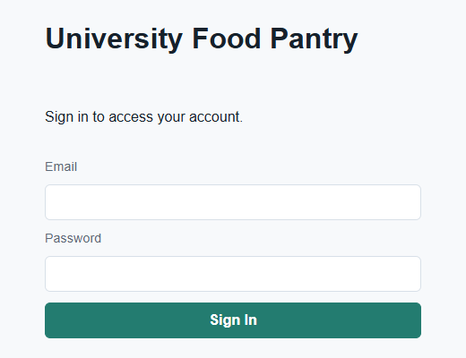




Sign-in, security and the live site
5 · IMPLEMENTATION: ABDULLAH (OUTPUT)
Accounts and roles (FR1)
Staff and student accounts; each role only reaches its own pages and API.
Security (NFR1)
Hashed passwords and session tokens, HttpOnly cookies, login rate limit, CSRF and Origin checks.
Inventory and donations (FR7)
API to add items, change stock and log donations. Seed data: 4 demo accounts, 10 items, 5 pickup times.
Deployed on Render
Live at university-food-pantry-cse-350.onrender.com
Staff go to the pickup desk; students go to the student page.
Notes:
Presenter: Abdullah. Live demo: open the site, sign in as staff@pantry.demo, show the staff desk, sign out, sign in as a student.

Slide 10
Code: sign-in and demo data
5 · IMPLEMENTATION: ABDULLAH (CODE)
// public/index.html: sign in, then send each role to its own page
const result = await api('/api/auth/login', { method: 'POST', body: { email, password } });
if (result.user.role === 'staff') {
window.location.assign('/staff.html');
} else if (result.user.role === 'student') {
window.location.assign('/student.html');
}
// scripts/seed.js: demo accounts, items with low-stock thresholds, pickup times
const accounts = [
['Pantry Staff', 'staff@pantry.demo', 'staff', ...],
['Student One', 'student1@pantry.demo', 'student', ...], // + student2, student3
];
// each item: name, category, stock, low-stock threshold
const items = [['Rice', 'Grains', 30, 5], ['Canned Soup', 'Canned Goods', 4, 5], ...];
for (const [name, email, role, password] of accounts) {
insertUser.run(name, email, hashPassword(password), role, now); // only the hash is stored
}
for (let day = 1; day <= 5; day++) { /* one 2:00 PM pickup time a day, capacity 10 */ }
Notes:
Presenter: Abdullah. Real code from public/index.html and scripts/seed.js (shortened with ...). Demo passwords are left out on purpose.

Slide 11
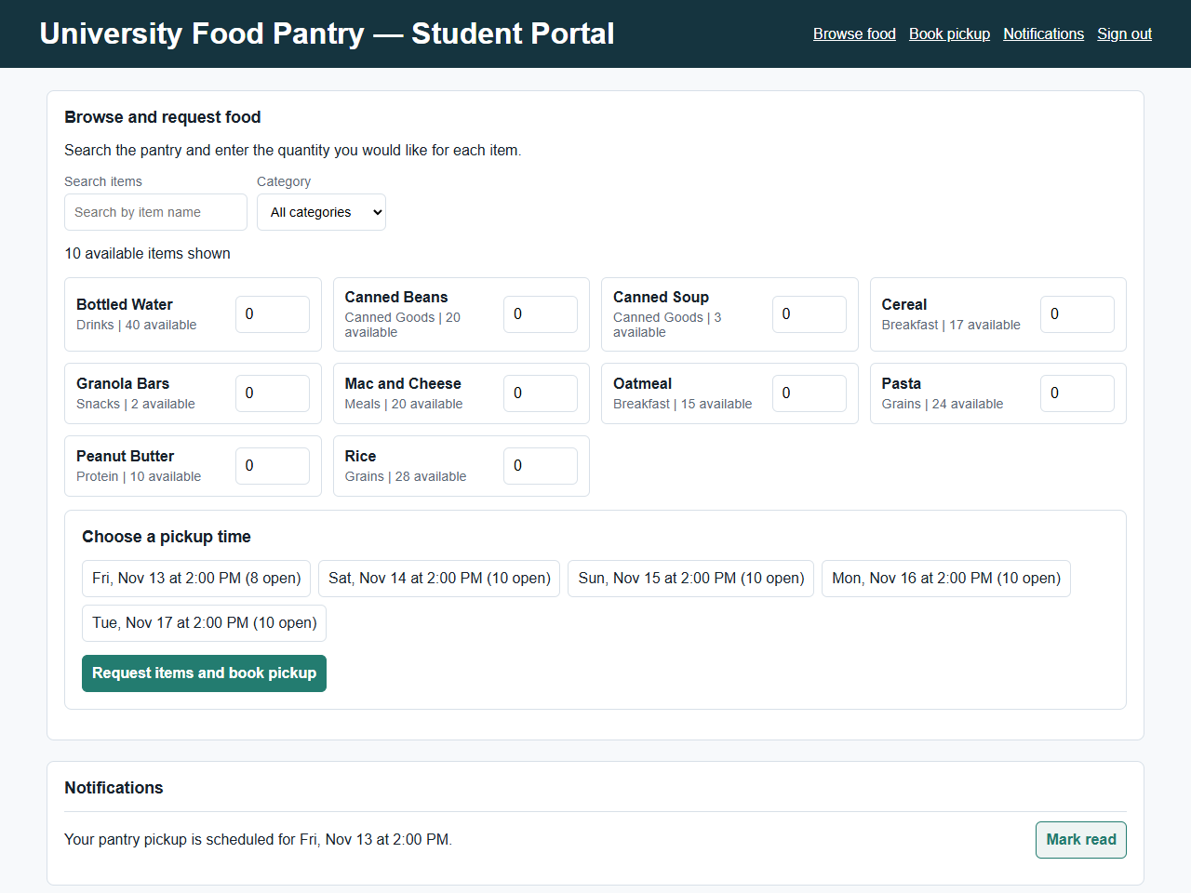
Student flow
5 · IMPLEMENTATION: MOHAMED (OUTPUT)
1
Sign in
2
Browse and search what is in stock
3
Choose items and quantities
4
Pick an open pickup time
5
Get "scheduled", then "ready" notifications
Notes:
Presenter: Mohamed. Live demo: sign in as student1, search, request two items, pick a time, show the notification.

Slide 12
Code: browse, search and filter
5 · IMPLEMENTATION: MOHAMED (CODE)
// public/js/student-filter.js: FR2 shows only active, in-stock items; FR3 searches and filters
export function availableItems(items) {
return items.filter(item => item.active === 1 && Number(item.available) > 0);
}
export function filterItems(items, query = '', category = '') {
const search = String(query).trim().toLocaleLowerCase();
const selectedCategory = String(category).trim().toLocaleLowerCase();
return availableItems(items).filter(item => {
const name = String(item.name ?? '').toLocaleLowerCase();
const itemCategory = String(item.category ?? '').toLocaleLowerCase();
return (!search || name.includes(search) || itemCategory.includes(search)) &&
(!selectedCategory || itemCategory === selectedCategory);
});
}
// public/js/student-pickup.js: re-draw the list as the student types or picks a category
searchInput.addEventListener('input', renderItems);
categorySelect.addEventListener('change', renderItems);
Notes:
Presenter: Mohamed. Real code from public/js/student-filter.js and public/js/student-pickup.js. Six unit tests cover these filters.

Slide 13
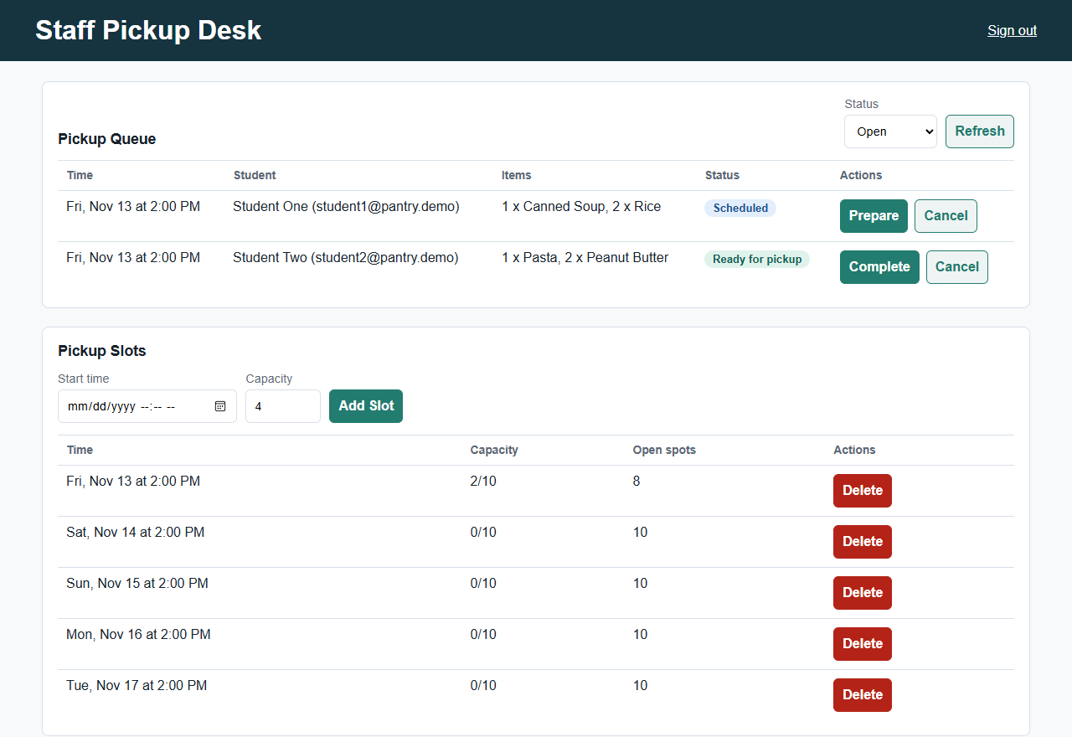
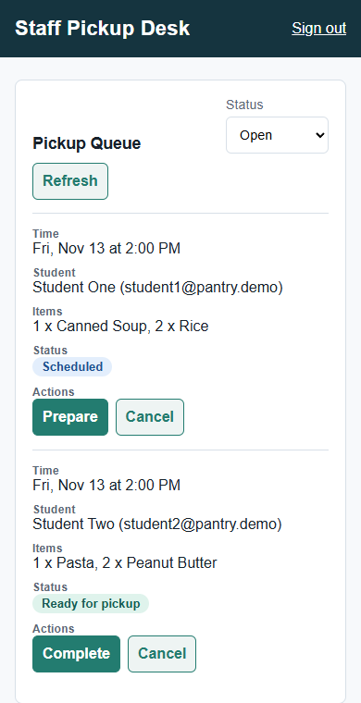
Staff pickup desk
5 · IMPLEMENTATION: ANDREW (OUTPUT)
Same page on a phone: table rows stack into cards.
Prepare: student is told the order is ready
Complete: stock leaves the shelf
Cancel: stock goes back, student is notified
Add or remove pickup times
Notes:
Presenter: Andrew (FR5, FR8). Live demo: sign in as staff@pantry.demo; prepare one pickup, complete another, cancel a third.

Slide 14

Booking a pickup is all-or-nothing
5 · IMPLEMENTATION: ANDREW (CODE)
Before a pickup is booked, the server checks:
// src/services/pickups.js, schedule()
return transaction(ctx.db, () => {
if (open) {
throw conflict('You already have an open pickup request.');
}
if (slot.booked >= slot.capacity) {
throw conflict('Pickup slot is full.');
}
const items = normalizeItems(ctx.db, data.items);
// insert the request, then for each item:
// UPDATE items SET reserved = reserved + ?
return getPickup(ctx, requestId);
});
One open request per student
Pickup time is in the future and not full
Each item's per-visit limit
Enough stock is available
The checks and the stock reservation run in one database transaction, so two students cannot take the last item.
Notifications (FR6):
Scheduled
Ready
Reminder, 24 h
Cancelled
Notes:
Presenter: Andrew (FR5, FR6). Cancelling gives the reserved stock back. Reminders come from an hourly job for pickups in the next 24 hours.

Slide 15
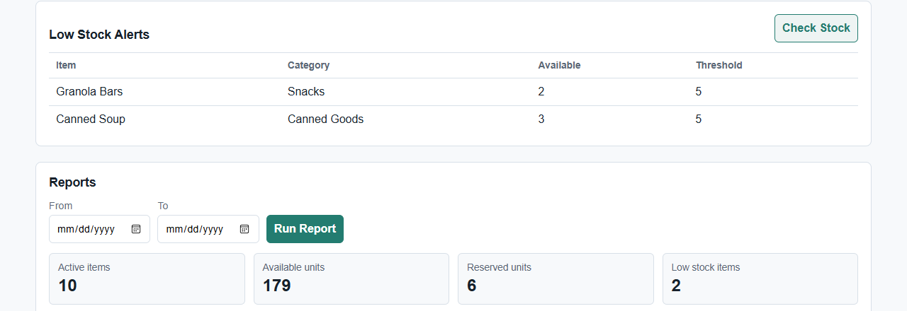
Staff see shortages before shelves run out
5 · IMPLEMENTATION: ANDREW (OUTPUT)
Low-stock alerts (FR9). Checked after every booking, pickup and cancellation, plus a Check Stock button. An alert closes itself when the item is restocked.
Usage report (FR10). Totals for a date range: pickups by status, top items, stock by category. Counts only, never names or emails.
Notes:
Presenter: Andrew (FR9, FR10). Live demo: click Check Stock, then Run Report.

Slide 16
AI-generated code, disclosed
5 · IMPLEMENTATION: AI-GENERATED CODE (5E)
65.0%
AI-generated or AI-assisted (upper bound)
Assignment requires at least 10%: met
Most of it is the QA test suite, written with Claude Code (47.7%)
Application code alone, without tests: 38% (1,110 of 2,898 lines)
Every AI-written file and change, and the tool used, is listed in docs/AI_USAGE.md
Notes:
Presenter: Andrew. Rubric 5e. Tools: Claude Code (Anthropic) and ChatGPT (OpenAI). The ChatGPT row counts whole files, so the totals are upper bounds.

Slide 17
Bugs we found and fixed
5 · IMPLEMENTATION: BUGS RAISED BY TESTERS AND HOW WE RESOLVED THEM (5F)
Where | What went wrong | How we fixed it
Login on Render | Every POST rejected (403) behind HTTPS | Trust Render's proxy (PR #12)
Live site clock | Ran on UTC: pickup times 5 hours off | Default to Eastern time (PR #23)
Usage report | Counted cancelled requests as usage | Leave them out (PR #12)
Fresh clone | npm start crashed: no data/ folder | Server creates it (PR #12)
Delete a pickup time | 500 error if it had past pickups | 409 with a clear message (PR #12)
Issue #11 | Home page returned 404 | Sign-in page (PR #14)
Issue #18 | Student sign-in led to a 404 | Student page (PR #22)
Issue #19 | Staff tab blocked after a student signed in | Page warns and links to sign in (PR #20)
API errors | Unknown route: HTML 404; big body: 500 | JSON 404 and 413 (PR #23)
Found by our end-to-end runs and by Gavin's QA tests and GitHub Issues. Every fix went in through a pull request, with tests re-run before merging.
Notes:
Presenter: Andrew. Rubric 5f. Full list with severity and status on the test report slide.

Slide 18
Sample test case TC_01
6 · TEST SCRIPT (TESTER)
Field | Value
Test Case ID | TC_01
Test Scenario | FR1: Staff sign-in
Test Status | Pass (run Nov 12, 2026) · browser test "staff sign in and land on the staff page"
Test Data | Email: staff@pantry.demo · password: the seeded demo password
Browser | Chromium (Playwright) and Microsoft Edge
Test step | Expected result for each step
Go to the live site | The sign-in page opens and shows Email and Password fields
Enter staff@pantry.demo | The Email field accepts the address
Enter the password | The password is accepted and shown as dots, not text
Click Sign In | The staff pickup desk (/staff.html) opens
Notes:
Presenter: Gavin. Rubric 6, in the assignment's test case format. Status comes from the automated test named on the slide, run on Nov 12.

Slide 19
Sample test case TC_06
6 · TEST SCRIPT (TESTER)
Field | Value
Test Case ID | TC_06
Test Scenario | FR4: Request food and book a pickup
Test Status | Pass (run Nov 12, 2026) · student page test "student can schedule a pickup"
Test Data | student1@pantry.demo · Rice, quantity 2 · an open pickup time
Browser | Chromium (Playwright) and Microsoft Edge
Test step | Expected result for each step
Sign in as student1 | The student portal opens and lists only in-stock items
Type "rice" in Search | Only Rice is listed
Enter 2 for Rice and pick a pickup time | The chosen pickup time is highlighted
Click "Request items and book pickup" | "Pickup scheduled" appears, and a notification gives the pickup time
Notes:
Presenter: Gavin. Rubric 6, in the assignment's test case format. Status comes from the automated test named on the slide, run on Nov 12.

Slide 20
All 15 test cases
6 · TEST SCRIPTS: EVERY REQUIREMENT
ID | Req | Scenario | Status | Verified by
TC_01 | FR1 | Staff sign-in opens the staff desk | Pass | Browser: sign-in
TC_02 | FR1 | Student sign-in opens the student page | Pass | Browser: sign-in
TC_03 | FR1 | Wrong password shows an error | Pass | Browser: sign-in
TC_04 | FR2 | Only active, in-stock items are listed | Pass | Unit: student filter
TC_05 | FR3 | Search and category filter narrow the list | Pass | Unit: student filter
TC_06 | FR4 | Request food and book a pickup | Pass | Unit: student page; integration
TC_07 | FR5 | Past or full pickup times are refused | Pass | Unit: booking edge cases
TC_08 | FR6 | Cancel releases stock and notifies the student | Pass | Browser: staff desk
TC_09 | FR7 | Staff add an item, change stock, log a donation | Pass | Unit: inventory API
TC_10 | FR8 | Prepare, then complete a pickup | Pass | Browser: staff desk
TC_11 | FR9 | Check Stock lists low-stock items | Pass | Browser: staff desk
TC_12 | FR10 | Usage report by date, counts only | Pass | Browser: staff desk
TC_13 | NFR1 | A student cannot see staff data | Pass | Browser: protected pages
TC_14 | NFR1 | Requests without the CSRF header are refused | Pass | Integration: real server
TC_15 | NFR | No accessibility violations; fits a phone | Pass | Browser: accessibility, phone
Notes:
Presenter: Gavin. Every test case maps to automated tests that passed on Nov 12. Full steps for each are in the written report.

Slide 21
Test report
7 · TEST REPORT
15 / 15 / 15
Defect | Severity | Status
Login on Render blocked (403) | Critical | Closed
Live site clock 5 hours off | High | Closed
#11 Home page 404 | High | Closed
#18 Student page 404 | High | Closed
#19 Staff tab blocked after account switch | Medium | Closed
Usage report counted cancellations | Medium | Closed
FR7 API: thresholds, limits, retiring items (3) | Medium | Open
Browsing slows during 10 sign-ins at once | Low | Open
test cases planned / executed / passed
0 failed
221 run · 218 pass
unit and integration tests
0 failed; 3 known FR7 gaps
34 / 34
browser and accessibility tests pass
Desktop and phone
8 / 9
20 defects found: 16 closed, 4 open. No critical or high-severity defects remain open.
load scenarios meet target
1 known issue (Low)
Notes:
Presenter: Gavin. Rubric 7. Numbers from npm test, npm run test:e2e and npm run test:perf on Nov 12. The 16 closed include 9 more listed in the written report. Severity proposed by Andrew; Gavin, confirm.

Slide 22
Delayed mid-sprint, caught up, on track to submit
8 · IMPLEMENTATION MILESTONES
Milestone | Planned | Actual | Status
Tech stack chosen | Tue, Nov 3 | Wed, Nov 4; changed to Express + SQLite Nov 9 | 1 day late
Repository and starter code | Tue, Nov 3 | Mon, Nov 9 | Late
Core features merged | Mon, Nov 9 | Tue, Nov 10 (FR1, FR5–FR10, FR7) | 1 day late
Sign-in and student pages | Mon, Nov 9 | Thu, Nov 12 | 3 days late
Testing and bug fixes | Tue–Wed, Nov 10–11 | Thu, Nov 12 | 1 day late
Deployed live on Render | Not in the plan | Thu, Nov 12 | Done
Slides and recording | Wed–Thu, Nov 11–12 | Thu–Fri, Nov 12–13 | 1 day late
Submit | Fri, Nov 13 | Fri, Nov 13 | On track
We were behind from the start because the repository went up late, then caught up by building and testing in parallel on Nov 12.
Notes:
Presenter: Andrew. Rubric 8. Dates from the team plan and GitHub history.

Slide 23
Who did what
9 · TEAM ASSIGNMENTS AND RESPONSIBILITIES
Andrew Merritt · Project manager and developer
Abdullah Saadawi · Developer
Planned the sprint, kept the timeline, reviewed and merged pull requests
Built pickup times, cancellations and notifications, fulfillment, low-stock alerts and the usage report (FR5, FR6, FR8–FR10), the staff page and styles
Fixed bugs; put together the deck and report
Set up the Express server
Built accounts, sign-in and roles (FR1) and security (NFR1)
Built the inventory and donations API (FR7) and the demo seed data
Deployed the site on Render
Mohamed Muse · Developer
Gavin Marvelle · QA lead
Built the student portal (FR2–FR4): browse in-stock items, search and category filter, request food and book a pickup
Wrote unit tests for the filters
Wrote the test plan and test cases
Built the unit, integration, browser, accessibility and load test suites (255 automated tests)
Logged Issues #11, #18 and #19; wrote the test report
Notes:
Presenter: Andrew. Rubric 9.

Slide 24




Ethical guidelines we followed
10 · ETHICAL GUIDELINES
Respect for ownership
Avoiding plagiarism
Open-source packages (Express, Playwright, axe-core, autocannon, jsdom) used under their licenses, listed in package.json
Our code is MIT-licensed
Every AI-generated file and change is credited by tool (Claude Code, ChatGPT) in docs/AI_USAGE.md
AI starter files carry a marker comment
Confidentiality
Promoting diversity and equity
Passwords and session tokens are stored only as hashes
Demo accounts only; no real student data in the repository
The usage report shows counts, never names or emails
Requests are private, to reduce stigma
0 WCAG 2.1 AA violations; tested keyboard-only
Works on phones as well as laptops
Notes:
Presenter: Andrew. Rubric 10: privacy, security, intellectual property and equity.

Slide 25
What we built
1
Live on Render: university-food-pantry-cse-350.onrender.com
Lessons learned
Andrew: Deploy and test on the live site early. Our two worst bugs, login being blocked on Render and the server clock running five hours off, only showed up once the site was deployed.
Abdullah: TO ADD
Mohamed: TO ADD
Gavin: TO ADD
2
Students request food privately and book a pickup
3
Staff run pickups, stock alerts and usage reports
4
Tested with unit, end-to-end, accessibility and load tests
Questions?
Notes:
Presenter: Andrew. One lesson learned from each person, then thank the audience.

