Slide 1


1
NEWSPAPER CONTENT ANALYSIS
Notes:
1
10/11/16

Slide 2
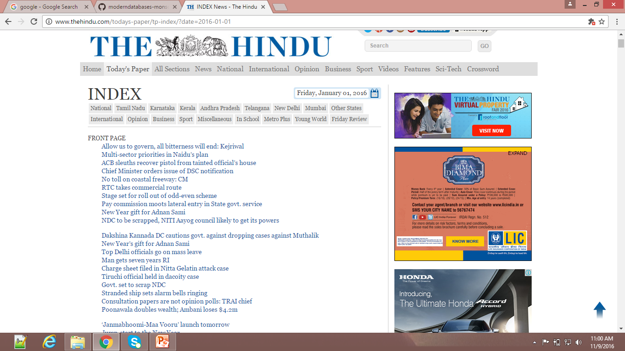

2
DATA

Slide 3
3
WORK SCHEME
First we will extract the data from front page of the Hindu newspaper by extracting the given URLs.
Convert it to readable format.
Program the word frequencies and will plan to categorize.
Analyse the words and conclude the scenario from it.
Planning to visualize the word according to given graph.

Slide 4
4
DATA EXTRACTION
Extracted contents of newspaper “THE HINDU” using “GREP”.
Extracted contents of newspaper “UK EXPRESS” using “Beautiful Soup”.

Slide 5
5
DATA CLEANING
Removed stop words
Removed punctuations.
Removed special characters

Slide 6
ANALYSIS -1
6
Used NLTK to count the frequency of the words.
Count most common words in the obtained cleaned data.
Generated the word cloud according to frequency of words.

Slide 7
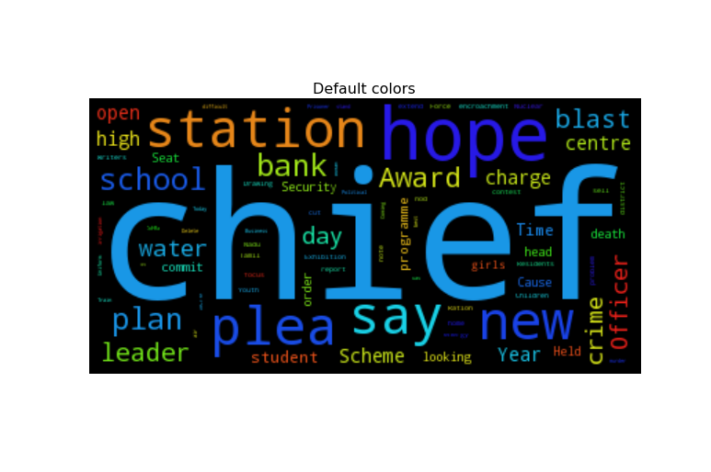
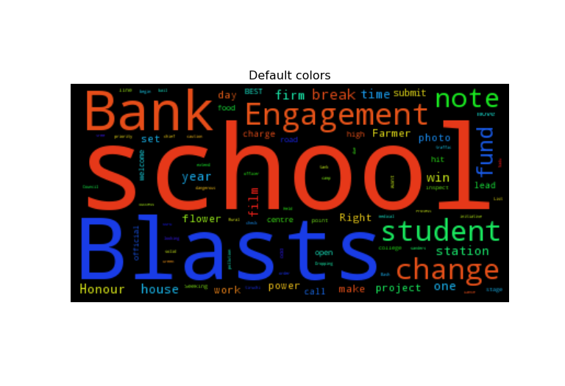
7
VISUALIZATION
2006
2016

Slide 8
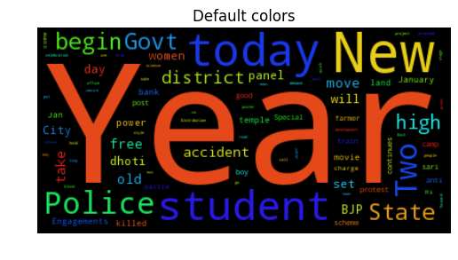
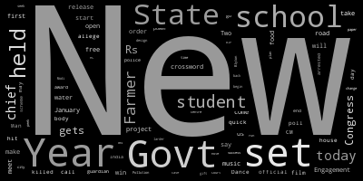
8
VISUALIZATION
2009
2011

Slide 9

9

