Slide 1

SCRAPING OUT THE CONTENTS OF NEWSPAPER DATA ANALYSIS
PRESENTED BY-
AAYUSHI GUPTA
RITHIN
SCHOOL OF INFORMATION SCIENCES MANIPAL

Slide 2
DATA DESCRIPTION
The data was in form of urls.
We extracted the data from urls using grep command.

Slide 3
DATA CLEANING
Removed stop words
Removed punctuations.
Removed special characters

Slide 4
DATA ANALYSIS AND VISUALIZATION
Used NLTK to count the frequency of the words.
Count most common words(around 1000) in the obtained cleaned data
Generated the word cloud according to frequency of words

Slide 5
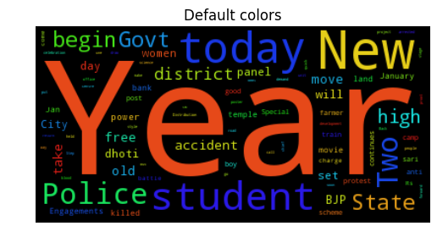
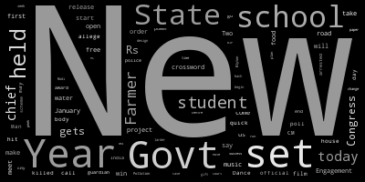
WORD CLOUD

