Slide 1



SCHOOL OF INFORMATION SCIENCES
MANIPAL
1
NEWSPAPER CONTENT ANALYSIS
AAYUSHI GUPTA
161046016
Notes:
1
10/11/16

Slide 2

2
WORK SCHEME

Slide 3
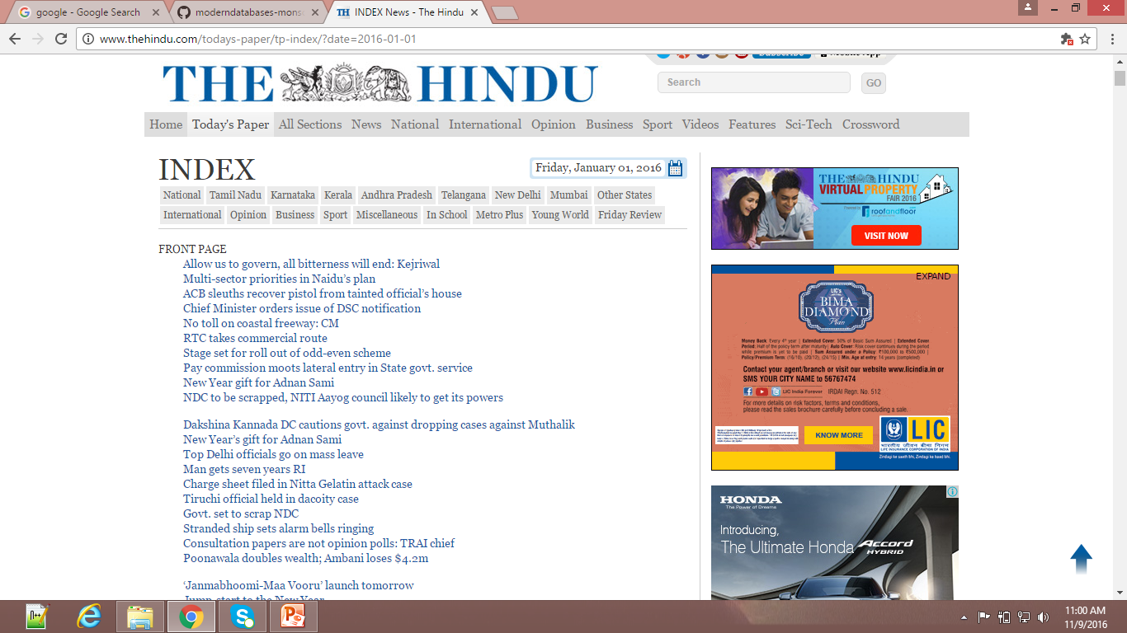
3
DATA

Slide 4
4
DATA EXTRACTION
Extracted contents of newspaper “THE HINDU” using “GREP”.
Extracted contents of newspaper “UK EXPRESS” using “Beautiful Soup”.

Slide 5
5
HTML SOURCE FILE

Slide 6
6
DATA CLEANING
Removed stop words
Removed punctuations.
Removed special characters

Slide 7
7
ANALYSIS -1
Used NLTK to count the frequency of the words.
Count most common words in the obtained cleaned data

Slide 8
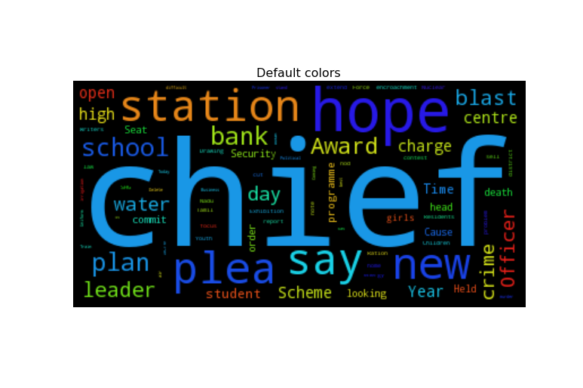
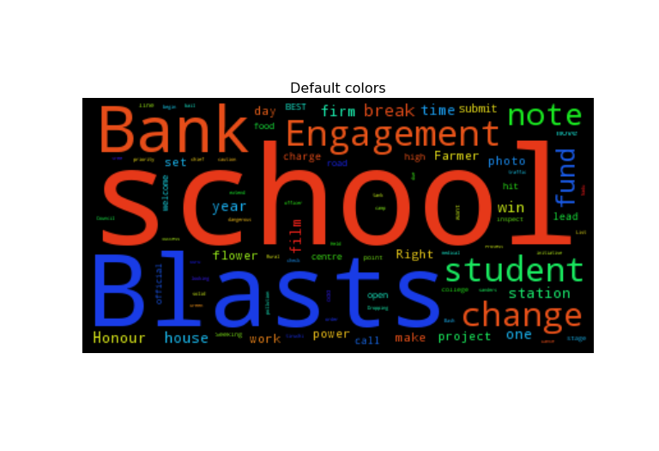
8
VISUALIZATION
2006
2016

Slide 9

9
Git Hub repository link :

Slide 10

10

