Slide 1
INTRODUCTION
My name is YUZUPENG,I come from Fujian China.

Slide 2

This is my university

Slide 3

This is my course

Slide 4
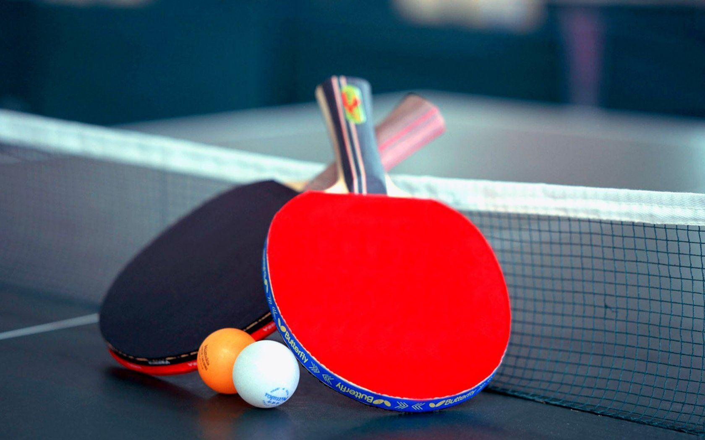
My hobby is playing table tennis

