Slide 1
Windows Kernel Internals
Object Manager
David B. Probert, Ph.D.
Windows Kernel Development
Microsoft Corporation

Slide 2
Kernel Object Manager (OB)
Provides underlying NT namespace
Unifies kernel data structure referencing
Unifies user-mode referencing via handles
Simplifies resource charging
Central facility for security protection

Slide 3
NT Name Space
\
arcname\
BaseNamedObjects\
callback\
device
HardDisk0\
dr0
driver\
FileSystem\
ntfs
KernelObjects\
  KnownDlls\
  ObjectTypes\
  RPC Control\
  Windows\
  apiport
  SbApiPort
  WindowsStations\
  winsta0

Slide 4
\ObjectTypes
Adapter
Callback
Controller
DebugObject
Desktop
Device
Directory
Driver
Event
EventPair
File
IoCompletion
Job
Key
KeyedEvent
Mutant
Port
Process
Profile
Section
Semaphore
SymbolicLink
Thread
Timer
Token
Type
WaitablePort
WindowsStation
WMIGuid

Slide 5
\ObjectTypes
Adapter
Callback
Controller
DebugObject
Desktop
Device
Directory
Driver
Event
EventPair
File
IoCompletion
Job
Key
KeyedEvent
Mutant
Port
Process
Profile
Section
Semaphore
SymbolicLink
Thread
Timer
Token
Type
WaitablePort
WindowsStation
WMIGuid

Slide 6
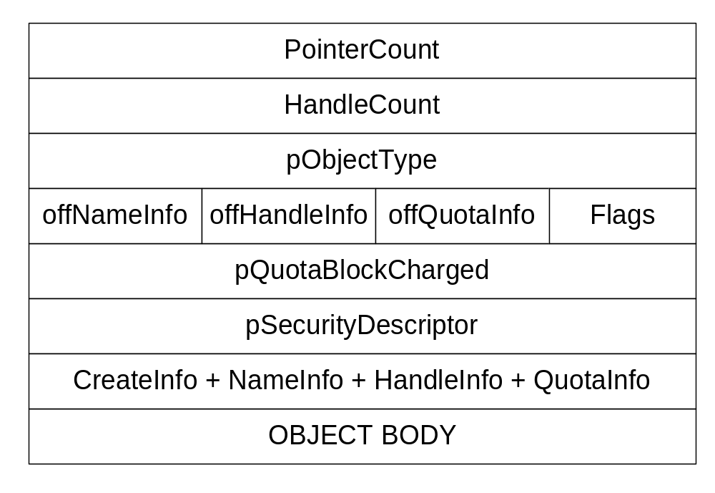
OBJECT_HEADER

Slide 7
Generic object services
namespace ops: directories, symlinks
NtQueryObject
NtQuery/SetSecurityObject
NtWaitForSingle/MultipleObjects
ObOpenObjectByName/Pointer
ObReferenceObjectByName/Handle
NtDuplicateObject
NtClose
ObDereferenceObject

Slide 8
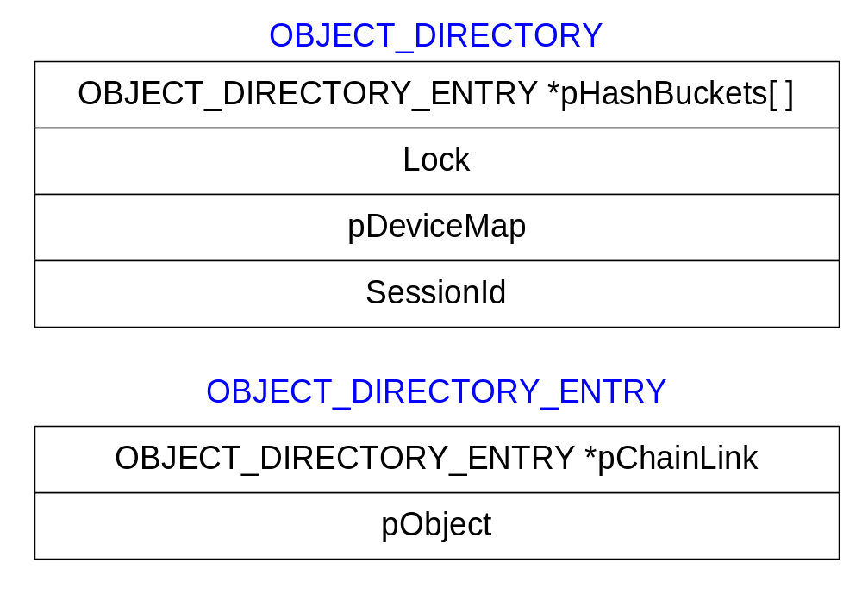
OBJECT_DIRECTORY

Slide 9
ObpLookupDirectoryEntry(pD, s)
object = NULL
idx = HASH(s)
pE = pD->HashBuckets[idx]
LockDirectoryShared(pD)
while (pE && !eqs(s, pE->Object->Name))
  pE = pE->pChainLink
if (pE)
  ObpReferenceObject(object = pE->Object)
UnlockDirectory(pD)
return object

Slide 10
Object Methods
OPEN: Create/Open/Dup/Inherit handle
CLOSE: Called when each handle closed
DELETE: Called on last dereference
PARSE: Called looking up objects by name
SECURITY: Usually SeDefaultObjectMethod
QUERYNAME: Return object-specific name
OKAYTOCLOSE: Give veto on handle close

Slide 11
Object Manager Types
Directory - namespace object
    Implementation hardwired
SymbolicLink - namespace object
    DeleteProcedure = ObpDeleteSymbolicLink
    ParseProcedure = ObpParseSymbolicLink
Type - represent object types
    DeleteProcedure = ObpDeleteObjectType

Slide 12
Object Manager lookups
ObpLookupObjectName(Name,Context)
  Search a directory for specified object name
  Use ObpLookupDirectoryEntry() on Directories
  Otherwise call object-specific ParseProcedure
    Implements symbolic links (SymbolicLink type)
    Implements file systems (DeviceObject type)

Slide 13
I/O Manager Types
Adapter - ADAPTER_OBJECT
Controller - CONTROLLER_OBJECT
Device - DEVICE_OBJECT
ParseProcedure = IopParseDevice
    DeleteProcedure = IopDeleteDevice
    SecurityProcedure = IopGetSetSecurityObject
Driver - DRIVER_OBJECT
    DeleteProcedure = IopDeleteDriver
IoCompletion - KQUEUE
    DeleteProcedure = IopDeleteIoCompletion

Slide 14
I/O Manager File Type
File - FILE_OBJECT
    CloseProcedure = IopCloseFile
    DeleteProcedure = IopDeleteFile
    ParseProcedure = IopParseFile
    SecurityProcedure = IopGetSetSecurityObject
    QueryNameProcedure = IopQueryName

Slide 15
IopParseDevice
(DeviceObject, Context, RemainingName)
  Call SeAccessCheck()
  If (!*RemainingName) directDeviceOpen = TRUE
  For file opens, get Volume from DeviceObject
  Update references on Volume and DeviceObject
  Construct an I/O Request Packet (IRP)
  FileObject = ObCreateObject(IoFileObjectType)
  Initialize FileObject
  Initiate I/O via IoCallDriver(VolumeDevice, IRP)
  Wait for I/O to signal FileObject->Event
  Return the FileObject to caller

Slide 16
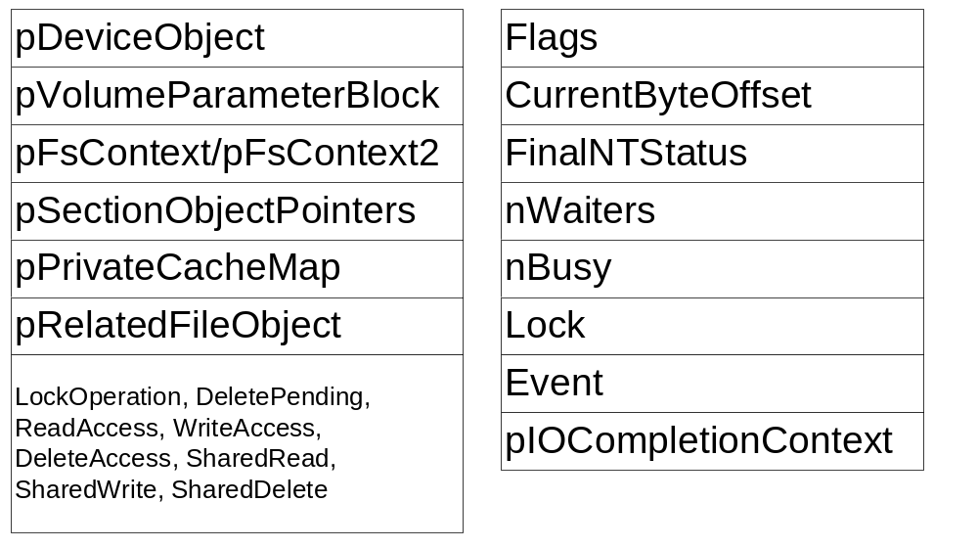
FILE_OBJECT

Slide 17
File Object (FO) flags
FO_FILE_OPEN
FO_SYNCHRONOUS_IO
FO_ALERTABLE_IO
FO_REMOTE_ORIGIN
FO_WRITE_THROUGH
FO_SEQUENTIAL_ONLY
FO_CACHE_SUPPORTED
FO_NAMED_PIPE
FO_STREAM_FILE
FO_MAILSLOT
FO_FILE_MODIFIED
FO_FILE_SIZE_CHANGED
FO_CLEANUP_COMPLETE
FO_TEMPORARY_FILE
FO_DELETE_ON_CLOSE
FO_OPENED_CASE_SENSITIVE
FO_HANDLE_CREATED
FO_FILE_FAST_IO_READ
FO_RANDOM_ACCESS
FO_FILE_OPEN_CANCELLED
FO_VOLUME_OPEN
FO_FILE_OBJECT_HAS_EXTENSION
FO_NO_INTERMEDIATE_BUFFERING
FO_GENERATE_AUDIT_ON_CLOSE
FO_DIRECT_DEVICE_OPEN

Slide 18
Process/Thread Types
Job - JOB
    DeleteProcedure = PspJobDelete
    CloseProcedure = PspJobClose
Process - EPROCESS
    DeleteProcedure = PspProcessDelete
Profile - EPROFILE
    DeleteProcedure = ExpProfileDelete
Section - SECTION
    DeleteProcedure = MiSectionDelete
Thread - ETHREAD
    DeleteProcedure = PspThreadDelete
Token - TOKEN
    DeleteProcedure = SepTokenDeleteMethod

Slide 19
Job methods - Close
PspJobClose - called by OB when a handle is closed
  Return unless final close
  Mark Job as closed
  Acquire the job's lock
  If job marked PS_JOB_FLAGS_CLOSE_DONE
    Release the JobLock
    Call PspTerminateAllProcessesInJob()
    Reacquire the JobLock
  Acquire the job's MemoryLimitsLock
  Remove any completion port from the job
  Release the MemoryLimitsLock
  Release the JobLock
  Dereference the completion port

Slide 20
Job methods - Delete
PspJobDelete - called by OB at final dereference
  Holding the Joblock callout to ntuser
  Acquire the PspJobListLock
  If part of a jobset then we are the job pinning the jobset
  tJob = next job in set and remove current job
  Release the PspJobListLock
  If (tJob) ObDereferenceObjectDeferDelete (tJob)
  If (Job->Token) ObDereferenceObject (Job->Token)
  Free pool allocated for job filters
  Unlink our JobLock from the global list

Slide 21
Synchronization Types
Event - KEVENT
EventPair - EEVENT_PAIR
KeyedEvent - KEYED_EVENT_OBJECT
Mutant - KMUTANT
    DeleteProcedure = ExpDeleteMutant
Port - LPCP_PORT_OBJECT
    DeleteProcedure = LpcpDeletePort
    CloseProcedure = LpcpClosePort
Semaphore - KSEMAPHORE
Timer - ETIMER
    DeleteProcedure = ExpDeleteTimer

Slide 22
Win32k.sys
Callback - CALLBACK_OBJECT
    DeleteProcedure = ExpDeleteCallback
WindowsStation, Desktop
    CloseProcedure = ExpWin32CloseProcedure
    DeleteProcedure = ExpWin32DeleteProcedure
    OkayToCloseProcedure = ExpWin32OkayToCloseProcedure
    ParseProcedure = ExpWin32ParseProcedure
    OpenProcedure = ExpWin32OpenProcedure

Slide 23
Processes & Threads
Access Token
Process
Object
VAD
VAD
VAD
Virtual Address Space Descriptors
Handle Table
object
object
Thread
Thread
Thread
. . .
Access Token

Slide 24
Handle Table (Executive)
Efficient, scalable object index structure
One per process containing ‘open’ objects
Kernel handle table (system process)
Also used to allocate process/thread IDs

Slide 25
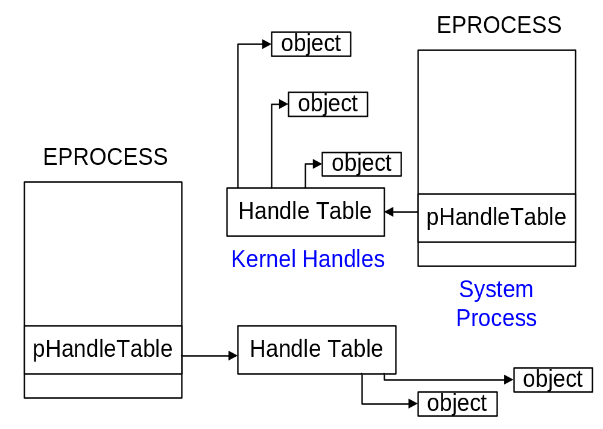
Process Handle Tables

Slide 26
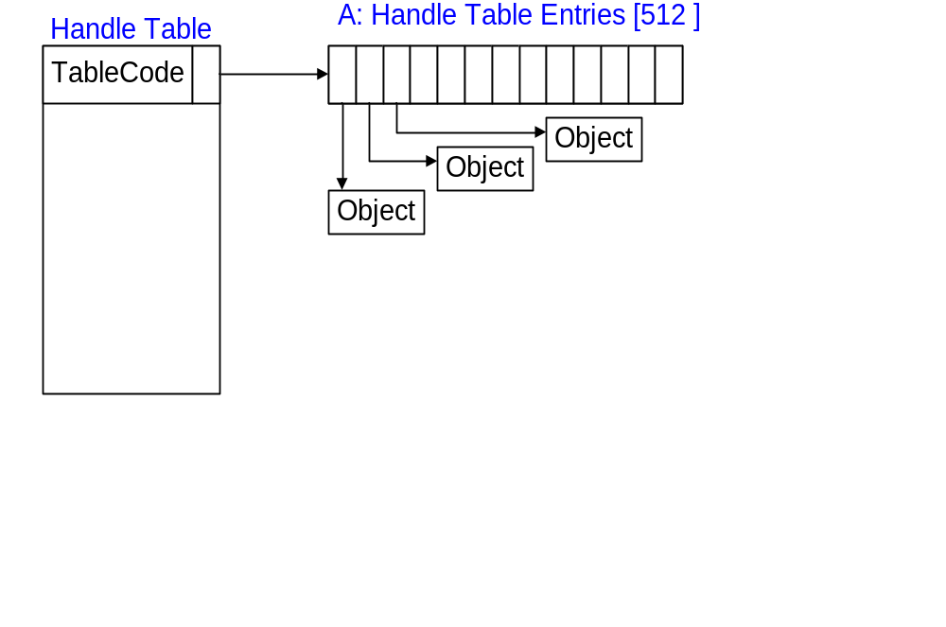
One level: (to 512 handles)

Slide 27
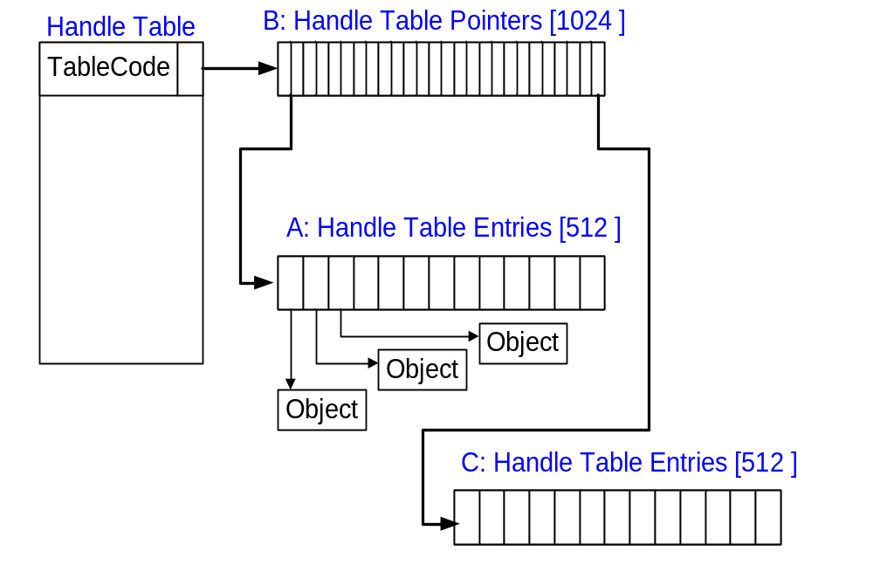
Two levels: (to 512K handles)

Slide 28
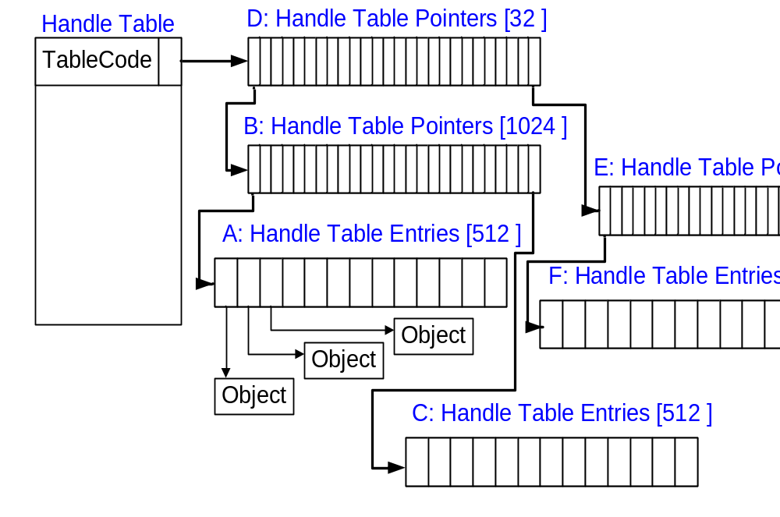
Three levels: (to 16M handles)

Slide 29
Handle Table Data Structure
TablePointer/Level | Points at handles
QuotaProcess | Who to charge
UniqueProcessId | Passed to callbacks
HandleTableLocks[N] | Locks for handles
HandleTableList | Global list of tables
HandleContentionEvent | Event to block on
DebugInfo | Stacktraces
ExtraInfoPages | Parallel table for audits
FirstFree/LastFree | The two handle free lists
NextHandleNeedingPool | Handles w/ memory
HandleCount | Handles in use

Slide 30
Handle Table Functions
ExCreateHandleTable – create non-process tables
ExDupHandleTable – called creating processes
ExSweepHandleTable – for process rundown
ExDestroyHandleTable – called destroying processes
ExCreateHandle – setup new handle table entry
ExChangeHandle – used to set inherit and/or protect
ExDestroyHandle – implements CloseHandle
ExMapHandleToPointer – reference underlying object
ExReferenceHandleDebugInfo – tracing handles
ExSnapShotHandleTables – handle searchers (oh.exe)

Slide 31
ExCreateHandle(table, entry)
NewHandleTableEntry = ExpAllocateHandleTableEntry()
KeEnterCriticalRegionThread()
*NewHandleTableEntry = *HandleTableEntry
ExUnlockHandleTableEntry()
KeLeaveCriticalRegionThread()

Slide 32
ExpAllocateHandleTableEntry()
while (1) {
  while (! (OldValue = Table->FirstFree)) {
    ExAcquirePushLockExclusive(TableLock[0]);
    If (OldValue = Table->FirstFree) break;
    If (OldValue = ExpMoveFreeHandles()) break;
    ExpAllocateHandleTableEntrySlow();
    ExReleasePushLockExclusive(TableLock[0]);
  }
  ExpUnlockHandleTableExclusive();
  Handle.Value = (OldValue & FREE_HANDLE_MASK);
  Entry = ExpLookupHandleTableEntry();

Slide 33
  Idx = ((Handle.Value)>>2) % HANDLE_LOCKS;
  ExAcquirePushLockExclusive(TableLock[idx]);
  if (OldValue != *(volatile)&Table->FirstFree) {
    ExReleasePushLockExclusive(TableLock[idx]);
    continue;
  }
  KeMemoryBarrier ();
  NewValue = *(volatile)&Entry->NextFreeTableEntry;
  Expected = InterlockedCompareExchange (&Table->FirstFree, NewValue, OldValue);
    ExReleasePushLockExclusive(Lock[idx]);
  if (Expected == OldValue) break;
}
InterlockedIncrement (HandleCount);
*pHandle = Handle;

Slide 34
ExpLookupHandleTableEntry
If Handle.Value >= NextHandleNeedingPool
  return NULL;
CapturedTable = *(volatile)&Table->TableCode;
CapturedTable = CapturedTable - TableLevel;
switch (CapturedTable & LEVEL_CODE_MASK) {
… index into tables according to level …
}
return Entry;

Slide 35
ExpMoveFreeHandles
// Move all free entries from the delayed free list
Old = InterlockedExchange (&Table->LastFree, 0);
Acquire and immediately release all the TableLocks to synch
if (! StrictFIFO) {
  // If FirstFree list is empty just stash the delayed list
  if (InterlockedCompareExchange (&Table->FirstFree,
        Old + GetNextSeq(), 0) == 0) return Old;
}
Reverse the chain to get: FirstEntry -> … -> LastEntry
New = FirstEntry + GetNextSeq();
while (1) {
  tmp = Table->LastFree;
  Entry->NextFreeTableEntry = tmp;
  if (tmp == InterlockedCompareExchange (Index, New, tmp))
    break;
}
return Old;

Slide 36
Object Manager Summary
Manages the NT namespace
Common scheme for managing resources
Extensible method-based model for building system objects
Memory management based on reference counting
Uniform/centralized security model
Support handle-based access of system objects
Common, uniform mechanisms for using system resources

Slide 37
Discussion

