Slide 1
Pandemic Employee Status Tracker

Slide 2
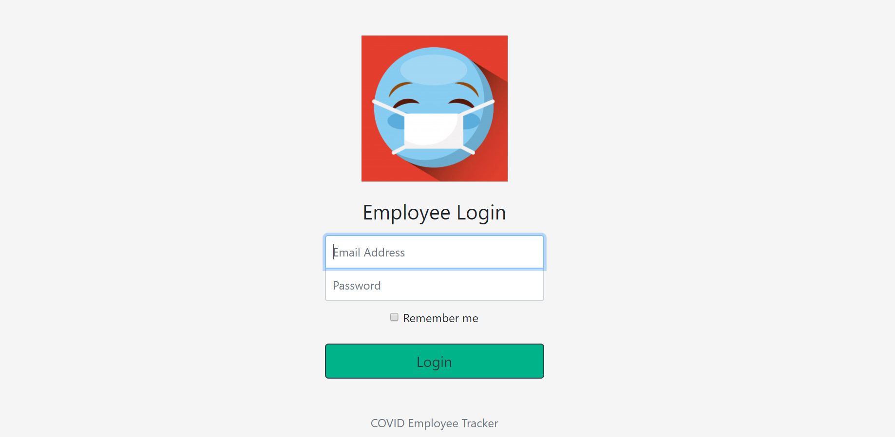

Slide 3
Track zones of team members
A manager will be able to track his team members during this pandemic. The manager will be able to graphically view the number of his team members in various zones and the company can take necessary actions to provide help.

Slide 4
Reach out to team members
The app can record information about an employee being alone or with family, and will be a platform for a stranded employee to connect with his team to reach out for any kind of help required

Slide 5
Plan phased upliftment of WFH
The app will display the employees living in various zones. This can help higher management in planning phased upliftment of WFH, and determine which employees be called first to the office. For example, for a Bengaluru based company, it makes more sense to call employees in the same city rather than someone living in Delhi.

Slide 6
Track mandatory home quarantine days after coming from another State
Many companies are also following 14-day mandatory WFH-rule even after the employees return to the work city. The managers can view the days left before an employee is ready to join the office.

Slide 7
Track number of employees inside the campus
Once employees start to return to workplace, the Site Admin can view the real time number and percentage of employees in the campus and in the various wings.

Slide 8
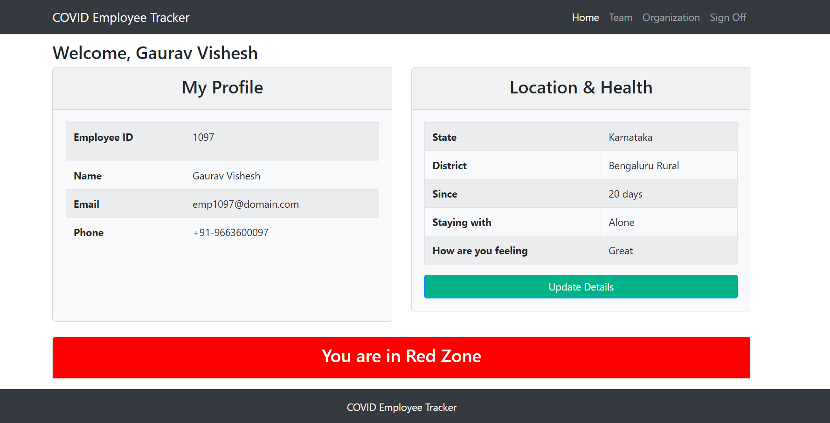
Home Page for employees

Slide 9
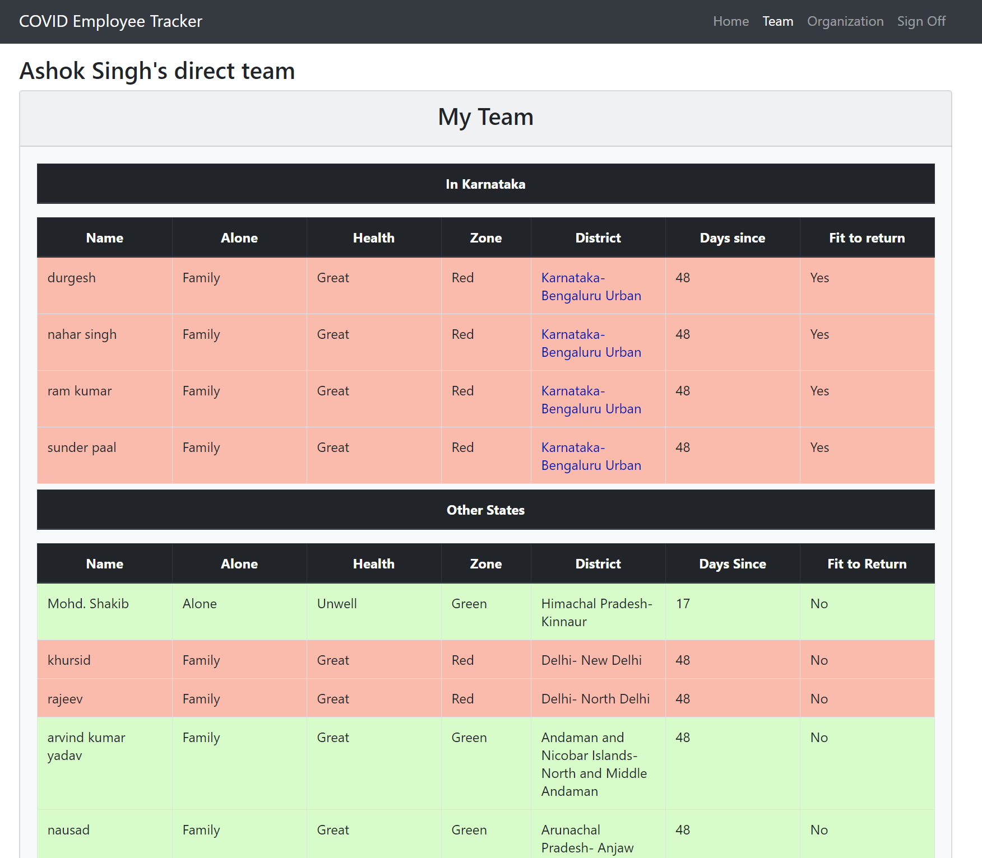
Team Page for managers

Slide 10
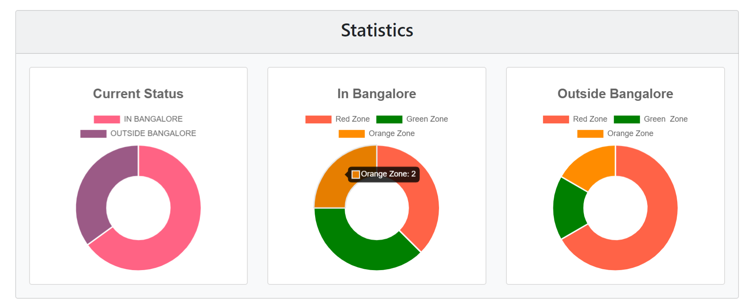
Team Statistics

Slide 11
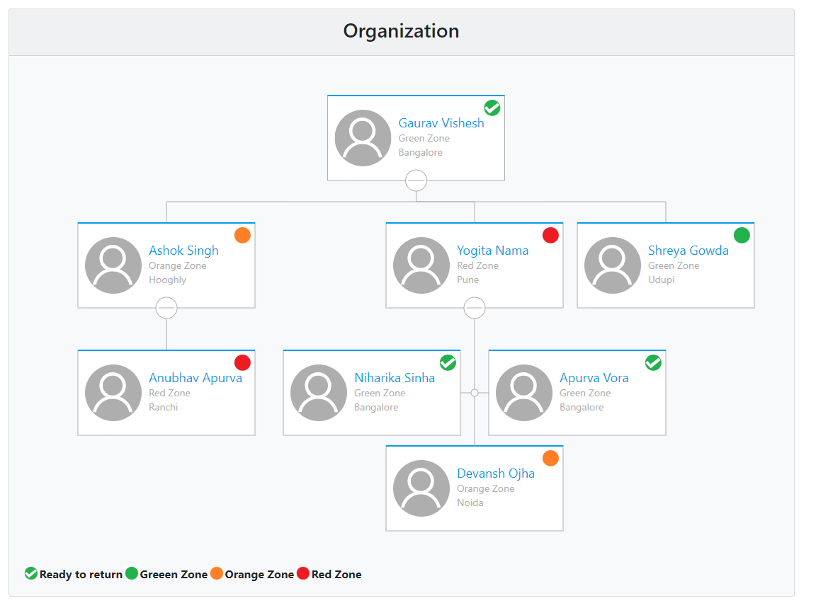
Interactive Organization Chart

Slide 12
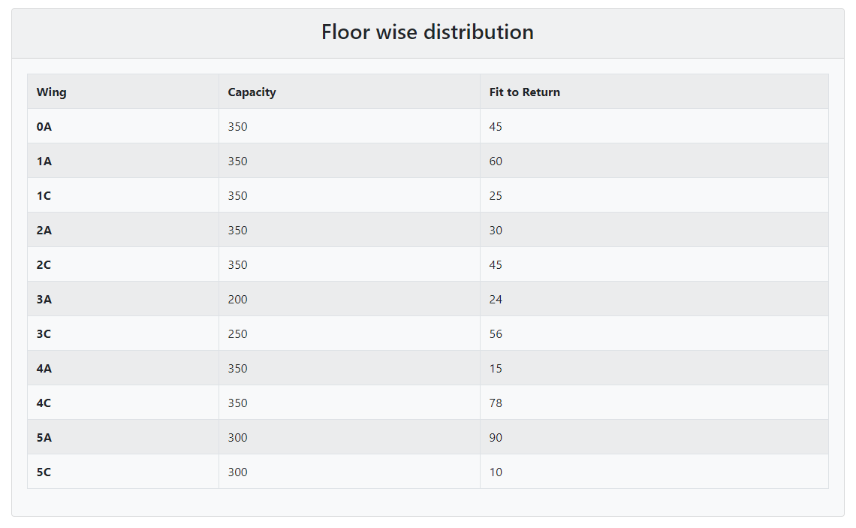
Floor/wing wise data

Slide 13
Floor/wing real time status
The real time entry and exit of an employee inside campus and in various wings can be recorder using the RFID ID cards (if the organization has one) or through any punching system which is in place.
The administrator can view the floor map and where is the designated seat of the employees who are inside the campus to make sure no two employees seated consecutive.
It would also show the percentage of employees in each wing so that overcrowding is avoided and social distancing can be maintained

Slide 14
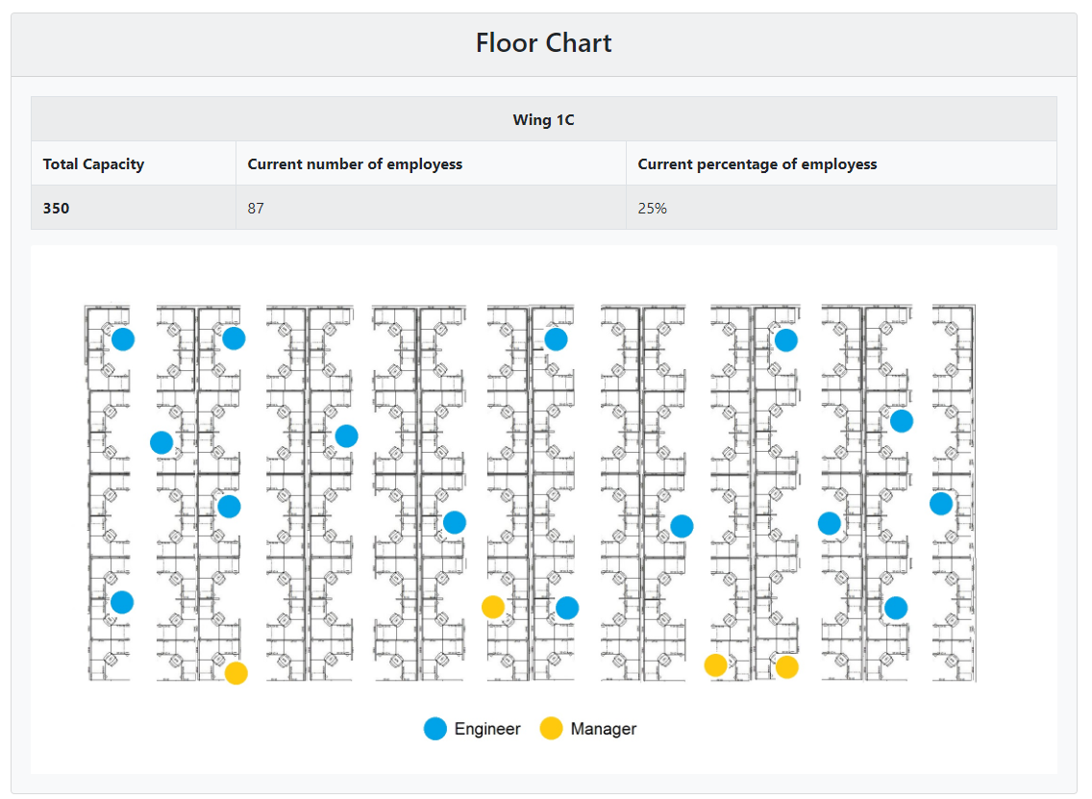
Floor/wing real time status

Slide 15
Status of project
Web portal is ready to be deployed.
It has to be integrated with the real database of organizations.
An employee scheduler is in progress, using which a manager can schedule his directs into the workplace
Android and IOS application will also be released for convenience

Slide 16
Niharika Sinha
Apurva Vora
Devansh Ojha
Anubhav Apurva
Thank you

