Slide 1
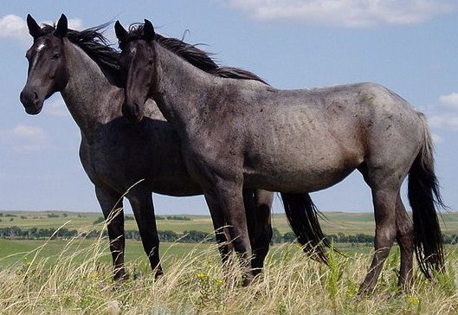
0. Setup
iTerm2
fish
micro
python3.8
yapf

Slide 2

1. Git

Slide 3

GitHub is not Git
GitHub will store our Git repository, but its copy is not any more ‘correct’ or ‘official’. Be careful of this.
It is your responsibility to manage conflicts.

Slide 4

Basic Workflow
`pull` to update your local repo
Make any changes
`add` to stage your changes
`commit` to add your changes to your repo
`push` to update the remote repo

Slide 5
Gotchas
Remember to pull
`add` every time
Always `commit -m “message”`
Status to see what’s staged
git-extras and the ignore file

Slide 6
2. Project Organization

Slide 7
The Pipeline
Our project will consist of multiple(?) pipelines
Each pipeline gets its own folder
Pipelines can depend on each other
The result of a pipeline is processed, usable data

Slide 8
File Types
README.md: file summary and description
Makefile: described later
Data files: prefer lists when possible
Script files: steps in the pipeline
Viewer/output scripts: give human-readable results

Slide 9
Rules – Script Files
Each script file functionally transforms n input data files into n output data files
Each transform should be a conceptual high-level step, with the assumption that intermediate data might have other uses later
Script files take input only from command line arguments. This does not apply to interactive ‘viewer’ scripts
Name scheme? aFromB or process name

Slide 10
Documentation
Readme with a summary, pipeline diagram, and description of each data file
Description and arguments at the top of each script file

Slide 11
3. make

Slide 12
Syntax
OutputFile : script.py inputOne inputTwo
  python3 script.py inputOne inputTwo > OutputFile

Slide 13
Why?
Scripts are only run when needed
Clearly defines a directional pipeline
Automatically refreshes data based on input/script changes

Slide 14
Example
(cd makeExample)

