Slide 1
Advent:
Advertising in
MatrixWorld
A presentation by Team Advent.

Slide 2
Premise
Advertising powers the economy of the Web today.
Major players in the Internet as we know it are driven by revenues from ad sales.
MatrixLand and by extension Web3 provides an avenue for decentralization of the advertising industry.

Slide 3
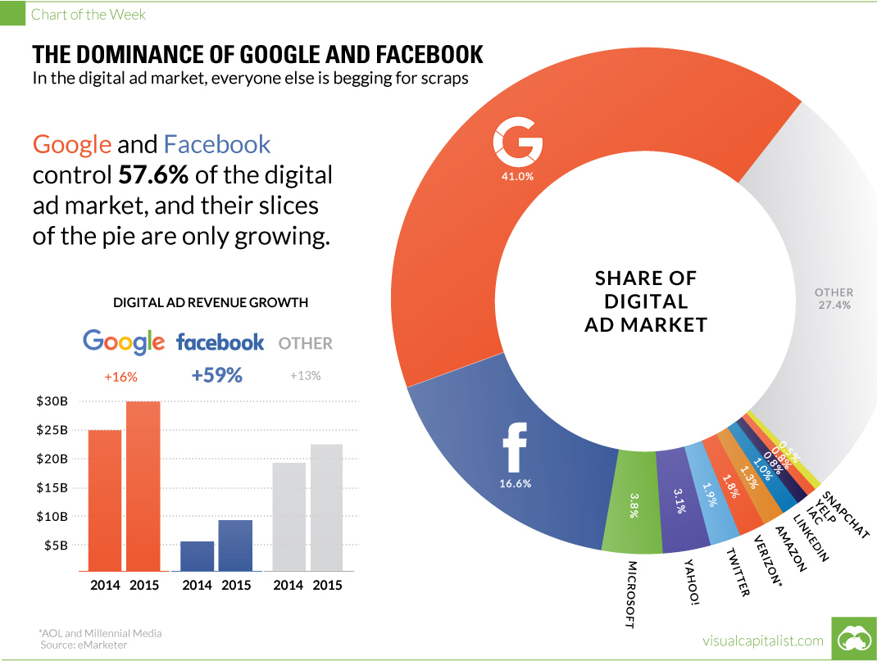

Slide 4
Explained
Advent allows MatrixLand owners to list advertising spaces for sale.
People can then purchase the rights to display their images, text and media on the advertised space on the plot
These advertised media are then made visible for viewing in the MatrixLand metaverse
Notes:
Instead of paying full price for plots, you can pay less to advertise
Can put idle land to work

Slide 5
How it works
User connects wallet and lists plot for advertising
A buyer purchases the advertising spot for the listed price
They are allowed to advertise their media on the listed plot.

Slide 6
Technical Implementation
Listing details are stored as well as scene editing privileges are stored in the Advent smart contract
When a user purchases the listed advertising spaces, the contract keeps track of new owners and the media they’re to advertise
This media is then minted into an NFT displayed on the advertising space in the MatrixLand.

Slide 7

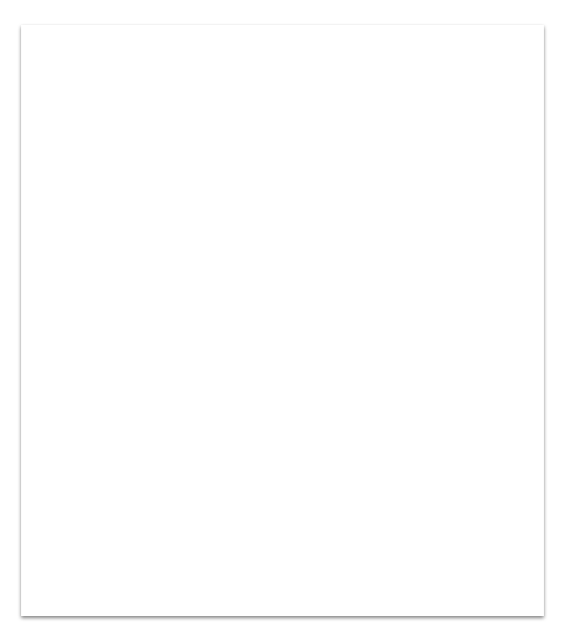
Thanks!

