Slide 1

Capstone project
SPORT_ANALYSIS

Slide 2

ER DIAGRAM

Slide 3
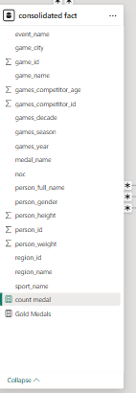
SUMMARY

Slide 4
Sport analysis
In the Sports Analysis, the tables used include Sport, Event, City, Games, Games City, NOC Region, Person, Person Region, Games Competitor, Medal, and Competitor Event.
Author analysis
The visuals provide insights into how many participants represented each country and city, how participation fluctuated year by year, and how some athletes competed for different countries. They also show the distribution of medals—gold, silver, bronze—and highlight that some participants did not win any medals.
Publication
explores the historical timeline of the Olympic Games, distinguishing between Summer and Winter editions since 1896. It highlights trends in the frequency of events, locations of host cities, and notable changes in hosting patterns, such as multi-city editions. This analysis helps uncover the global expansion and organizational evolution of the Olympics over time.
Games Analysis
examines the evolution of sports and events in the Olympics, including additions, removals, and shifts in popularity. It highlights gender-based classifications—Men's, Women's, and Mixed events—and tracks participation trends across different disciplines. This analysis reveals how the Olympic program has adapted to global sporting interests over time.
Sports and Events

Slide 5



Objective: To examine the variety and evolution of sports featured in the Olympic Games by identifying trends in sport inclusion across editions, participation rates, and gender distribution. The goal is to uncover shifts in global interest and guide recommendations for future sport selection. In POWER BI overview should given
Analysis scope: This analysis explores all sports featured in the Olympic Games across different editions. It focuses on the number of sports, their seasonal classification (Summer/Winter), gender-based event availability, and trends in sport additions or removals over time.
Goal: The goal is to identify key trends in the inclusion, popularity, and gender balance of Olympic sports over time. This insight will help support strategic decisions on sport selection, event design, and equitable representation in future Olympic Games.

Slide 6
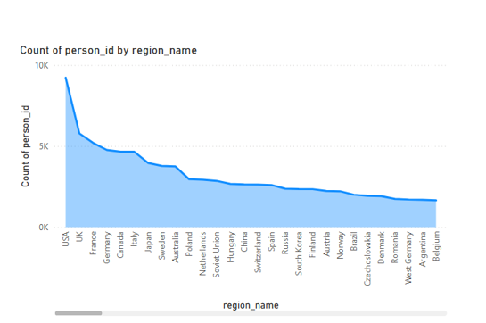
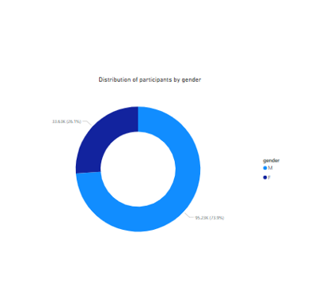
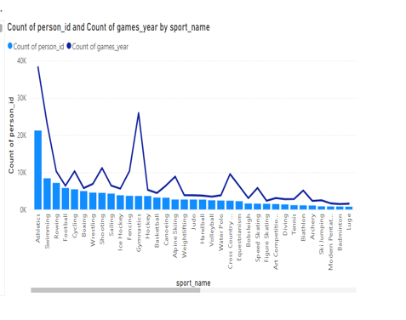
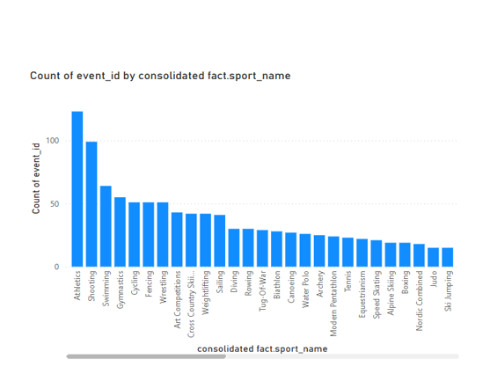

Slide 7
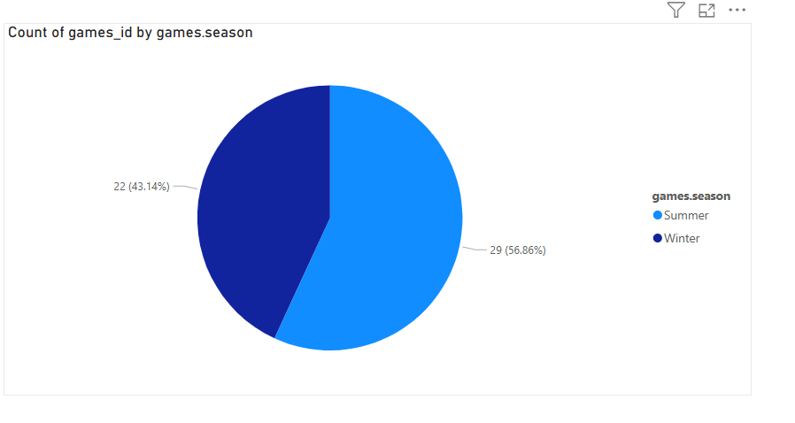
How many Olympic games have been held in each
Season (summer vs winter ?
An evaluation of the distribution of Olympic games by season, using the games_id count grouped by games.season ,indicates that 56.86% of the events occurred during the summer season, while 43.14% were held in the winter season. This suggests a higher frequency of summer Olympic editions over time, highlighting a seasonal skew in the historical scheduling of the games.

Slide 8
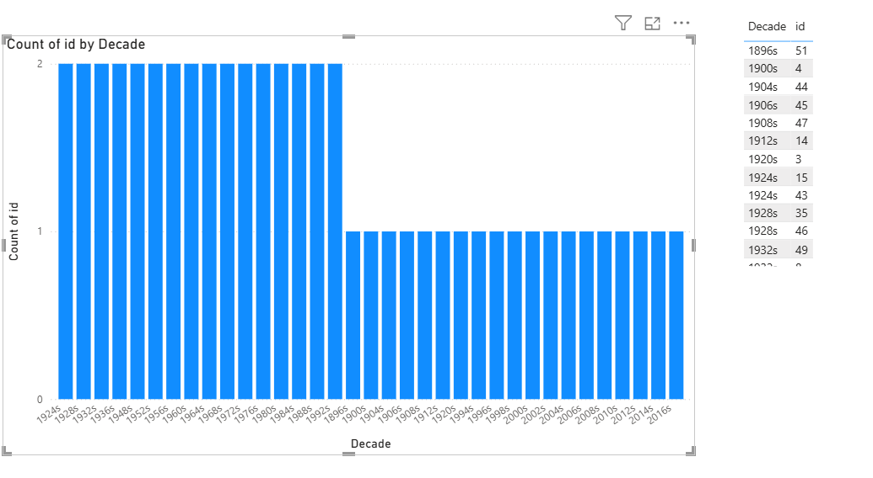
What is the distribution of games across different decades?
The chart displays the distribution of Olympic Games across various decades. From the 1930s to the 1990s, each decade consistently hosted two editions of the Games, indicating a stable pattern. However, starting from the 2000s, the number of Games per decade reduced to one. This change could be due to scheduling shifts, global events, or adjustments in the hosting pattern. The earlier decades also show some irregularities, likely due to world wars or organizational changes. Overall, the chart highlights both consistency and disruption in the historical timeline of the Olympic Games.

Slide 9
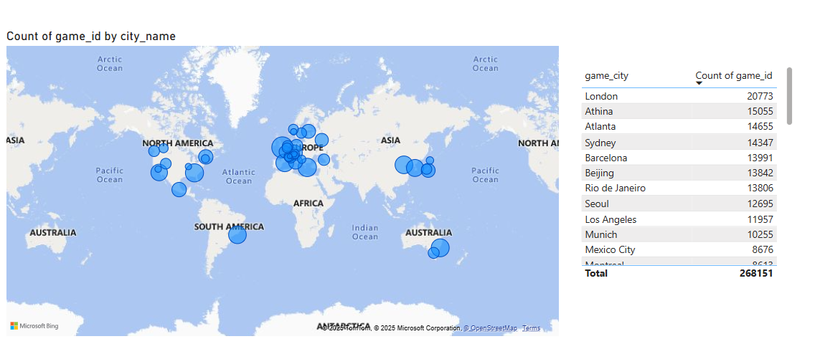
3.Which cities have hosted the most Olympic Games?
London has hosted the most Olympic Games based on game ID counts, followed by Athina and Atlanta. These cities show strong historical ties to the Olympics, with repeated appearances due to official hosting and athlete participation records.

Slide 10
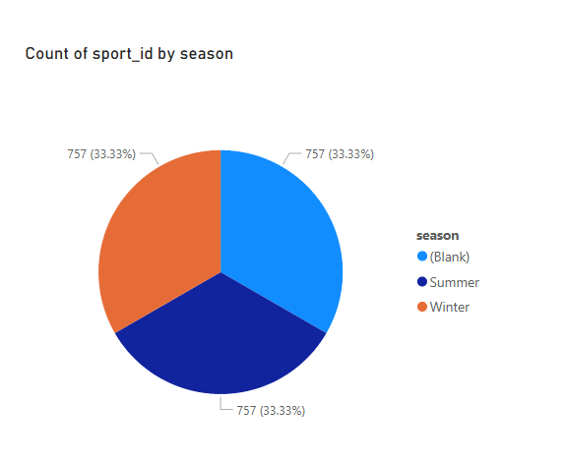
4.What is the distribution of sports between Summer and Winter Olympics?
The distribution of sports between the summer and winter Olympics appears to be relatively equal when comparing based on sport_id Additionally, some sports are not assigned to any specific season, and these are represented as blank values in the dataset . Overall ,sports are nearly evenly distributed among the three categories summer, winter and blank(unassigned),indicating a balanced representation across Olympic seasons.

Slide 11
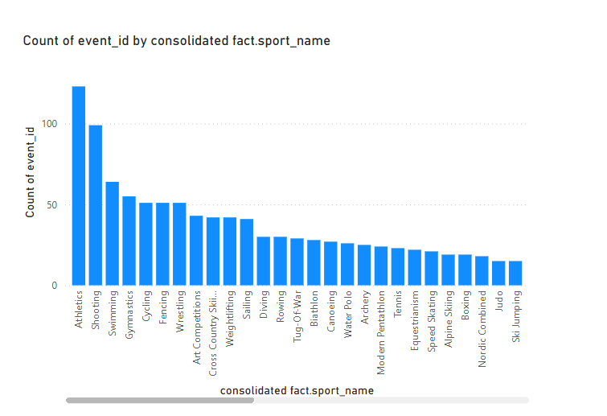
5.Which sports have the highest number of events in the Olympics?
Athletics has the highest number of events in the Olympic Games, followed closely by Shooting. These two sports hold the top positions in terms of event count and are the most featured disciplines across Olympic editions. Following them are Swimming, Cycling, Sailing, Wrestling, and Art Competitions, which also have a significant number of events. In contrast, Tennis has comparatively fewer events, placing it among the sports with the lowest event counts.

Slide 12
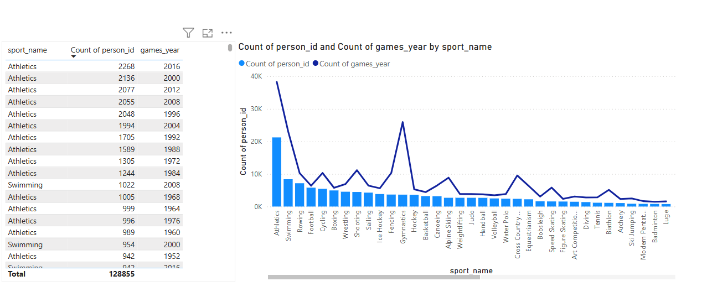
6.How has the participation in each sport evolved over time?
The participation in each sport has evolved significantly over time. For instance, sports like Basketball, Speed Skating, and Athletics saw notable participation in the 1992 Olympics, with approximately 11.13k participants, and in 1988, with around 9.76k participants. Sports such as Handball and Luge also had high participation in 1976, reaching about 7.15k participants. These figures highlight how the popularity and scale of participation in different sports have varied over the years, reflecting changing trends, global interest, and inclusion of new events.
Count of games year raise to fall Athletics ,shooting, rowing, football etc.

Slide 13
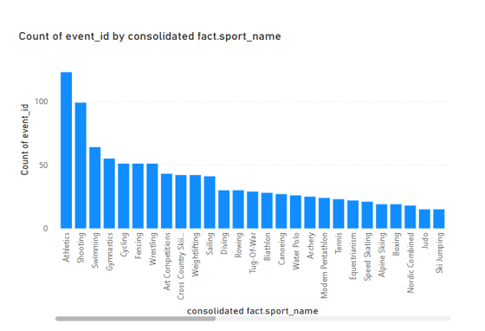
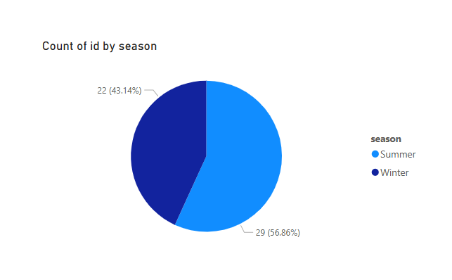
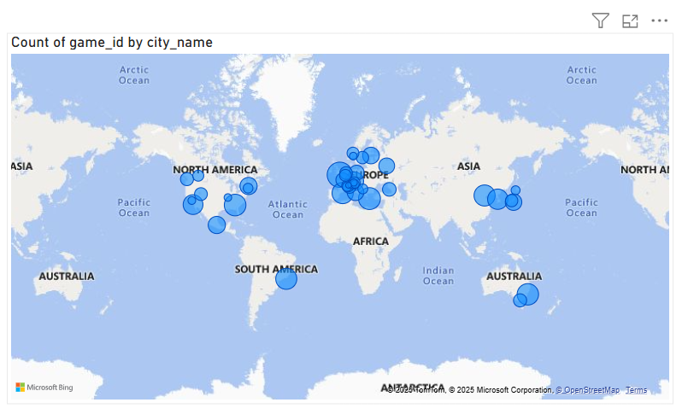
ANALYSIS BY COUNTRY OVER SEASON ON SPORT

Slide 14
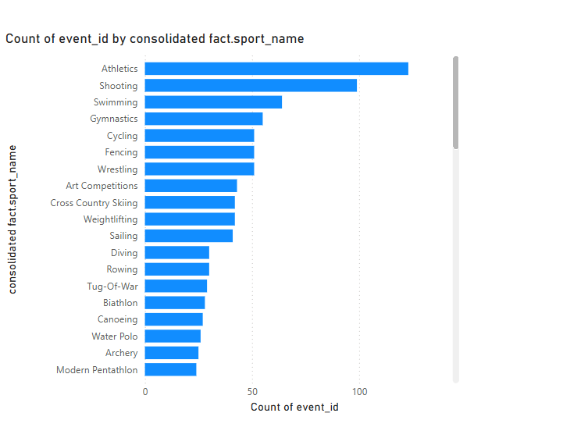
7.How many events are there in each sport?
Each sport in the Olympics consists of different events, and the number of events varies significantly from one sport to another. The event distribution ranges from high to low based on event _ id counts. Sports like Athletics and Shooting have the highest number of events, each with more than 100 events, making them the most diversified disciplines in terms of competition categories. Following them are Cycling, Sailing, and Wrestling, which also have a considerable number of events. On the other end of the spectrum, sports like Tug of War have the fewest, with only 1 recorded event, indicating limited representation in the Olympic program. This variation illustrates how the structure and prominence of sports within the Olympics differ greatly.

Slide 15
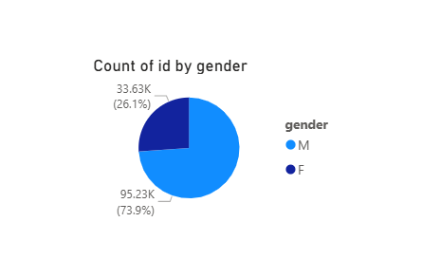
8.What is the distribution of events by gender (Men, Women, Mixed)?
The distribution of Olympic events by gender shows a significant difference in participation. Based on the count of event _ id, men account for approximately 26.1%, with around 33.63k events. In contrast, women represent a much larger share, accounting for about 73.9%, with 95.23k events. This indicates a strong emphasis on women's events in the dataset, which may reflect changes in gender inclusion policies over time.

Slide 16
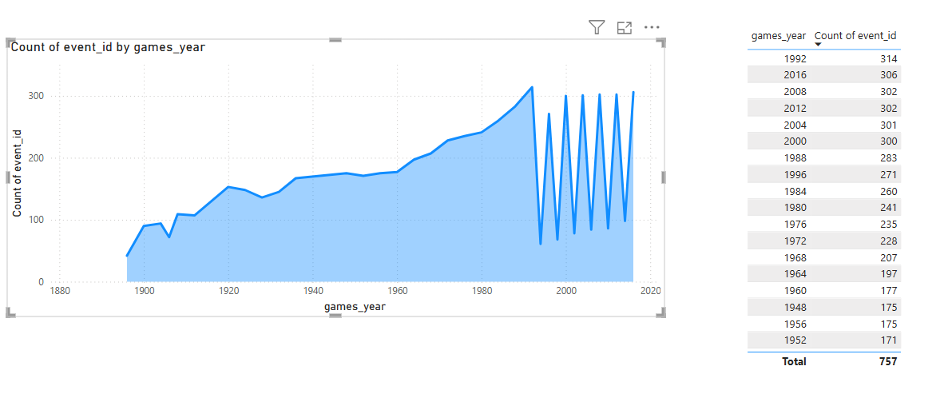
9.How has the number of events changed over time?
The number of events in the Olympic Games varies from year to year, reflecting changes in the sports program. For example, there were 314 events in 1992, while 2016 featured 306 events. These fluctuations occur as new sports and events are added or removed. The changes reflect evolving global interests, gender inclusion, and strategic decisions by the Olympic Committee. Overall, the event count highlights the dynamic nature of the Olympic Games.

Slide 17
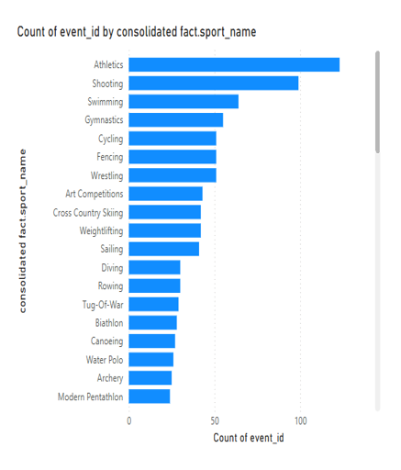
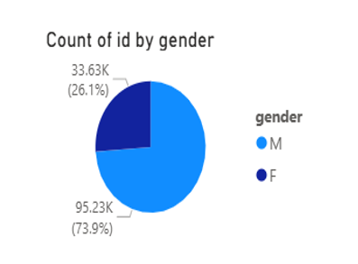
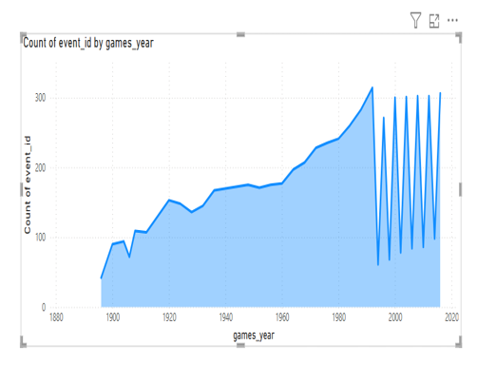
ANALYSIS OVER GAMES YEAR ON EVENTS BY GENDER

Slide 18
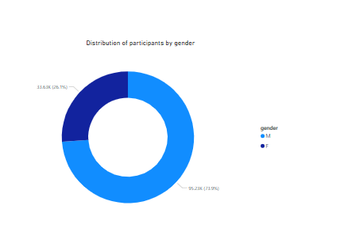
10.What is the distribution of participants by gender?
The distribution of Olympic events by gender shows a significant difference in participation. Based on the count of event _ id, men account for approximately 26.1%, with around 33.63k events. In contrast, women represent a much larger share, accounting for about 73.9%, with 95.23k events. This indicates a strong emphasis on women's events in the dataset, which may reflect changes in gender inclusion policies over time.

Slide 19
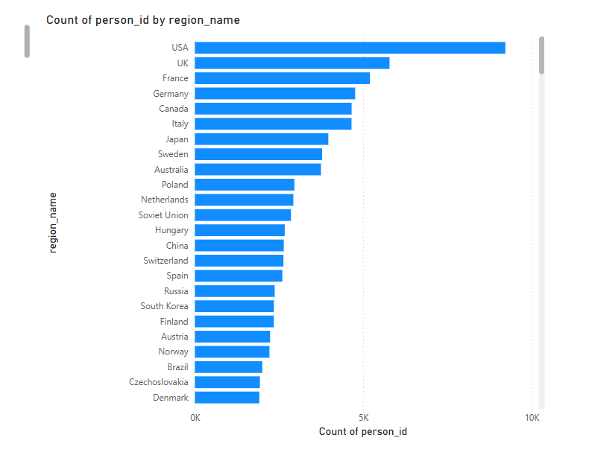
11.Which countries have the highest number of participants in the Olympics?
An analysis of Olympic participation by region indicates that the United States leads with the highest number of athletes. This can be attributed to the country's strong emphasis on sports and consistent investment in athletic development, resulting in nearly 9225 participants over the years. The United Kingdom ranks second with approximately 5783 . Other countries with significant participation include France, Germany, Canada, Italy, and Japan. These regions have demonstrated a consistent and long-standing commitment to the Olympic Games, reflecting their active engagement in international sports competitions.

Slide 20
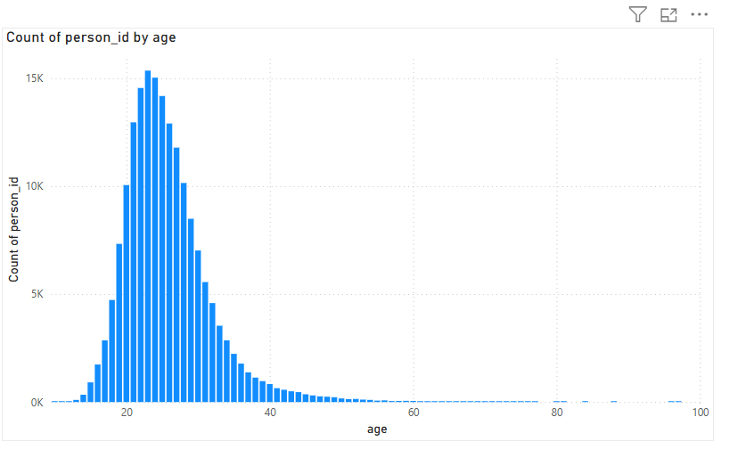
12.How does the age distribution of participants vary across different games?
The chart displays the age distribution of Olympic participants based on the count of person IDs. Most athletes fall within the age range of 18 to 30, with a sharp peak around age 22, indicating this is the most common age for Olympic competition. The number of participants declines significantly after age 30, with very few athletes above 40. This suggests that Olympic-level performance is concentrated in younger age groups, reflecting the physical demands of elite sports.

Slide 21
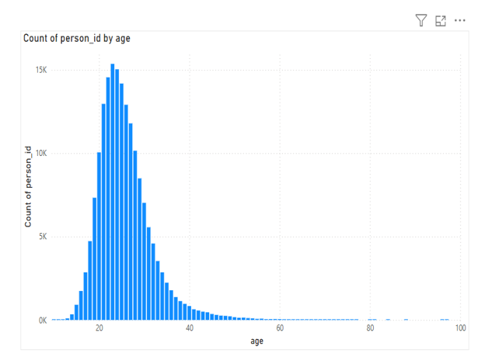
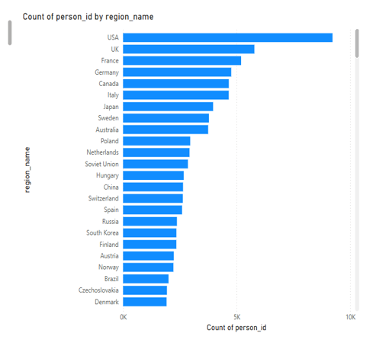
ANALYSIS PERSON AGE CHANGE IN REGION

Slide 22
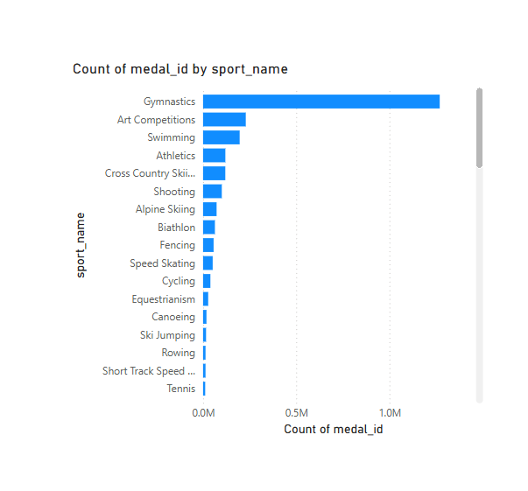
13.How many medals have been awarded in each Olympics?
The chart shows the distribution of Olympic medals by sport. Gymnastics stands out with the highest number of medals awarded, far surpassing other sports. Art Competitions, Swimming, and Athletics follow but with significantly lower medal counts. Most other sports have comparatively smaller medal tallies, indicating a more limited number of events or participation. This highlights how certain sports offer more medal opportunities than others in the Olympics.

Slide 23
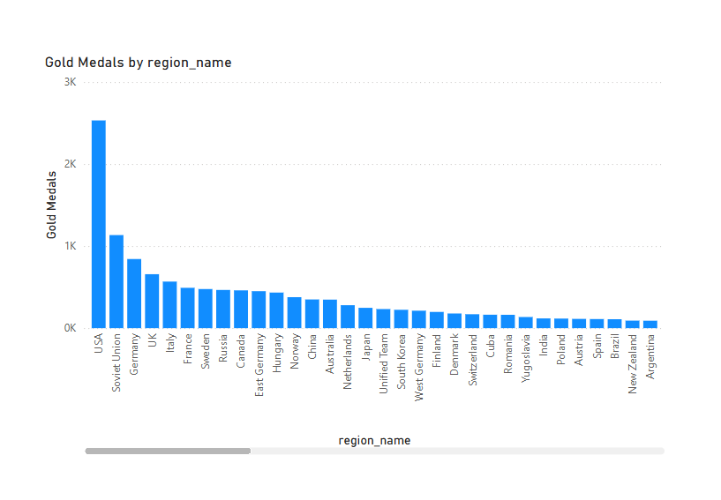
14.Which countries have the highest number of gold medals?
The chart displays the distribution of Olympic gold medals by region. The USA leads significantly, with more than double the gold medals of the next closest region, the Soviet Union. Other strong performers include Germany, UK, and Italy, though their counts are considerably lower. This reflects historical dominance and consistent athletic excellence from certain countries across Olympic history.

Slide 24
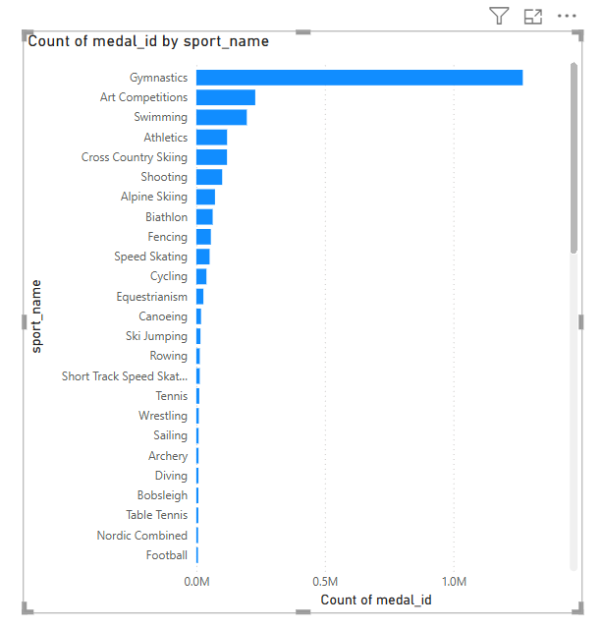
15.How does the medal distribution vary across different sports?
The chart illustrates the number of Olympic medals awarded across different sports. Gymnastics dominates with the highest medal count by a large margin, reflecting its numerous events and strong global participation. Art Competitions, Swimming, and Athletics also hold notable positions but with significantly fewer medals. Sports like Football, Nordic Combined, and Table Tennis show minimal medal counts, likely due to fewer events or more recent inclusion in the Games. This visualization emphasizes the varying scale of competition across Olympic sports.

Slide 25
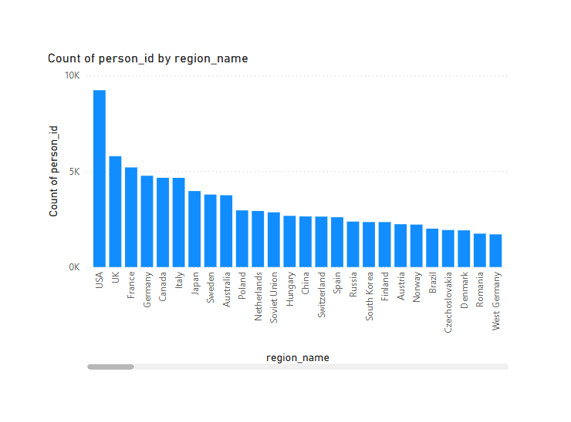
16.How many regions or NOCs participate in each Olympic Games?
An analysis of Olympic participation by region indicates that the United States leads with the highest number of athletes. This can be attributed to the country's strong emphasis on sports and consistent investment in athletic development, resulting in nearly 9225 participants over the years. The United Kingdom ranks second with approximately 5783 . Other countries with significant participation include France, Germany, Canada, Italy, and Japan. These regions have demonstrated a consistent and long-standing commitment to the Olympic Games, reflecting their active engagement in international sports competitions.

Slide 26
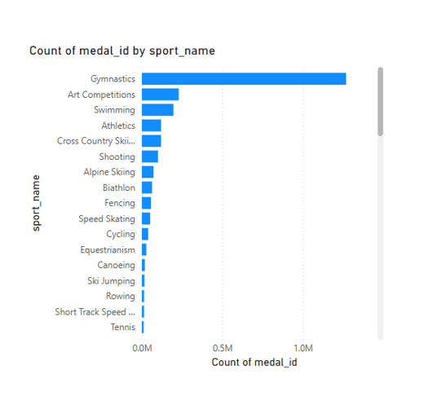
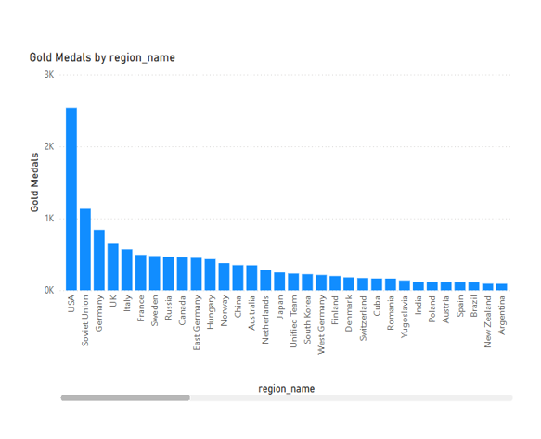

Slide 27
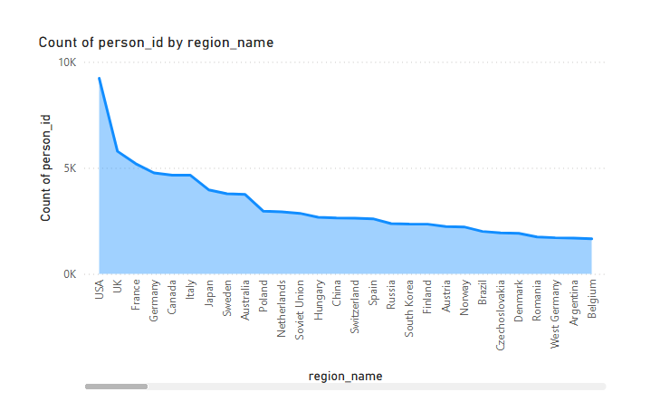
17.Which regions have the highest number of participants in the Olympics?
An analysis of Olympic participation by region indicates that the max number participant United States leads with the highest number of athletes. This can be attributed to the country's strong emphasis on sports and consistent investment in athletic development, resulting in nearly 9225 participants over the years. The United Kingdom ranks second with approximately 5783 . Other countries with significant participation include France, Germany, Canada, Italy, and Japan. These regions have demonstrated a consistent and long-standing commitment to the Olympic Games, reflecting their active engagement in international sports competitions.

Slide 28
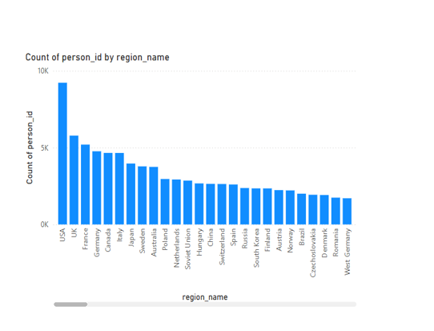
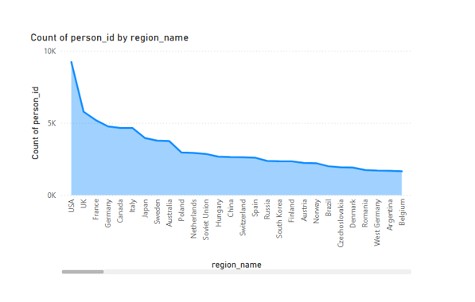

Slide 29
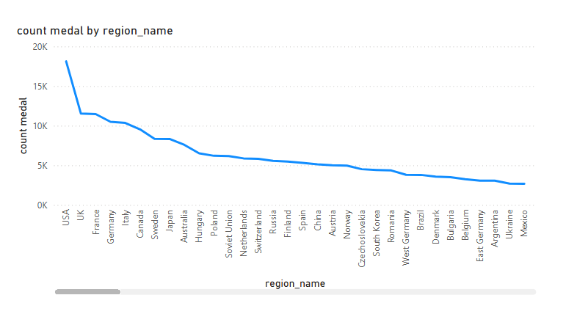
18.What is the distribution of medals among different regions?
The total number of medals awarded is 260,971, distributed across various countries and regions around the world. For example, Afghanistan has received 89 medals, Albania has been awarded 74, and American Samoa has earned 46 medals. Algeria has a higher count with 492 medals distributed among its athletes. Each country’s medal tally reflects its athletes’ performances over many Olympic Games, highlighting the global diversity in sports excellence. This wide distribution of medals showcases the competitive spirit and achievements of nations from all corners of the globe. Overall, the medal counts serve as a testament to the dedication and skill of athletes representing their countries on the international stage.

