Slide 1

H o u s e P r i c e
P re d i c t i o n
u s i n g M a c h i n e
L e a r n i n g
Ayush Gupta
(D21007)
&
Preethi Vijayaraghavalu (D21026)

Slide 2


O U T L I N E
Hypothesis
Final Model Fitting
Exploratory Data Analysis
Hyper Parameter Tuning
Initial Model Fitting
Model Testing
Feature Engineering
Conclusion

Slide 3
The main purpose of this study is to analyze potential factors that influence the price of housing in the city of King County, Washington DC, USA. To achieve this, the dataset on Housing is analyzed and a hypothesis was performed.
For this analysis, our conjecture is that the housing price will differ significantly with the number of bathrooms.
HYPOTHESIS
Will the Prices of houses with increase in number of bathrooms, are equal or not equal?
There is also a tentative price rise and decrease
based on the Year built of the houses
Will the Older Built houses result in increase of pricing of the houses due to more maintenance?

Slide 4
Exploratory Data Analysis is a process of examining or understanding the data and
extracting insights or main characteristics of the data. EDA is generally classified into two
methods, i.e. graphical analysis and non-graphical analysis.
EDA is very essential because it is a good practice to first understand the problem statement and the various relationships between the data features before getting your hands dirty.
Technically, The primary motive of EDA is to
Examine the data distribution
Handling missing values of the dataset(a most common issue with every
dataset)
Handling the outliers
Removing duplicate data
Encoding the categorical variables
Normalizing and Scaling
Exploratory Data Analysis (EDA)

Slide 5
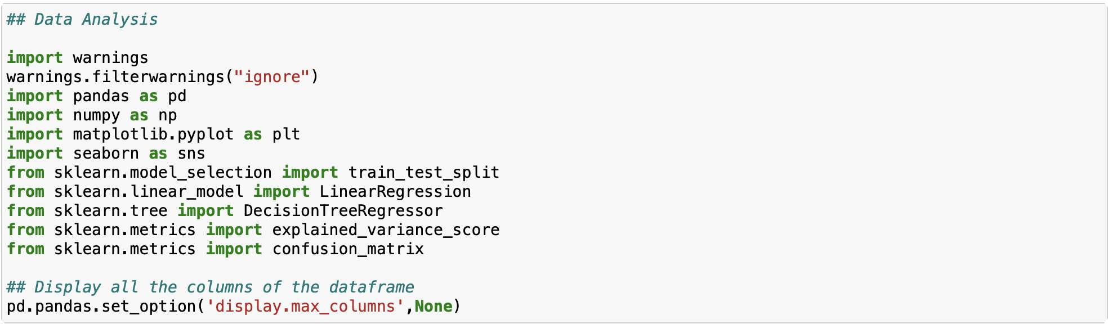
Step 1 :
First, we will import all the python libraries that are required for this, which include NumPy for numerical calculations and scientific computing, Pandas for handling data,
and Matplotlib and Seaborn for visualization.

Slide 6
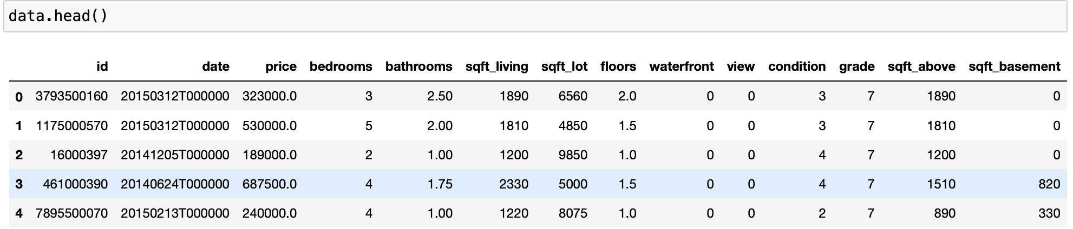
Step 2 :
Then we will load the data into the Pandas data frame.
Step 3:
We can observe the dataset by checking a few of the rows using the head() method, which returns the first five records from the dataset.

Slide 7
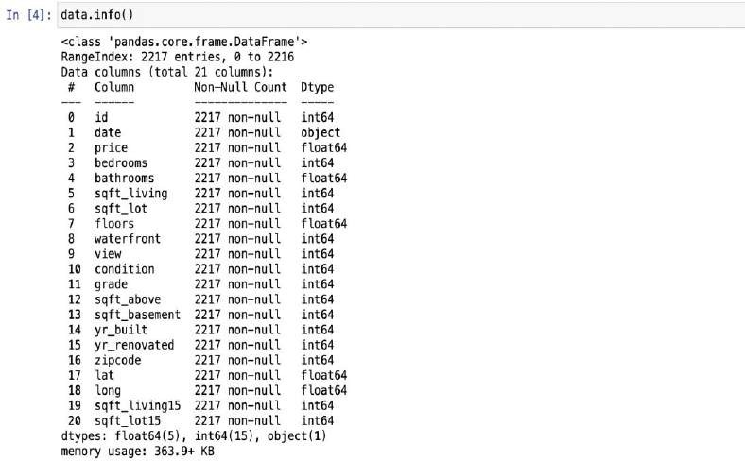
Step 4 :
Using shape, we can observe the dimensions of the data.
Step 5 :
info() method shows some of the characteristics of the data such as Column Name, No. of non-null values of our columns, Dtype of the data, and Memory Usage.
From this, we can observe, that the data which we have doesn’t have any missing values. We are very lucky in this case, but in real-life scenarios, the data usually has missing values which we need to handle for our model to work accurately.

Slide 8
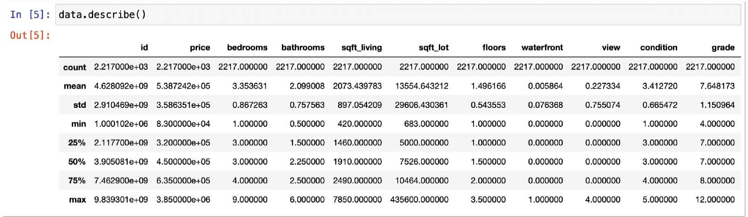
Step 6 :
We will use describe() method, which shows basic statistical characteristics of each numerical feature (int64 and float64 types): number of non-missing values, mean, standard deviation, range, median, 0.25, 0.50, 0.75 quartiles.

Slide 9
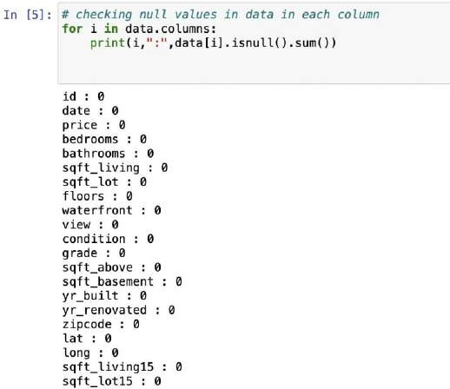
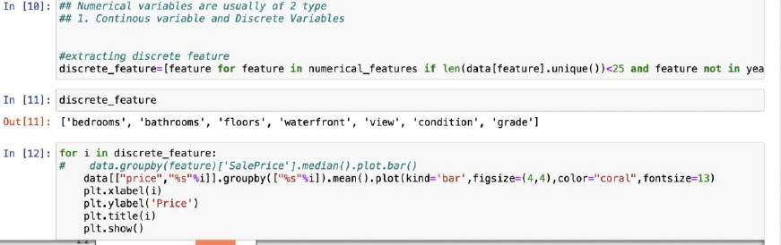
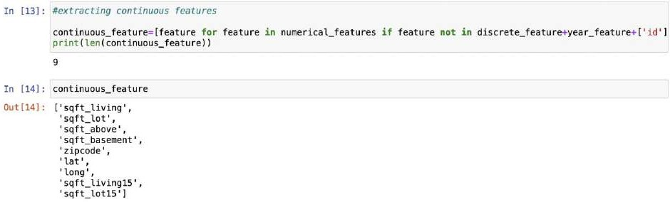
Step 7 :
Handling missing values in the dataset. Luckily, this dataset doesn’t have any missing values, but the real world is not
so naive as our case.
Step 8:
Splitting up the numerical variables in the data as discrete and continuous variables and extracting them.

Slide 10

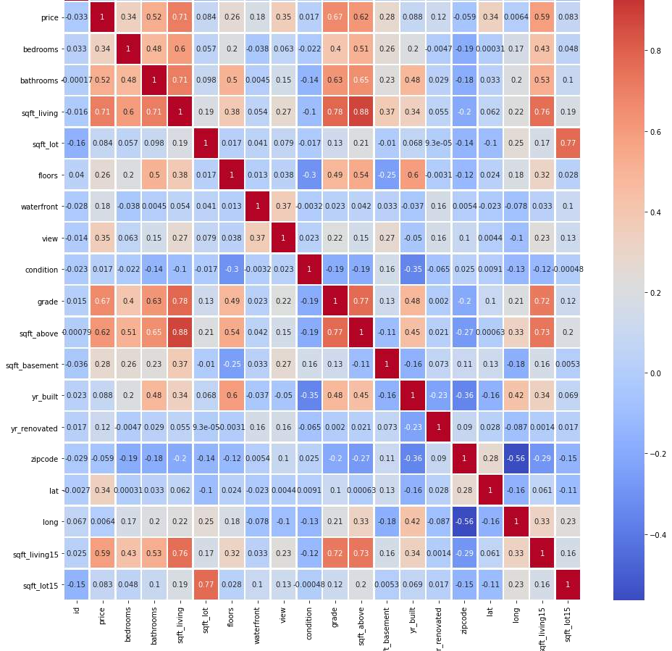
Step 9 :
We can find the pairwise correlation between the
different columns of the data using the corr() method. (Note
– All non-numeric data type column will be ignored.)
data.corr() is used to find the pairwise correlation of all columns in the data frame. Any ‘nan’ values are automatically excluded.
The resulting coefficient is a value between -1 and 1 inclusive, where: 1: Total positive linear correlation, 0: No linear correlation, the two variables most likely do not affect each other, -1: Total negative linear correlation
Now, we will create a heatmap using Seaborn to visualize the correlation between the different columns of our data:

Slide 11
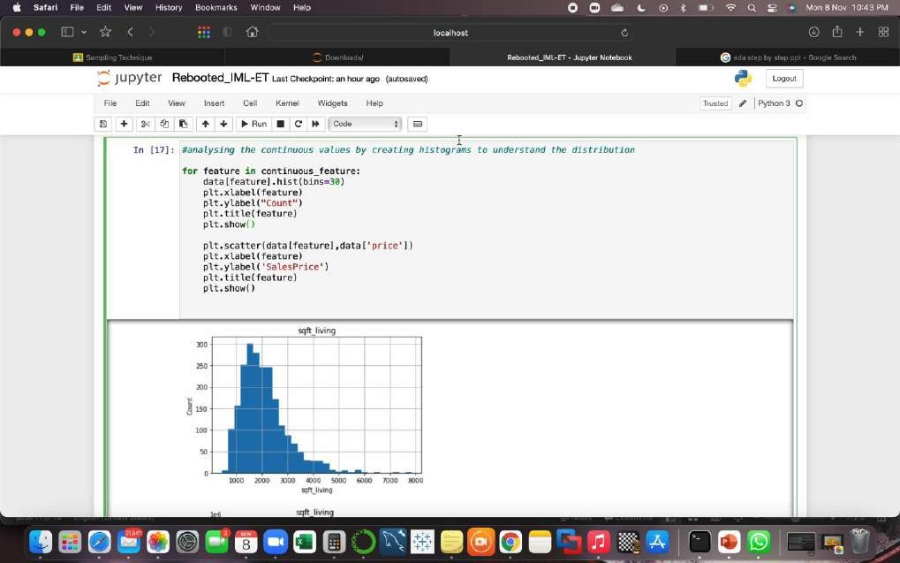
Step 10:
Analysing the continuous values by creating histograms to understand the distribution

Slide 12
INITIAL MODEL FITTING
After analyzing year_feature , discrete_feature and continuous features v/s price. We observe
that following variables have a corelation >0.5 with price:-
[ 'bathrooms', 'sqft_living', 'grade', 'sqft_above','sqft_living15’]
Step 1:
In First attempt of fitting model we take all the independent variables for predicting target variable , Using Linear Regression model by doing cross-validation of 10-fold, we determine the Root Mean Square Error(RMSE) , R-Squared of our model
[ 'bathrooms', 'sqft_living', 'grade', 'sqft_above','sqft_living15’] → Independent Variables
[‘price’]→ Dependent Variables
RMSE score is: 232734.2204257465
R-squared score is: 0.5587357758967998

Slide 13
Step 2:
In second attempt we observed that sqft_living is corelated to grade and sqft_above , with coffeicient of correlation >0.65 , this makes sqft_living roughly dependent with grade and sqft_above
, so we can try to fit the model without grade and soft_above
INITIAL MODEL
FITTING
(contd):
[ 'bathrooms', 'sqft_living','sqft_living15’] → Independent Vari ables
[‘price’]→ Dependent Variables
RMSE score is: 240532.81908393564
R-squared score is: 0.5278962737575922
(It turned out to be giving less R2 and more RMSE)

Slide 14
Step 3:
In 3 Attempt we try to have a liner regression , so wee keep on sqft_living to predict target variable,
[ 'sqft_living'] → Independent Variables
INITIAL MODEL FITTING
(contd):
[‘price’]→ Dependent Variables
RMSE score is: 240532.81908393564
R-squared score is: 0.5278962737575922
(turns out that result is same as in attempt 2)

Slide 15
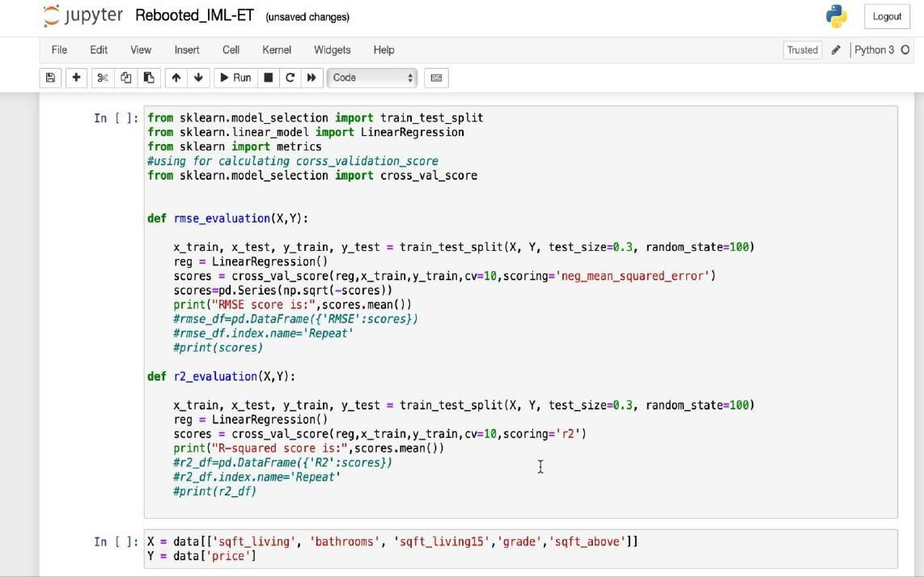
INITIAL MODEL FITTING O/P DEMO:

Slide 16
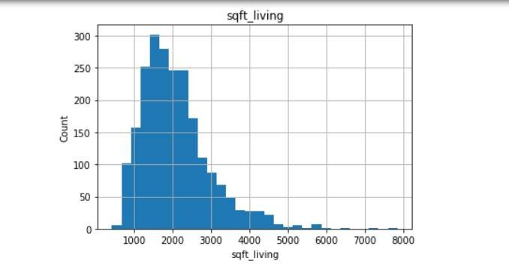
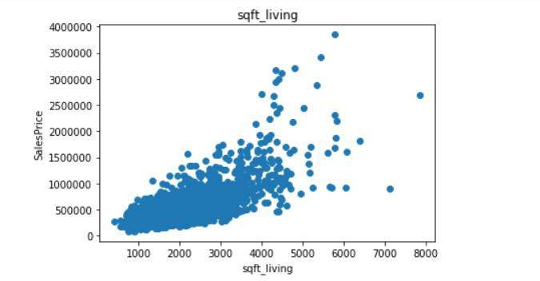
FEATURE ENIGINEERING
A> Implementing logarithmic transformation:-
Before logarithmic transformation RMSE and r2 score:-
X =
data[['sqft_living','grade','s qft_above’]] , Y = data['price’],
RMSE score is:
232622.3513474019
R-squared score is:
0.5591403960932072
for eg, before logarithmic transformation , sqft_living is skwed to right , and scatter plot is spread out

Slide 17

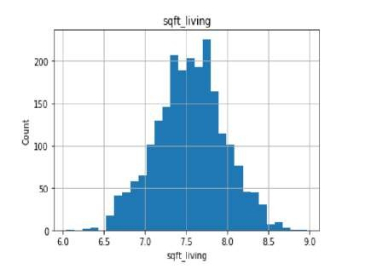
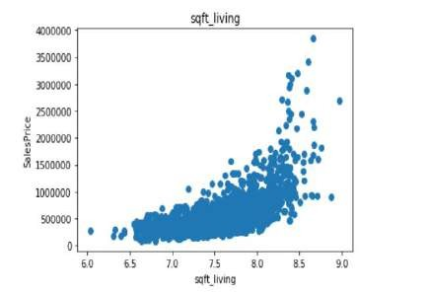
FEATURE ENGINEERING (contd):
After logarithmic transformation , RSME and R2 score
X =
data[['sqft_living','grade','sqft_above’
]] , Y = data['price’], RMSE score is: 232622.3513474019
R-squared score is: 0.5591403960932072
(we observed that we are getting the same RMSE and R2 score even after logarithmic transformation)
After log transformation , the distribution is less- skewed and more centered and less spread out

Slide 18
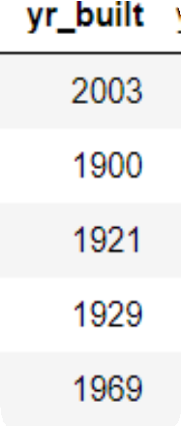
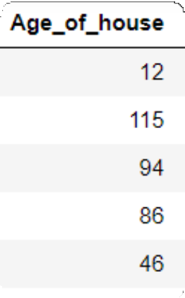
FEATURE ENGINEERING (contd):
B> Implemented old Feature to new Feature
Transformation
After logarithmic transformation, to reduce our RMSE and increase R2 score we use old feature to new feature transformation
We have converted year_build of our feature to “Age of House”
X = data[['sqft_living','grade','sqft_above’]] , Y =
data['price’],
RMSE score is: 231864.7618515001
R-squared score is: 0.5644728985102629
(we observe that our RMSE is reduced and r2 is increased)

Slide 19
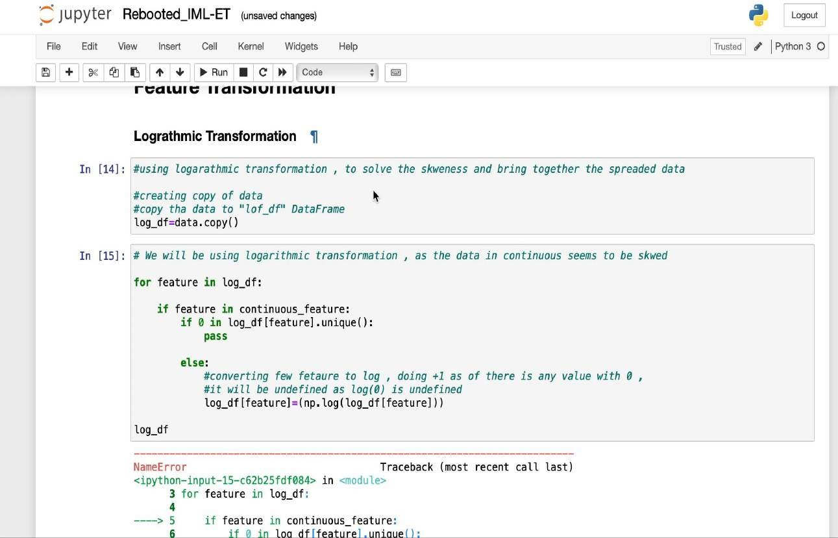

FEATURE ENGINEERING
O/P DEMO:

Slide 20
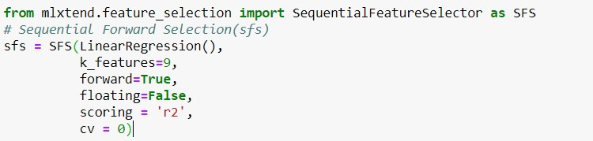
Forward Selection or Backward Elimination Methods
Forward selection, start fitting the model with each individual feature one at a time and select the feature with the minimum r2 score. Then again fits a model with two features by trying combinations of the earlier selected feature with all other remaining features and similarly is fits until a minimum r2 score is not achieved with combination of all features
FINAL MODEL
FITTING
SequentialFeatureSelector() function accepts the following major arguments :-
LinearRegression() is an estimator for the entire process. Similarly, it can be any classification based algorithm.
k_features indicates the number of features to be selected. It can be any random value, but the optimal value can be found by analyzing and visualizing the scores for different numbers of features.
forward and floating arguments for different flavors of wrapper methods, here, forward = True
and floating = False are for forward selection technique.
The scoring argument specifies the evaluation criterion to be used. For regression problems, there is only r2 score in default implementation.

Slide 21
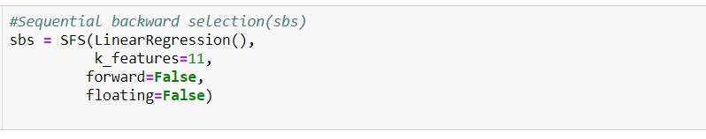
FINAL MODEL FITTING (Contd.)
In backward elimination, we start with the full model (including all the independent variables) and then remove the insignificant feature with the highest p-value(> significance level). This process repeats again and again until we have the final set of significant features
All parameters are same , just that forward
is kept “false” for backward selection
Here we are directly using the optimal value of k_features argument in both forward selection and backward elimination. In order to find out the optimal number
of significant features, we can use the hit and trial method for different values of k_features and make the final decision by plotting it against the model performance.

Slide 22
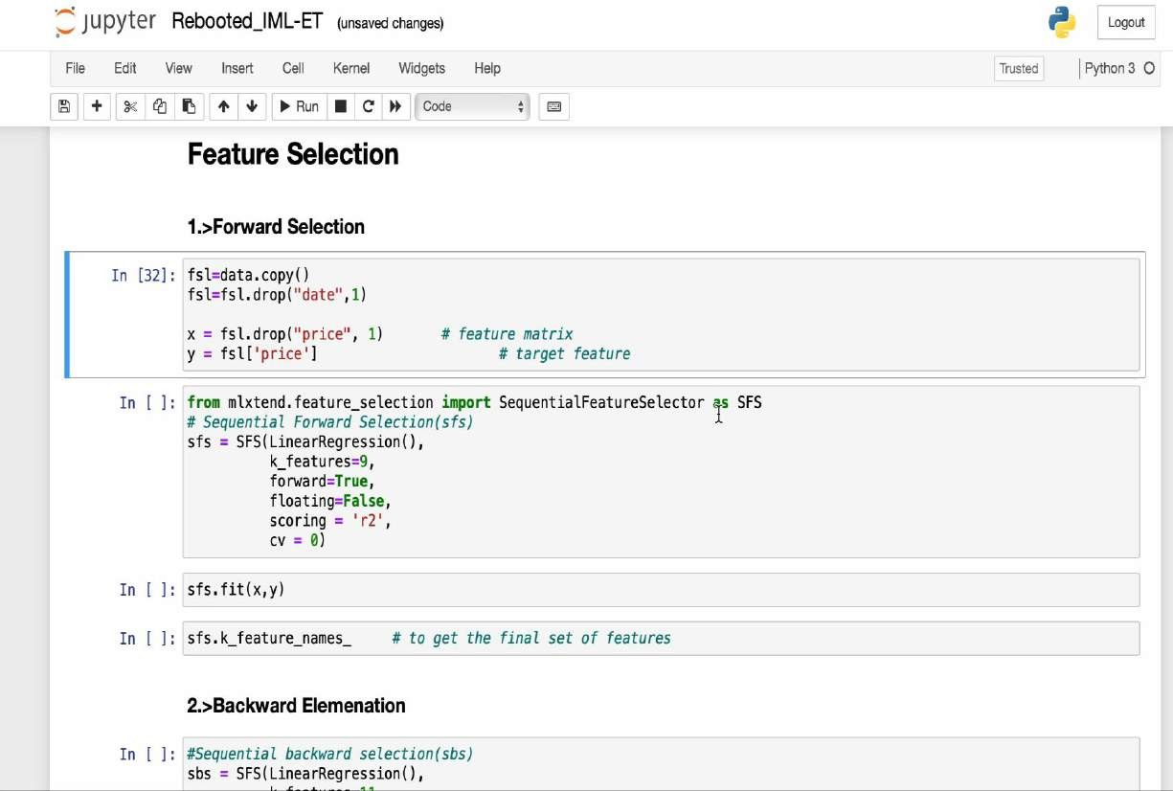
FINAL MODEL FITTING
O/P DEMO:

Slide 23
DECISION TREE REGRESSION
Decision tree builds regression or classification models in the form of a tree structure. It breaks down a dataset into smaller and smaller subsets while at the same time an associated decision tree is incrementally developed. The final result is a tree with decision nodes and leaf nodes
We need to pick a variable and the value to split on such that the two groups are as different from each other as possible.
Selecting dependent and independent variables
X = data[['sqft_living','bathrooms','sqft_living15','grade','sqft_above’]]
Y = data['price’]
Fitting the model with dept =3 and number of leaf in each node to be 5
After fitting the model we get RMSE value as : 281479.94414763

Slide 24
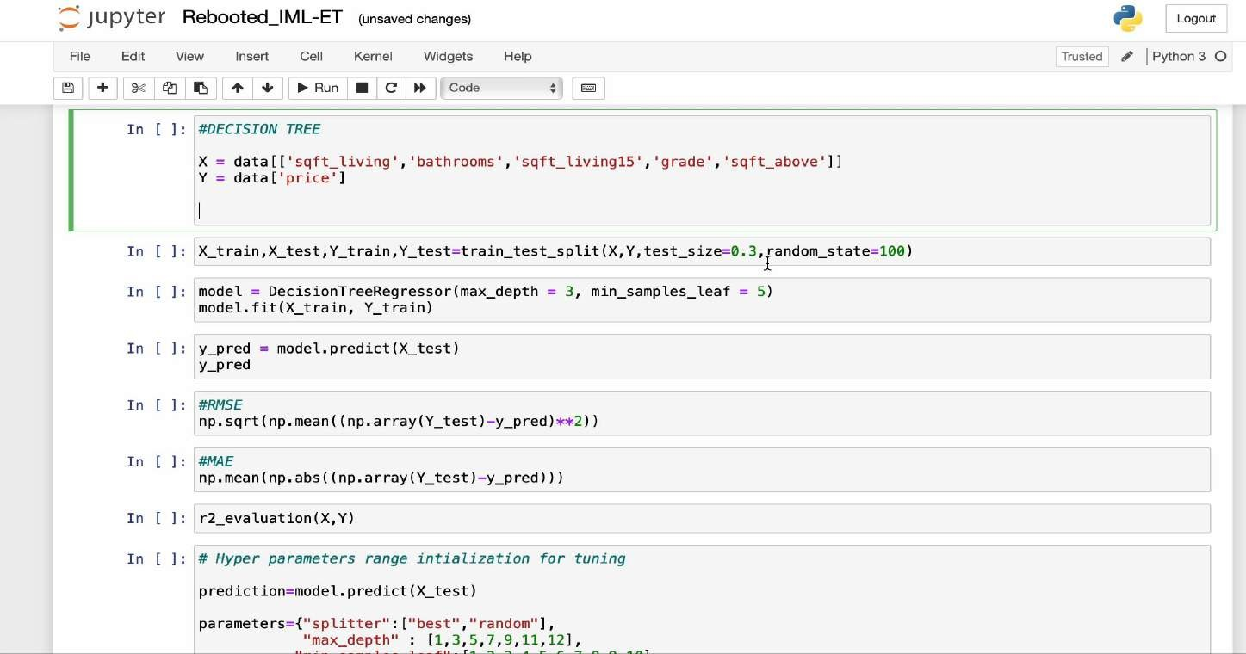
DECISION TREE O/P DEMO:

Slide 25
HYPER PARAMETER TUNING
Many a times while working on a dataset and using a Machine Learning model we don't know which set of
hyperparameters will give us the best result.
Passing all sets of hyperparameters manually through the model and checking the result might be a hectic work and may not be possible to do.
.To get the best set of hyperparameters we can use Grid Search. Grid Search passes all combinations of hyperparameters
one by one into the model and check the result.
Finally, it gives us the set of hyperparameters which gives the best result after passing in the model.
We did not provide any tuning parameters while initializing the tree as a result of which algorithm split the training data till the leaf node. Due to which depth of tree increased and our model did the overfitting.
That's why we are getting high score on our training data and less score on test data. So to solve this problem we would use hyper parameter tuning.

Slide 26
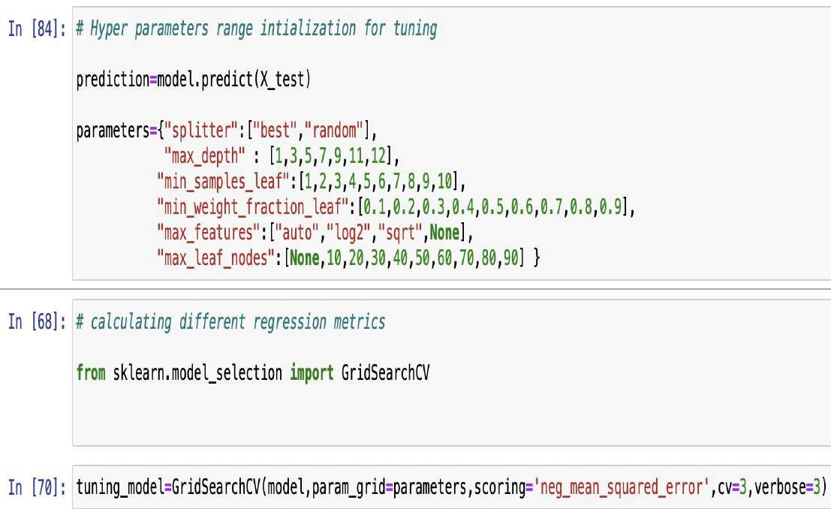
Step 1:
We initialize hyperparameters random range using Gridsearch to find the best parameters for our decision tree model.

Slide 27
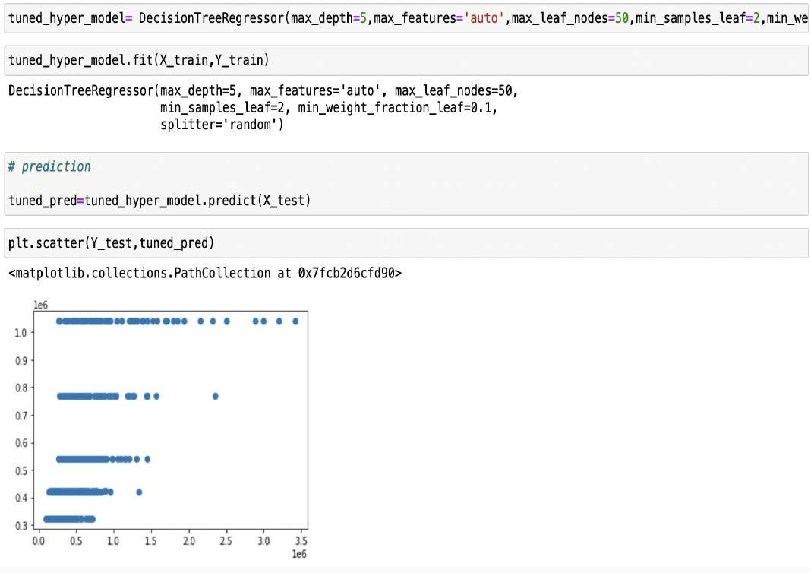
Step 2:
Training Decision Tree With Best
Hyperparameters

Slide 28

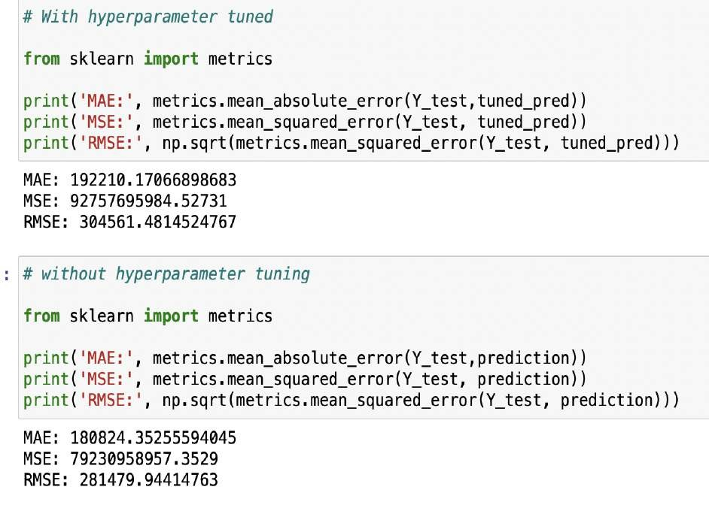
Step 3:
Let us compare now Error rate of our model with hyper tuning of parameters to our original model which is without the tuning of parameters.

Slide 29
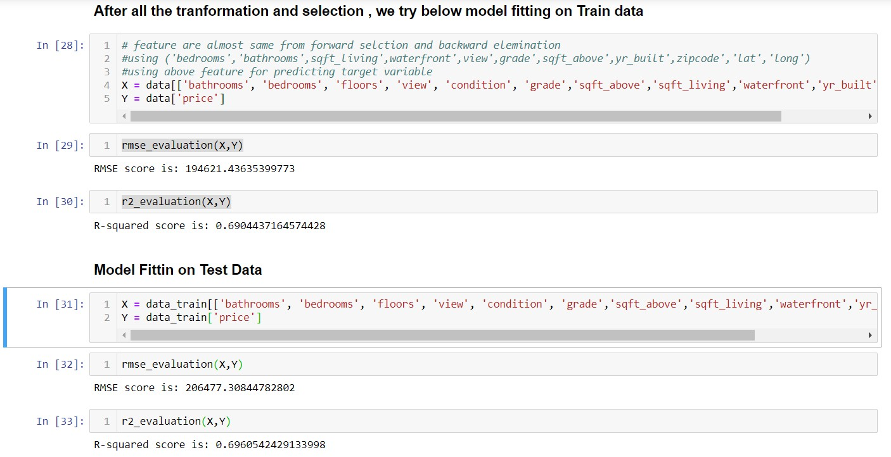
MODEL TESTING

Slide 30
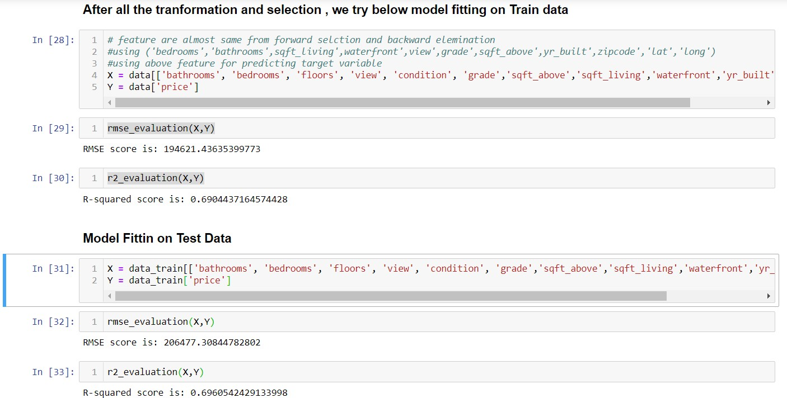
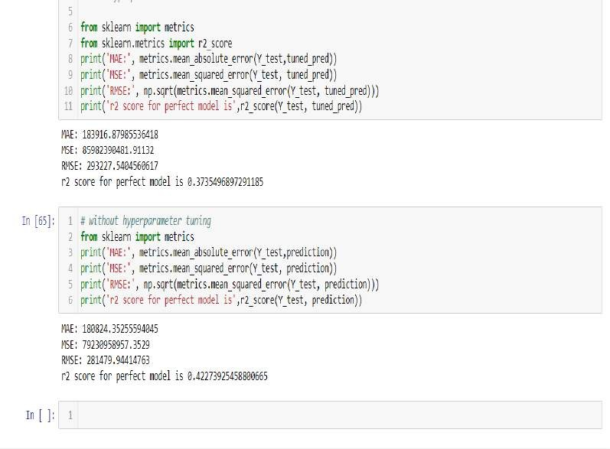
CONCLUSION
Multiple Linear Regression
Decision Tree
We are getting better RSME and R-Squared scores from linear regression , hence for further prediction, we will be using Linear Regression

Slide 31

THANK YOU

