Slide 1

WidgetsX Market Website
Binary Classification Model
Presented by: Fernando Aguilar

Slide 2
Agenda
01
Background
02
Factsheet
03
Important Features
04
The Model
05
Recommendations

Slide 3

Background
The company’s website been in operation for a year and serves as a marketplace for a national audience.
Visitors either make a purchase or not when visiting the website. It is imperative to classify this users depending on their behavior in order to personalize the marketing strategy according to the kind of user.

Slide 4
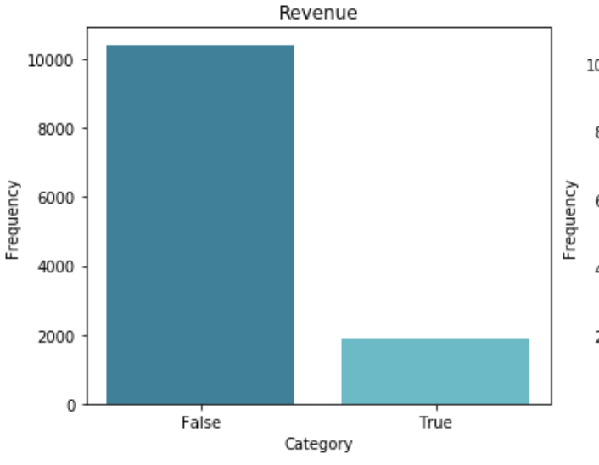
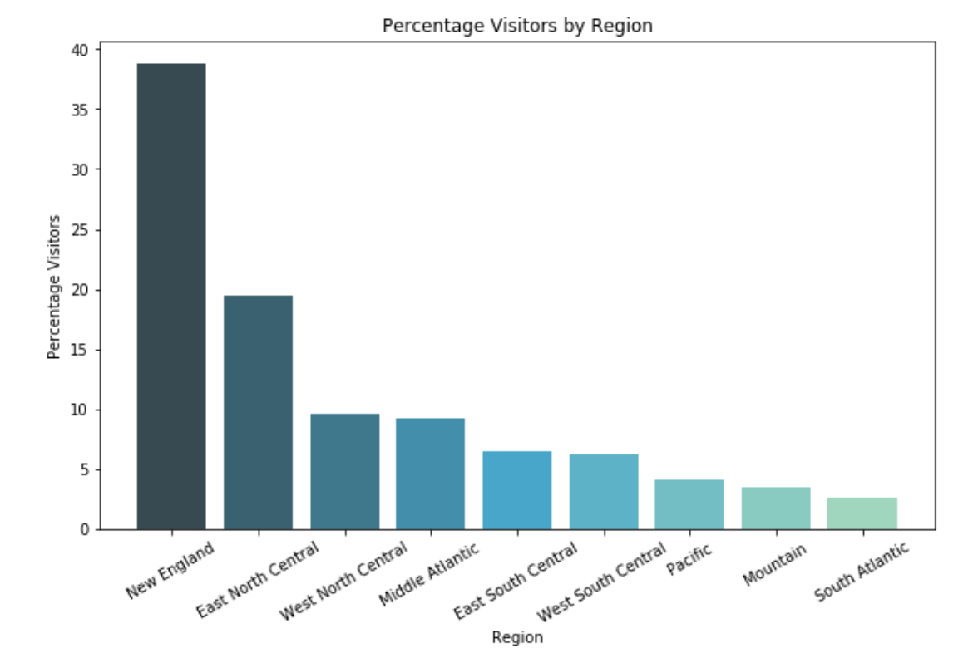
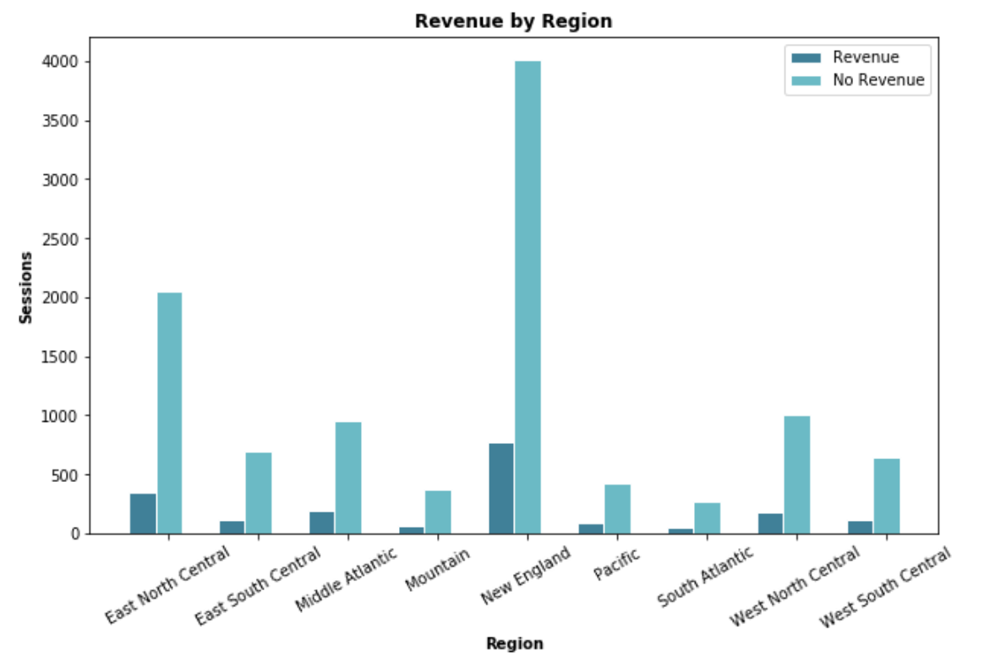
Factsheet
Only 15% of the sessions resulted in sales.
New England and East North Central regions account for 60% of the visitors.

Slide 5
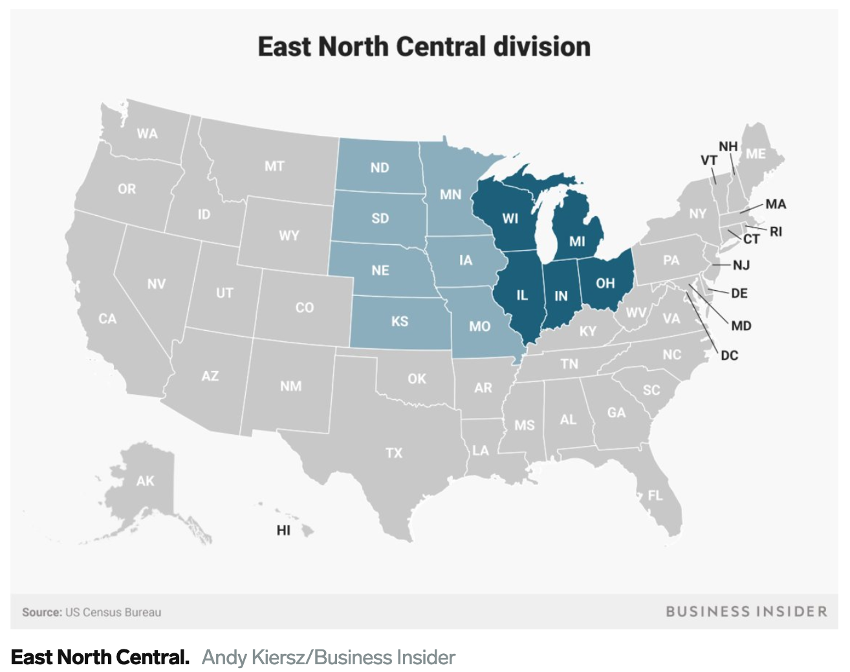
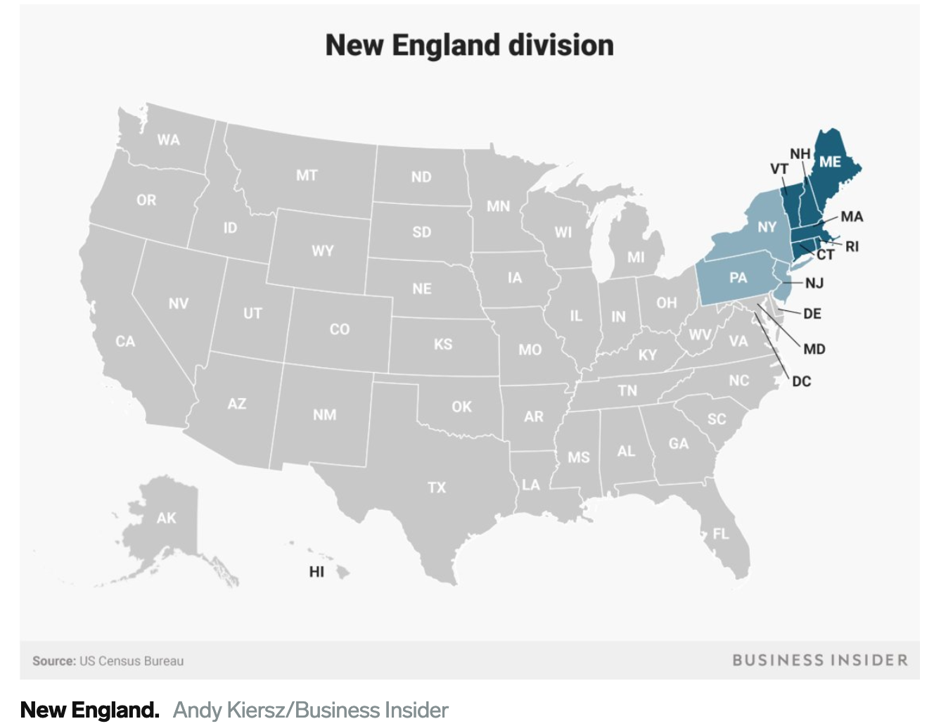

Slide 6
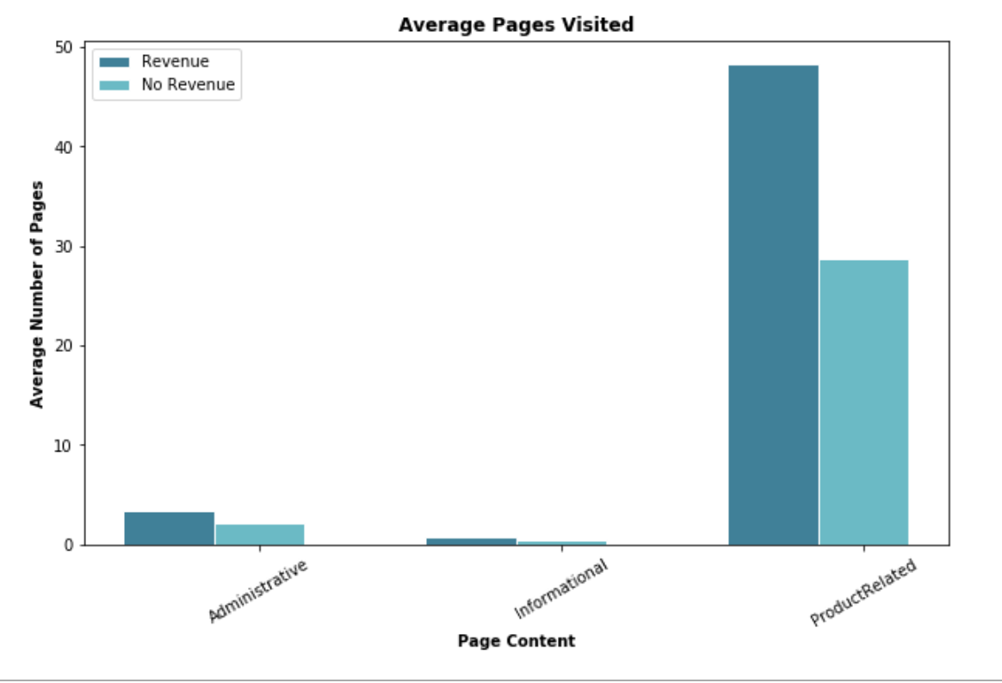
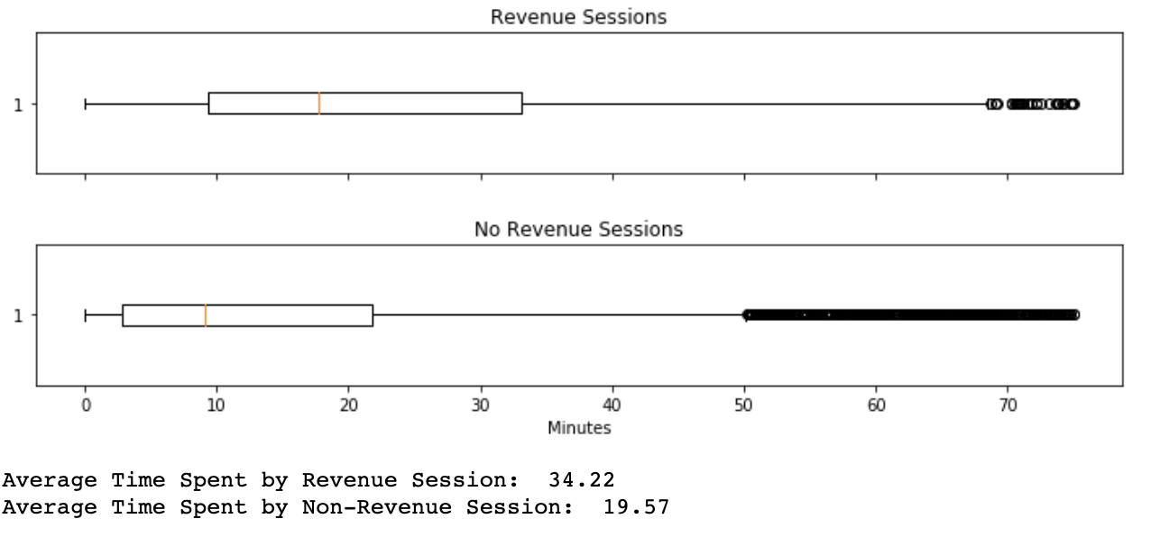
Factsheet

Slide 7
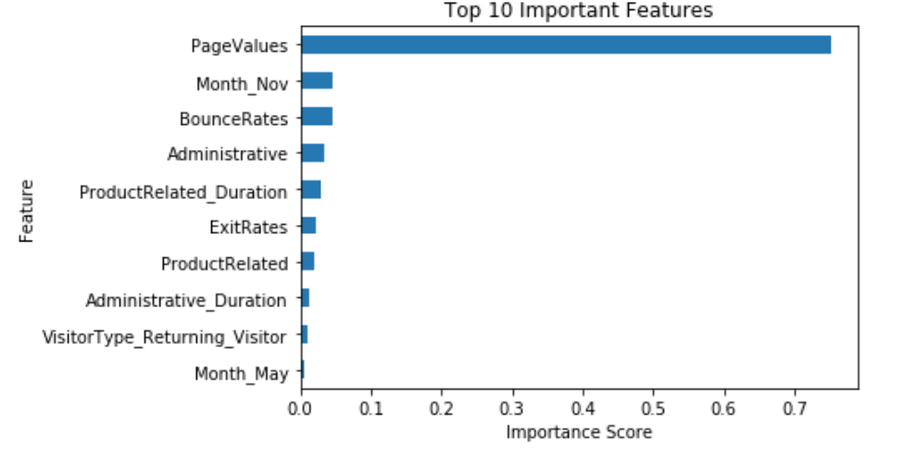
Important Features

Slide 8
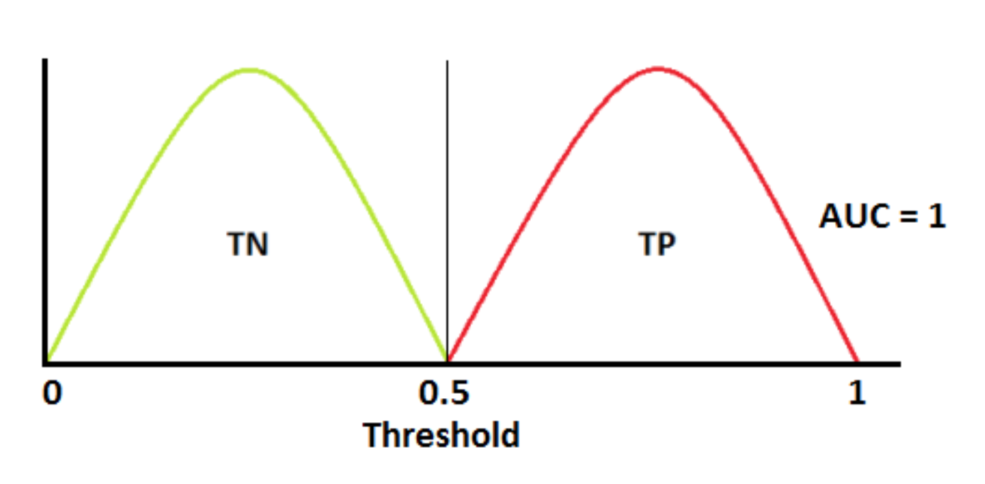
The Classification Model
Able to distinguish between revenue generating behavior and non revenue generating behavior.
Accurately predict non revenue generating sessions as non revenue generating and revenue generating sessions as revenue generating.

Slide 9
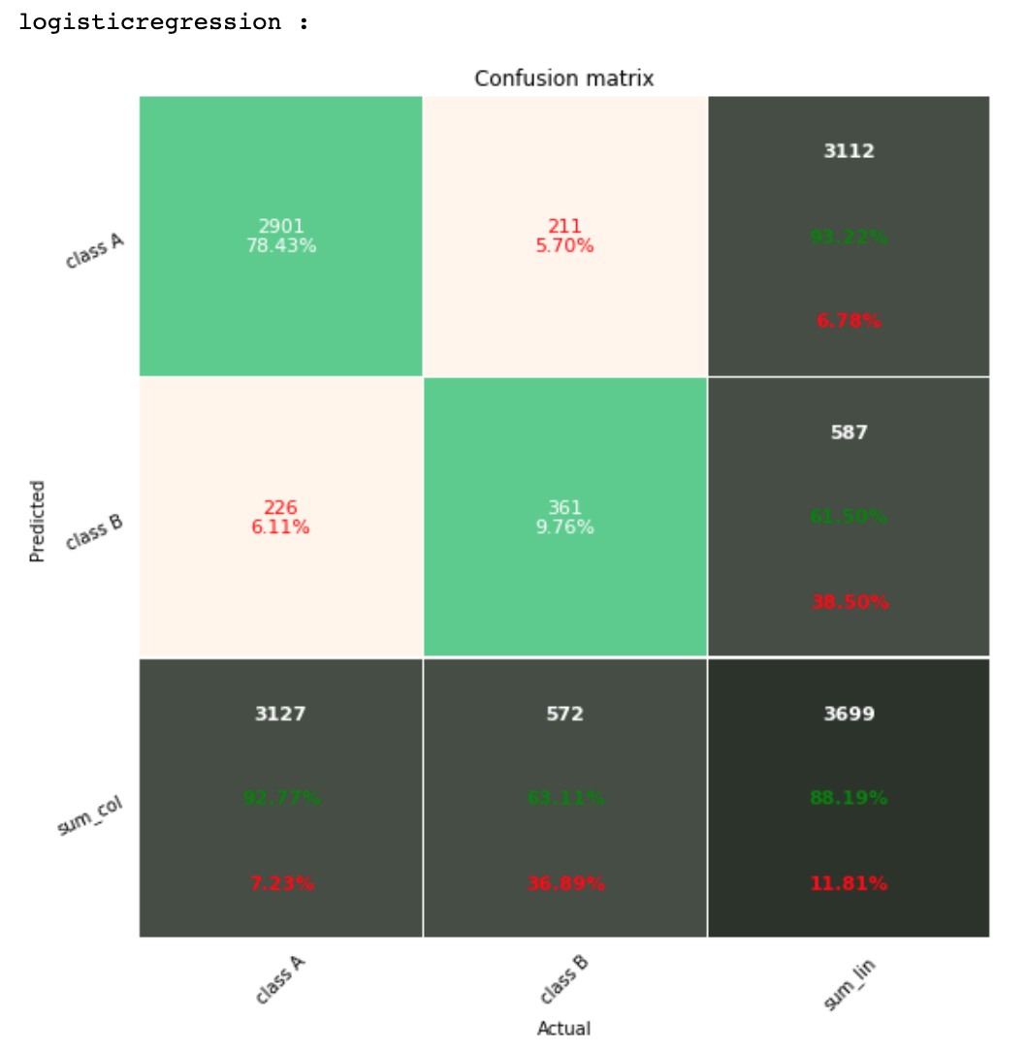
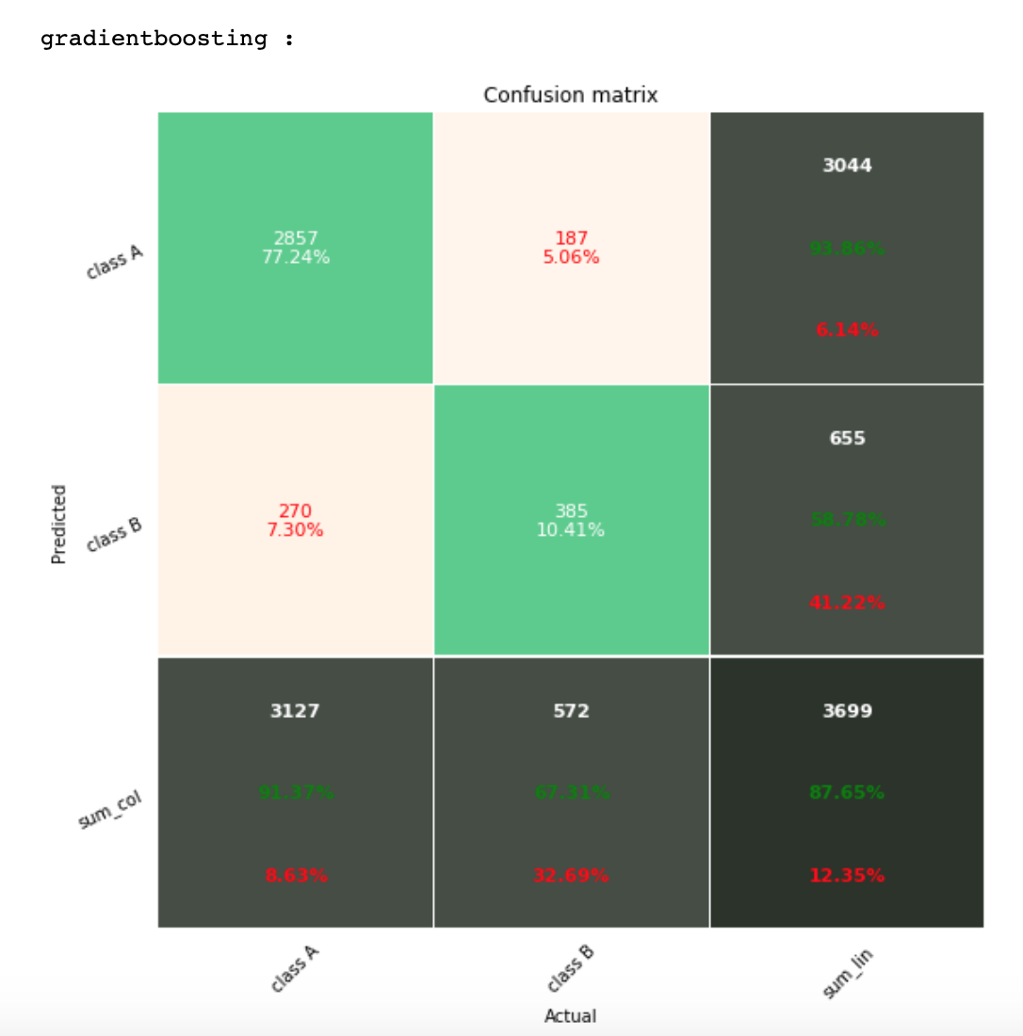
Classification Results

Slide 10
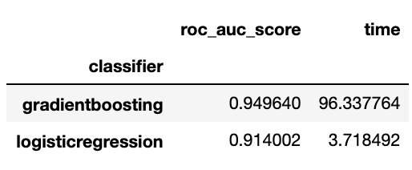
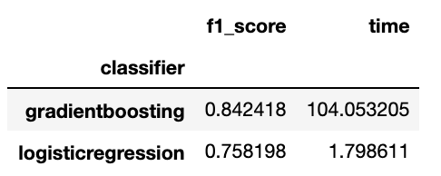
Recommendations
Enhance website content
Identify pages with high bounce rates and direct the traffic to other pages
Analyze pages with high page value to replicate their characteristics in other pages
Market segmentation by visitor region
Deploy both models if possible to measure time to predict behavior in real time
Fastest model: Logistic Regression
Best performance model: Gradient Boosting

Slide 11
Thank You
Any questions?
For the full notebook please visit:
https://github.com/feraguilari/dsc-mod-5-project-online-ds-pt-021119/blob/master/student.ipynb

