Slide 1

Alibabua Market Website
Binary Classification Model
Presented by: Fernando Aguilar

Slide 2
Agenda
01
Background
The objective of the binary classification project and its justification.
02
The Models
Overview of the models used to create the binary classification model and their performance metrics.
03
The Dataset
Overview of the dataset in regards to its composition and distribution.
04
Pipelines and GridSearchCV
Explanation of pipelines, and GridSearchCV and its use.
05
Recommendations
Findings and conclusion.

Slide 3

Background
The company’s website been in operation for a year and serves as a marketplace for a national audience.
Visitors either make a purchase or not when visiting the website. It is imperative to classify this users depending on their behavior in order to personalize the marketing strategy according to the kind of user.

Slide 4
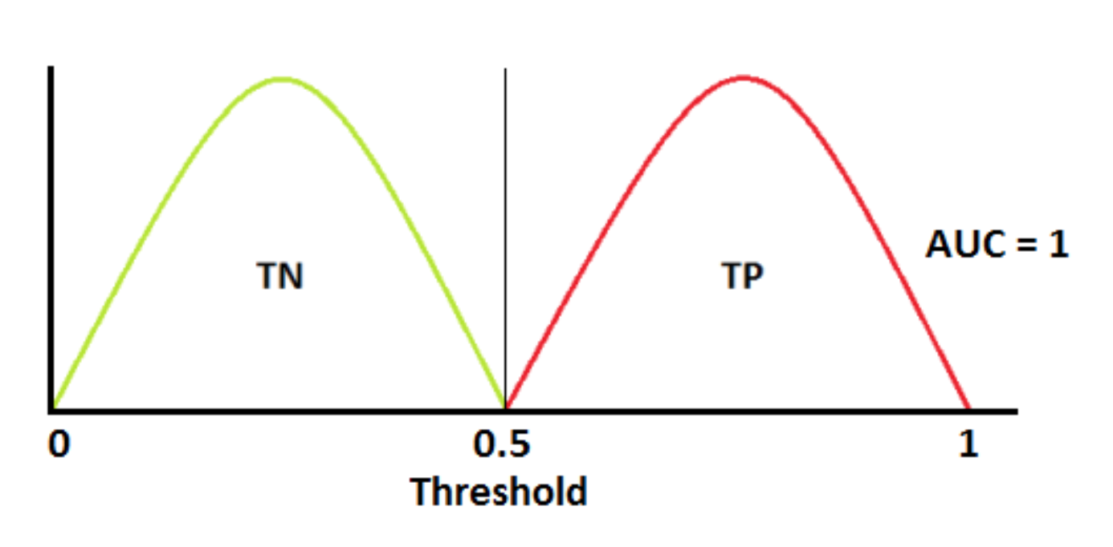
The Classification Models
Logistic Regression
Decision Trees
Random Forests
Gradient Boosting
Metrics:
F1 Score
AUC Score

Slide 5
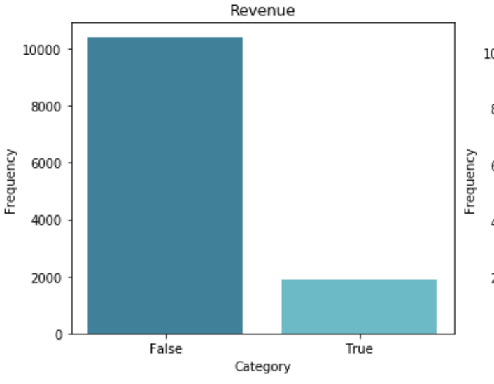
The Dataset
8 Categorical Features
9 Numerical Features
Binary target variable
Imbalanced dataset

Slide 6
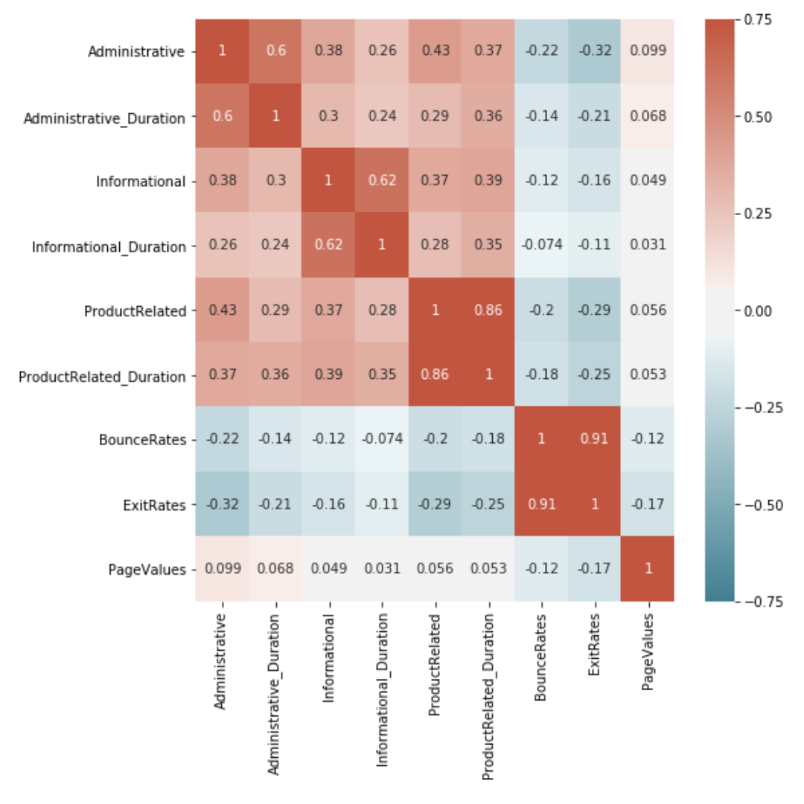
Prepping The Dataset
High multicolinearity amongst numerical features.
One hot coding categorical features
Scaling numerical features
Feature Engineering.

Slide 7
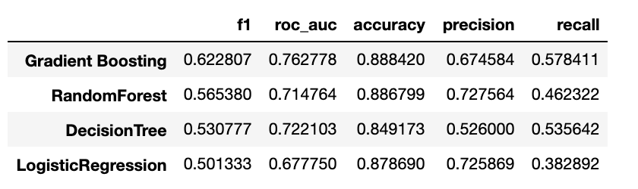
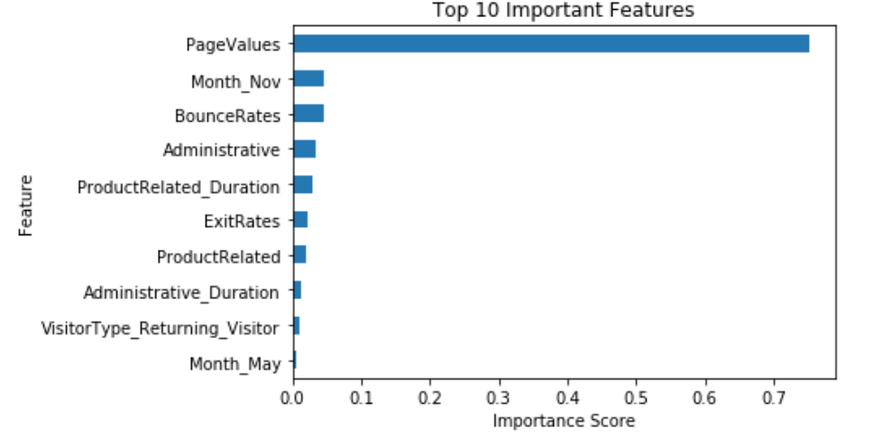
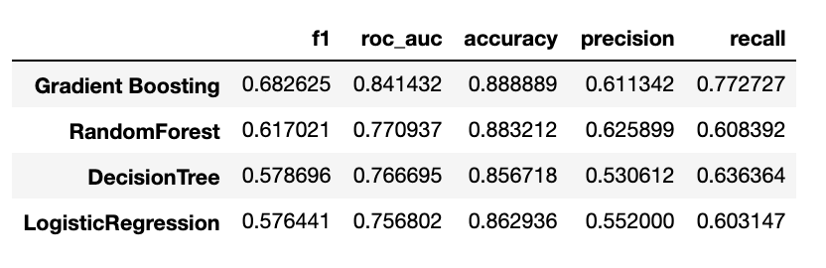
Pre-processing results

Slide 8
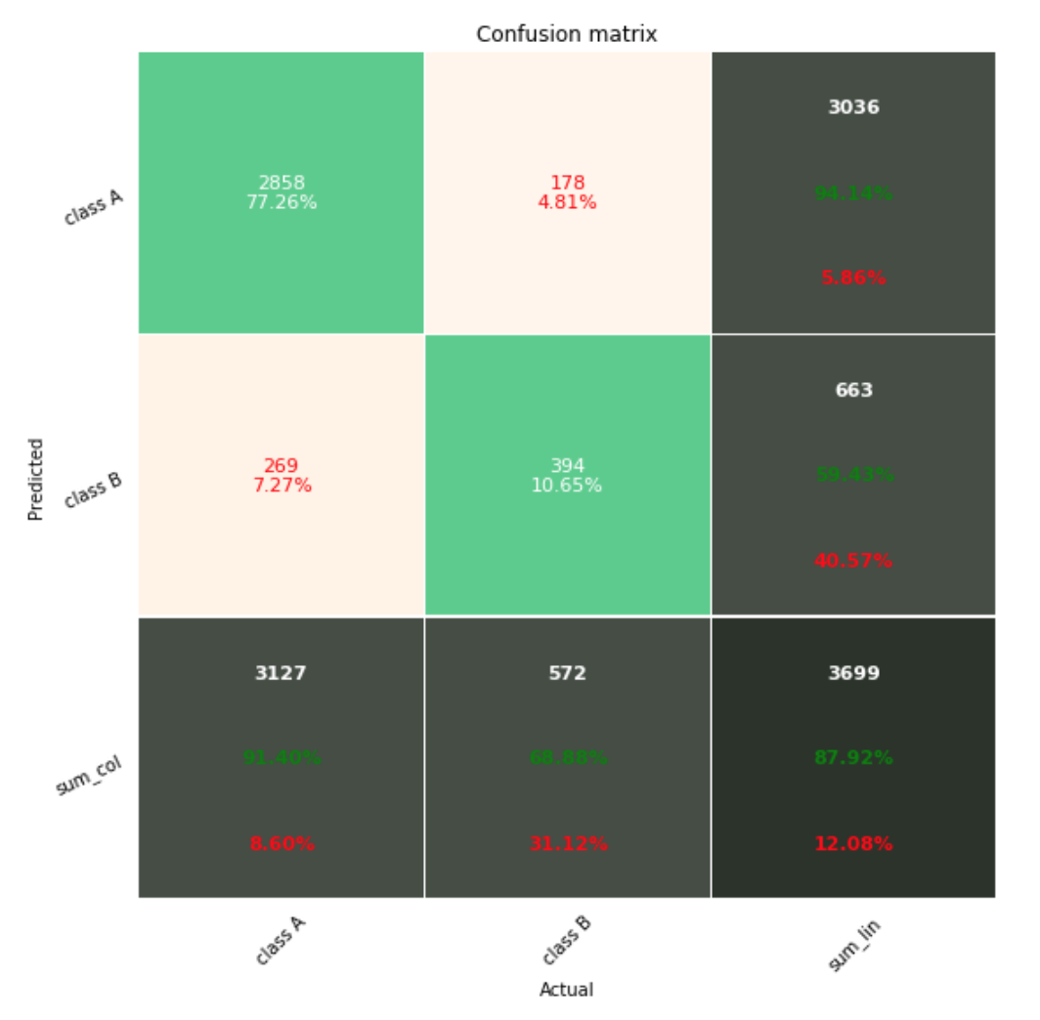
Pipelines and GridSearchCV

Slide 9
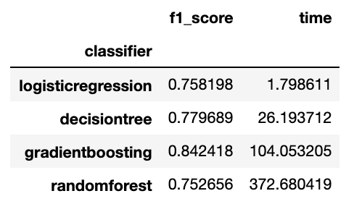
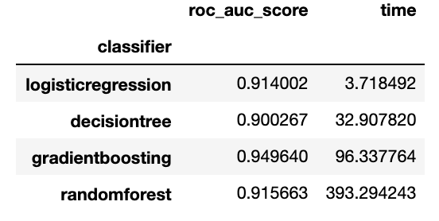
Recommendations
Fastest model: Logistic Regression
Best performance model: Gradient Boosting
The performance difference is marginal, however it would be beneficial to test it liv eon the website and see if the GradientBoosting can perform immediately, in which case is preferred. If, however, it takes much longer than the Logistic Regression, then Logistic Regression is preferred since an immediate action is required to incentivize revenue generating behavior of the user.

Slide 10
Thank You
Any questions?
For the full notebook please visit:
https://github.com/feraguilari/dsc-mod-5-project-online-ds-pt-021119/blob/master/student.ipynb

