Slide 1
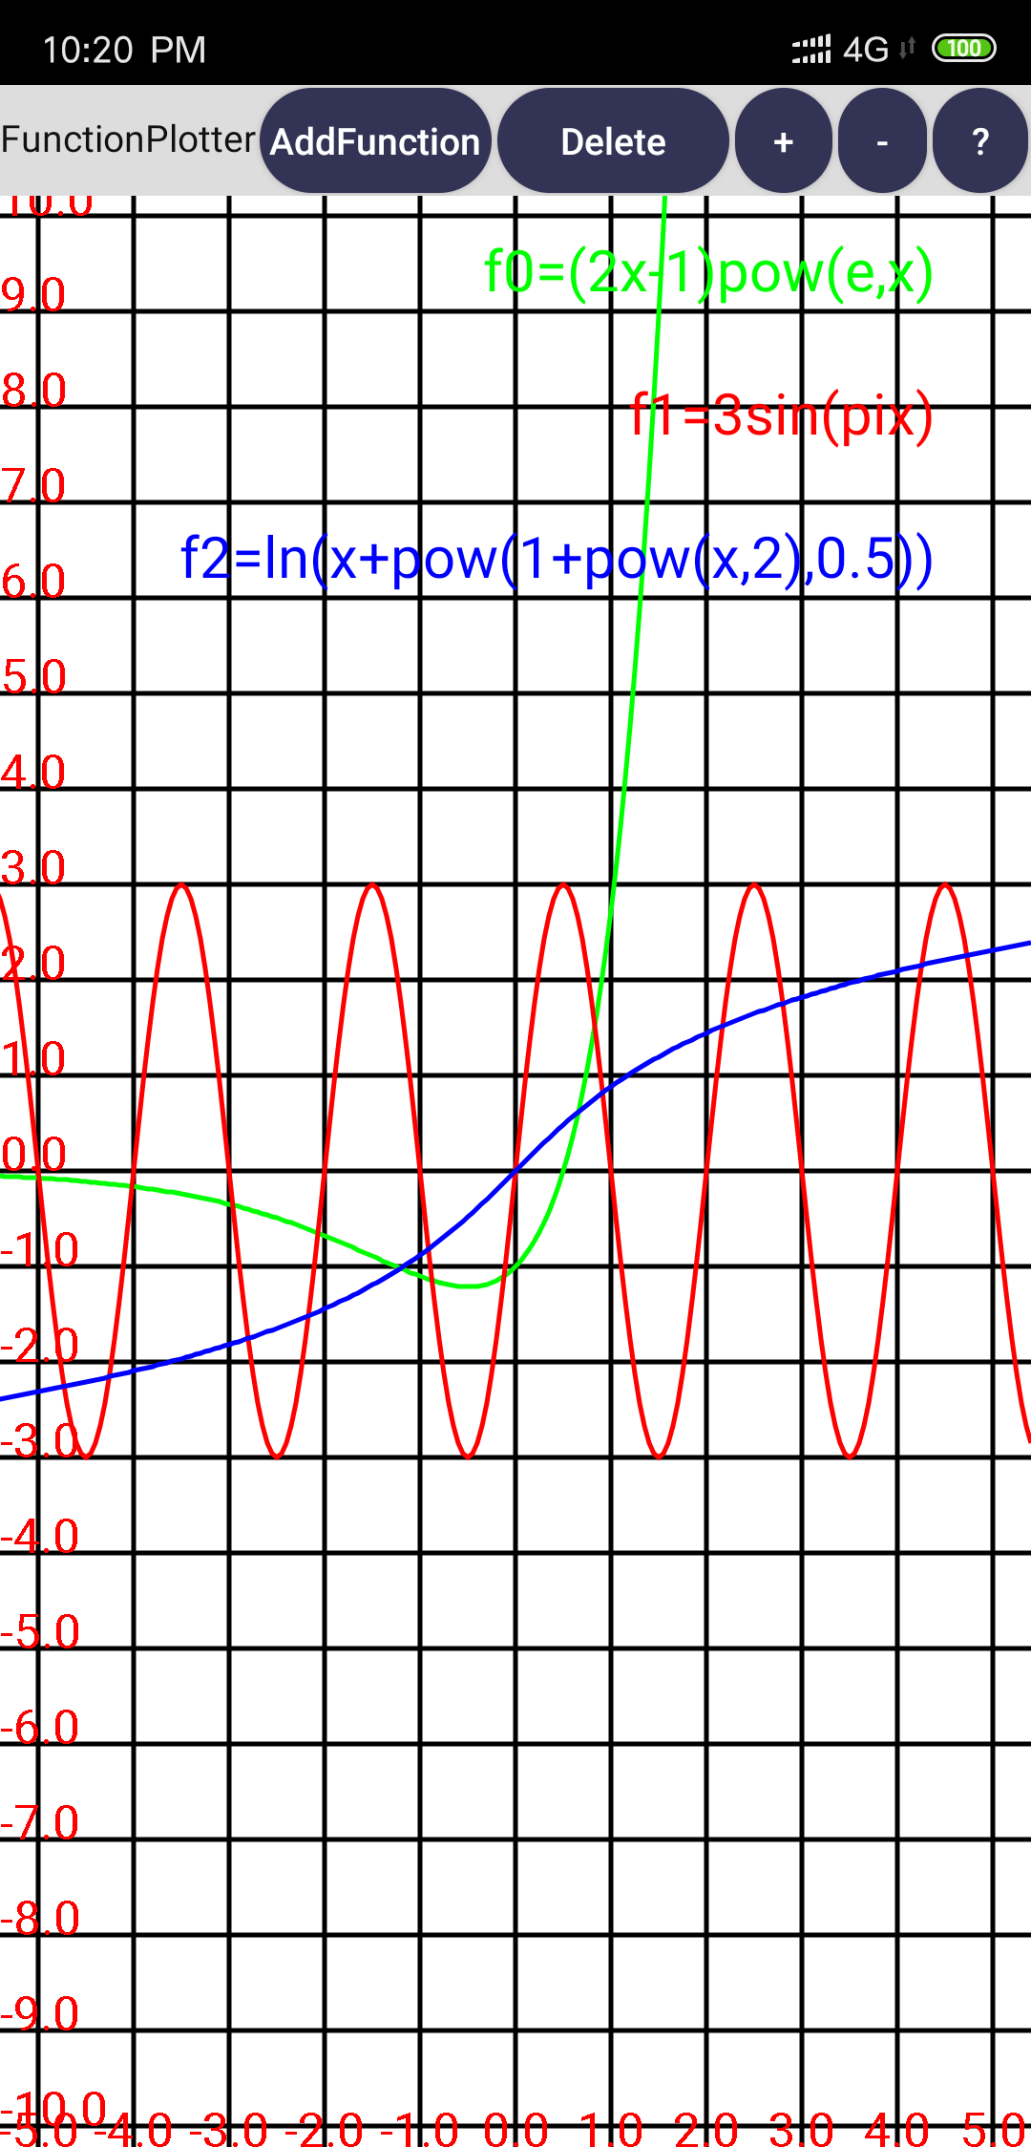
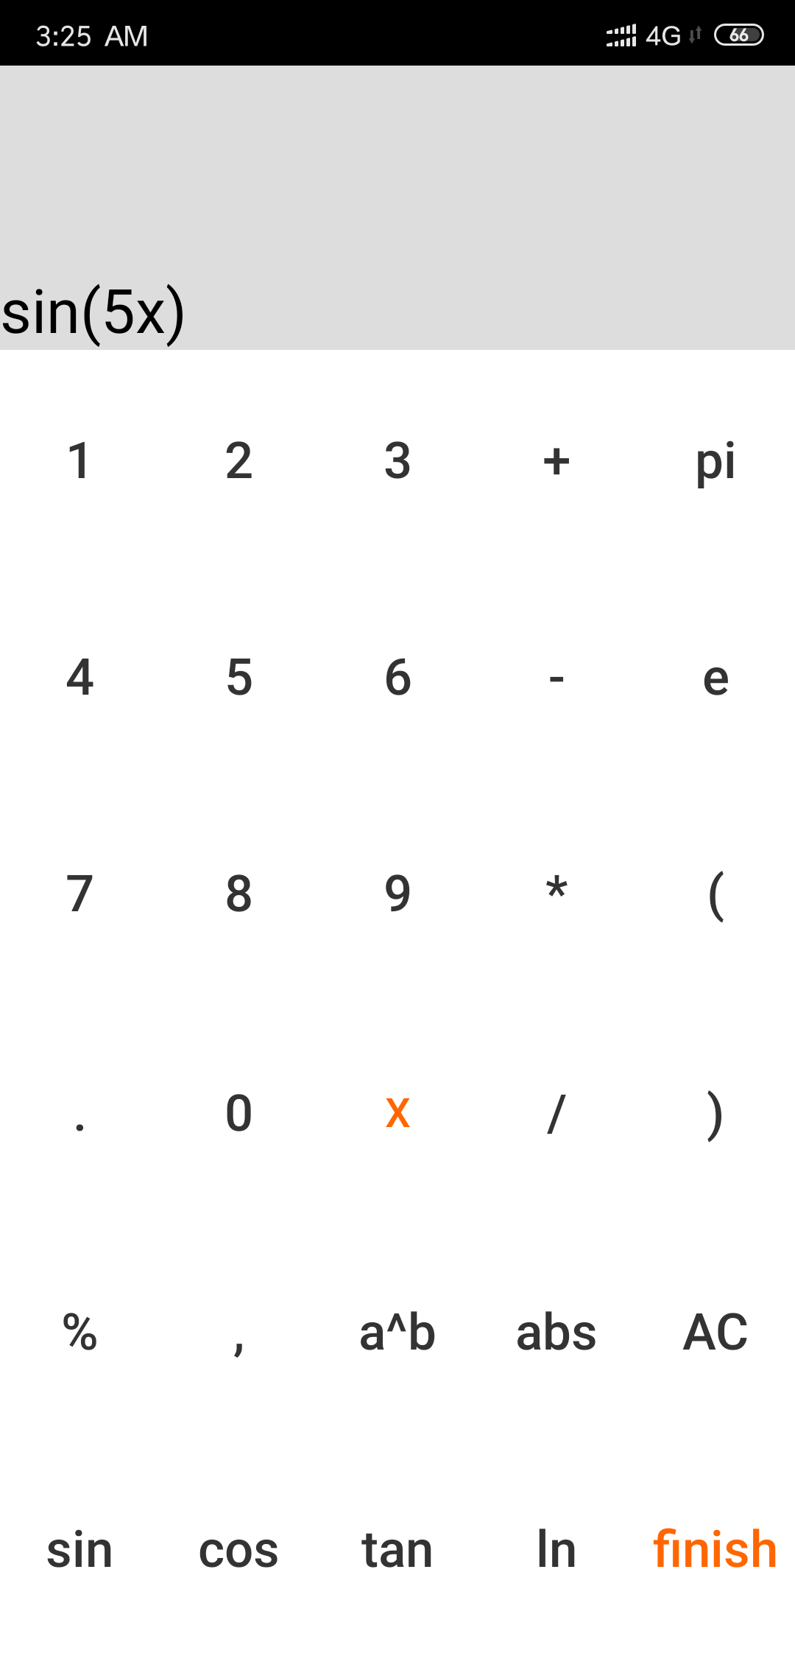
FunctionPlotter

Slide 2
1.Initial prototype
3.FunctionPlotter demo
2.Introduction
4.A general overview of the code
5.Difficulties
6.Limitaions

Slide 3
Initial prototype
function_plotter_prototype.mp4

Slide 4
Introduction
Function plotter can draw several function curves on the screen, and support the functions of sliding, zooming in/out and deleting curves.

Slide 5
FunctionPlotter demo
function_plotter.mp4

Slide 6
A general overview of the code

Slide 7
MainActivity
DrawView
btn_delete
btn_add_function
btn_help
btn_smaller/btn_larger
AddNewFunction
Delete
Help

Slide 8
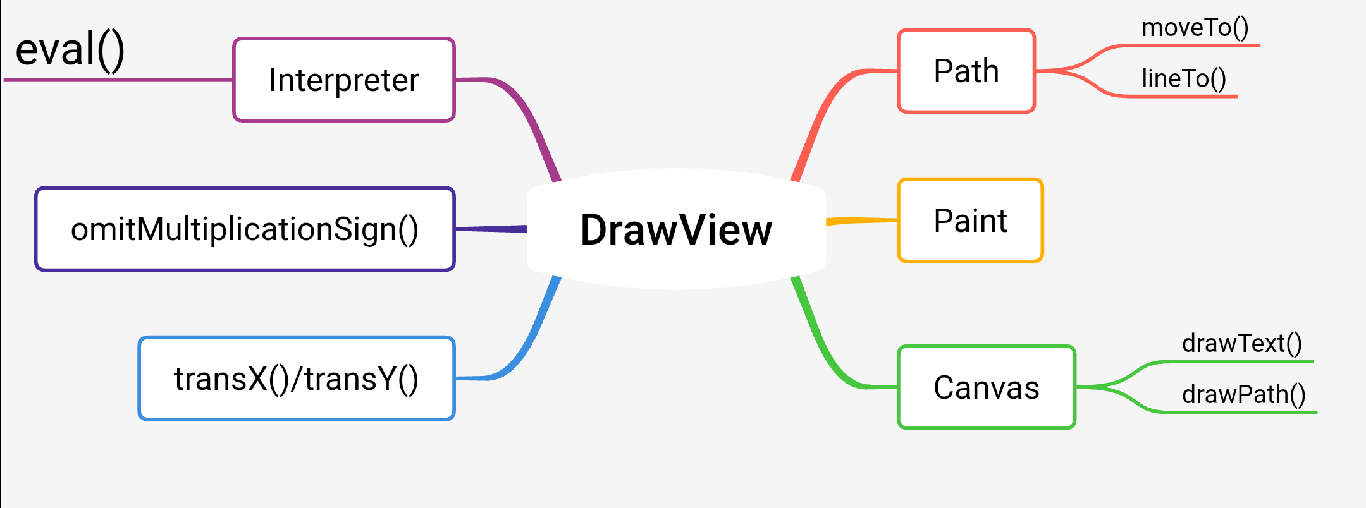
Important functions and classes in DrawView

Slide 9
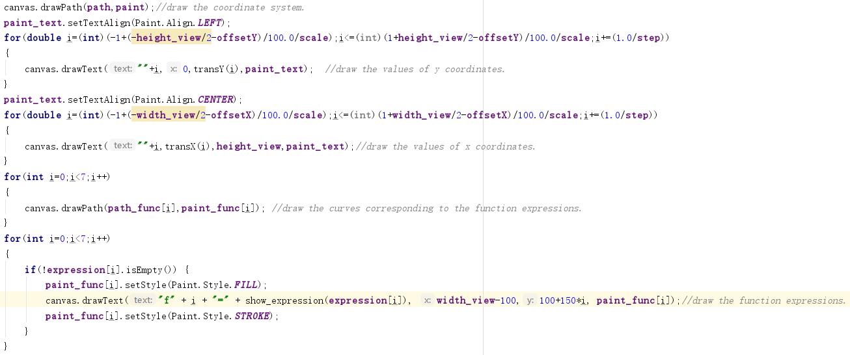
Some code in onDraw()

Slide 10
Difficulties
1.Conversion between actual coordinates and screen coordinates(pixel).
x_sc=width_view/2+100*x_ac*scale+offsetX
y_sc=height_view/2-100*y_ac*scale-offsetY

Slide 11
Difficulties
2.How to execute a String to get the result?
Using the bsh lib.
There is an “Interpreter” class which provides a function ‘eval()’to compile a String dynamically.

Slide 12
Difficulties
3.If the expression string entered by the user is invalid, how can I detect it?
The Interpreter.eval(String s) will thrown a ParseException if the input s is invalid, so I can test the validity and remind users if it is invalid.

Slide 13
Limitations
The function Interpreter.eval() is time-consuming. So, sliding gets a little bit unfluent when there are too many curves.

Slide 14
Thanks!

