Slide 1
ADVANCED PARKING SYSTEM
BY-
NITIN BISHT
ABHISHEK KUMAR

Slide 2
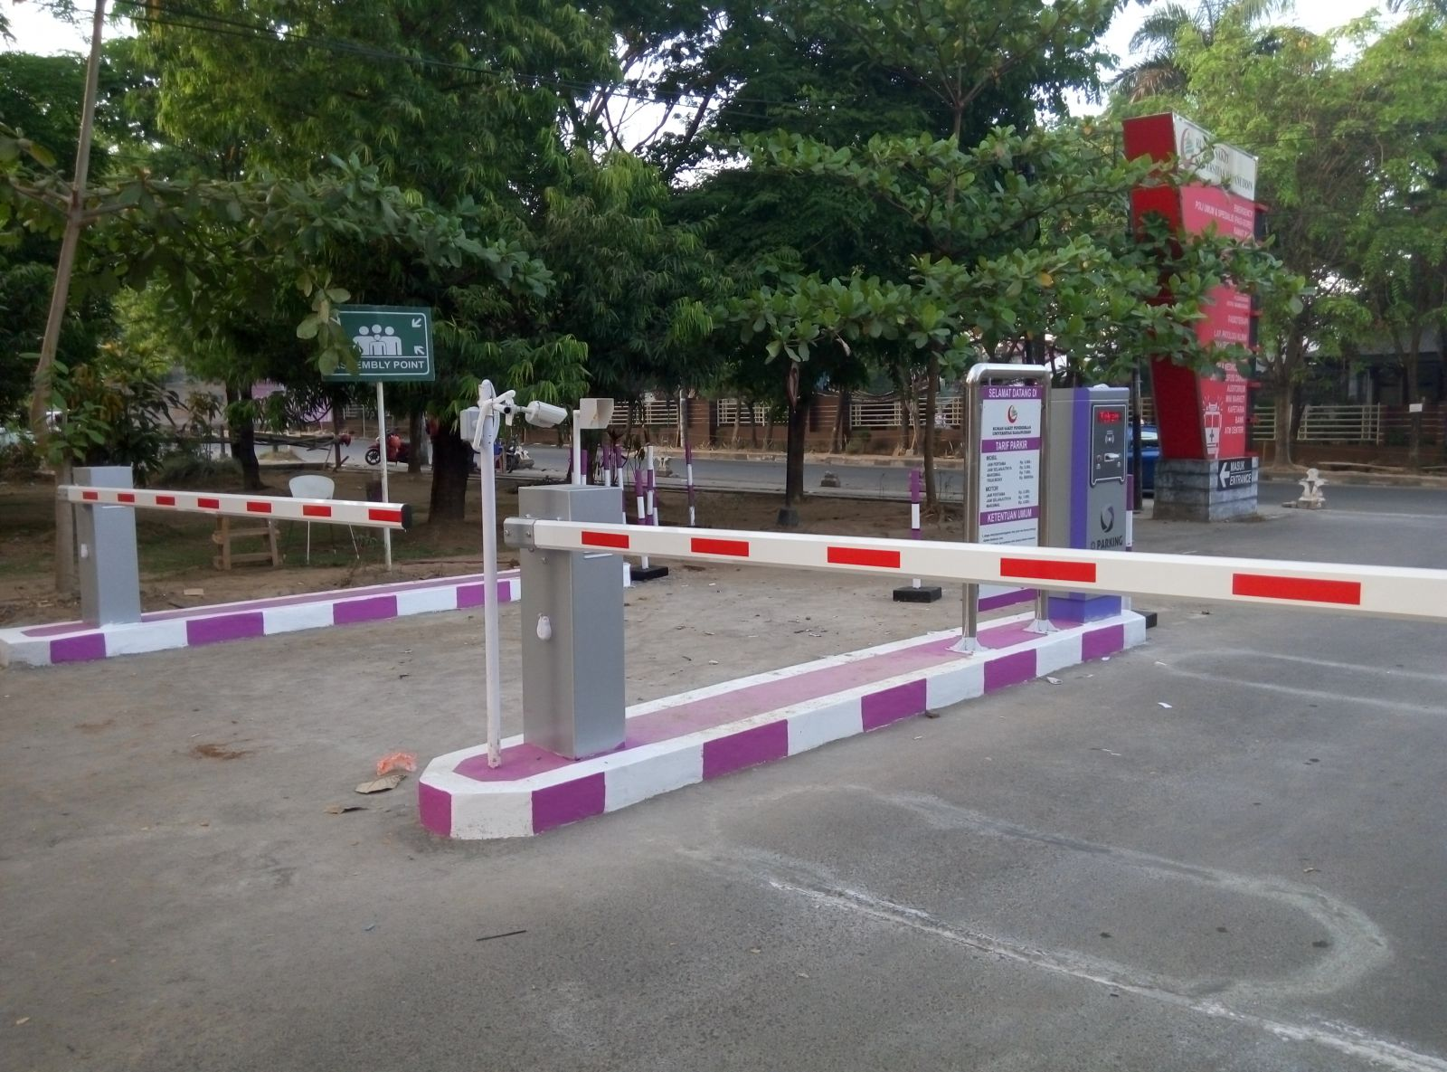
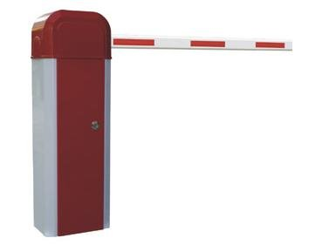
Present Scenario:
Authentication is required at gate.

Slide 3
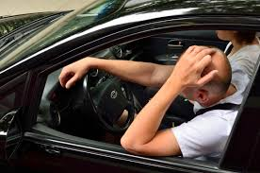
Lot of parking slots available but not knowing where to park in.
There is no system design for navigation.

Slide 4
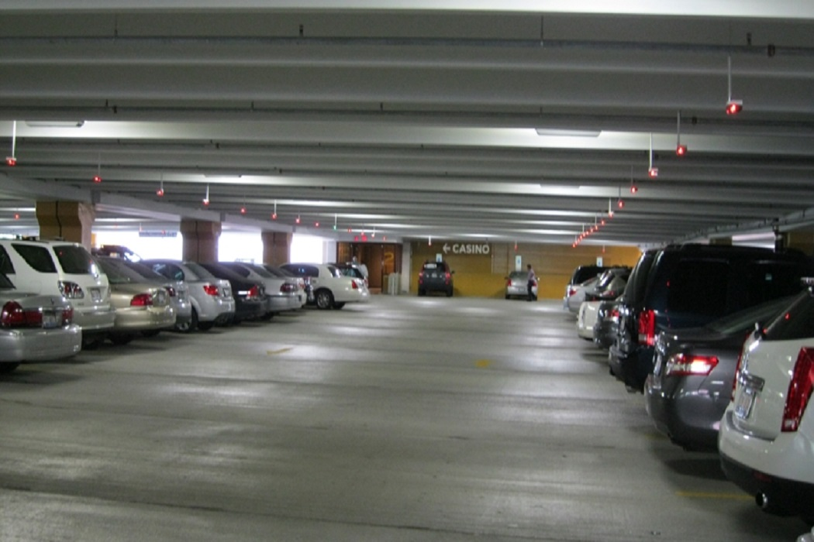
After a struggling for it, you find a space and quickly park your car before any one else does and rush to your work or family.

Slide 5

THAT’S OLD WAY OF DOING.

Slide 6


Slide 7
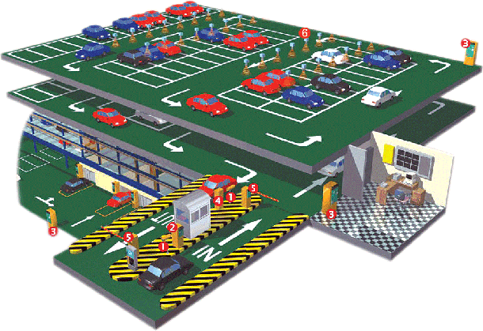

Slide 8
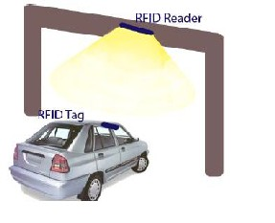
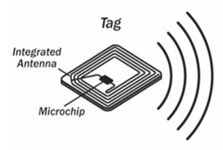
Using RFID(Radio Frequency ID) technology to authorise the vehicle and let the vehicle in.

Slide 9
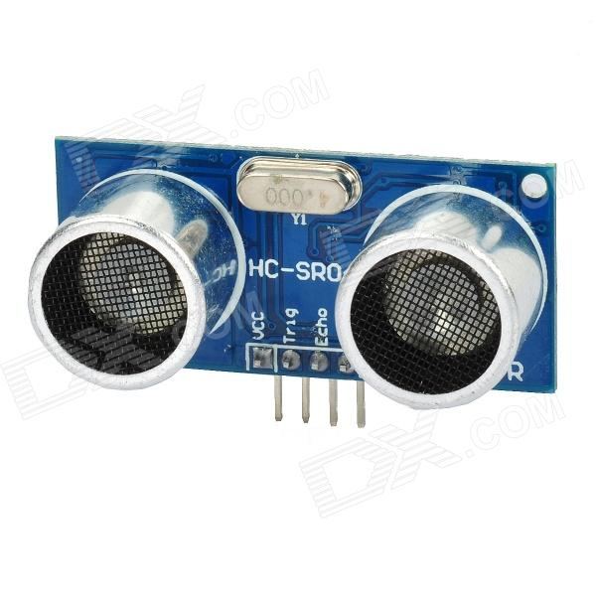
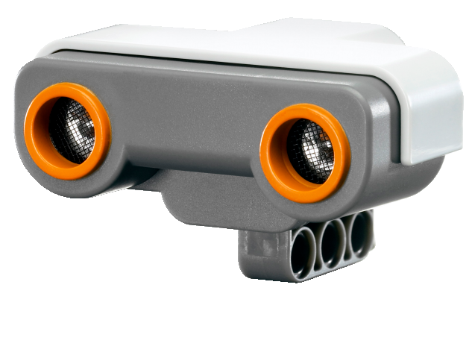
Using Ultrasonic Sensor to give real time feedback of slot availability .

Slide 10
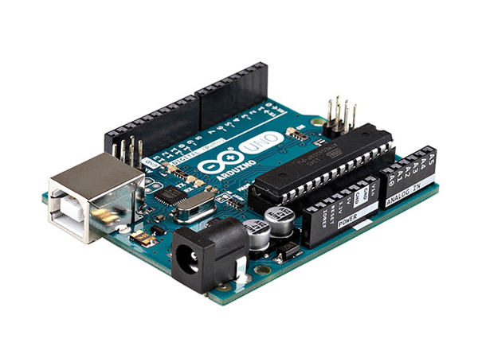
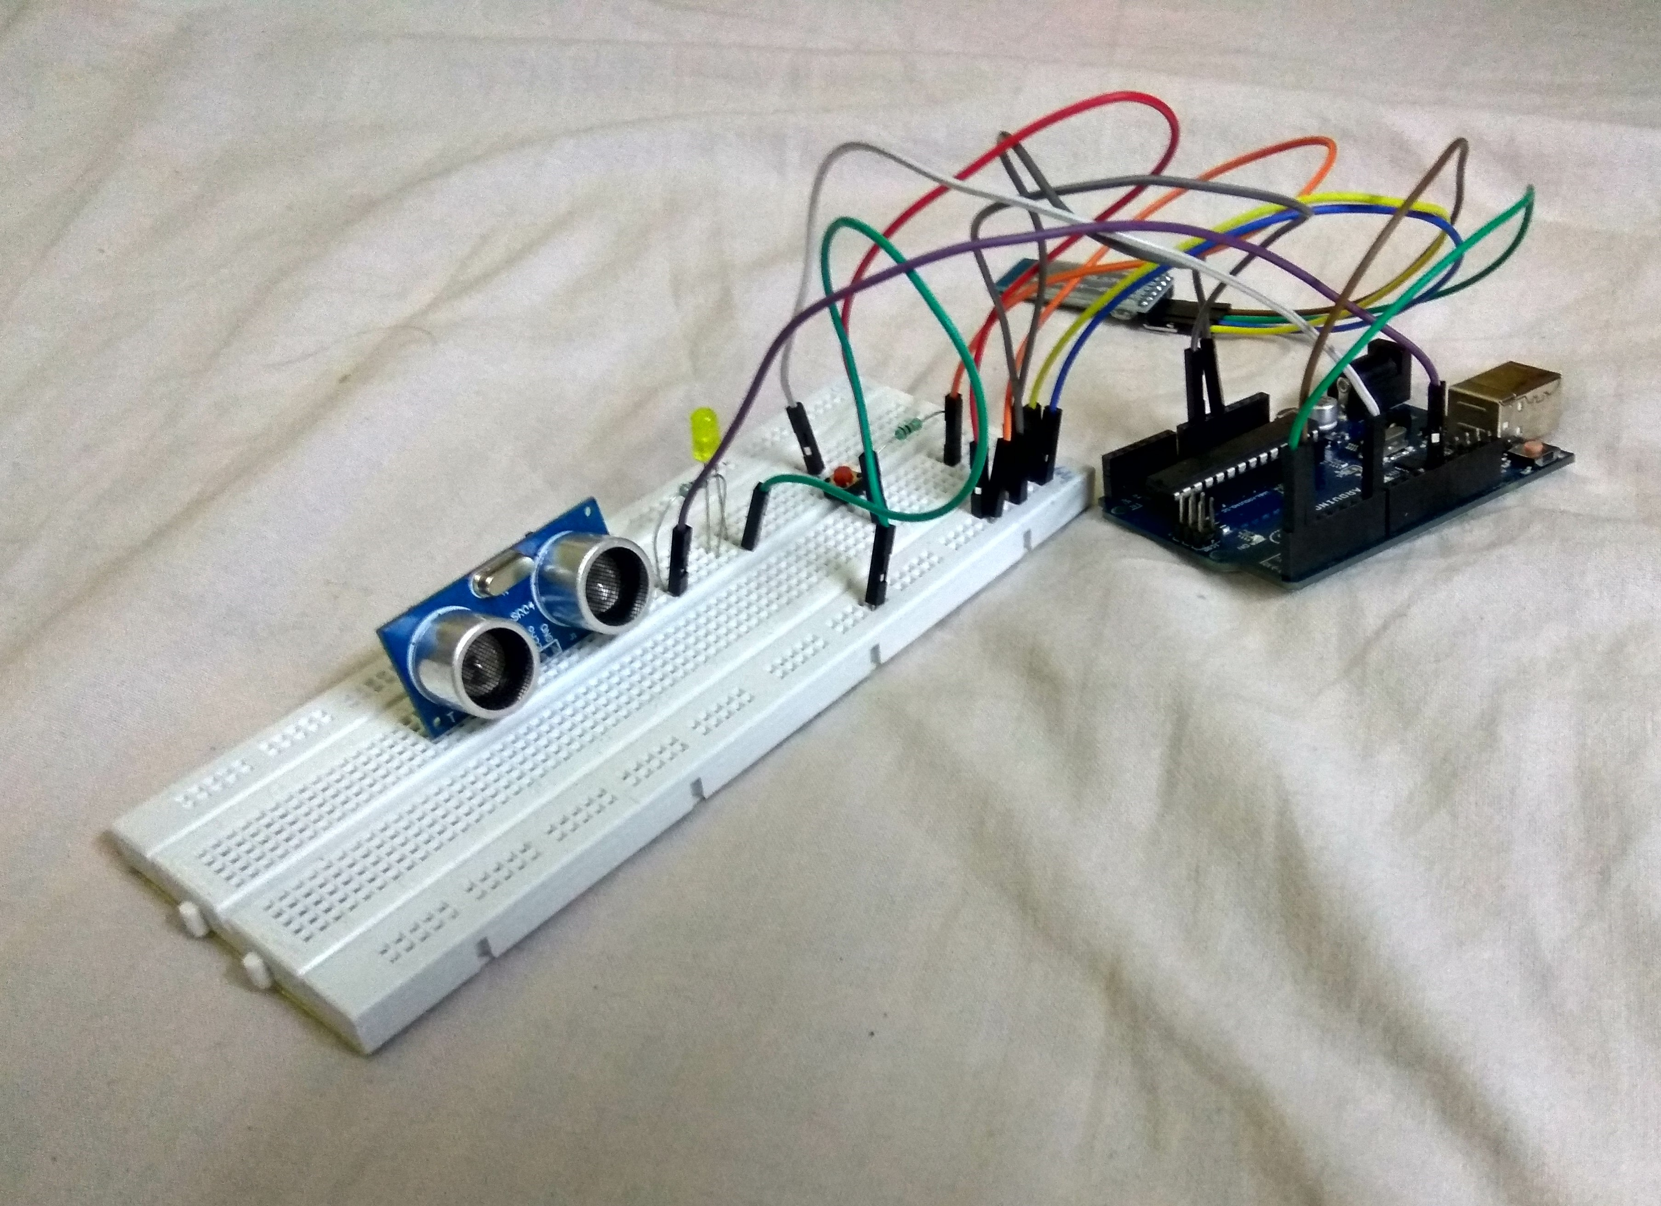
Using Arduino for processing it.

Slide 11
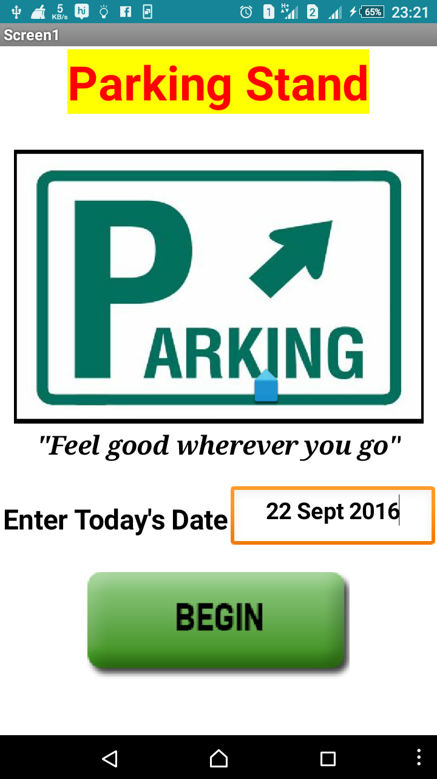
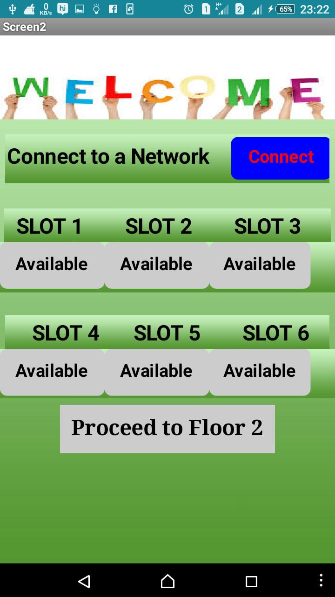
Android application

Slide 12
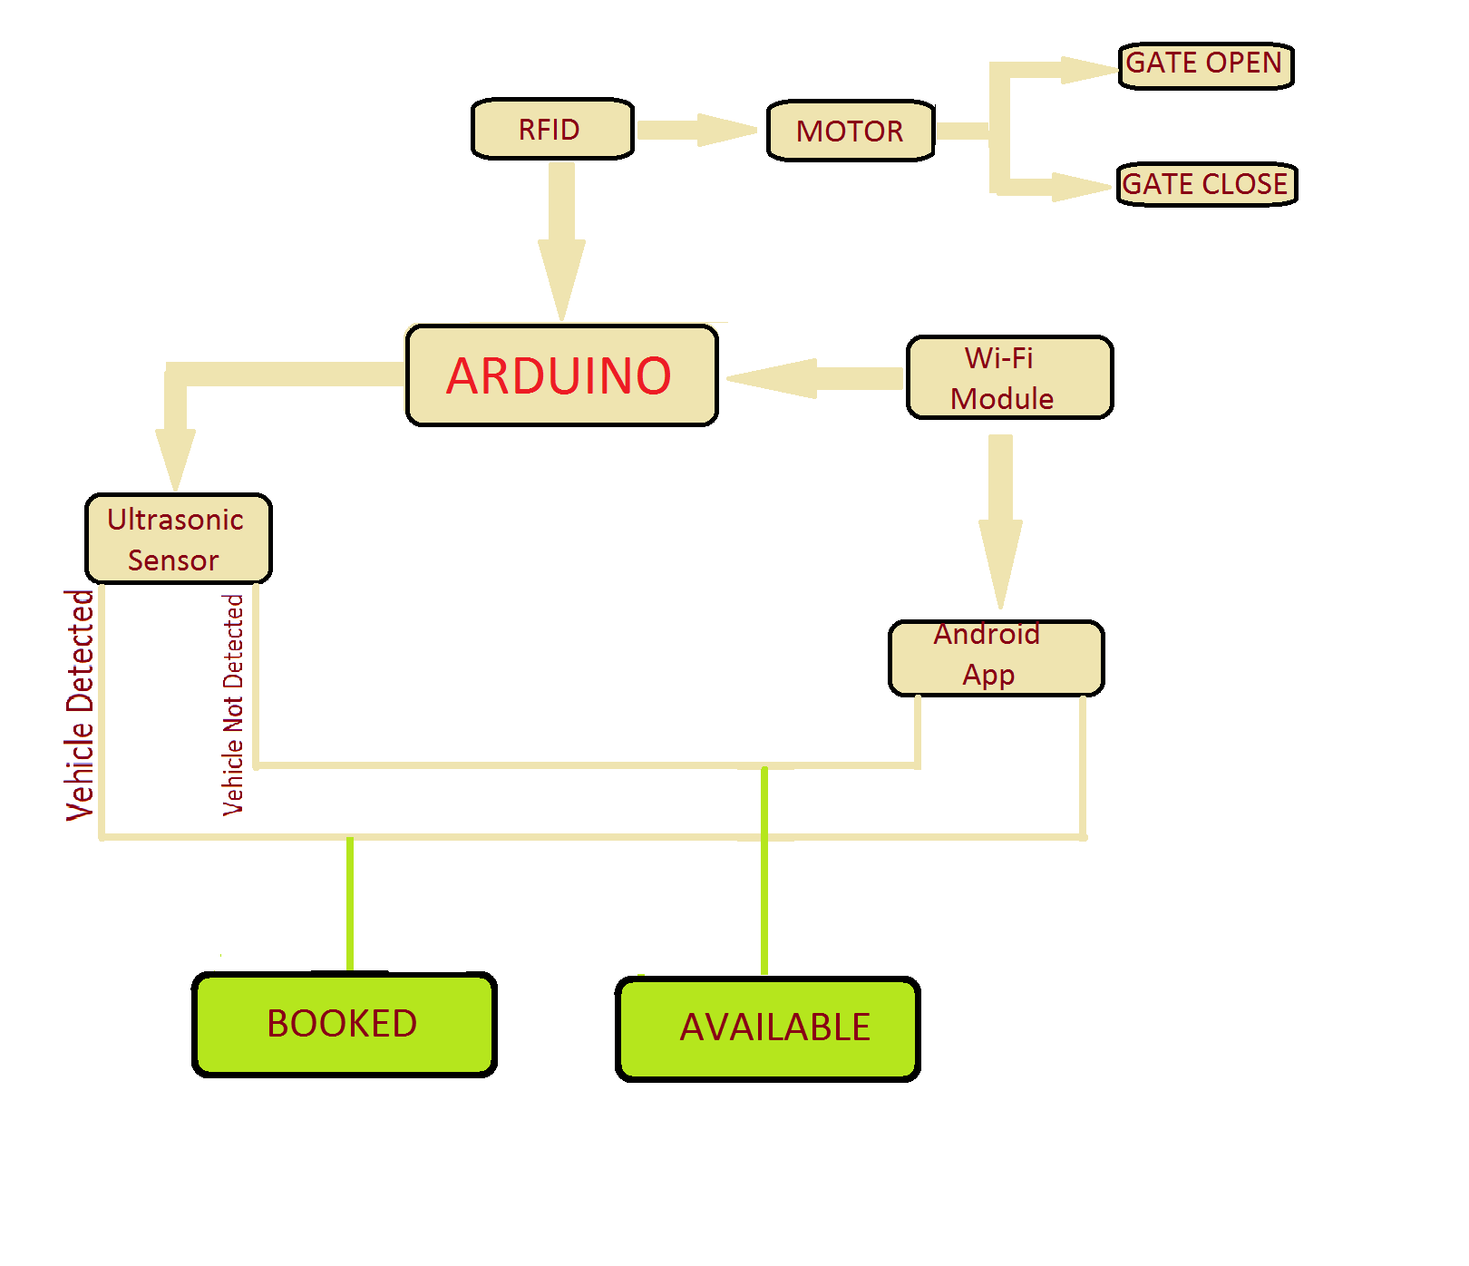

Slide 13

Features of our Parking System :
System will be fully automated.
Every vehicle will be given the nearest slot for parking i.e. slots will be provided
System will navigate the vehicle where exactly it has to go.
We can get the real time feedback of the slots allotted.

Slide 14
Thank You

