Slide 1

Adversarial attacks in NLP
Wang Hengyi
Peking University
why23@pku.edu.cn

Slide 2
Contents
Adversarial attacks via words substitution
template : find and edit based on rules & predictions
End-to-end: white box attacks based on gradient
Defend
Certificated robustness
Future work

Slide 3
Why substitution?
Recall adv attacks in CV: perturbation on input data
Obstacle: discrete nature of natural language
Compromise: to perturb a single word
Principles: similarity in the input; mistakes in the output
Question: How to approximate one word with another?

Slide 4
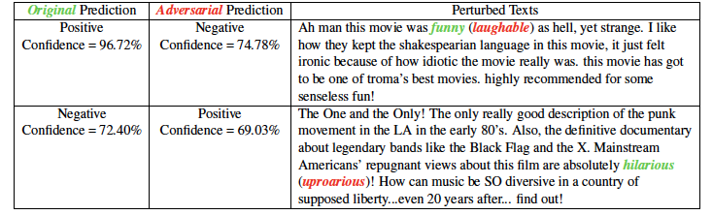
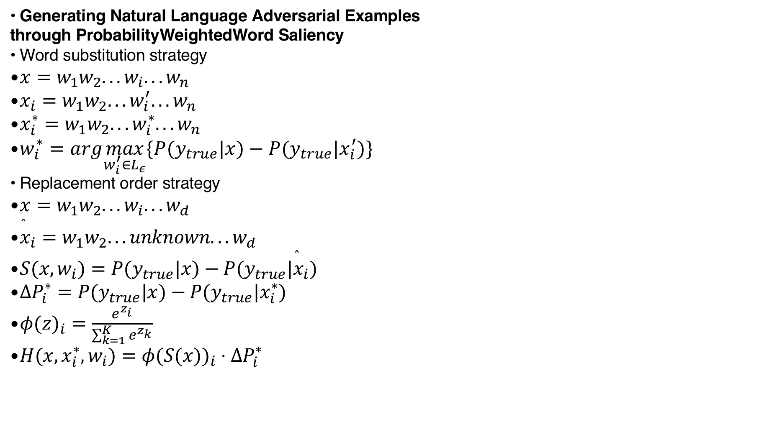
Candidates from KB&KG
Generating Natural Language Adversarial Examples
through ProbabilityWeightedWord Saliency
Word substitution strategy
$x=w_{1}w_{2}...w_{i}...w_{n}$
$x_{i}=w_{1}w_{2}...w_{i}^{′}...w_{n}$
$x_{i}^{∗}=w_{1}w_{2}...w_{i}^{∗}...w_{n}$
$w_{i}^{∗}=arg\max_{w_{i}^{′}∈L_{ε}}\{P(y_{true}|x)−P(y_{true}|x_{i}^{′})\}$
Replacement order strategy
$x=w_{1}w_{2}...w_{i}...w_{d}$
${\overset{̂}{x}}_{i}=w_{1}w_{2}...unknown...w_{d}$
$S(x,w_{i})=P(y_{true}|x)−P(y_{true}|{\overset{̂}{x}}_{i})$
$ΔP_{i}^{∗}=P(y_{true}|x)−P(y_{true}|x_{i}^{∗})$
$φ(z)_{i}=\frac{e^{z_{i}}}{\sum_{k=1}^{K}{e^{z_{k}}}}$
$H(x,x_{i}^{∗},w_{i})=φ(S(x))_{i}⋅ΔP_{i}^{∗}$
键入说明。

Slide 5
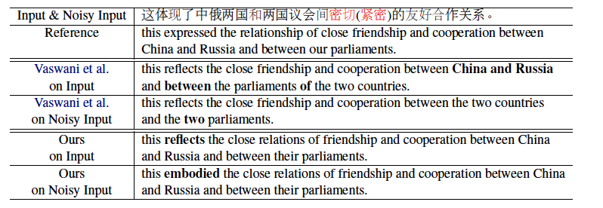
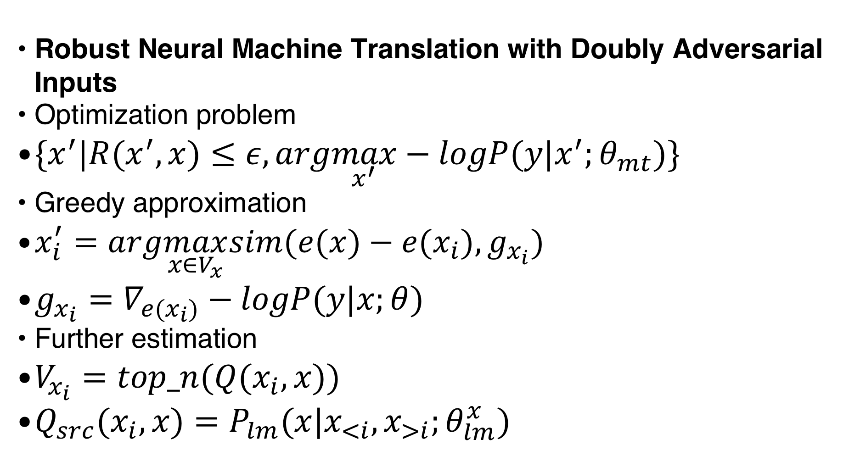
Top K from LM
Robust Neural Machine Translation with Doubly Adversarial Inputs
Optimization problem
$\{x^{′}|R(x^{′},x)≤ε,arg\max_{x^{′}}−logP(y|x^{′};θ_{mt})\}$
Greedy approximation
$x_{i}^{′}=arg\max_{x∈V_{x}}sim(e(x)−e(x_{i}),g_{x_{i}})$
$g_{x_{i}}=∇_{e(x_{i})}−logP(y|x;θ)$
Further estimation
$V_{x_{i}}=top_n(Q(x_{i},x))$
$Q_{src}(x_{i},x)=P_{lm}(x|x_{<i},x_{>i};θ_{lm}^{x})$
键入说明。

Slide 6
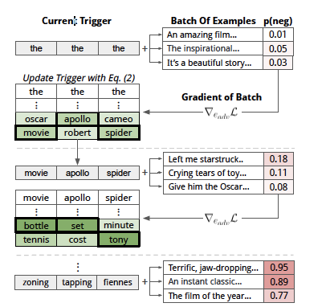
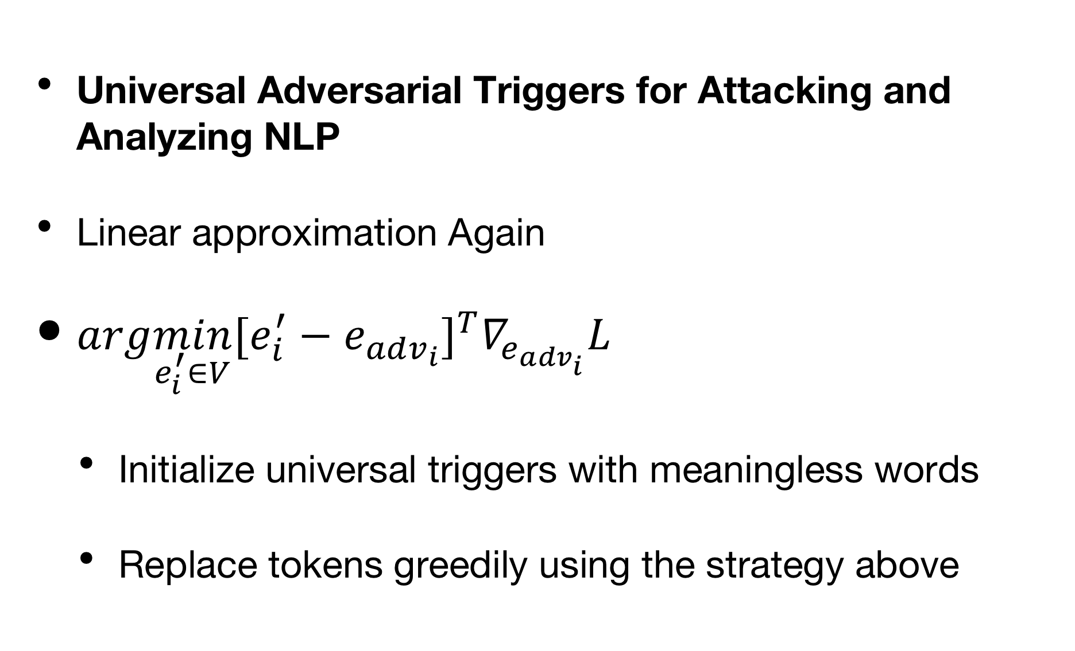
Append and replace
Universal Adversarial Triggers for Attacking and Analyzing NLP
Linear approximation Again
$arg\min_{e_{i}^{′}∈V}[e_{i}^{′}−e_{adv_{i}}]^{T}∇_{e_{adv_{i}}}L$
Initialize universal triggers with meaningless words
Replace tokens greedily using the strategy above
键入说明。

Slide 7
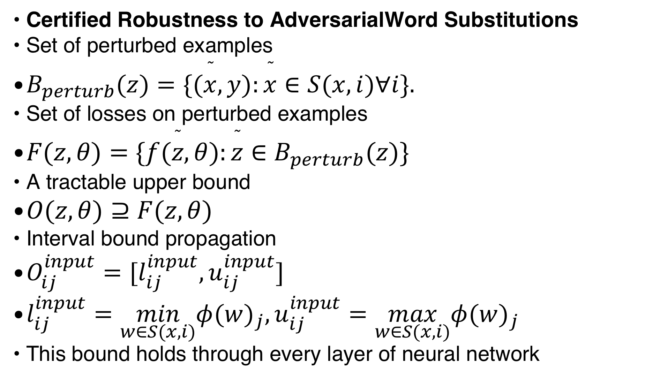
Defence via training
Certified Robustness to AdversarialWord Substitutions
Set of perturbed examples
$B_{perturb}(z)=\{(\overset{˜}{x},y):\overset{˜}{x}∈S(x,i)∀i\}.$
Set of losses on perturbed examples
$F(z,θ)=\{f(\overset{˜}{z},θ):\overset{˜}{z}∈B_{perturb}(z)\}$
A tractable upper bound
$O(z,θ)⊇F(z,θ)$
Interval bound propagation
$O_{ij}^{input}=[l_{ij}^{input},u_{ij}^{input}]$
$l_{ij}^{input}=\min_{w∈S(x,i)}φ(w)_{j},u_{ij}^{input}=\max_{w∈S(x,i)}φ(w)_{j}$
This bound holds through every layer of neural network
键入说明。

Slide 8
Future Work
Black box attack? Downstream task?
Test the reasoning ability?
Modify corresponding sentences at the same time?

Slide 9
Thanks!
Q & A

