Slide 1
Paper Reading
2019.11.03
Baifeng Shi

Slide 2
Content
Internal Statistics in Natural Vision Data (Follow-up)
SinGAN: internal statistics + GAN (ICCV2019 Best Paper Award) [1]
Deep Image Prior (CVPR2018) [2]
Internal statistics of video (ICCV2019) [3]
Check out the previous talk here
Other stuff recently read about
Informative Attention (NIPS2006) [4]
Information in a Neural Network (ICLR2020 under review) [5]

Slide 3
Internal Statistics: Take a look back
External Statistics: distribution of images (patches) in a huge dataset
Internal Statistics: distribution of patches in a single image
(e.g. patch recurrence)

Slide 4
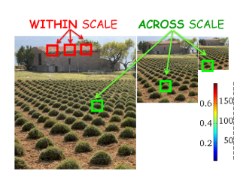

Internal Statistics: Take a look back
Patch pattern diversity is limited in a single image
Similar patches tend to recur in a single image
Lower entropy

Slide 5
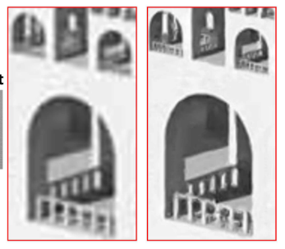
Internal Statistics: Take a look back
Super Resolution

Slide 6
SinGAN: Internal Statistics + GAN
What is GAN doing?
- Approximating a real distribution (sample-based)
What distribution describes an image’s internal statistics?
- Distribution of patches in the image (different location / scale)\
- Lower Entropy -> Easier to approximate

Slide 7
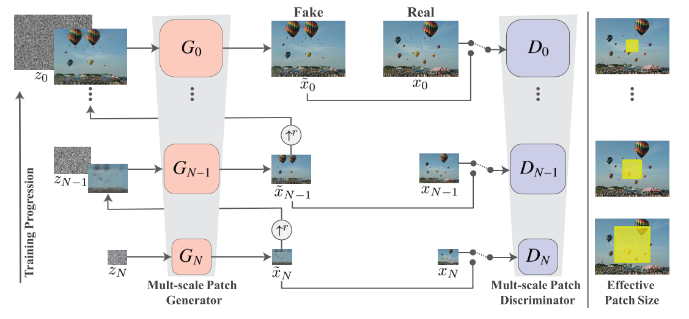
SinGAN: Internal Statistics + GAN

Slide 8
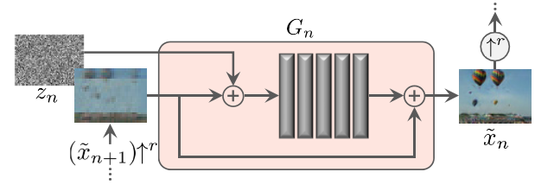
Question though
Why add twice?

Slide 9


Question though
What if we remove reconstruction loss?

Slide 10
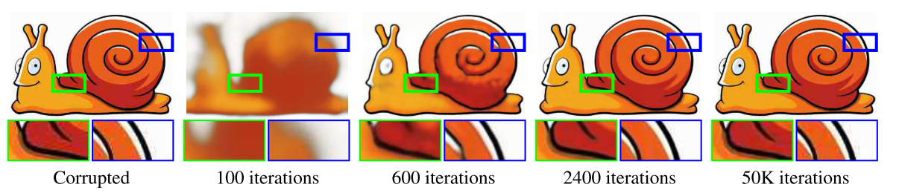
Deep Image Prior
Coarse to fine

Slide 11
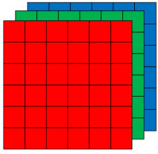
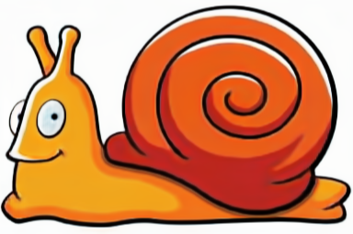
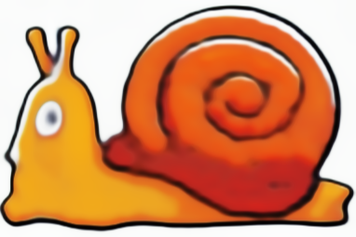
Deep Image Prior
Anything to do with Internal Statistics? Sparcity (low entropy)
frequency domain
Space domain
Measurement
(like wavelet transform)
Reconstruction

Slide 12
Deep Image Prior
Every kernel is a basis.
Sparcity of patches -> sparcity of bases -> low network capacity needed

Slide 13
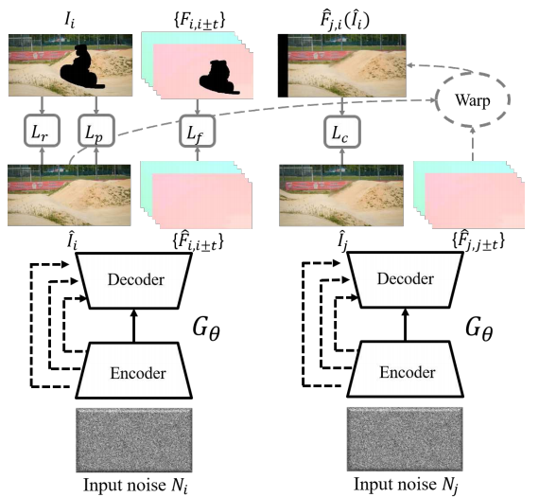
Internal statistics of video – video inpainting
Perceptual loss
Rgb recon loss
consistency loss
Flow recon loss

Slide 14
Content
Internal Statistics in Natural Vision Data (Follow-up)
SinGAN: internal statistics + GAN (ICCV2019 Best Paper Award) [1]
Deep Image Prior (CVPR2018) [2]
Internal statistics of video (ICCV2019) [3]
Check out the previous talk here
Other stuff recently read about
Informative Attention (NIPS2006) [4]
Information in a Neural Network (ICLR2020 under review) [5]

Slide 15
Informative attention
When we look at something, where are we looking at?
- Somewhere unnormal

Slide 16
What is unnormal?
unnormal
unnormal
unnormal
unnormal
unnormal
unnormal
unnormal
unnormal
unnormal
normal
unnormal
unnormal
unnormal
unnormal
unnormal
unnormal
unnormal
unnormal

Slide 17
What is unnormal?
Unnormal things? Rare things.
How to define rare?
- A patch you cannot find elsewhere is RARE.

Slide 18
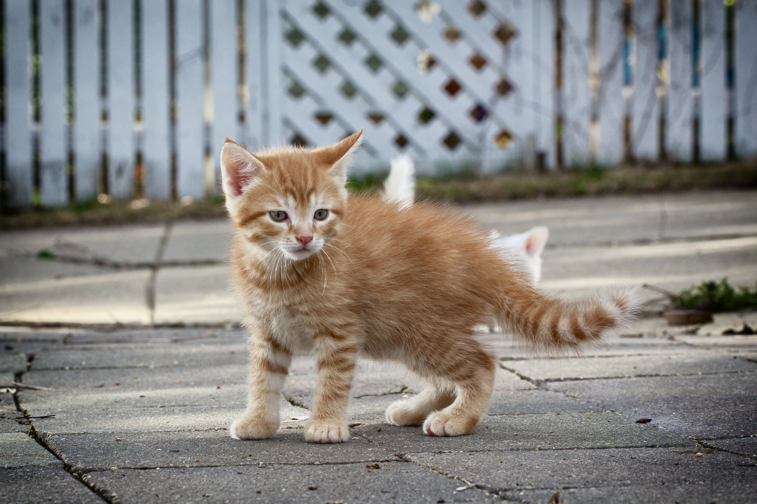
What is rare?
Is texture rare?
NO!
It’s all over her body.
Are eyes rare?
YES!
Only demons have eyes all over the body.

Slide 19
How to quantify ‘rare’?

Slide 20
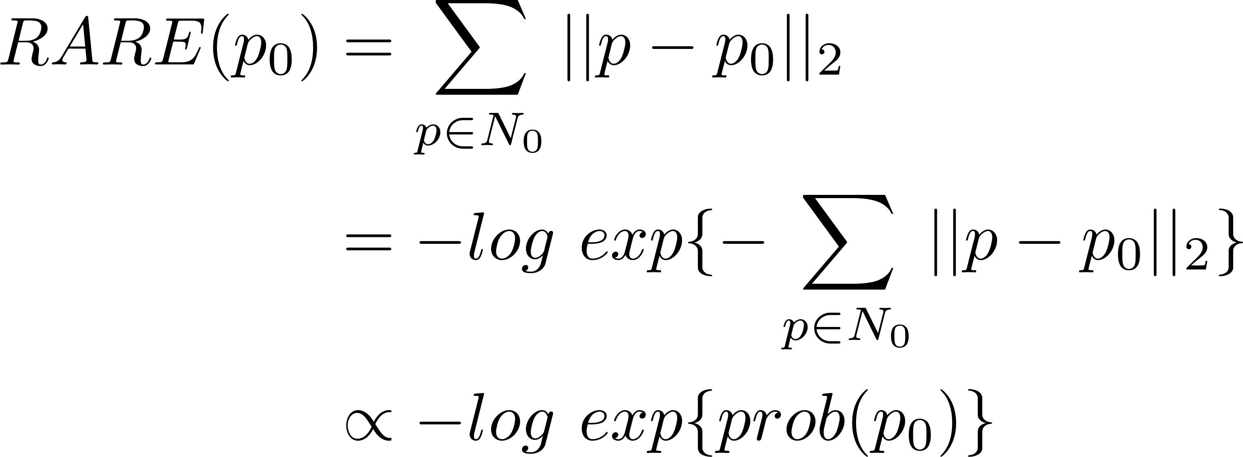
A Perspective from Information Theory
(Gaussian Mixture)
(Shannon Information)

Slide 21
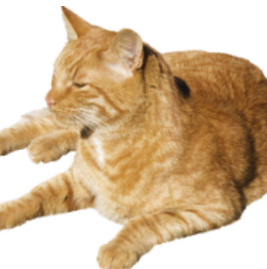
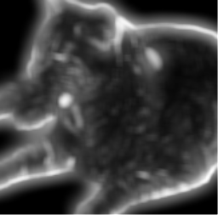
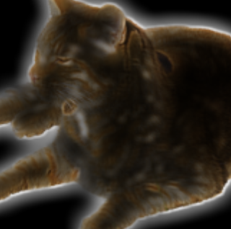
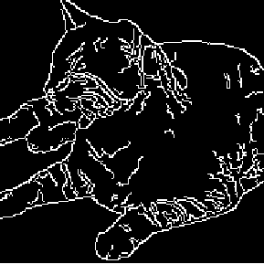
Original image
Informative attention
Informative mask
Edge detection

Slide 22
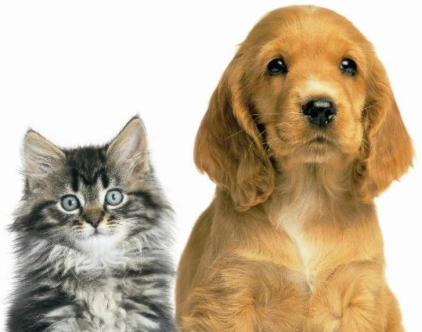
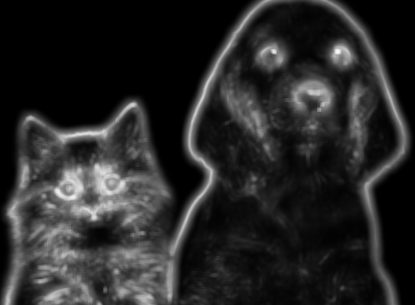
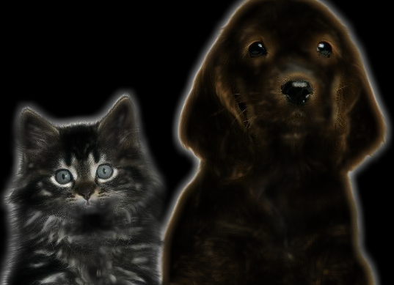
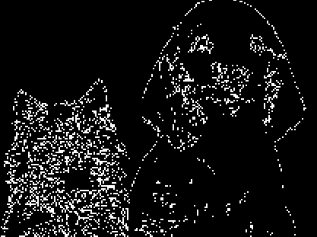
Original image
Informative attention
Informative mask
Edge detection

Slide 23
Information in a Neural Network
Where is information in a neural network?
In its weights? In its activations?

Slide 24
Information in a Neural Network
How do we measure the information a neural network carries?
By accuracy on training set?
By accuracy on test set?
By complexity of its weights?

Slide 25
Preliminary
PAC-Bayesian
Fisher Information
Mutual Information
SGD

Slide 26
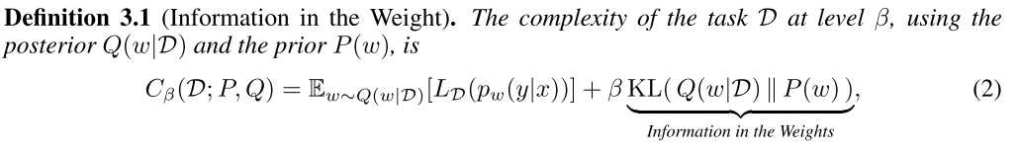
Information in a Neural Network

Slide 27

Information Controls Generalization
PAC-Bayesian:

Slide 28
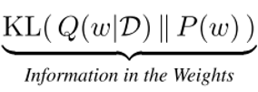
Shannon / Fisher Information in the Weights
P(w) is a prior. By setting different form of prior, we have different form of information.

Slide 29

Shannon / Fisher Information in the Weights
Mutual Information

Slide 30

Shannon / Fisher Information in the Weights
Setting prior P(w) as uninformative Gaussian prior
Fisher Information

Slide 31
Information in the Learning Dynamics
Proposition:
Optimizing through SGD, rather than minimizing directly the loss function, minimizes a free energy

Slide 32
Reference
[1] Shaham, Tamar Rott, Tali Dekel, and Tomer Michaeli. "SinGAN: Learning a Generative Model from a Single Natural Image." arXiv preprint arXiv:1905.01164 (2019).
[2] Ulyanov, Dmitry, Andrea Vedaldi, and Victor Lempitsky. "Deep image prior." Proceedings of the IEEE Conference on Computer Vision and Pattern Recognition. 2018.
[3] Zhang, Haotian, et al. "An Internal Learning Approach to Video Inpainting." arXiv preprint arXiv:1909.07957 (2019).

Slide 33
Reference
[4] Bruce, Neil, and John Tsotsos. "Saliency based on information maximization." Advances in neural information processing systems. 2006.
[5] Achille, Alessandro, and Stefano Soatto. "Where is the Information in a Deep Neural Network?." arXiv preprint arXiv:1905.12213 (2019).

