Slide 1
Paper Reading
2019.10.06
Baifeng Shi

Slide 2
Reading List
Internal Statistics of a Single Natural Image
Zontak, Maria, and Michal Irani. CVPR 2011. IEEE, 2011.
“Zero-Shot” Super-Resolution using Deep Internal Learning
Shocher, Assaf, Nadav Cohen, and Michal Irani. CVPR 2018.
Blind Deblurring Using Internal Patch Recurrence
Michaeli, Tomer, and Michal Irani. ECCV 2014.
Semi-parametric Image Synthesis
Qi, Xiaojuan, et al. CVPR 2018.

Slide 3
Internal Statistics of a Single Natural Image
External Statistics vs. Internal Statistics
External Statistics: distribution of images (patches) in a huge dataset
Internal Statistics: distribution of patches in a single image
(e.g. patch recurrence)

Slide 4
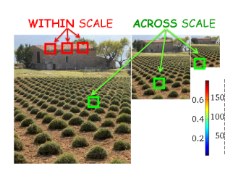

Patch Recurrence
Patch pattern diversity is limited in a single image
Similar patches tend to recur in a single image
Lower entropy

Slide 5
Observation 1
Given a patch extracted from an image, it will almost surely recur again in the same image. However, it may not appear in another image.

Slide 6
Observation 2
Recurrence density is a function of
distance from the original location
mean gradient within the patch

Slide 7
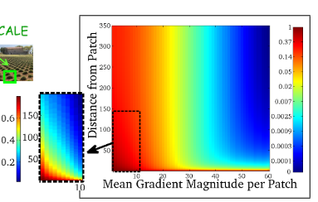

Observation 2
Smooth patches recur very frequently, whereas highly structured patches recur much less frequently.
A patch tends to recur densely in its closest vicinity (small dist), and its frequency of recurrence decays rapidly as the distance from the patch increases

Slide 8
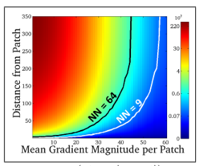
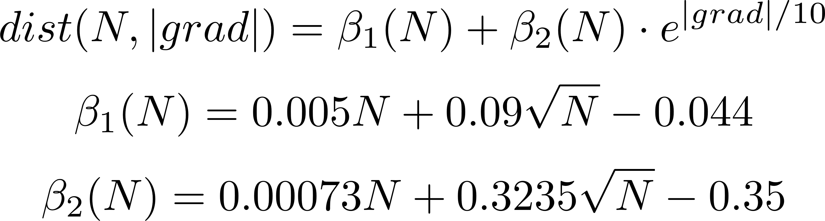
Observation 2
Integrate density w.r.t. area to get number of recurrence
level set

Slide 9
Observation 2
We could use the property in algorithms (e.g. Non-local Means)
small-gradient patch | large-gradient patch
High density | Low density
Dominated by noise | Dominated by content
Small search area | Large search area

Slide 10
Observation 3
Recurrence density is invariant across different scales (without changing scale of patches)
which means, patterns in images can also be found in downscaled ones.

Slide 11
Observation 4
More than 80% of the patches in natural images tend to have low mean gradient magnitude.
However, quality of images mainly depends on large-gradient parts.
Uneven distribution of gradient magnitudes needs taken into consideration.

Slide 12
Observation 5
Internal statistics have (compared to external statistics)
Lower prediction error (divergence between prediction and gt)
lower prediction uncertainty (inconsistence among predictions)

Slide 13
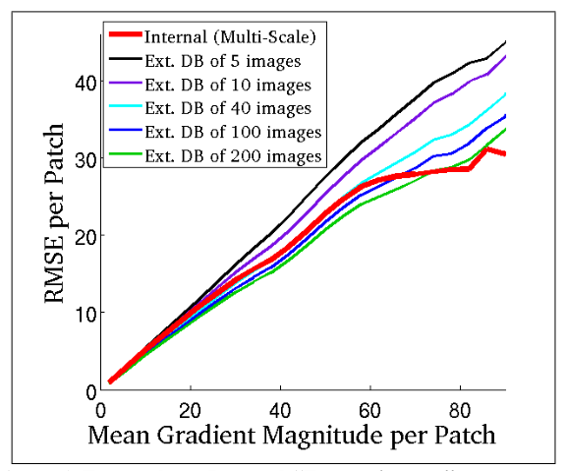
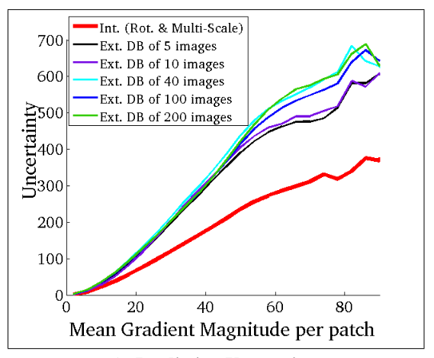
Observation 5

Slide 14
Reading List
Internal Statistics of a Single Natural Image
Zontak, Maria, and Michal Irani. CVPR 2011. IEEE, 2011.
“Zero-Shot” Super-Resolution using Deep Internal Learning
Shocher, Assaf, Nadav Cohen, and Michal Irani. CVPR 2018.
Blind Deblurring Using Internal Patch Recurrence
Michaeli, Tomer, and Michal Irani. ECCV 2014.
Semi-parametric Image Synthesis
Qi, Xiaojuan, et al. CVPR 2018.

Slide 15
“Zero-Shot” Super-Resolution using Deep Internal Learning
A super-resolution algorithm utilizing property of internal statistics
Directly train a network on each test data
image-specific network (like DIP)
using only internal statistics

Slide 16



“Zero-Shot” Super-Resolution using Deep Internal Learning
Test data only have low-resolution images.
How to learn the mapping from low-res to high-res ?
Downscale the low-res to a lower-resolution , and learn the mapping from to .
(utilizing scale invariance of internal statistics)

Slide 17
Reading List
Internal Statistics of a Single Natural Image
Zontak, Maria, and Michal Irani. CVPR 2011. IEEE, 2011.
“Zero-Shot” Super-Resolution using Deep Internal Learning
Shocher, Assaf, Nadav Cohen, and Michal Irani. CVPR 2018.
Blind Deblurring Using Internal Patch Recurrence
Michaeli, Tomer, and Michal Irani. ECCV 2014.
Semi-parametric Image Synthesis
Qi, Xiaojuan, et al. CVPR 2018.

Slide 18
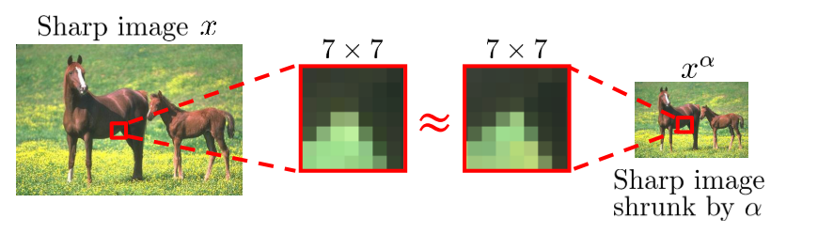
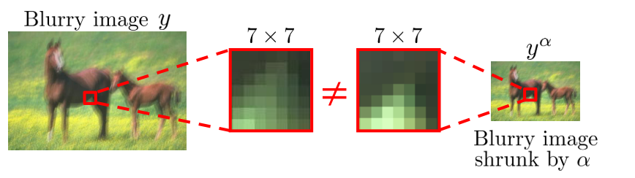
Blind Deblurring Using Internal Patch Recurrence
How can internal statistics help deblurring?

Slide 19
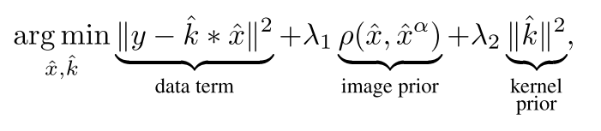
Blind Deblurring Using Internal Patch Recurrence
Blurring kernel
Reconstructed image
Reconstructed and downscaled
Blurred image
Maximize likelihood of blurred image
Maximize across-scale patch recurrence in reconstructed image

Slide 20
What else can internal statistics help with?
Lots of low-level vision tasks, like denoising, inpainting etc.

Slide 21
Reading List
Internal Statistics of a Single Natural Image
Zontak, Maria, and Michal Irani. CVPR 2011. IEEE, 2011.
“Zero-Shot” Super-Resolution using Deep Internal Learning
Shocher, Assaf, Nadav Cohen, and Michal Irani. CVPR 2018.
Blind Deblurring Using Internal Patch Recurrence
Michaeli, Tomer, and Michal Irani. ECCV 2014.
Semi-parametric Image Synthesis
Qi, Xiaojuan, et al. CVPR 2018.

Slide 22
Semi-parametric Image Synthesis
What if internal statistics are totally unavailable?
For example, when we need to synthesize a image from its semantic segmentation?
External statistics can also help!

Slide 23
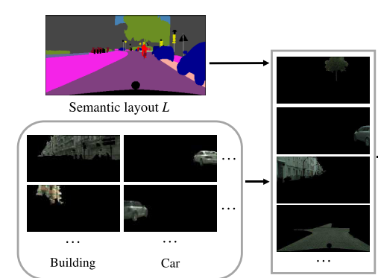
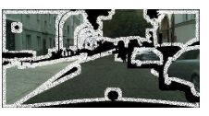
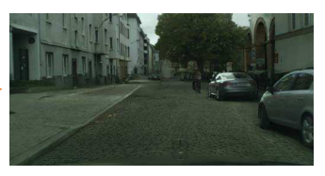
Semi-parametric Image Synthesis
Refining network
canvas
output
External memory
Retrieved patches

