Slide 1
PSYLIQ INYERNSHIP TASK-1
PHARMA DATA ANALYSIS
Annu Jha

Slide 2
1. Schema Design
Given the provided dataset, create a Power BI data model with appropriate tables and relationships, considering the Distributor, Customer Name, City, and other relevant columns.
Snapshot of Dataset.

Slide 3
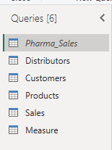
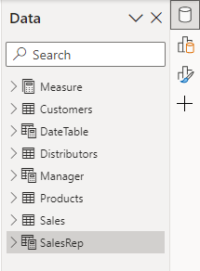
After uploading and cleaning the data I have created multiple tables in Power Query editor from the existing data set i.e. Pharma_Sales. And I have created three tables i.e. DateTable, Manager, and SalesRep table by using DAX function.

Slide 4
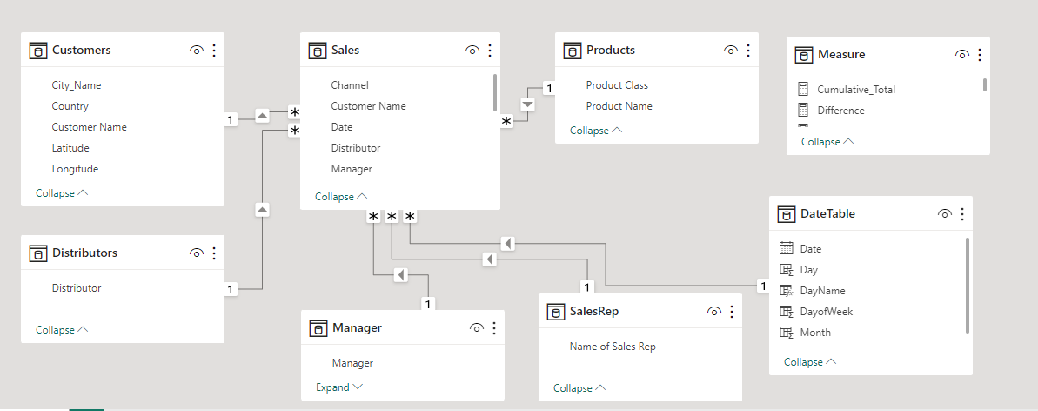
Schema Design

Slide 5
2. Relationships
Establish the necessary relationships between the tables in your data model. For instance, connect the "Sales" table to the "Customers" table.

Slide 6
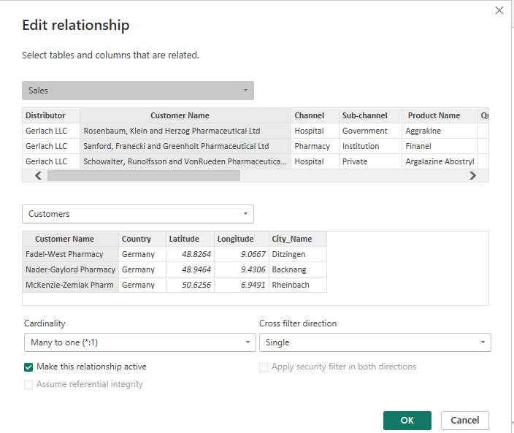
Multiple Relationships created as per requirement.

Slide 7
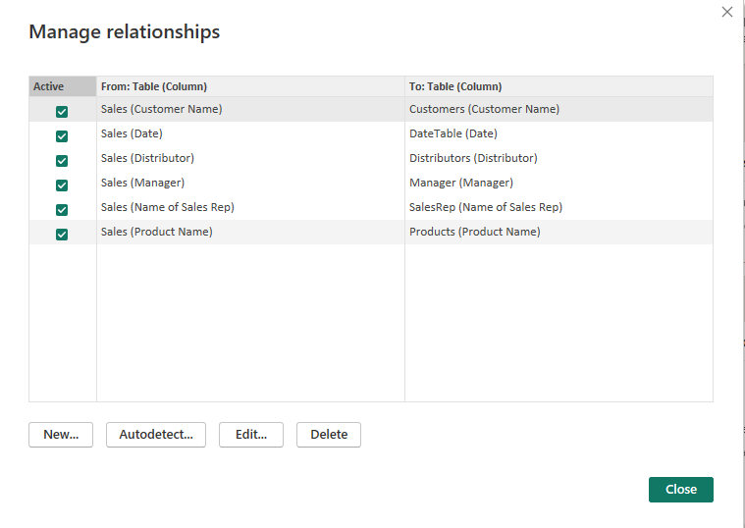
Multiple Relationships created as per requirement.

Slide 8
3. Role-Playing Dimensions
In your data model, demonstrate how you'd handle role-playing dimensions for "Sales Rep" and "Manager."

Slide 9
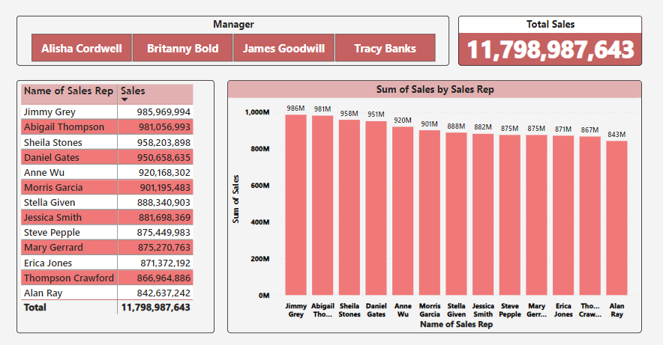
Role-Playing Dimensions

Slide 10
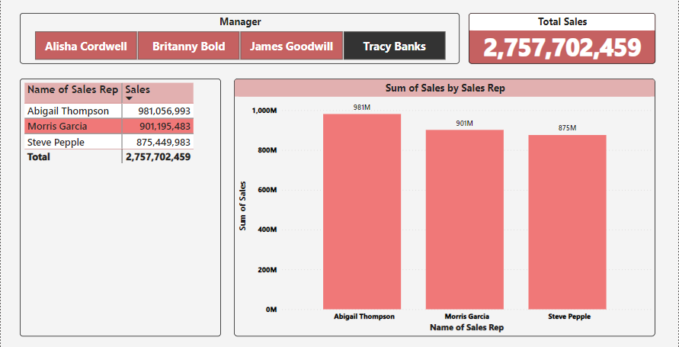
Role-Playing Dimensions

Slide 11
4. Schemas
Build a star schema based on the data and explain how your schema design helps optimize report performance.

Slide 12
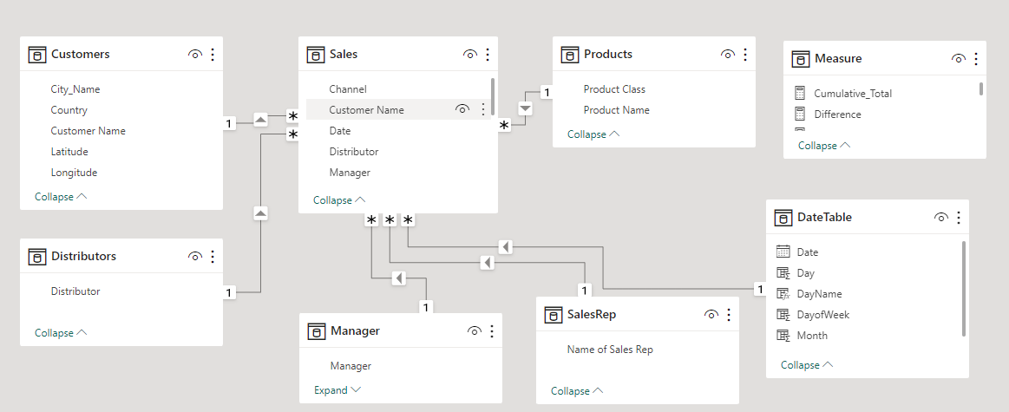
Sales table is a Fact Table and others are Dimension Table.

Slide 13
Schema design helps optimize report performance.
To build a star schema based on the provided data, we'll organize the data into a central fact table surrounded by dimension tables. This design optimizes report performance by simplifying queries, reducing data redundancy, and enabling efficient data retrieval. Here's how we can design the star schema based on the given dataset:
Fact Table: Sales Table
Dimension Tables: Customer, Distributor, Manager, SalesRep, Products and DateTables are Dimension table.
Schema Design Benefits:
  Simplified Queries: Analysts can easily navigate between the fact table and multiple dimension tables to retrieve necessary information, making queries more intuitive.
  Reduced Redundancy: Each dimension table stores unique values, reducing data redundancy and improving storage efficiency.
  Optimized Performance: The denormalized structure facilitates efficient joins between the fact table and dimension tables, resulting in optimized query performance.
  Enhanced Flexibility: The star schema design allows for easy expansion and modification with the addition of new dimensions, providing flexibility for future reporting requirements.
  Improved Maintenance: Star schemas are relatively easy to maintain, with changes to dimension tables being implemented without disrupting the entire schema.

Slide 14
5. Row-Level Security
Set up row-level security in your data model, restricting access for a specific sales team. Show which measures are affected.

Slide 15
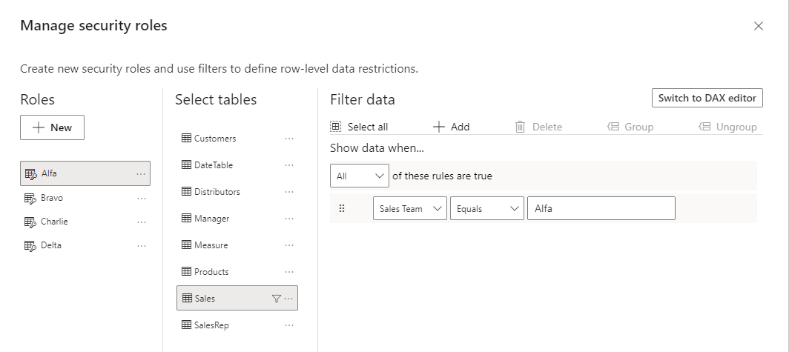
Defining Row-Level Security

Slide 16
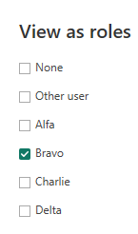
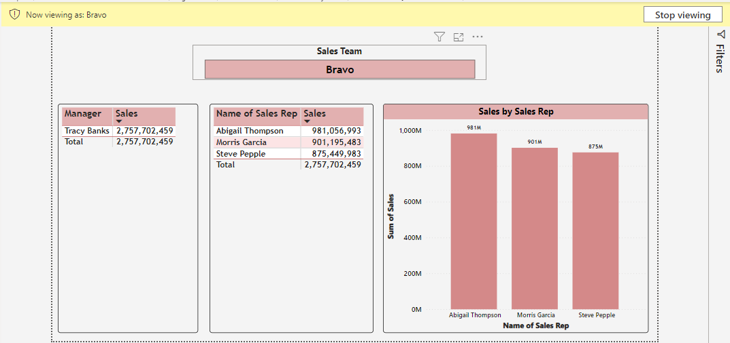
View of Row-Level Security

Slide 17
6. Calculated Column vs. Measures
Calculate the total sales for each product both as a calculated column and a measure. Compare the results and explain the differences.

Slide 18

Calculated Column
Calculated Measure
Differences:
The calculated column calculates the total sales for each product at the row level. It computes the sales amount for each row in the table and adds it as a new column in the table.
The measure, on the other hand, calculates the total sales dynamically based on the context of the visualization or query. It aggregates the sales amounts across rows based on the current filter context or row context.
One key difference is that measures are calculated dynamically and can respond to changes in filters or slicers, while calculated columns are static and cannot be changed based on the report's context.

Slide 19
7. Time Intelligence Function
Using DAX, create a measure that calculates the year-to-date (YTD) sales for each month.

Slide 20
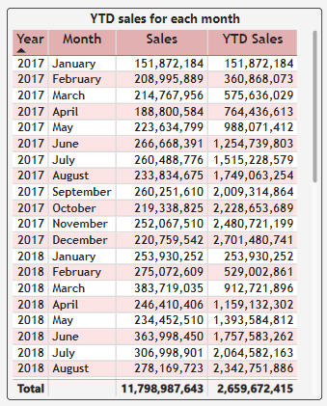
YTD Sales for each month

Slide 21
8. Filter Context vs. Row Context
Write a DAX calculation that shows the total quantity sold by each sales rep. Explain how filter and row contexts apply.

Slide 22
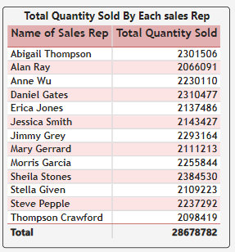

Slide 23
9. Ranking
Create a DAX measure that ranks products by sales. Display the top 5 products by rank in a visual.

Slide 24
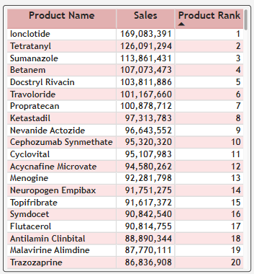
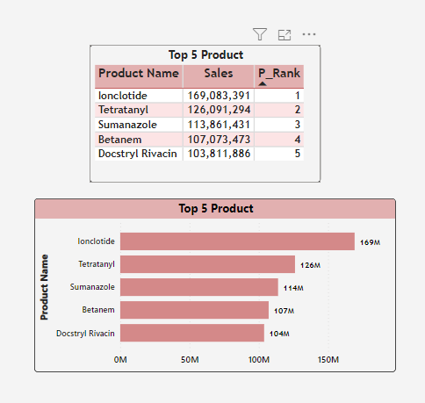

Slide 25
10. Drill-Through
Build a report where users can drill through from a summary to detailed data. For example, starting from a map, drill through to a table of individual sales for a specific city.

Slide 26
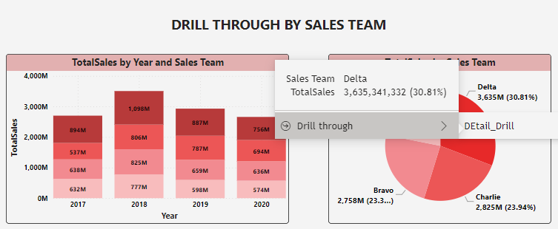
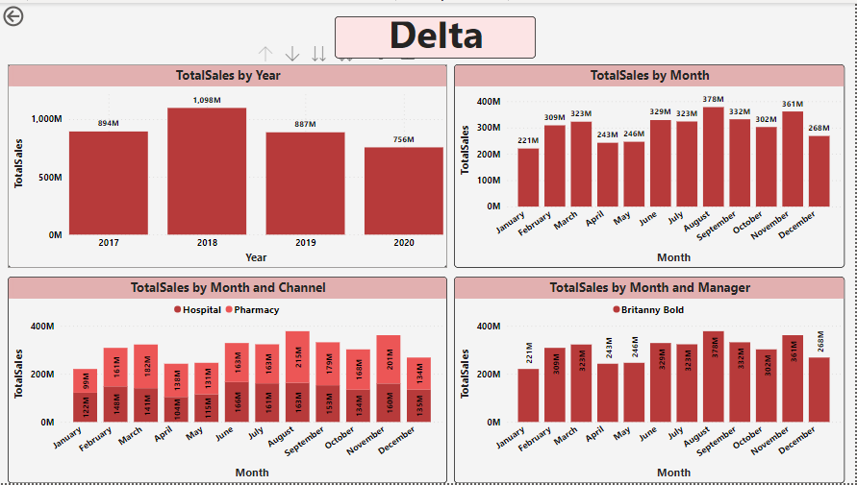

Slide 27
11. Bookmarks and Buttons
Create a report with bookmarks and buttons that allow users to navigate between different pages or states within the report.

Slide 28
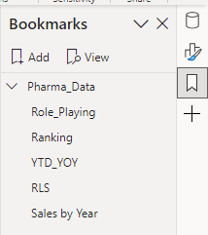
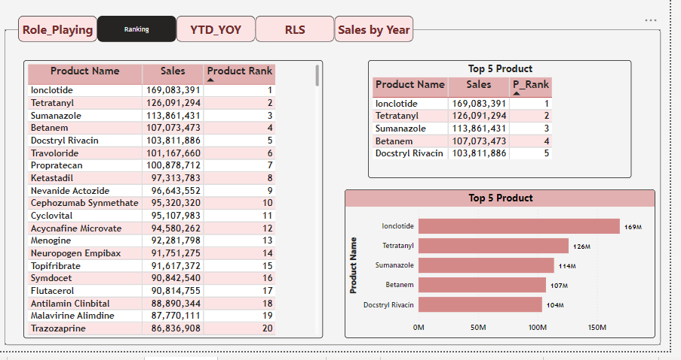

Slide 29
12. Conditional Formatting
Apply conditional formatting to a measure so that it changes color when sales exceed a certain target value.

Slide 30
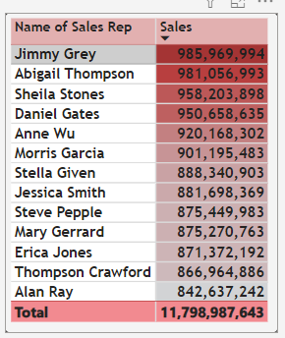
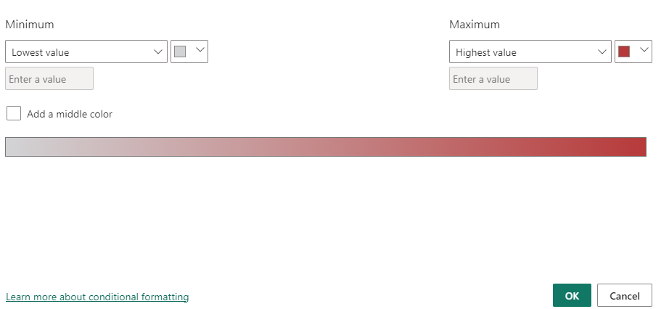

Slide 31
13. Calculated Columns
Add a calculated column to your data model that calculates the total cost of each product (Quantity x Price).

Slide 32
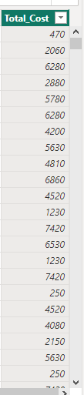

Slide 33
14. New Column from Example
Use the "New Column from Example" feature to add a column that categorizes cities into regions based on a predefined mapping.

Slide 34
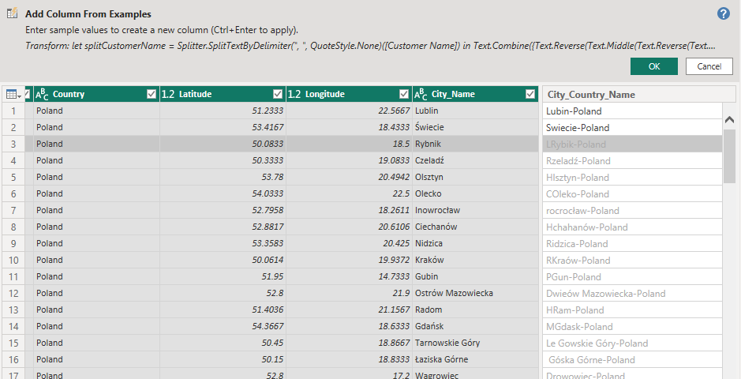

Slide 35
15. Time-Based Calculation
Create a measure that calculates the year-over-year (YoY) growth in sales for each month.

Slide 36

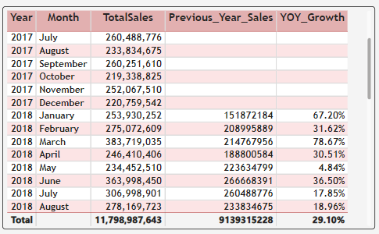

Slide 37
16. Cumulative Total
Develop a measure to show the cumulative total of sales over time and visualize it in a line chart.

Slide 38
