Slide 1



INTERNSHIP TASK – 2 Corona Virus Analysis with SQL
INTERNSHIP TASK – 2 Corona Virus Analysis with SQL
INTERNSHIP TASK – 2 Corona Virus Analysis with SQL
By. ANNU JHA
Batch – MIP-DA-09
By. ANNU JHA
Batch – MIP-DA-09

Slide 2
INTRODUCTION
This project uses SQL to analyze COVID-19 data and understand the pandemic's impact. By exploring a dataset of COVID-19 cases, we answer important questions about confirmed cases, deaths, and recoveries across different countries and over time. This analysis helps us see how the virus has spread and affected different regions, demonstrating how SQL can be used to examine real-world data.

Slide 3
PROBLEM STATEMENT
The COVID-19 pandemic has significantly impacted public health, creating an urgent need for data-driven insights to understand the virus's spread.
As a data analyst, I have been tasked with analyzing a COVID-19 dataset to derive meaningful insights and present my findings. This analysis will help understand the virus's spread, impact, and trends over time, thereby aiding informed decision-making.

Slide 4
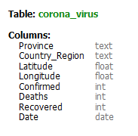
DATASET
Description of each column in dataset:
Province: Geographic subdivision within a country/region.
Country_Region: Geographic entity where data is recorded.
Latitude: North-south position on Earth's surface.
Longitude: East-west position on Earth's surface.
Date: Recorded date of CORONA VIRUS data.
Confirmed: Number of diagnosed CORONA VIRUS cases.
Deaths: Number of CORONA VIRUS related deaths.
Recovered: Number of recovered CORONA VIRUS cases.

Slide 5
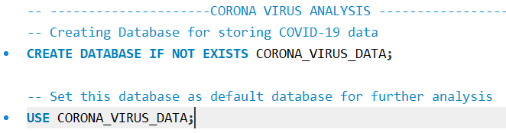
DATABASE CREATION
Note: Here, I created the database and made it the default for further analysis.

Slide 6
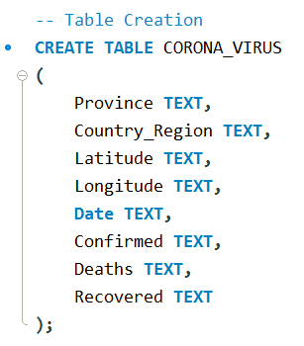
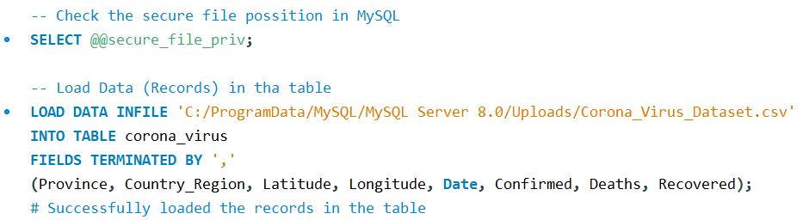
TABLE CREATION AND RECORD UPLOADING
Note: In the table, I define the data type of each field as "TEXT" so that I can change the data type after successfully uploading the records into the table.

Slide 7
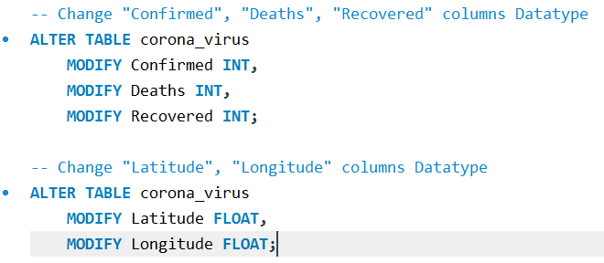
CHANGING DATATYPE
Here, I changed to the appropriate data types.

Slide 8
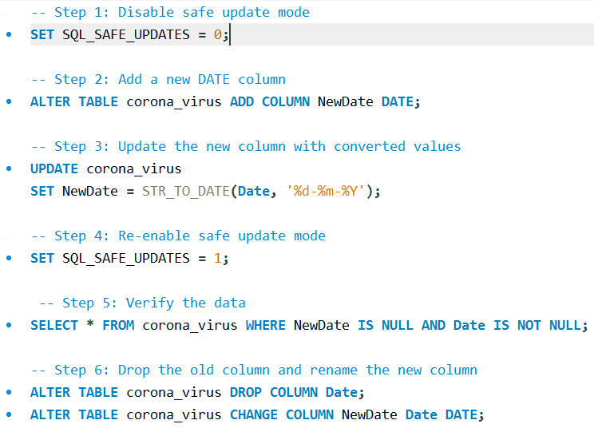
CHANGING DATE COLUMN DATA TYPE FROM TEXT TO DATE

Slide 9

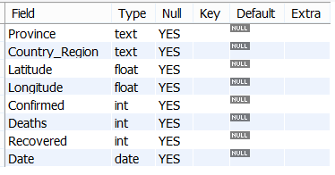
TABLE DETAILS

Slide 10

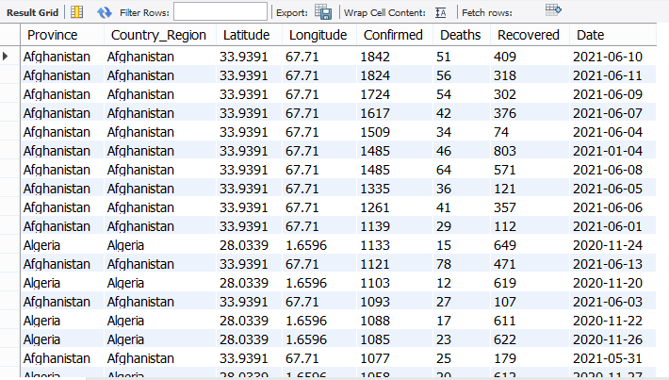
VIEWING THE TABLE DATA

Slide 11
INSIGHTS FROM CORONAVIRUS DATA ANALYSIS

Slide 12
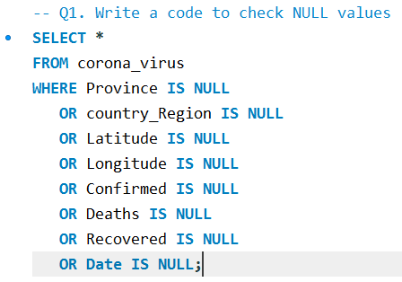
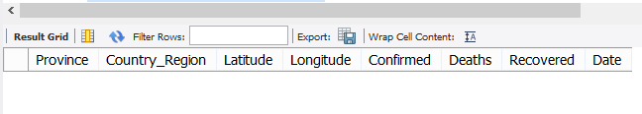

1. TO AVOID ANY ERRORS, CHECK MISSING VALUE / NULL VALUE
Insights: The analysis reveals that there are no null values present in the table.

Slide 13
2. If NULL values are present, update them with zeros for all columns.
Insights: As the output indicates the absence of null values in the table, there is no requirement to update any null values.
Insights: As the output indicates the absence of null values in the table, there is no requirement to update any null values.
Insights: As the output indicates the absence of null values in the table, there is no requirement to update any null values.

Slide 14
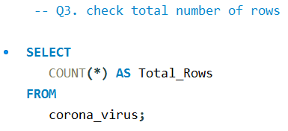

3. Check total number of rows in the table.
Insights: The table "corona_virus" contains 78,385 rows.

Slide 15
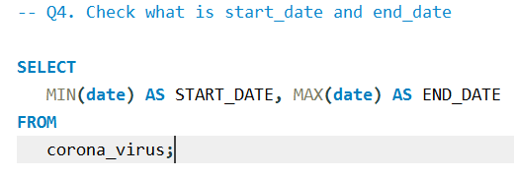

4. Verify the start and end dates of corona virus reporting.
Insights: According to the data, the start date of reporting coronavirus cases is 2020-01-22, and the end date is 2021-06-13.

Slide 16
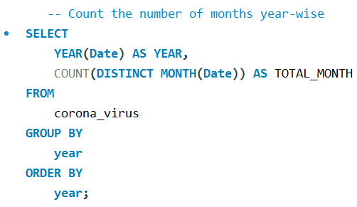
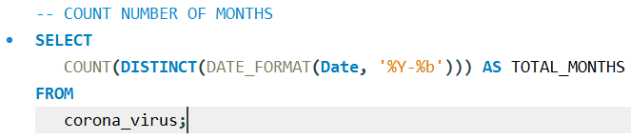
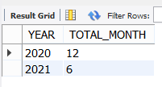

5. Number of month present in dataset
Insights: The data reveals a complete set of records for each month in 2020, totalling 12 months, enabling a comprehensive analysis of COVID-19 trends. However, for 2021, we only have data for 6 months, resulting in a total of 18 months of records available for analysis.

Slide 17
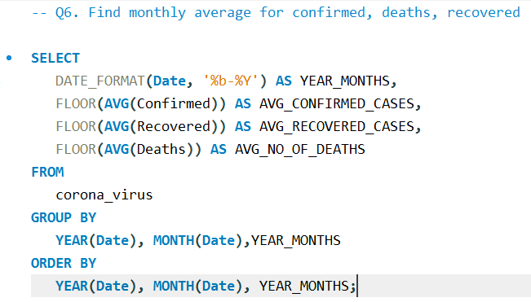
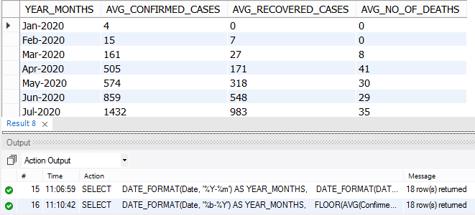
6. Find monthly average for confirmed, deaths, recovered
Insights: The monthly average query shows the average number of confirmed cases, deaths, and recoveries each month. This helps identify trends and changes in the pandemic's impact over time.

Slide 18
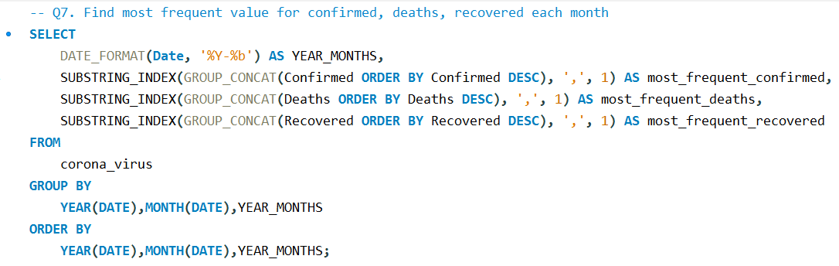
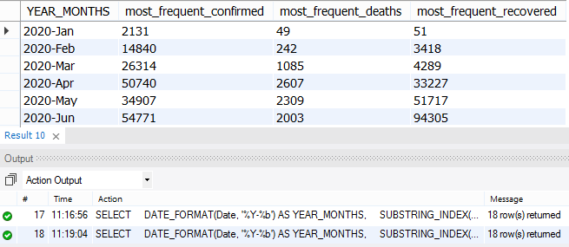
7. Find most frequent value for confirmed, deaths, recovered each month.
Insights: The most frequent values for confirmed cases, deaths, and recoveries each month reveal the most common outcomes during the pandemic. This helps identify typical monthly figures and detect any recurring patterns or anomalies.

Slide 19
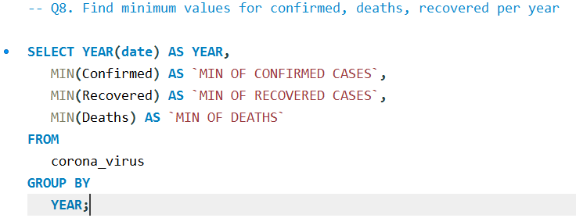
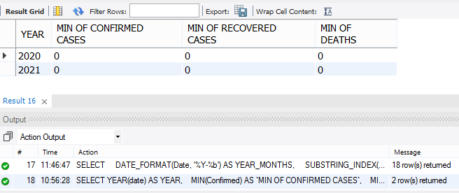
8. Find minimum values for confirmed, deaths, recovered per year.
Insights: The minimum values for confirmed cases, deaths, and recoveries per year highlight the lowest recorded figures annually. These insights help identify the least severe periods of the pandemic each year.

Slide 20
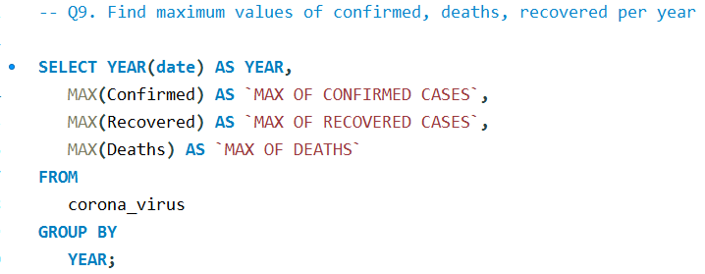
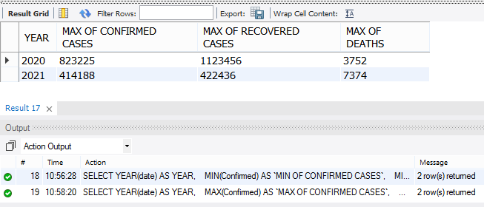
9. Find maximum values of confirmed, deaths, recovered per year
Insights: The maximum values for confirmed cases, deaths, and recoveries per year highlight the highest recorded figures annually. These insights help identify the most severe periods of the pandemic each year.

Slide 21
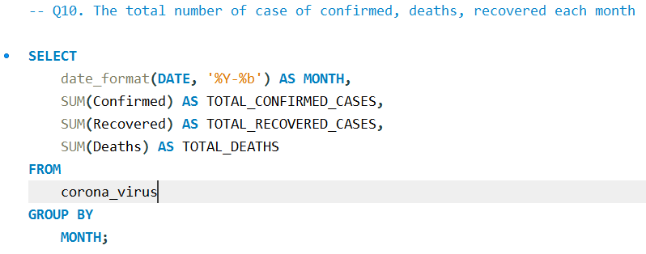
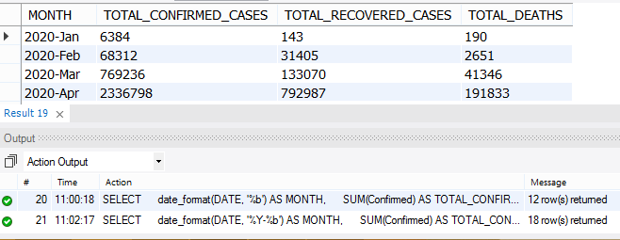
10. The total number of case of confirmed, deaths, recovered each month.
Insights: The total number of confirmed cases, deaths, and recoveries each month provides a comprehensive view of the pandemic's impact over time. These insights help track the monthly progression and severity of COVID-19.

Slide 22
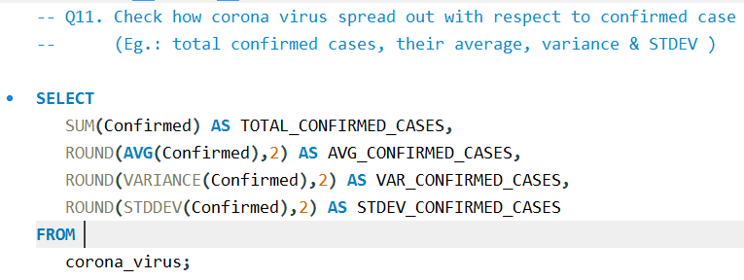
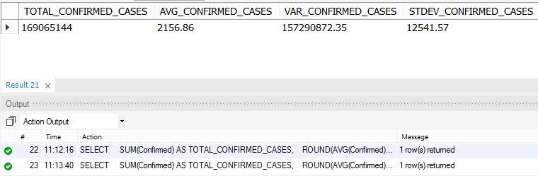
11. Check how corona virus spread out with respect to confirmed case.
Insights: Analyzing the total confirmed cases, their average, variance, and standard deviation shows how COVID-19 cases are distributed. These insights help understand the overall spread, consistency, and volatility of the pandemic's impact over time.

Slide 23
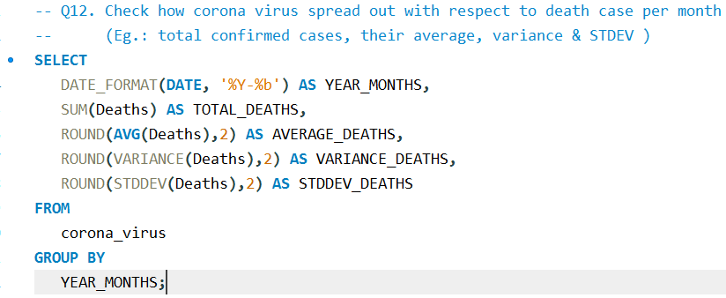
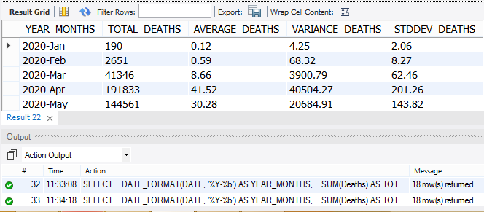
12. Check how corona virus spread out with respect to death case per month.
Insights: Analyzing the total deaths, their average, variance, and standard deviation per month reveals how fatalities are distributed. These insights help understand the overall spread, consistency, and variability of COVID-19's impact on mortality each month.

Slide 24
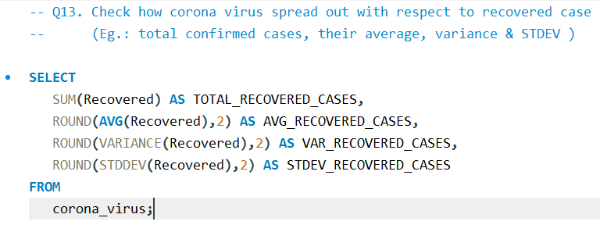
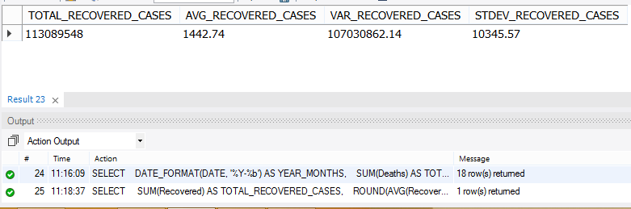
13. Check how corona virus spread out with respect to recovered case.
Insights: Analyzing the total recoveries, their average, variance, and standard deviation per month reveals how recoveries are distributed. These insights help understand the overall spread, consistency, and variability of COVID-19 recovery rates over time.

Slide 25
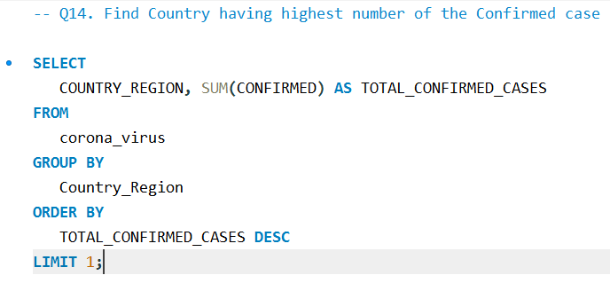

14. Find Country having highest number of the Confirmed case.
Insights: The United States has the highest number of confirmed COVID-19 cases, with approximately 33,461,982 cases reported. This reflects the significant impact of the pandemic in the country, highlighting the importance of ongoing efforts to mitigate its spread and manage its effects.

Slide 26
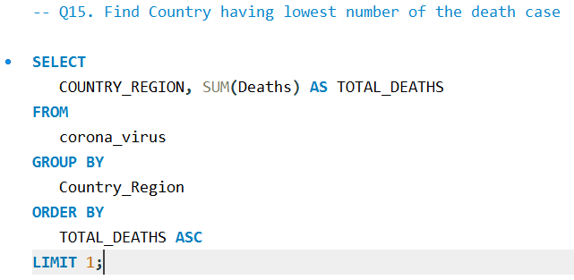

15. Find Country having lowest number of the death case.
Insights: Dominica stands out with the lowest number of reported COVID-19 deaths, recording none. This underscores the effectiveness of measures taken within the country to mitigate the impact of the pandemic and highlights the importance of proactive public health strategies in saving lives.

Slide 27
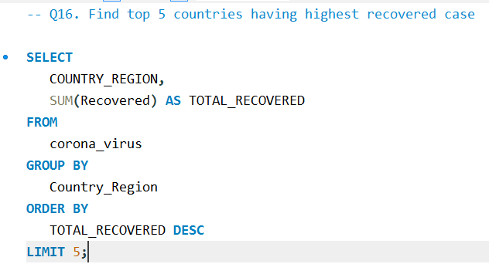
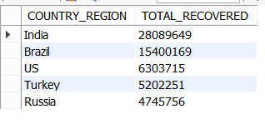
16. Find top 5 countries having highest recovered case.
Insights: India, Brazil, the US, Turkey, and Russia are the top five countries with the most people recovering from COVID-19. This shows that efforts to help people get better are working in these places. It also reminds us that fighting the virus requires everyone to work together worldwide.

Slide 28
THANKYOU

