Slide 1
Preliminary Investigation into Factors Influencing Gene Expression

Slide 2
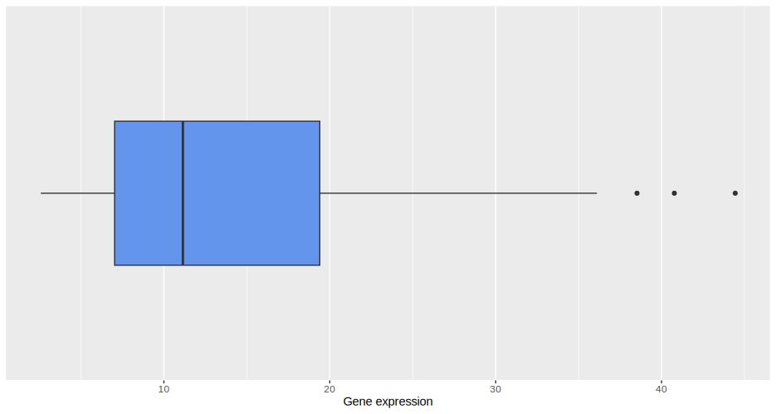
Gene Expression Boxplot and Table
Mean | Sd | Min | Q1 | Med | Q3 | Max
14.3 | 9.76 | 2.58 | 7.03 | 11.1 | 19.4 | 44.4

Slide 3
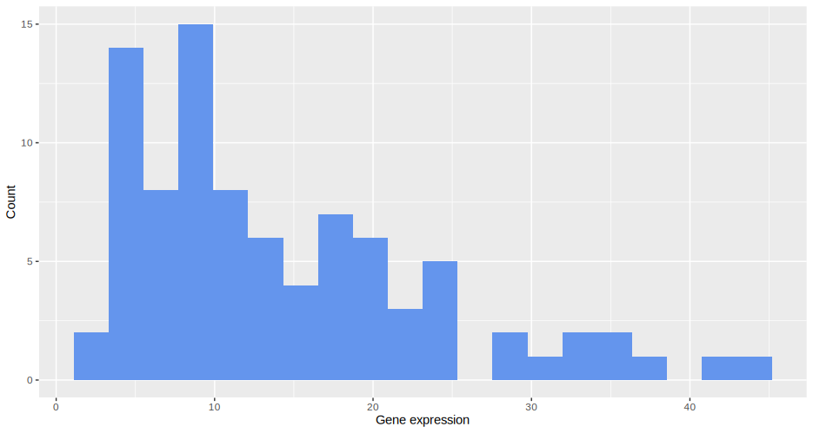
Gene Expression Histogram

Slide 4
Initial Analysis
The initial analysis shows that there are four primary relationships that significantly influence the gene expression
Cell line
Concentration
Both treatment and cell line
Both treatment and concentration

Slide 5
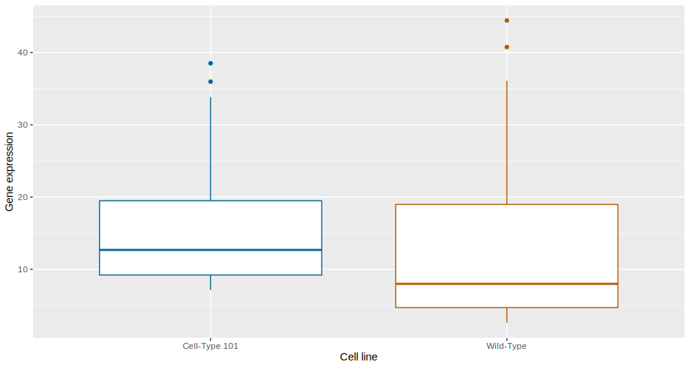
The effect of the cell line

Slide 6
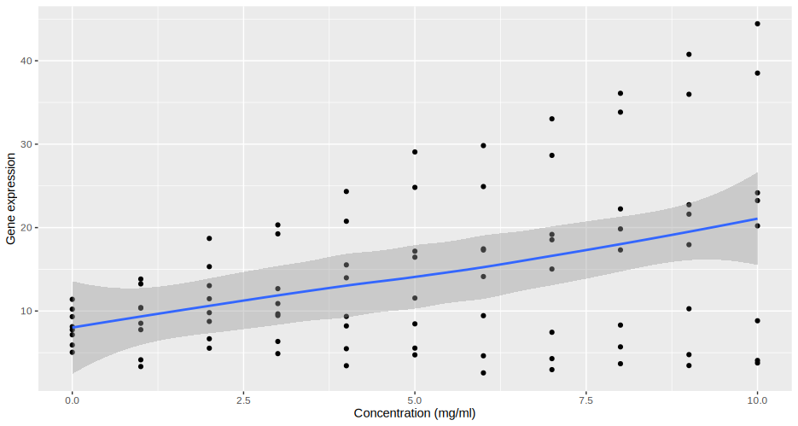
The impact of concentration

Slide 7
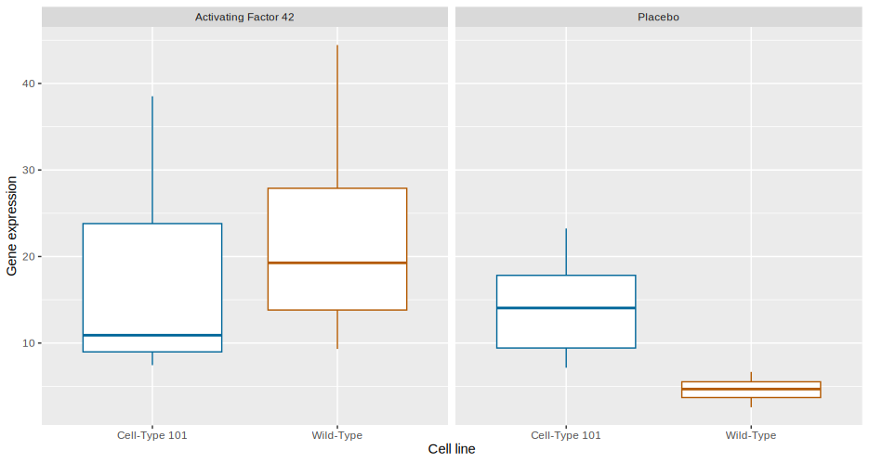
The interaction from treatment and cell type

Slide 8
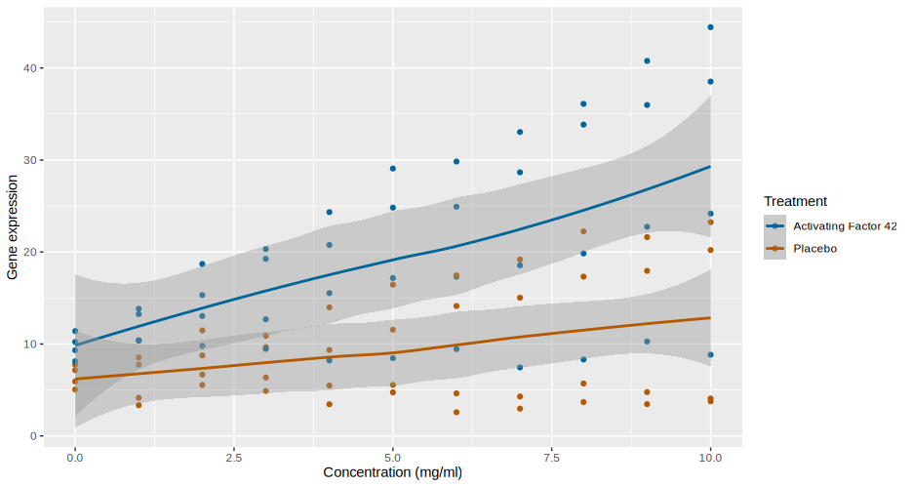
The influence of treatment type and concentration

