Slide 1
An Explainable Student Digital Twin for Teacher-Facing Learning Analytics
Aibyn Talgat · Astana IT University · [[Educational program]] · [[study period]]
Master's dissertation
Scientific supervisor: [[name, academic degree and title, affiliation]]

Slide 2
1. Relevance of the research / Актуальность исследования
• LMS store large volumes of learning activity, but their built-in analytics are descriptive — they rarely predict or explain student outcomes.
• Teachers need timely, interpretable, per-student insight to intervene early, not retrospective aggregate dashboards.
• Modern ML risk models are increasingly accurate but opaque ("black box"), which limits teacher trust and real adoption.
• An open question in learning analytics: do engineered "digital-twin" features actually beat a competent LMS baseline — and are the explanations stable enough to rely on?
• Reproducible, leakage-aware and honest evaluation (including negative results) is under-reported in the field.

Slide 3
2. The purpose and objectives of the research / Цель и задачи исследования
• Purpose:
– Design and rigorously evaluate an explainable, teacher-facing Student Digital Twin — a lean, time-aware weekly student-state representation with an XAI layer — and test whether feature richness improves prediction.
• Objectives:
– Build a versioned, leakage-aware weekly student-state data model and an end-to-end teacher-facing interface.
– Implement and compare a model family: Ridge / Linear, Logistic Regression, Random Forest, Gradient Boosting (grade and pass-risk).
– Run a nested feature ablation (A_simple → B_lms → B_lms+mastery → C_twin) on real public data.
– Add a perturbation-based XAI layer (permutation importance + local perturbation) and measure explanation stability (Kendall τ).
– Externally validate across two OULAD cohorts (DDD, BBB) and a second institution (KU Leuven).

Slide 4
4. Object and subject of research / Объект и предмет исследования
• Object:
– The process of teacher-facing learning analytics — predicting and explaining student academic progression from LMS interaction and assessment data.
• Subject:
– An explainable Student Digital Twin representation (lean weekly student-state features) and the predictive value plus explanation stability of its engineered features relative to a competent LMS baseline.

Slide 5
5. Scientific methods used / Применяемые научные методы. Initial data / Используемые исходные данные
Classification (pass) — OULAD DDD 2013J, student-grouped
• Methods:
– Supervised ML: Ridge/Linear (grade), Logistic Regression, Random Forest, Gradient Boosting (pass).
– Nested feature ablation with fixed-model comparison.
– Two splits: student-grouped (generalization) and temporal-forward (early warning).
– Perturbation XAI: permutation importance + local median-replacement.
– Stability: Kendall τ rank correlation + Jaccard top-k; bootstrap CIs.
• Initial data:
– OULAD DDD 2013J — 1,938 students, 67,830 weekly snapshots.
– OULAD BBB 2013J — 2,237 students, 80,532 weekly snapshots.
– KU Leuven 1819 — 1,495 students (engagement-only).
– Grain: 1 row = 1 student × 1 week.
Regression (final score) — RMSE, lower is better

Slide 6
n1. Conclusions on the scientific work done for each task / Выводы по проделанной научной работе по каждой задаче
Ablation — gradient boosting RMSE (lower is better)
• Data model & UI: a leakage-aware weekly Student Digital Twin and an end-to-end teacher interface were built (reproducible pipeline).
• Models: all four families reach F1 0.85–0.86 and ROC-AUC 0.95 on DDD — the pass target is genuinely predictive (never F1 = 1.0).
• Ablation (right): engineered Twin value is course- and split-dependent, not robust. Mastery helps only on BBB temporal-forward (6.31 → 5.28 RMSE); on DDD and on student-grouped splits it is null.
• XAI: explanations are interpretable but regime-sensitive (see Conclusion).
• External check: across 2 OULAD cohorts + KU Leuven, added feature richness does not robustly improve prediction.

Slide 7
6. Results of the implementation of the IMWP / Результаты выполнения ИПРМ
1. Scientific internships / Научная стажировка
№ | Internship organization / Место прохождения стажировки | Period / Сроки | Results / Результаты | Mark / Отметка
1 | [[organization]] | [[dates]] | [[results]] | [[ ]]
2. Plan for publishing scientific papers / План издания научных публикаций
№ | Title of the article / thesis Наименование статьи / тезиса | Publication / conference Издание / конференция | Completion dates / Сроки | Mark / Отметка
1 | Does Feature Richness Help? A Reproducible, Honest Evaluation of a Student Digital Twin and Its Explanation Stability Across Two Institutions | IEEE SIST 2026 — Computational Intelligence track (Applications of CI in Education) | [[submission date]] | In preparation

Slide 8
n2. Author's publications and the master student's personal contribution / Публикации автора и персональный вклад магистранта
• Publication (in preparation): A. Talgat. "Does Feature Richness Help? A Reproducible, Honest Evaluation of a Student Digital Twin and Its Explanation Stability Across Two Institutions." Target: IEEE SIST 2026, Computational Intelligence track.
• Personal contribution of the master student:
– Conceived the research question and the falsifiable, dependency-driven experiment design.
– Built the full reproducible, leakage-aware pipeline (data model, models, ablation, XAI).
– Ran all experiments on OULAD DDD/BBB 2013J and KU Leuven 1819 and produced the frozen artifacts.
– Performed the explanation-stability analysis (Kendall τ) and wrote the manuscript.
• [[Add co-authors and their contribution share if applicable]]

Slide 9
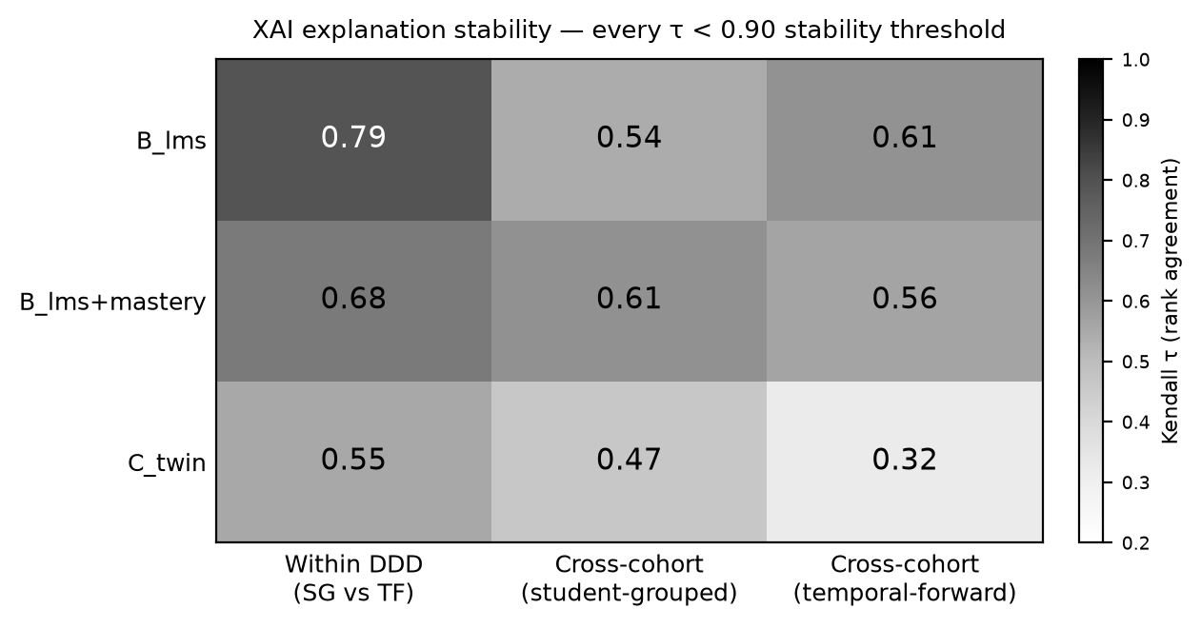
Conclusion / Заключение
• The full Digital Twin was not justified: engineered feature richness does not robustly beat a competent LMS baseline.
• The finding is honest and heterogeneous across 2 OULAD cohorts + 2 institutions — course- and split-dependent, not a uniform win.
• XAI explanations are interpretable but regime-sensitive: Kendall τ 0.55–0.79 within a course, 0.32–0.61 across cohorts — every value below the 0.90 stability bar (heatmap).
• Contribution is methodological and cautionary: a reproducible, leakage-aware protocol + teacher UI + a documented synthetic-target circularity failure mode — not an accuracy record.

