Slide 1
Factors of Crime Index in U.S.
We will focus on two most widely-debate factors:
• Population
• Rate of firearm ownership
Expected result:
• Crime rate and population are corelated.
• Crime rate and rate of firearms ownership are corelated
Null Hypothesis:
• Crime rate and population are not corelated.
• Crime rate and rate of firearms ownership are not corelated.
PRESENTED BY: Yuze Li
17 Aug Wed

Slide 2
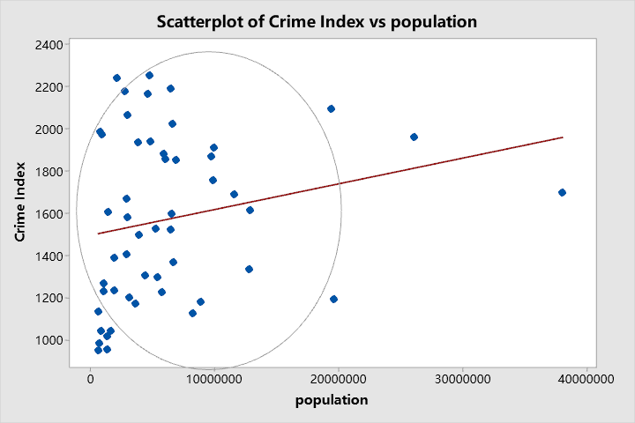
About the research:
• Data Resources: https://data.gov
--- U.S. Crime Index State Rank
--- U.S. Firearm ownership rate
--- U.S. Population 2021
• Sample size: 51 states of the U.S. (and improvement…)
• Data Visualization … (boxplot, bar chart, scatter plot, linear(quadratic) fit… )
---box plot: Recognize the outliers
---bar chart: Visualize how to crime rate will change while the independent variable is increasing(expected an increasing crime rate).
--- scatter plot
--- linear(quadratic) fit: Show more accurate trend of crime rate.

Slide 3
• Null Hypothesis …
• Expected results …
• Methodology correlation analysis (r)
• Significance … (Prove with data, but not discussion…)
--- Choose where to live…
• Evaluate this research … (limitation and challenges…)
--- Difference of population probably leads to other differences which will impact on crime index
--- The statistical error ( unlicensed gun…)

Slide 4
Thank you for listening!

