Slide 1
Deployment of Commune
Team: winwinwin

Slide 2
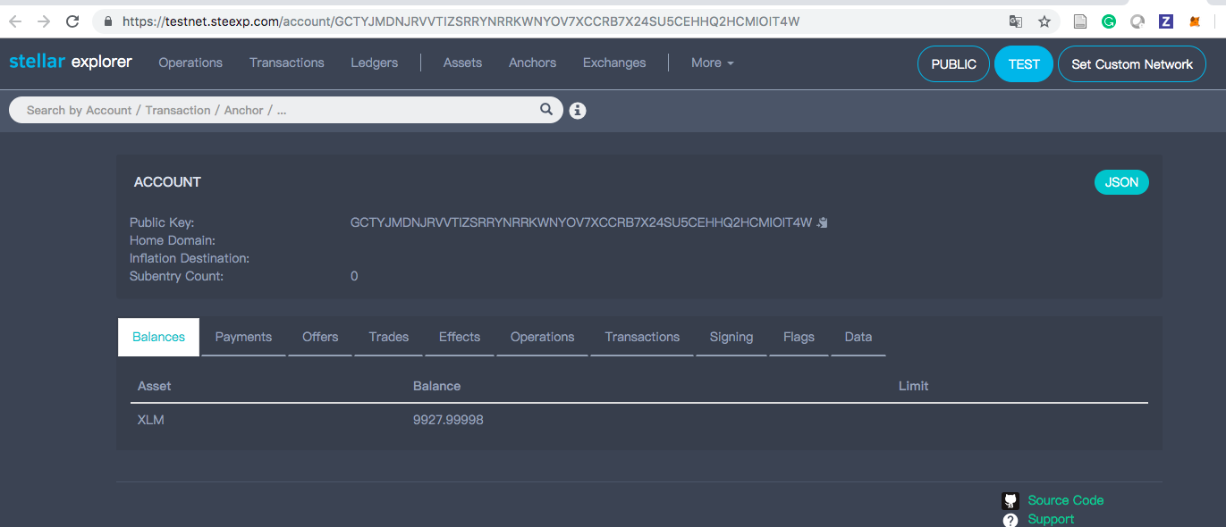
Test Account

Slide 3
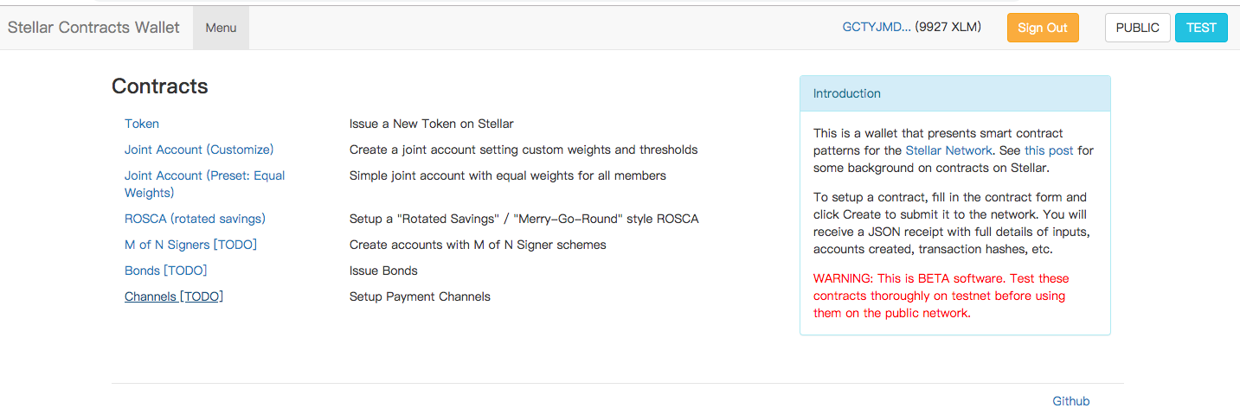
Dapp

Slide 4
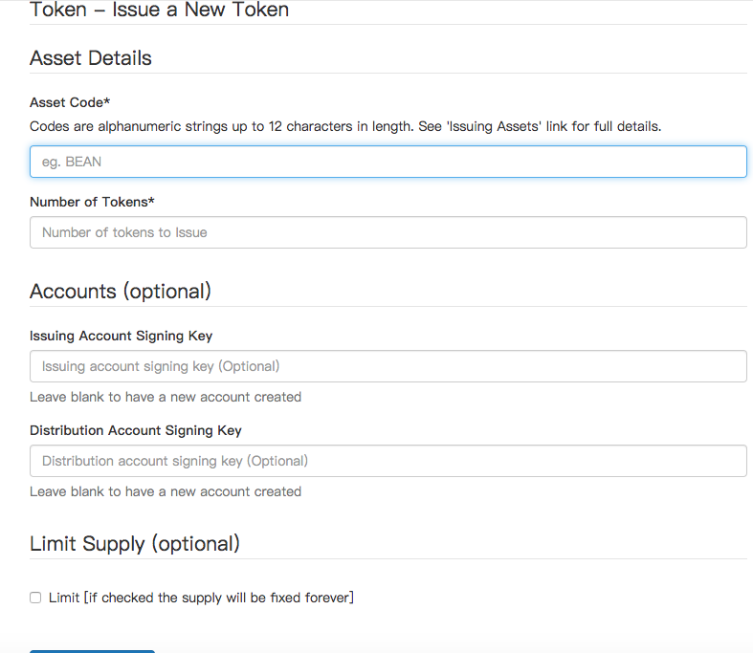
Token Issuance

Slide 5
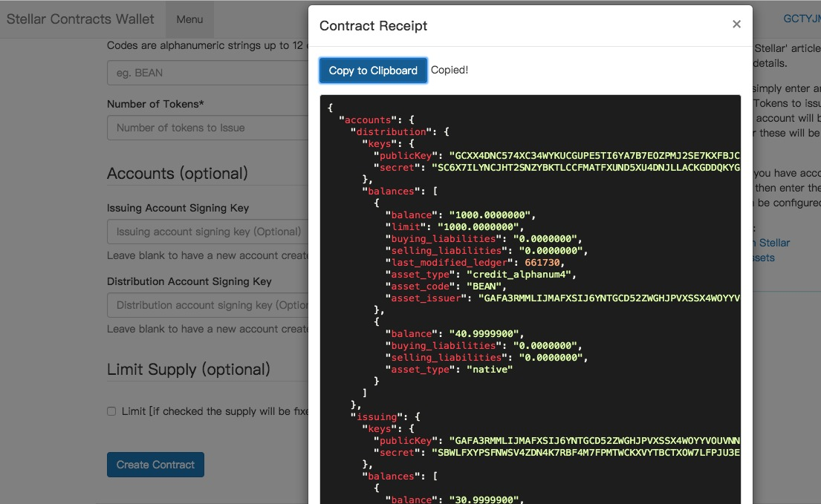
Receipt

Slide 6
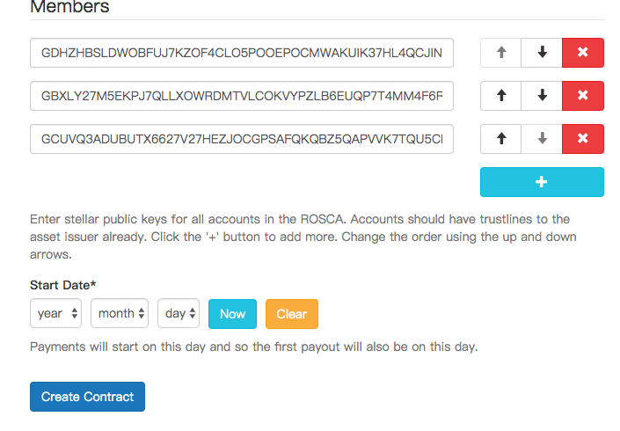
Deposit

Slide 7
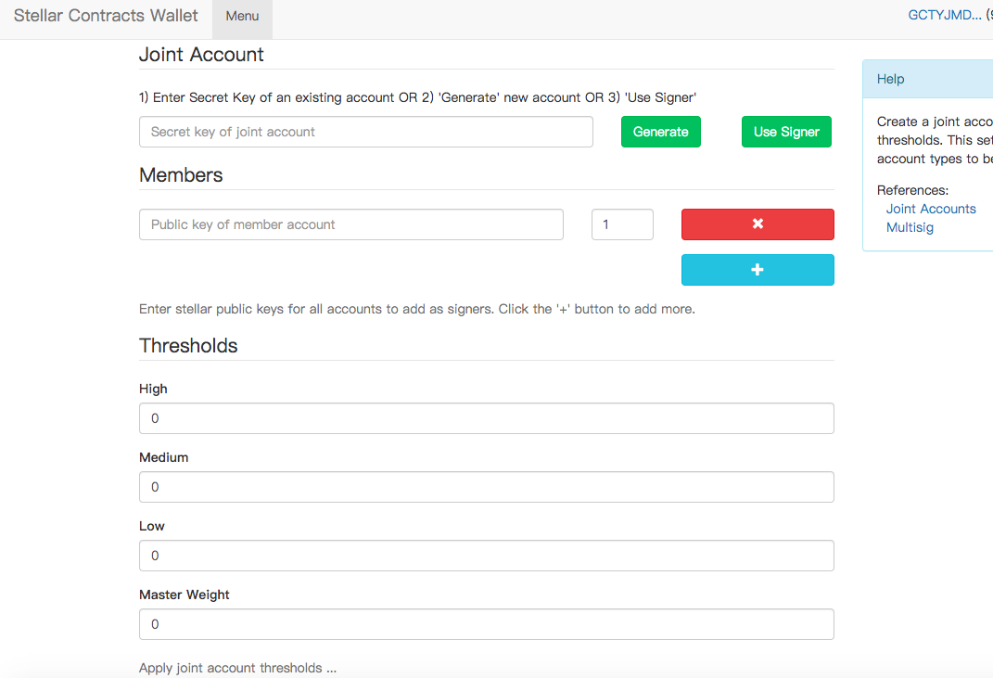
Account Operation

Slide 8
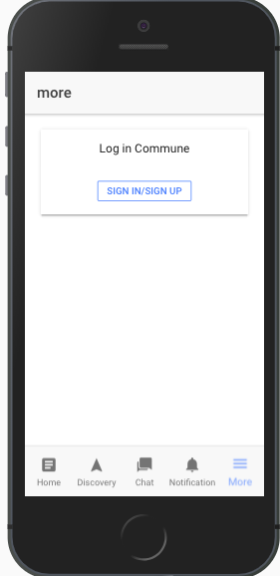
Commune Mobile App

Slide 9
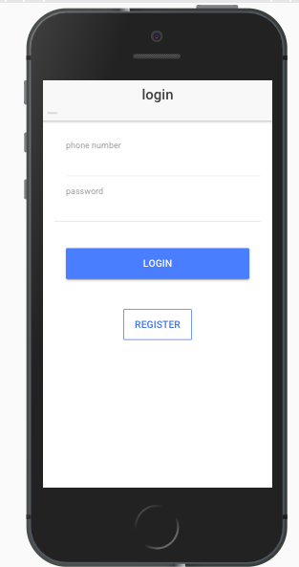
Login

Slide 10
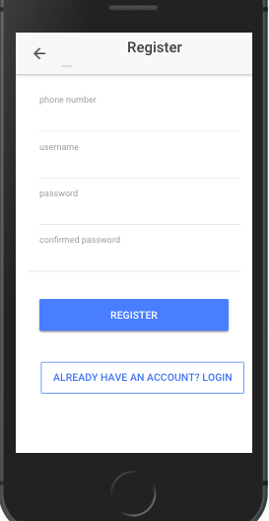
Reg.

Slide 11
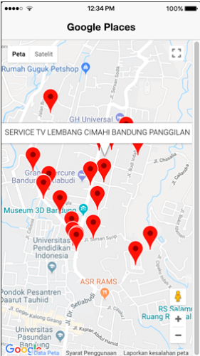
Accept shop shown

Slide 12
Reference
https://developers.google.com/maps/documentation/embed/guide
https://www.djamware.com/post/5a99e68380aca714d19d5b9a/places-searches-using-ionic-3-angular-5-and-google-maps-and-places-apis
https://github.com/a190884810
https://www.stellar.org
https://www.stellar.org/developers/horizon/reference/index.html

