Slide 1
Exploring the Chicago Crime Scene
Alejandro Garcia
Foundations of Data Science in R

Slide 2
Introduction & Motivation
For the past years, Chicago has been considered one of the most dangerous cities in the US. The motivation behind this project is to help the Chicago Police Department make better decisions with the use of data. Its important for them to receive key insights from this dataset

Slide 3
Data Wrangling
The dataset for this project can be found here: https://www.kaggle.com/currie32/crimes-in-chicago
This dataset is pretty clean but there were few modifications like eliminating missing values and changing categotical data to numerical

Slide 4
Data Description
The following slides represent in graphs the most common columns of the dataset

Slide 5
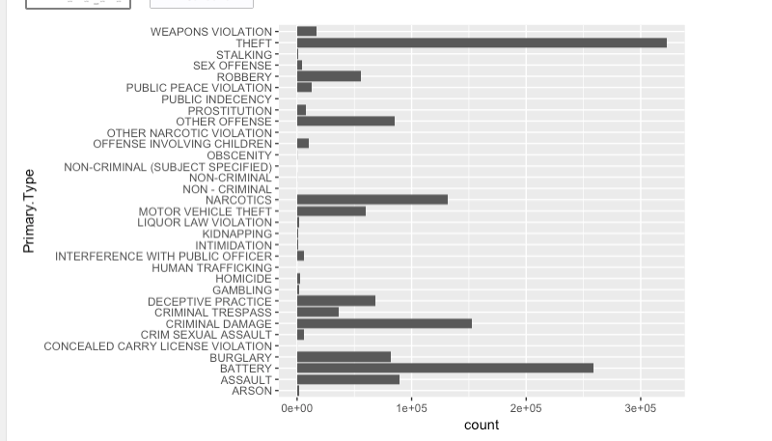
Primary Type
It is clear from this graph that the most common types of crimes are
Theft
Battery robbery
Criminal damage
Narcotics

Slide 6
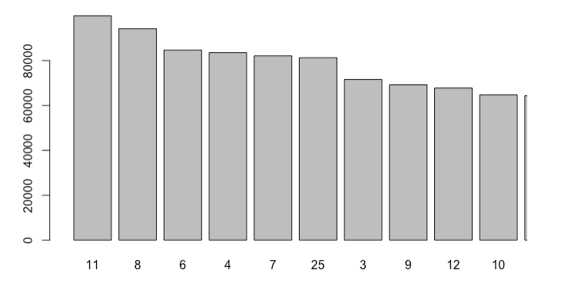
district
The most common Districts where crimes occur
District 11
District 8
District 6
District 4
District 7

Slide 7
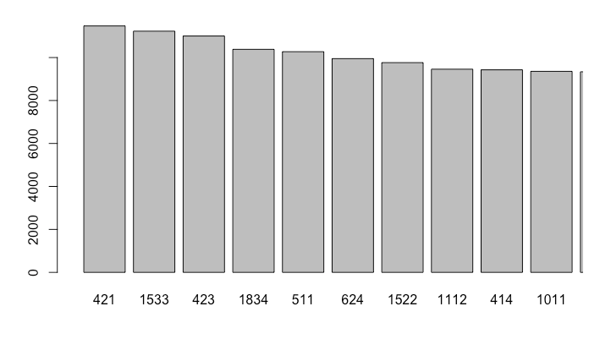
beat
Most common beat (a small police geographical area)

Slide 8
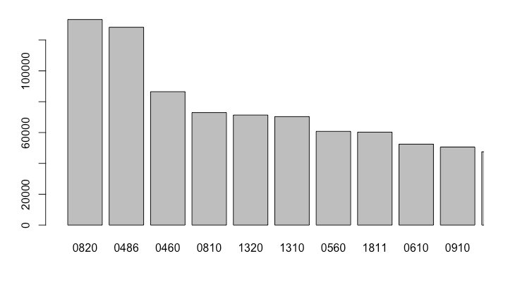
iucr
The most common IUCR Codes
Theft of $500 and under
Domestic battery
Battery robbery
Damage to property

Slide 9
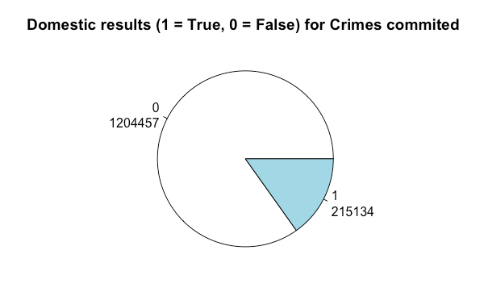
Domestic results
Out of all the crimes, only about 15% where domestic

Slide 10
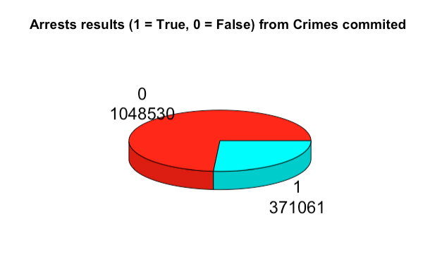
Arrests
Out of all the crimes committed, only 26% of the crimes resulted in an arrest

Slide 11
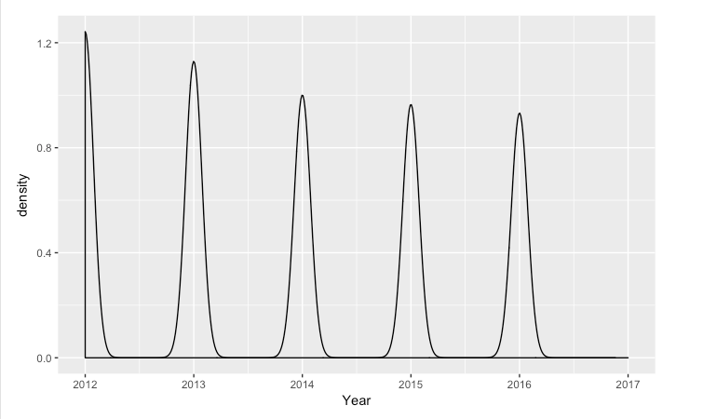
Crimes in each year
From this density plot we can observe how crimes have decreased since year 2012, however it has not decreased drastically from 2014-2016

Slide 12
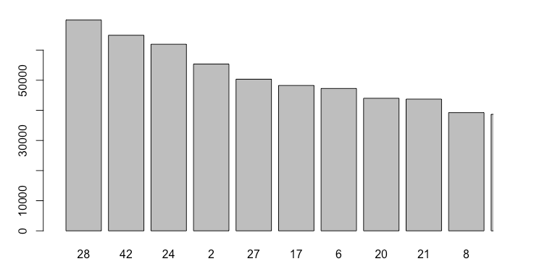
ward
The Ward is simply the City Council District where the crimes occurs

Slide 13
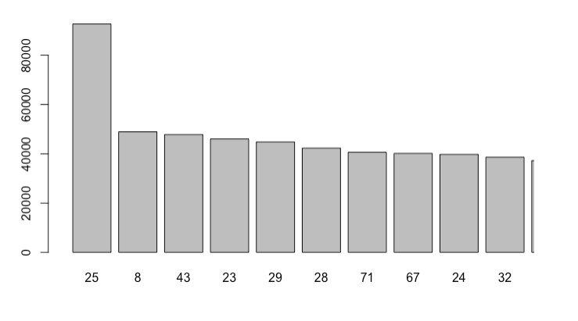
Community area
The most common Areas where crimes occur in Chicago

Slide 14
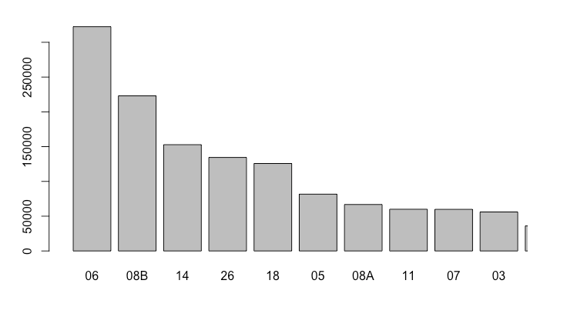
Fbi code
The most common FBI Codes
Larceny
Simple Battery
Vandalism

Slide 15
Results
From the previous graphs we were able to obtain significant information like:
Most common type of crimes
Decrease in crime rate from year 2012-2017
Crimes that resulted in Arrests
Top IUCR Codes
Most common areas where crimes occur
Top FBI Codes

Slide 16
Recommendations
Based on the analysis done on the Chicago crime scene data set, we are able to offer several recommendations to the Chicago Police Department
Focus on the most common types of crimes in order to prevent them
More arrests have to be made per crime, only 26% of the criminals where arrested
Theft of $500 in the streets is very common, definitely have more patrols going around the area
Set a specific perimeter for the areas where crime scene is extremely high

