Slide 1
Incentivising charity accountability
Diarmuid McDonnell, Univ. of Birmingham
Alasdair Rutherford, Univ. of Stirling

Slide 2
Context
The behaviour of charitable organisations, and their willingness to be accountable, is a pressing policy issue in the UK.
Some evidence of how charities respond to regulatory incentives/interventions but mainly focused on financial thresholds and mandatory reporting requirements.
Abundance of “data in the wild”.

Slide 3
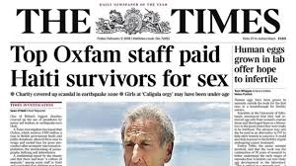


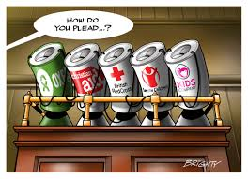
Oxfam Scandal

Slide 4
Regulatory Responses
The UK charity regulators responded in an immediate and direct manner.
On 14 February 2018 the Scottish regulator sent an email providing detailed guidance for charities with regards to two key issues: safeguarding, and reporting serious incidents.
  strongly advised to address serious incidents “vigorously and transparently”.
CCEW and CCNI responded similarly.

Slide 5
Serious Incident Reporting (SIR)
All three UK charity regulators operate a SIR scheme:
  Scotland (2016)
  England & Wales (2008)
  Northern Ireland (2017)
Not a legal requirement but strongly encouraged.
Fraud & theft, criminal activity, disqualified trustees, safeguarding.

Slide 6
Aims
What effect did the Oxfam scandal have on the willingness of charities to be transparent or accountable? [General]
Did regulatory interventions in the wake of the Oxfam scandal increase the reporting rate of serious incidents? [Specific]

Slide 7
Research Design
RQ1: Were regulatory calls to action an effective incentive for the sector to increase its serious incident reporting rate?
RQ2: Did the impact of this incentive vary across jurisdictions?
Interested in identifying a causal effect: quasi-experimental research design.

Slide 8
Interrupted Times Series (ITS)
ITS estimates causal effect of a large-scale intervention on an outcome:
  Policy change occurring at a particular point in time.
ITS analysis divides a time series into two segments and employs regression to “measure statistically the changes in level and slope in the postintervention period compared to the preintervention period” (Penfold & Zhang, 2013, p. S39).

Slide 9
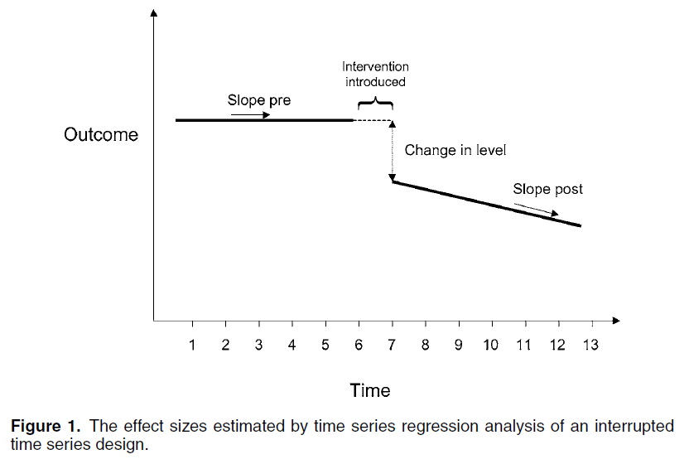
Interrupted Times Series (ITS)

Slide 10
Interrupted Times Series (ITS)
Strengths:
  Controls for the secular trend.
  Conduct analyses on population rates.
  Conduct stratified analyses.
  Analyse unintended consequences
  Clear and easy-to-interpret graphical results.
Limitations:
  At least 8 observations pre and post intervention.
  Difficult to find suitable control/comparison cases.
  Cannot make inferences about individual level outcomes from population rates.

Slide 11
Interrupted Times Series (ITS)
A robust, unbiased estimate of a causal effect once the following are accounted for:
  Secular trend (i.e. correct functional form)
  Seasonality or cyclicality
  Duration of the intervention
  Competing contemporaneous interventions
  Random variation
  Autocorrelation

Slide 12
Interrupted Times Series (ITS)
Yt = B0 + B1Tt + B2Xt + B3XtTt + et
We estimate our ITS statistical model using the itsa package in Stata 15 (see Linden, 2015).

Slide 13
Data
SIR data for Scotland: Apr 2016 – May 2018
221 charities have submitted 240 reports concerning 287 serious incidents in the first 26 months of the scheme.
Aggregate organisational level data to construct population level time series:
  Number of serious incident reports per month.

Slide 14
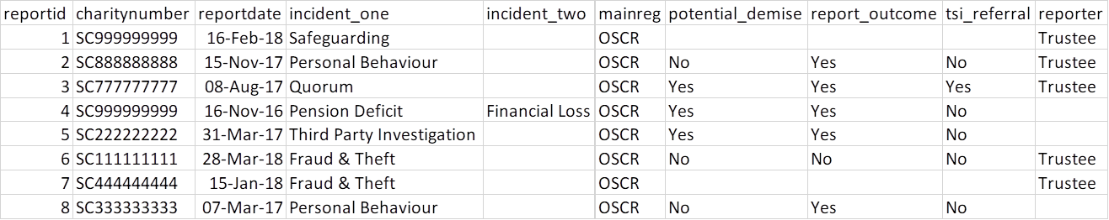
Data

Slide 15
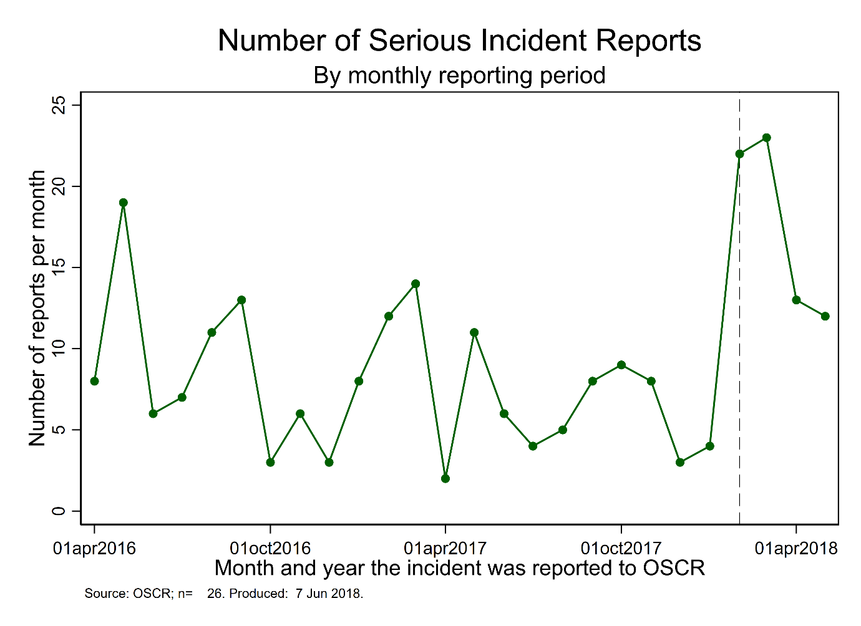
Results

Slide 16
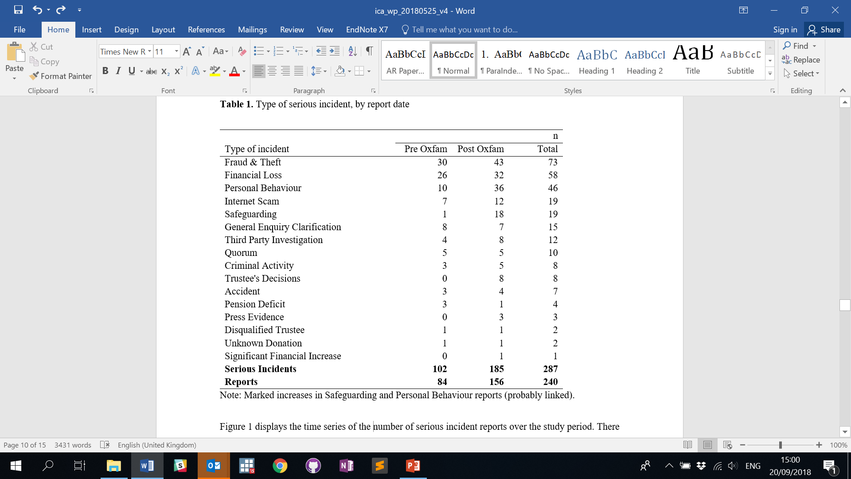
Results

Slide 17
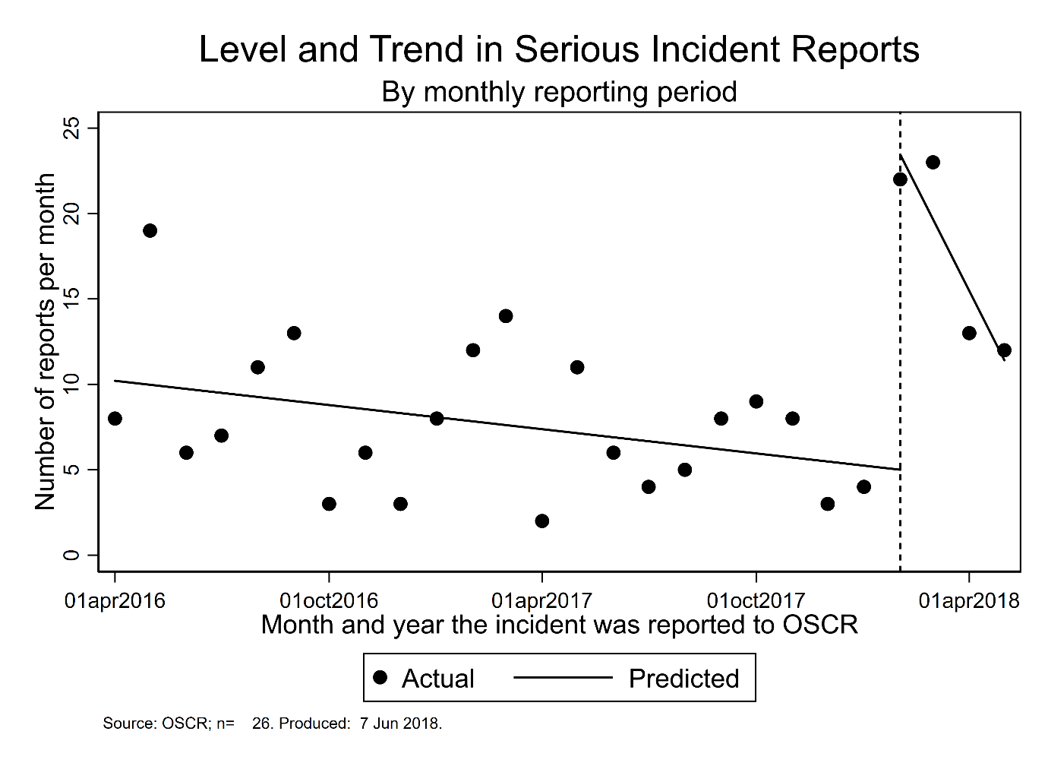
Results

Slide 18
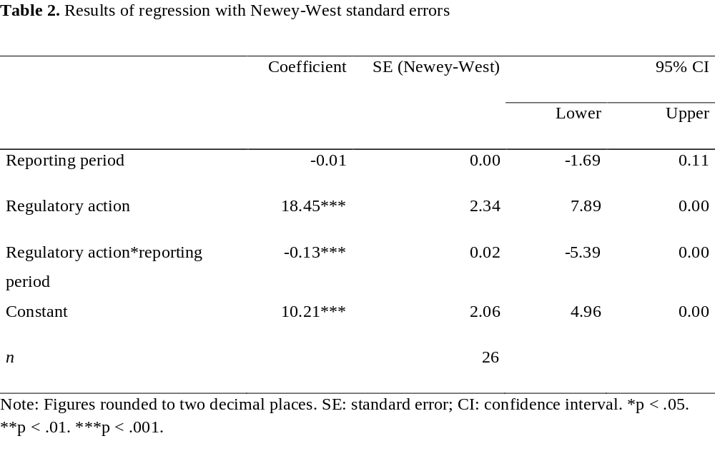
Results

Slide 19
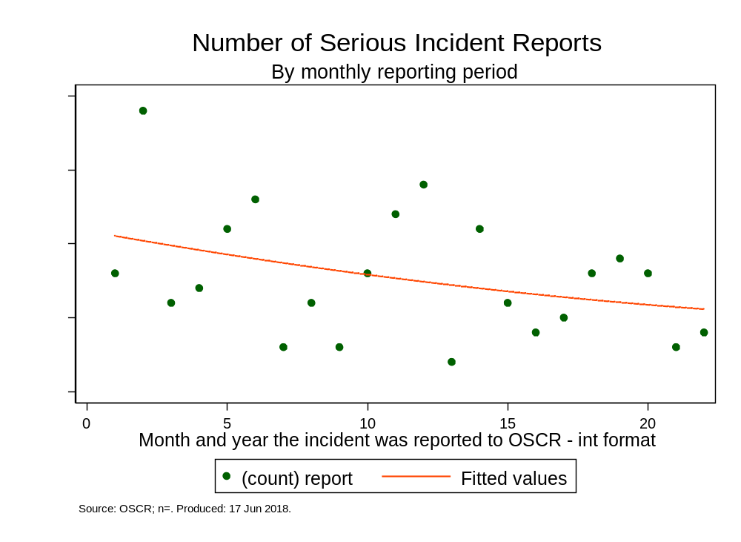
Diagnostics
Functional form

Slide 20
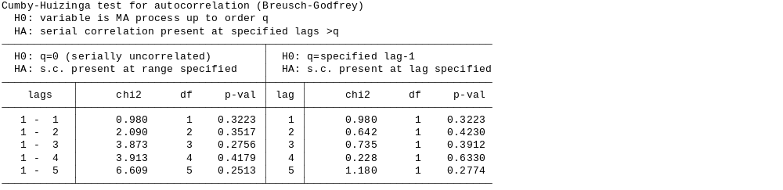
Diagnostics
Autocorrelation

Slide 21
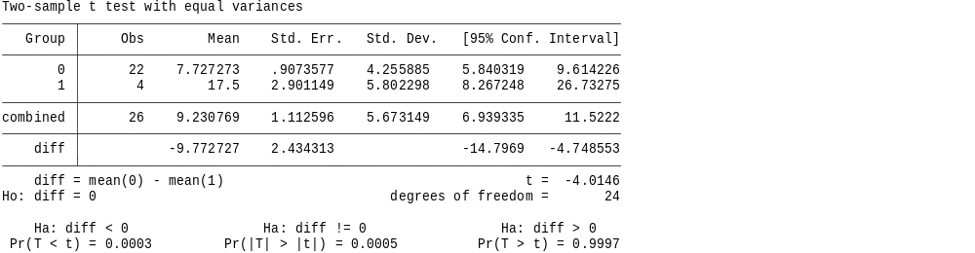
Diagnostics
Difference in mean outcomes

Slide 22
Next Steps
Procure further data from OSCR, CCNI and CCEW – 31/03/2019.
Further diagnostics:
  Competing contemporaneous interventions
  Alternative estimators
  Test different intervention periods
Logit/mlogit modelling of types of incidents reported.
Share repository of syntax and data.

Slide 23
Further Information
https://diarmuidm.github.io/
First paper: https://bit.ly/2wbGJBI
OSCR and other charity regulators are increasingly engaging in open data initiatives:
  Scotland [https://bit.ly/2NVJXUZ]
  England and Wales [https://bit.ly/1MP3vln]
  Northern Ireland [https://bit.ly/2pnHl4h]
  Republic of Ireland [https://bit.ly/2ppBnQg]

