Slide 1
The Gender Pay Gap for Nonprofit Executives: Identification and Potential Remediation.
Nonprofit Data Virtual Seminar Series
Nathan Grasse
Jesse Lecy

Slide 2
Women represent 70% of the nonprofit workforce, but hold a minority of leadership positions. (1) Does the gender pay gap exist for executives? (2)How big is it? (3) What can be done about it?

Slide 3
Evidence of a Gender Pay Gap for Nonprofit Directors and Chief Financial Officers: New Panel Estimates
Nathan Grasse
Brianne Heidbreder
Sharon Kukla-Acevedo
Jesse Lecy

Slide 4
Origins of the Pay Gap
High-Paying Firms
Low-Paying Firms
Female Candidates
Male Candidates
Explicit, Implicit bias (glass ceilings)
Grooming (glass walls)
Gender norms
Caretaker obligations

Slide 5
Data
Compensation: IRS E-File Data
Nonprofit Characteristics: NCCS
Gender Codes: Social Security Administration

Slide 6
The IRS 990 E-Filer Data
2010: The IRS began accepting electronic 990 submissions
2015: Lawsuit regarding FOIA Requests
2016: E-file data was released in as XML files on AWS

Slide 7
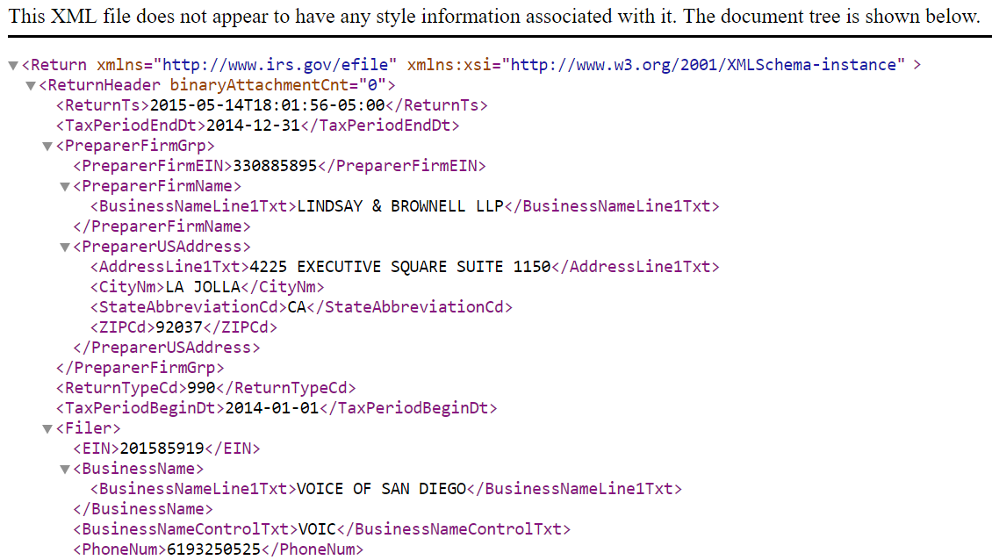
XML Documents

Slide 8
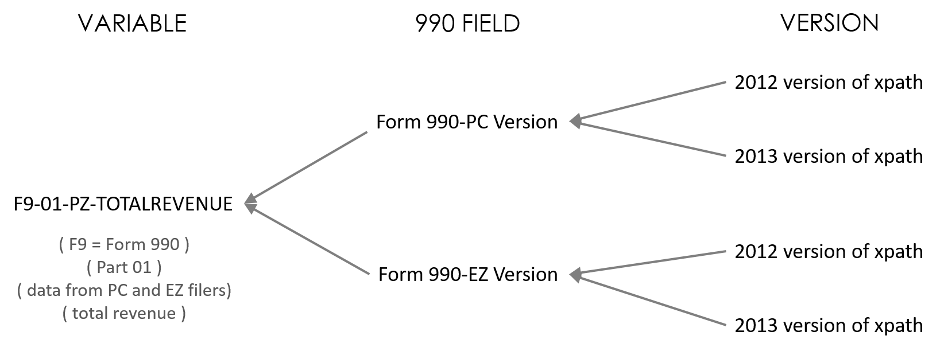
Master Concordance File: Grouping Xpaths by a Common Variable

Slide 9
Data for one variable might be located at multiple “addresses” (xpaths)
The variable name includes information about the form and part of the variable, and what forms include that variable (the scope)

Slide 10
XPATHs
“Path” (address in XML doc)
Variable Name
"//Return/ReturnData/IRS990/CYProgramServiceRevenueAmt
Data in XML File

Slide 11
EXAMPLE USE: Current Year Program Service Revenue
## COPY AND PASTE XPATHS FROM IRS SPREADSHEET
V_990CPSRpost2013 <- "//Return/ReturnData/IRS990/CYProgramServiceRevenueAmt"
V_990CPSRpre2013 <- "//Return/ReturnData/IRS990/ProgramServiceRevenueCY"
V_990CPSR.EZpost2013 <- "//Return/ReturnData/IRS990EZ/ProgramServiceRevenueAmt"
V_990CPSR.EZpre2013 <- "//Return/ReturnData/IRS990EZ/ProgramServiceRevenue"
psr.current.xpath <- paste( V_990CPSRpost2013, V_990CPSRpre2013,
V_990CPSR.EZpost2013, V_990CPSR.EZpre2013, sep="|" )
## GRAB THE DATA FROM THE XML DOC
PSRCURRENT <- xml_text( xml_find_all( doc, psr.current.xpath ) )
## STANDARDIZE THE DATA THROUGH PRODUCTION RULES
PSRCURRENT <- changeMissingToZeros( PSRCURRENT )
4 Versions of the Same Variable:
PC and EZ; Pre and Post 2013 Changes

Slide 12

academics, aspen institute, charity navigator, guidestar, chronicle of philanthropy, pro publica

Slide 13
Panel of ED and CFO Salary Data
We isolate leadership transitions
Use years t-1 and t+1
Old Director
NewDirector
Year = t-1
Year = t
Year = t+1
Overlap Year

Slide 14
How to code gender for 12 million directors and boards members?

Slide 15


Slide 16
Gender Package in R
https://lecy.github.io/arnova-2017-workshop/workshop/coding_gender.html#coding_titles

Slide 17
Form 990 – Part VII: Board & Managers
PAT TRUJILLO
SANDY SZABAT
MS. SUSAN ARMENDARIZ
DR. BRIAN PARKHILL
REV. CLINT SINGLEY
LCDR RONALD MCCAMPBELL
1 KIM MORRISON
2 SAMUEL HERNANDEZMORENO

Slide 18
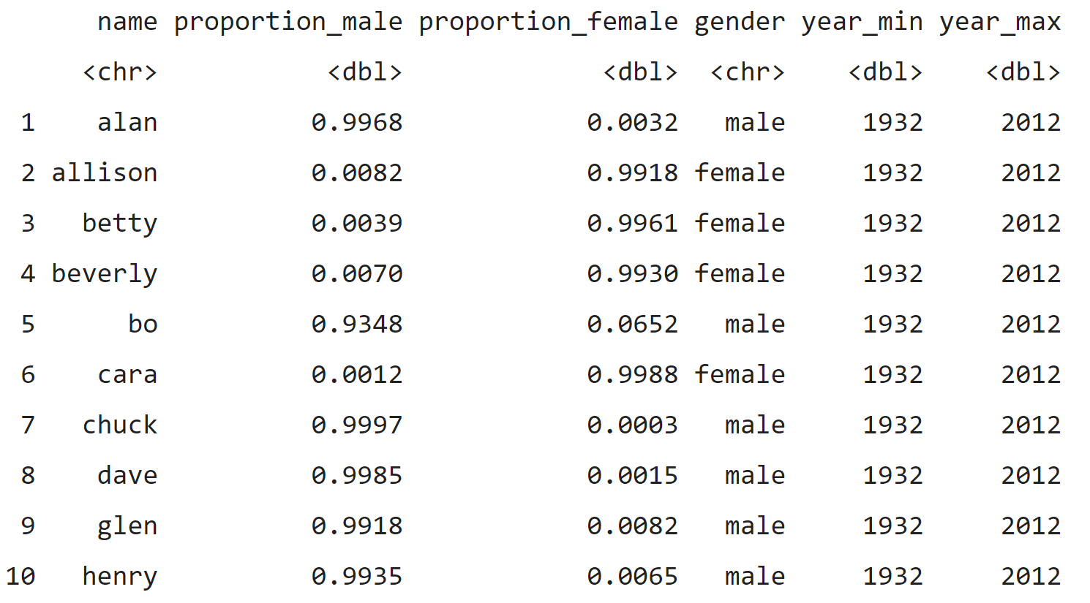

Slide 19
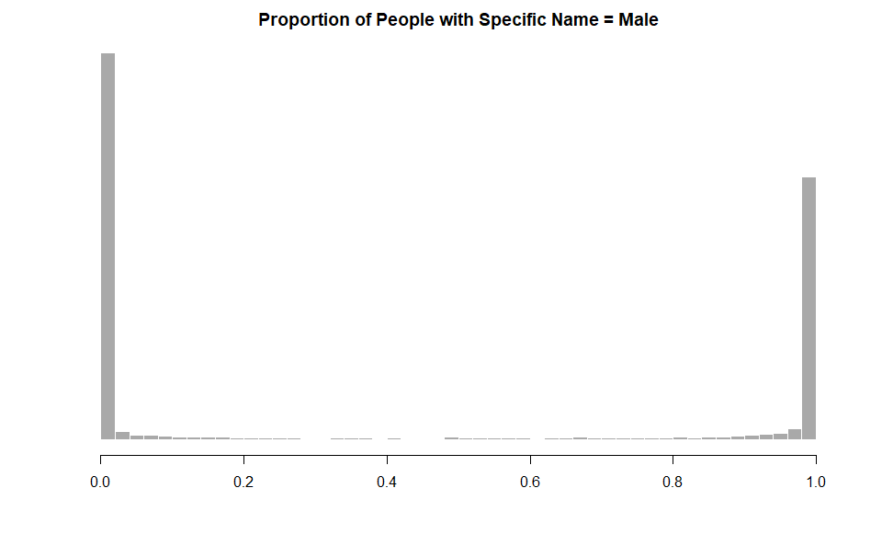
99% of Lindas are female
99% of Trevors are male
Devons and Traceys are more ambiguous, but they make up a small part of the data
female
male

Slide 20
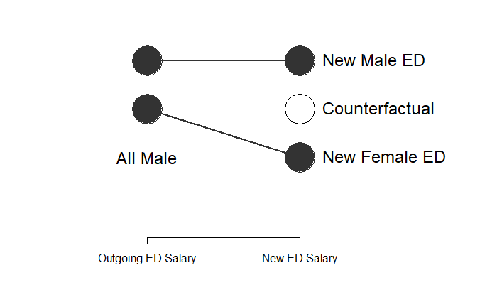
Estimating the Pay Gap for NP Directors
Pay Gap

Slide 21
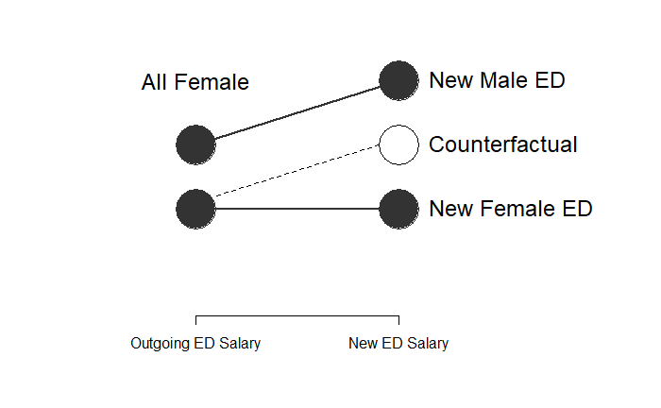
Pay Gap

Slide 22
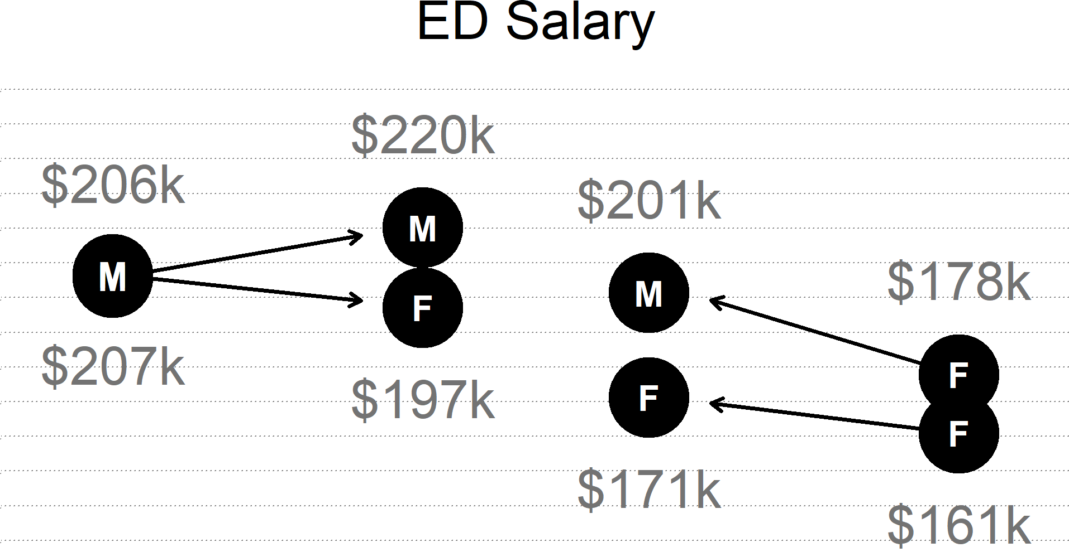
Pay Gap:
Expected: $207 + (220-206) = $221
Actual: $197
Gap: $221 - $197 = $24 = 11.6%

Slide 24
Results:
Pay Gap for Eds: 11%
Pay Gap for CFOs: 11%

Slide 25
Are there best practices for reducing the pay gap?

Slide 26
Do Female Board Members Reduce the Gender Pay Gap?
Leonor Camarena
Jesse Lecy
Nathan Grasse

Slide 27
Critical Mass Theory
Kanter, R. M.: 1977, Men and Women of the Corporation (Basic Books, New York).
Kanter, R. M.: 1977, ‘Some Effects of Proportions on Group Life’, American Journal of Sociology 82(5), 965– 990.

Slide 28
$Pay Gap= \frac{Salary − Male Counterfactual }{Salary}$
$${salary}_{t+1}=b_{0}+b_{1}{male}_{t+1}+b_{2}{salary}_{t−1}+Xβ+ε$$

Slide 29
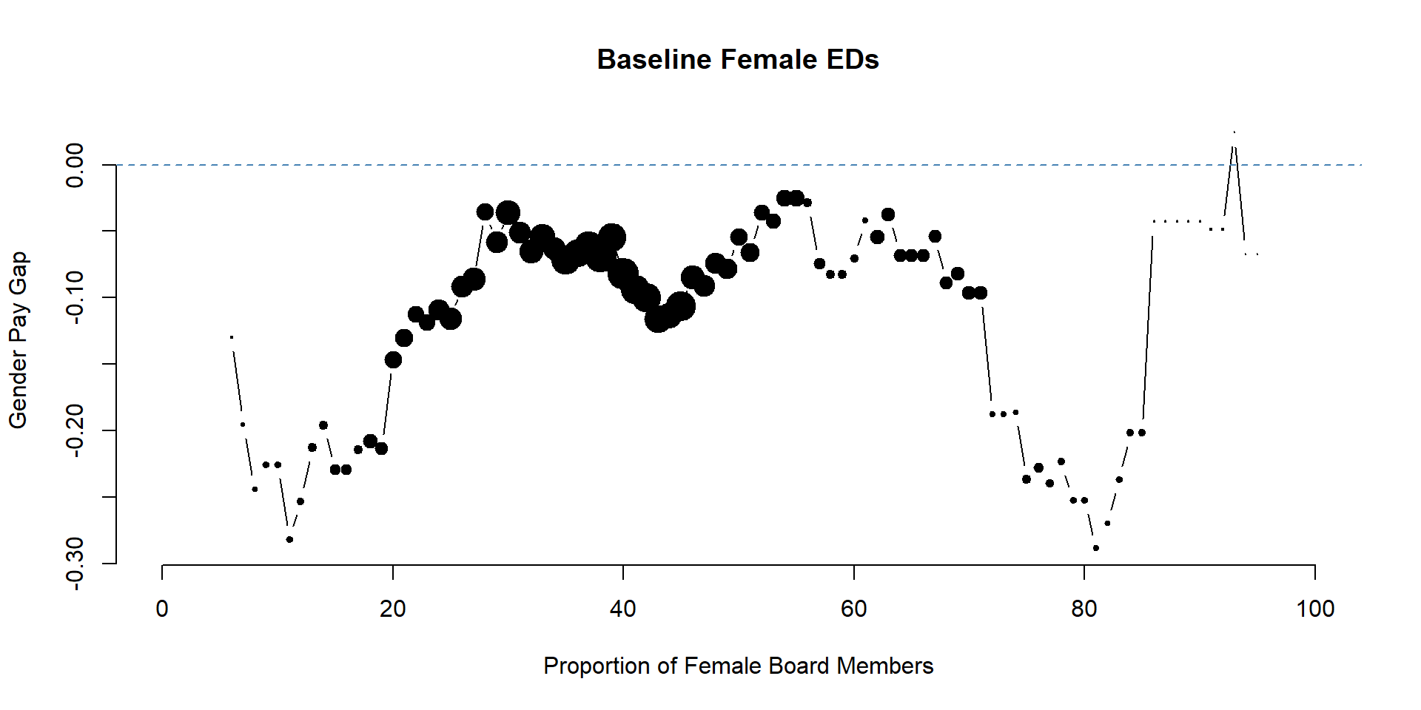

Slide 30
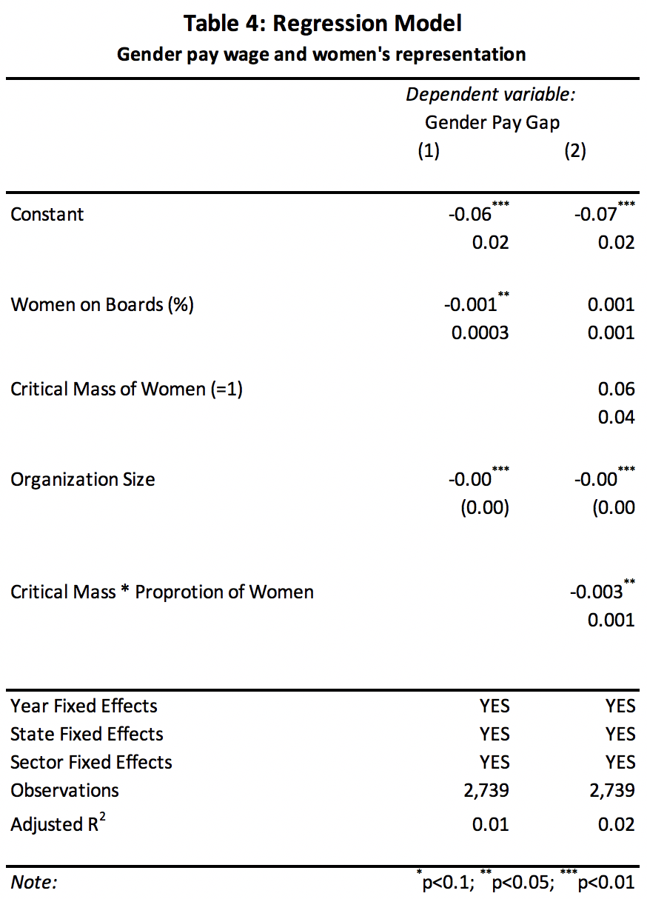

Slide 31
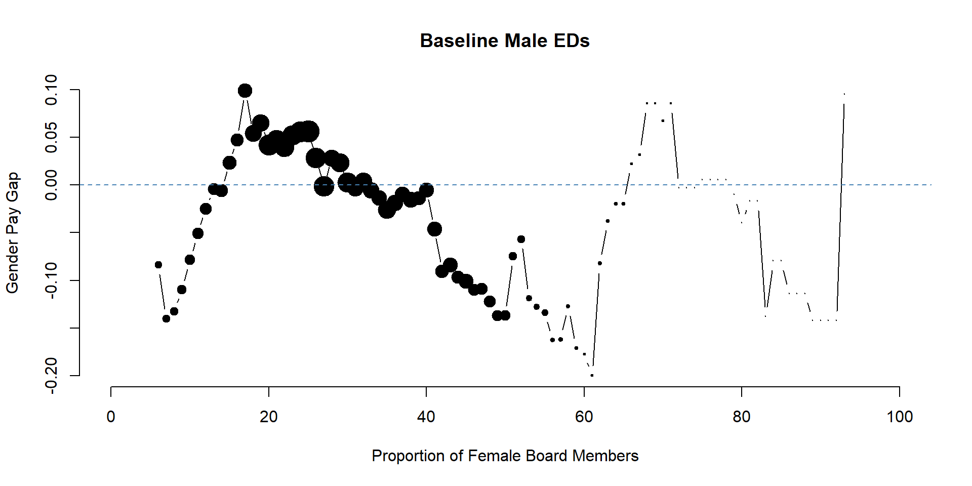

Slide 32
Compensation Best Practices
Nathan Grasse
Jesse Lecy

Slide 33
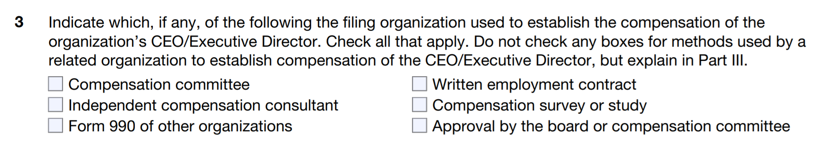
Data: 990 - Schedule J

Slide 34
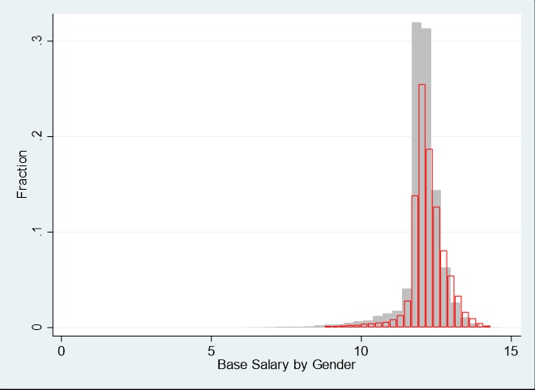
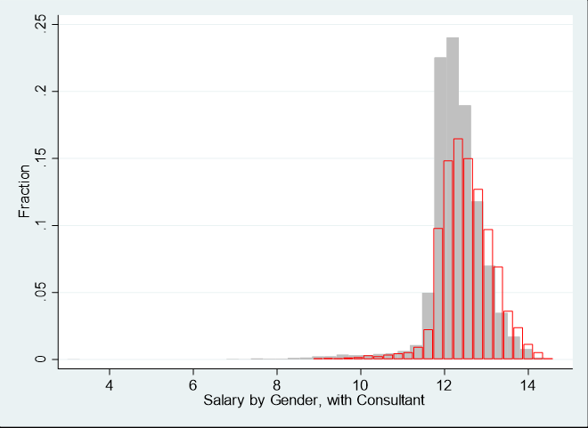
Salary Surveys vs. Consultants

Slide 35
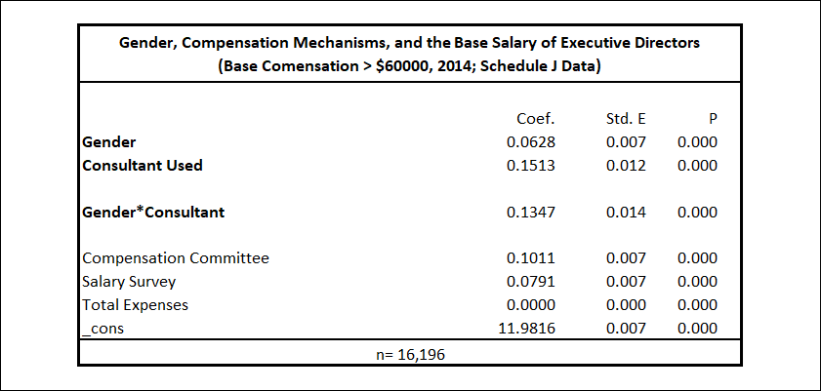
Salary Surveys vs. Consultants

Slide 36
Questions?

