Slide 1
Some TSRC contributions to the third sector data environment
John Mohan, TSRC, Birmingham mohanj@bham.ac.uk
Focus on UK (in practice nearly all about English and Welsh) charities
TS definition: organisations, private, self-governing, noncompulsory, non-distribution of profits (NB definition also includes individual vol. Action)
Includes
  History and reconstruction of data
  Geographical information
  Temporal data – foundations vs. registrations
  financials

Slide 2
Regulatory data on charities
Charity Commission data:
  Depends on financial threshold for registration and reporting (£5000 currently)
  Key information pertaining to charity including
    Area of benefit (if specified – around 40% don’t)
    Governing documents (description of documents, and their dates, relating to the establishment and development of the organisation)
    Objects (i.e. purposes, beneficiary group, how purposes will be carried out)
    Financial data
  Digitisation and preservation
  Financials: E and W: reconstructed from old media: c. 3 Mn observations for around 70 000 charities observed continuously early 90s onwards

Slide 3
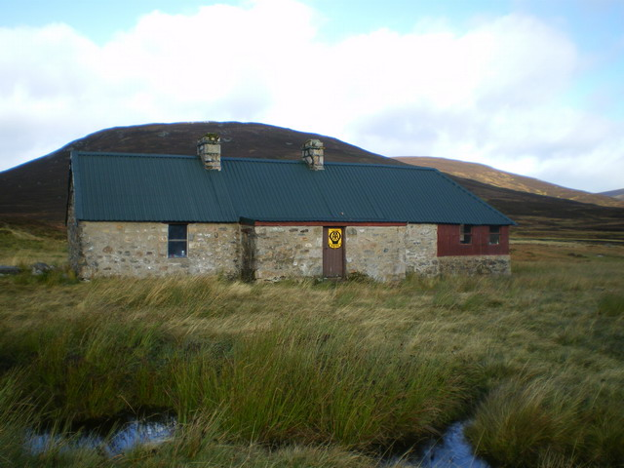

Slide 4
TSRC contributions: Geography - of what is the spatial distribution of TSOs a measure?
Linking charities to communities – nature of relationship to place (consider Mountain Bothies Association, RNLI)
Ancient Parishes – charities tied to spatial units that no longer exist but still spending fairly large sums
WALTON ON THAMES CHARITY | ANCIENT PARISH OF WALTON ON THAMES. | 3115289
ESTATE CHARITY OF WILLIAM HATCLIFFE | ANCIENT PARISHES OF GREENWICH LEE AND LEWISHAM | 1508653
HAMPTON FUEL ALLOTMENT | PRIMARILY THE ANCIENT PARISH OF HAMPTON. | 1439876
CHARITY OF RICHARD CLOUDESLEY | ANCIENT PARISH OF ISLINGTON. | 1430473
MICHAEL YOAKLEY'S CHARITY | ANCIENT PARISHES OF MARGATE, BIRCHINGTON AND ACOL. | 1154799
HACKNEY JOINT ESTATE CHARITY | ANCIENT PARISH OF ST. JOHN HACKNEY | 1018956

Slide 5
TSRC contributions: Geography - of what is the spatial distribution of TSOs a measure?
Substantive interest – what do charities give to communities, e.g. opportunities to volunteer?
Developing LA-level indicators
Registered vs operating in a community
English and Welsh charities linked to local authorities: consider scale of operation, beneficiary group, public benefit, whether or not GM only, whether or not active: N of charities varies substantially depending on your substantive question
Identify local (i.e. active, operating within a single LA) charities
Charity distribution: small +ve influence of local charities on likelihood of volunteering

Slide 6
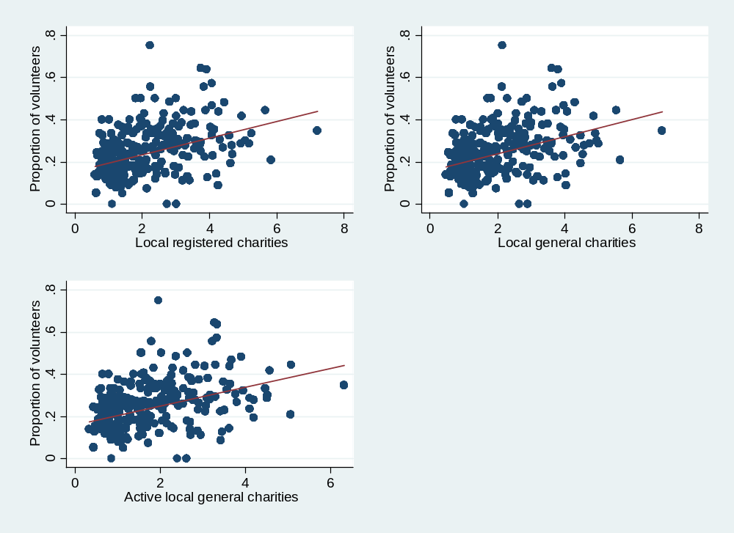
Geography: what does a TSO presence give to communities?

Slide 7
History: when were organisations established?
Registration versus “foundation” or “establishment” dates
Extraction of data from governing documents
Give us information about plausible earliest date at which we recognise features of a formal organisation
BUT registration dates limited to post-1961 – so extracted data from gov docs: examples:
WHITGIFT CHARITIES ACT 1969 AS VARIED OR AMENDED BY A SCHEME 6 JUNE 2011
SCHEME OF THE CHARITY COMMISSION SEALED 12/11/1897;
SAINT MARTIN'S RECTORY(BIRMINGHAM) ACT 1893 AS AMENDED BY STATUTORY INSTRUMENT MADE 1ST JANUARY 1964. AS FURTHER AMENDED BY SCHEME DATED 2 NOVEMBER 2006.;
I) ORDERS AND CONSTITUTIONS OF FOUNDER 4TH DECEMBER 1684 II) SCHEMES OF 21ST JUNE 1910, 30TH NOVEMBER 1917 AND 1ST NOVEMBER 1957&#x0D; AS AMENDED BY RESOLUTION DATED 01 FEB 2016;

Slide 8
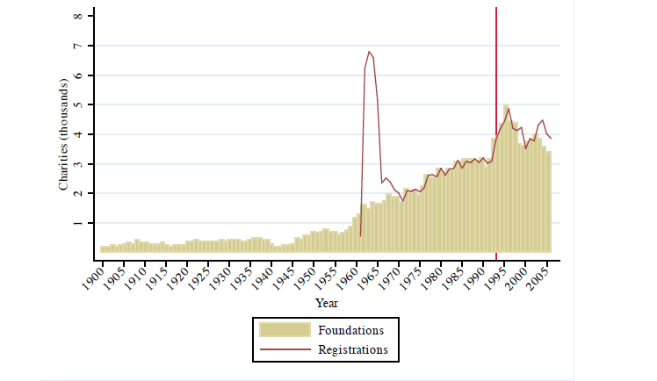
Charity dates of establishment, 1900-
www.shaw-trust.org.uk

Slide 9
TSRC contributions: charity financials
Charity accounts data 2006-:
  limitations of regulatory data (voluntary / generating funds / charitable activities) so capture from notes to accounts
  Partnership with NCVO – develop c. 10 000 representative sample captured continuously
  Used by ONS (National Accounts), NCVO (Almanac)
Analyses:
  organisation-level trends (next slide: proportion of organisations experiencing 25% shortfall on revenues, 2004-14: is the financial position getting worse?
  Others (not discussed here) subsector level
  Growth of earned income
  senior staff salaries
  Employment estimates
  FP 7 Euro comparisons

Slide 10
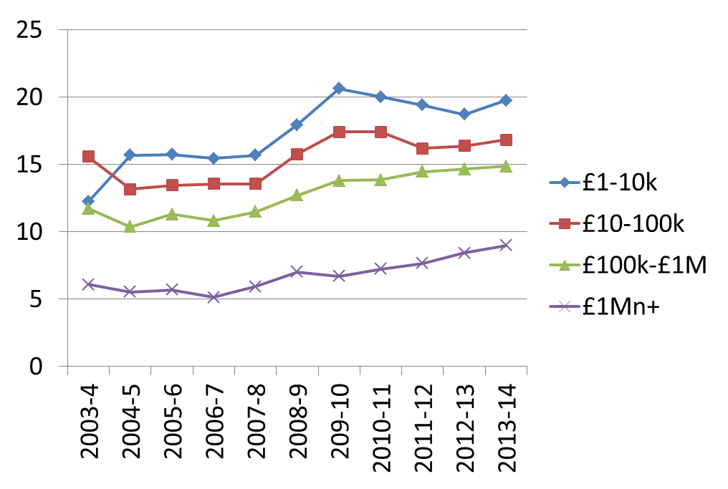
Financial indicators: Tuckman-Chang ratios, 67 000 E and W charities appearing continuously, 2004-14

Slide 11
Defining income trajectories
Using Rigg and Sefton (2006)’s model of household income trajectories
NOTE based on relative movement among income distribution not absolute change
Assign charities to percentiles of income distribution for each year; calculate mean position in distribution, differences between each year’s position and the mean, and differences in position at the beginning and end of the period
Six trajectories defined: Flat ; Flat with blips; rising; falling; fluctuating; other.
Notes:
In particular, Rigg and Sefton (2006) analyse the income trajectories of people at different stage of their lives based on a person’s individual features and family circumstance. Using 10 years of the British Household Panel Survey (BHPS), they classified the probability of experiencing 6 different types of income trajectories: flat, flat with blips, rising, falling, fluctuating and other. Thus, we extend this existing body of work and distinguish different types of income trajectories of voluntary organisations in England and Wales over the last 16 years.
The mean is computed using fourteen of the sixteen observations excluding two outliers (i.e. those furthest away from the mean for all observation).
The reason we decide a 10 percentile criterion for movement is that this is roughly equivalent to the rule that a trajectory is ‘flat’ if the incomes distribution does not go beyond two decile group boundary. 10 percentiles are within the movement that would still qualify as ‘flat’.
To ensure that the trend is not being ‘artificially’ generated by outliers, we test that the coefficient is still significant without two outliers (the outliers are the two furthest away from the trend line).

Slide 12
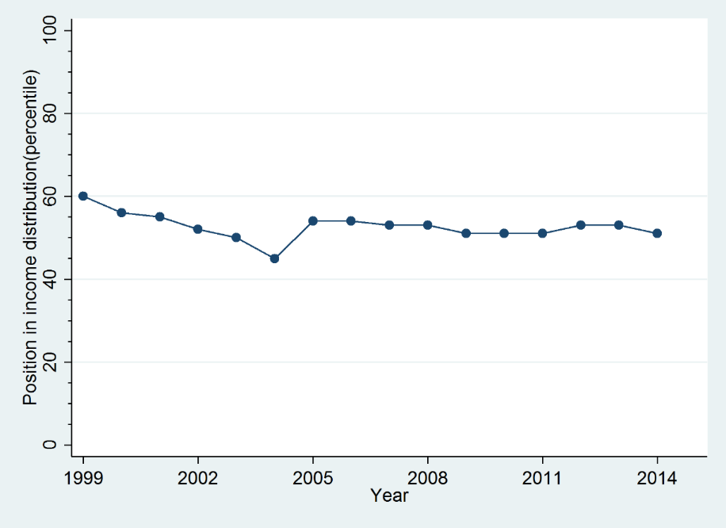
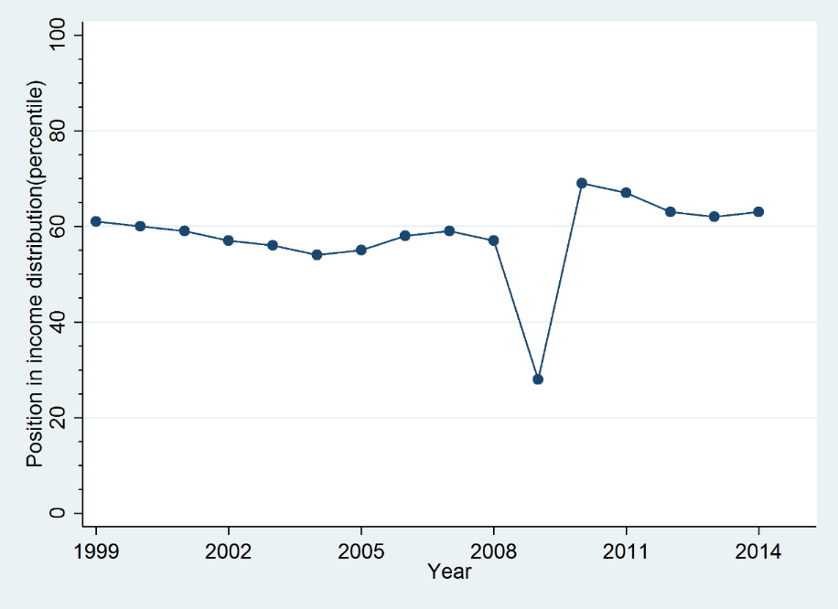
Illustrative income trajectories
Flat: all <(+/- 10 pctiles from mean
Flat with blip(s) trajectory: <=2 deviations
Notes:
Flat: Relatively stable position in the income distribution over the 16 years: all observations within a band of plus or minus ten percentile from the mean.
Flat with blips: Similar to flat pattern, but allowing up to two one-year blips or one two-year blip in either direction over the 16 years. A blip is defined as a deviation of more than 10 percentiles (either plus or minus) from the mean.

Slide 13
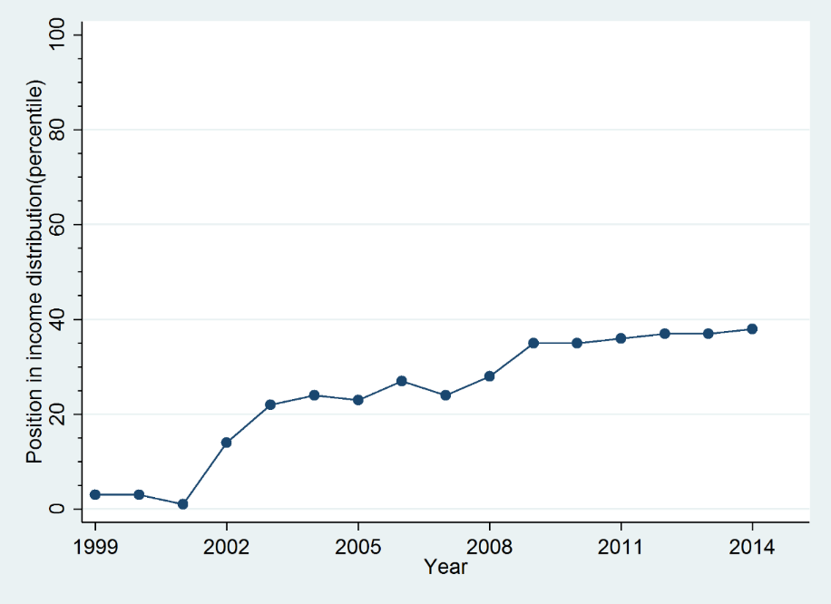
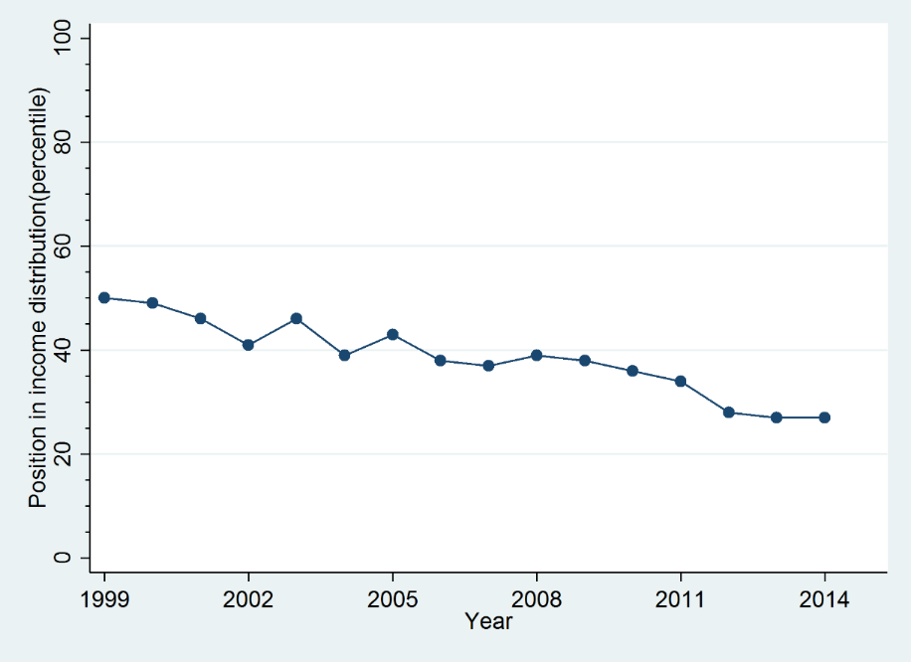
Illustrative income trajectories(2)
Rising trajectory (>20 pctiles)
Falling trajectory (> 20 pctiles down)
Notes:
Rising: A significant rising pattern in the income distribution, equivalent to at least 20 percentiles over the 16 years. Some downward movement is allowed given that the overall trend is positive and significant.
Falling: A significant decline in the income trajectory, equivalent to at least 20 percentiles over the 16 years, applying the same criteria used to define rising trajectories.

Slide 14
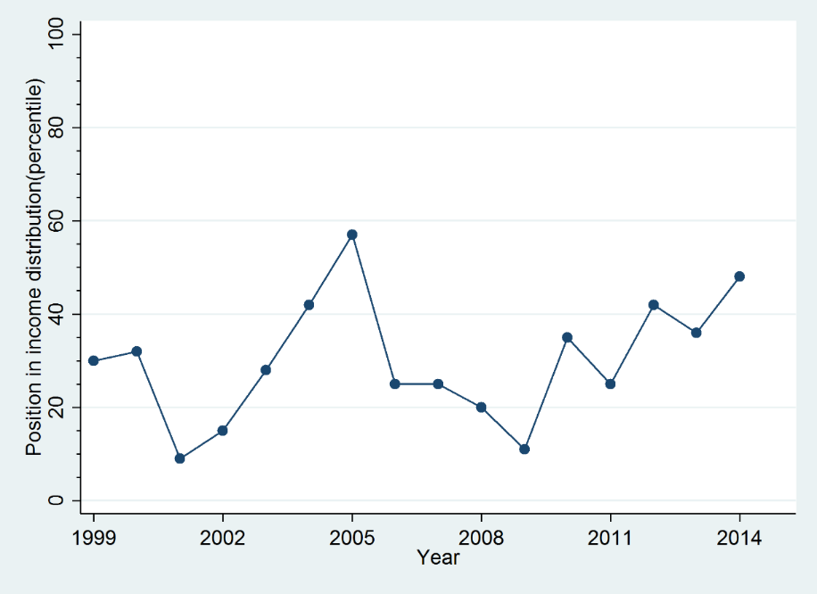
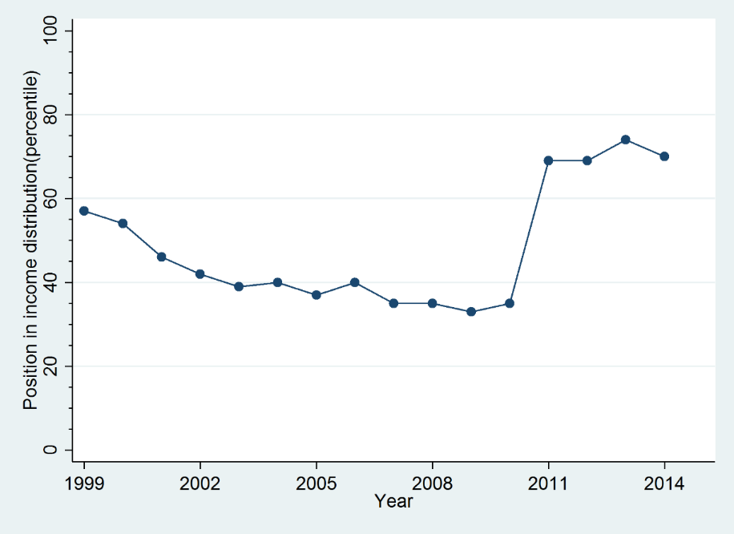
Illustrative income trajectories (3)
Fluctuating (>=3 substantial movements up or down)
Other trajectory (not elsewhere specified)
Notes:
Fluctuating: at least three substantial movements within the income distribution - up/ down/up or down/up/down - over the sixteen year period. To count as substantive, the swing between a local maxima and minima (or vice versa) has to be at least 22.5 quasi percentiles in each case.
Other: all other income patterns not classified above.

Slide 15
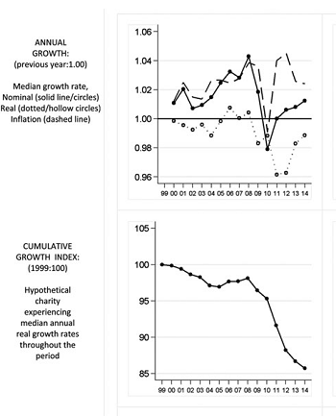

Annual and cumulative growth:
all charities
Source: Charitable organisations, the Great Recession
and the Age of Austerity: Longitudinal Evidence for England and Wales
Journal of Social Policy, 2016
Notes:
Figure 2. Annual and cumulative growth: all charities
Notes: Horizontal axis shows year (1999-2014; see endnote 2 for definition of annual periods).
Results also presented in Table 2.

Slide 16
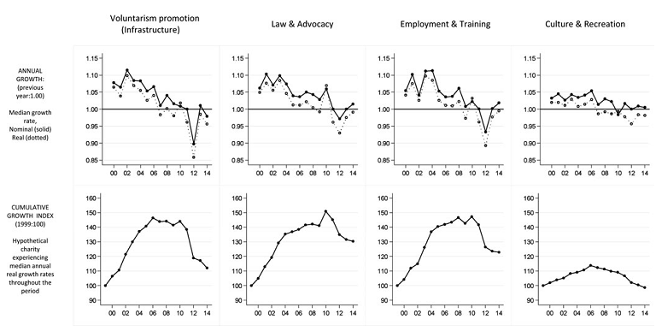
Annual and cumulative growth by ICNPO category:
organisations experiencing distinctive decreases in income
Source: Charitable organisations, the Great Recession
and the Age of Austerity: Longitudinal Evidence for England and Wales
Journal of Social Policy, 2016
Notes:
Figure 4. Annual and cumulative growth by ICNPO category: organisations experiencing distinctive decreases in income
Notes: Voluntarism promotion -ICNPO 8200 and NCVO 8.2; Law & Advocacy - ICNPO 7100/7200 and NCVO 7; Employment & Training – ICNPO 6300 and
NCVO 6.3; Culture & Recreation – ICNPO 1100/1200/1300 and NCVO 1. For full list of categories see Table 1. Horizontal axis shows year (1999–2014; see endnote
2 for definition of annual periods). Results also presented in Table 2.

Slide 17
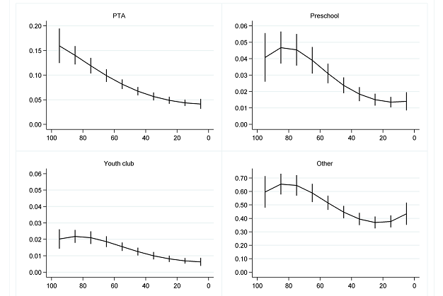
Rates of charitable foundation for specific kinds of charities,
by percentile of deprivation at the local authority level

Slide 18
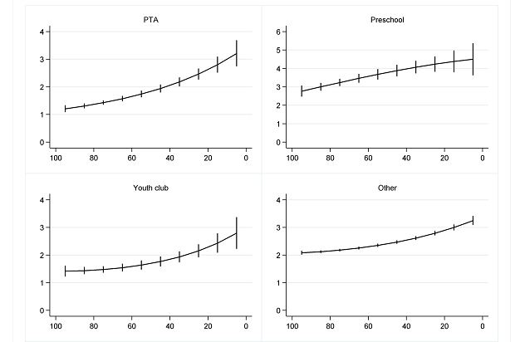
Rates of charitable dissolution for specific kinds of charities,
by percentile of deprivation at the local authority level

Slide 19
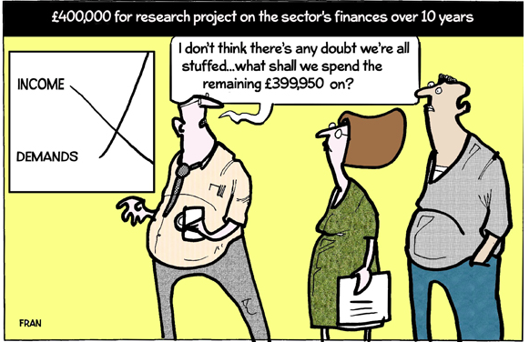
But there will always be sceptics about the value of this work: cartoon from Third Sector, 2015 – financial crises in voluntary organisations are a self-evident truth, requiring no further work!
John Mohan
Third Sector Research Centre
University of Birmingham

