Slide 1
Identifying fields and service areas using UK charity data
Challenges and opportunities
Chris Damm - Research Fellow, CRESR

Slide 2
Introduction
1. Academic and research context - 'mapping' work and field theory
2. Review of current approaches used to classify service areas and industries - their pros and cons
3. Outline of alternative approach using key word searching and 'new' activities data, acquired via data scraping
4. Conclusions and next steps

Slide 3
Mapping and classification of charities
Extensive research efforts to 'map' the voluntary sector
This means cataloguing the number of relevant organisations (usually charities) and their aggregate characteristics (income, assets, etc.)
Sometimes at the sector level, (e.g. NCVO Almanac)
Or comparing internationally (e.g. John Hopkins Comparative Nonprofit Sector Project)
But very often focussed on a particular sub-section of the voluntary sector, such as a particular geography or service area
Usually undertaken or commissioned by academics, government, and umbrella / infrastructure bodies

Slide 4
Reasons for mapping / classifying
Highlight scale and importance, as well as threat and vulnerability (especially when by umbrella bodies)
Explain variation in the voluntary sector, as well as its impact on other factors
To understand the voluntary sector and how it operates
Help to target resources and interventions
Final point is controversial - claims of statecraft and domination by powerful actors (Nickel and Eikenberry, 2016)
Key point is: in who's interest is to conduct this type of activity?

Slide 5
Field theory - an academic rationale for mapping VS subfields
Strands within new institutionalism (DiMaggio and Powell, 1983), Bourdieu (Bourdieu and Wacquant 1992) and Strategic Action Fields (Fligstein and McAdam, 2011)
On the ascendant within voluntary sector research as a way of exploring contextualised agency (Barman, 2016)
"Fields are seen as arenas within which actors convene to advance their interests and purposes amidst evolving rules and understandings about what the field is, how it operates and what is at stake.
Fields are overlapping and nested; constituted at different levels from the third sector, through vertical policy domains down to individual organisations" (Macmillan et al. 2013).

Slide 6
Mixed method approach needed
Most aspects of fields are qualitative (norms, perceptions and shared understandings)
But there is also an important role for quantitative work, starting with identifying field participants
Classification by features such as size, geography and service type (or industry) is a first step to looking at fields quantitatively
But limited number of quantitative VS specialists in the UK
Important to make it easier for researchers to use quantitative data in this way - one means is sharing knowledge

Slide 7
Service areas / industries / policy fields
Focus here is specifically on industries and service areas, though these shouldn't be seen as synonymous with fields
Service areas conceptualise a common service type or activity, often aimed towards a particular type of need
Sometimes referred to as 'vertical' fields, in contrast to the 'horizontal' field of the voluntary sector (Kendall 2003)
One of the most important aspects of a charities' environment - accounts for most policy / regulation
Examples include areas such as domestic abuse, learning disabilities, mental health, homelessness, asylum seekers (some of Lloyds Bank Foundation priority areas).

Slide 8
Current classification methods - the charity register
Classification system in the annual returns asks 'what does your charity do'?
1. General charitable purposes | 7. Accommodation / housing | 13. Economic / community development / employment
2. Education / training | 8. Religious activities | 14. Armed forces / emergency services efficiency
3. The advancement of health and saving of lives | 9. Arts / culture / heritage / science | 15. Human rights / religious or racial harmony / equality or diversity
4. Disability | 10. Amateur sport | 16. Recreation
5. The prevention or relief of poverty | 11. Animals | 17. Other charitable purposes
6. Overseas aid / famine relief | 12. Environment / conservation / heritage

Slide 9
Issues with charity register measures
Overlaps and blurs with a separate beneficiary group question, e.g. Disability vs People with disabilities
Some of the categories are extremely broad or 'catch all' categories - "General charitable purposes"
The level of specificity is not enough to capture Lloyds funding categories, e.g. asylum seekers
Charities can tick all that apply, and sometimes do so generously!
This means there's no indication of what their main area is
So OK, but only if you're lucky with your service area and want to err on the side of inclusivity

Slide 10
ICNPO categories
International Classification of Non-profit Organisations
Developed at John Hopkins University as part of work on the UN System of National Accounts
Designed to work across different national contexts to enable international comparisons
Based on their most important form of economic activity - i.e. only one category per charity
Using key word searches and cross-referencing with some lists, NCVO have applied the ICNPO categories to the charity register

Slide 11
A sample of the ICNPO categories
Culture and Arts | Nursing Homes | Employment and Training
Sports | Mental Health and Crisis Intervention | Civic and Advocacy Organizations
Other Recreation and Social Clubs | Other Health Services | Law and Legal Services
Primary and Secondary Education | Social Services | Political Organizations
Parent Teacher Associations | Scout groups and youth clubs | Grant-making foundations

Slide 12
ICNPO categories - advantages
Standardised and widely recognised categories allow comparison across different studies and national contexts
One category per charity limit avoids the dilution effect of 'tick all that apply' style approaches
Covers a wider range of categories than the annual return data

Slide 13
ICNPO categories - disadvantages
Limit to the 'main' category is a double edged sword. Many charities are multi-purpose
This can give misleading results (for example Work Programme charities)
The classifications quickly fall out of date and need updating: charities change their focus, new charities are added to the register etc.
The categories are still not fine grained enough to identify many service areas - including the LBF priority areas
Limits to the effectiveness of key word searches - depends on the underlying data

Slide 14
Bespoke keyword searches
Possible to use key words searches in a similar way, but on a more bespoke basis
NCVO (2012) used key word searches (combined with stakeholder knowledge) to identify the charities involved in the field of addiction services
This approach allows researchers to hone in on the specific field of interest
Allows researchers to avoid 'one per charity' limit if needed
BUT: previous efforts have had to rely on names and charitable objects as the source data
Charitable objects are often written in antiquated and / or legalistic language

Slide 15
An alternative - activities data
A 400-word description of ‘current activities’ is taken as part of the annual return
This can be viewed on a charity by charity basis online using the search tool, but isn't part of the current charity register download
The charity commission would not make the activities data available in a data file format
Fits similar experiences of other researchers - there are now several variables not available
Acquired the data via data scraping - using code and the 'Rvest' package in R to collect and aggregate the data

Slide 16
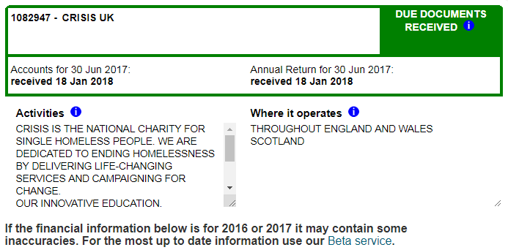

Slide 17
An example - foodbanks
Attempt to identify organisations operating as food banks using the charity register
Identified 587 organisations (there are probably more now)
Manual inspection suggests very few false positives - i.e. almost all were delivering emergency food, though a few were raising funds for a different charity
Many of these would be unlikely to receive 'foodbank' as their main classification of economic activity (as for ICNPO categories)

Slide 18
Two examples:
ROTARY CLUB CHARITY FUND
International;- shelter boxes, shoeboxes, Hamlin Fistula, Polio Plus, Rotary Foundation
National: floods
Local;- sailing project, Christmas breakfast, D of E, kids out, food bank, instrument hire, town Christmas lights, art workshop, defibrillator, link visiting, mosaic, local development trust, museum, toast club
COMMUNITY TRUST
Education and training for young people age 16-24; foodbank

Slide 19
Cross referencing (false negatives)
Using the Trussell Trust and the Independent Food Aid Network websites, attempted to identify all of the food bank charities in Greater Manchester
Out of 19 Trussell Trust Foodbanks, 4 had not been identified by key word searching
Of those listed on the Independent Food Aid Network site, only one was identified by key word searching
Their activities tended to be written in quite general terms, without outlining what they actually did to help their community or beneficiaries

Slide 20
Concluding points
Bespoke key word searching provides a more flexible way of identifying services areas and moving towards a mixed methods, field based approach
Possible to improve the underlying data due to data scraping
The results seem relatively reliable but not comprehensive
Worth supplementing with additional lists and registers if possible
Does provide a foundation for a wide range of research applications in modelling, sampling and mapping
I've had a lot of interest from colleagues in coming up with lists of charities operating in different service areas

Slide 21
Concluding points - next steps
How to make the data and the techniques available to a wider audience? - most people can't code, or even access the charity register in its current form
It may be possible to create an online tool using Shiny (a way of making web apps in R), which would provide a list of charity numbers in response to key words

Slide 22
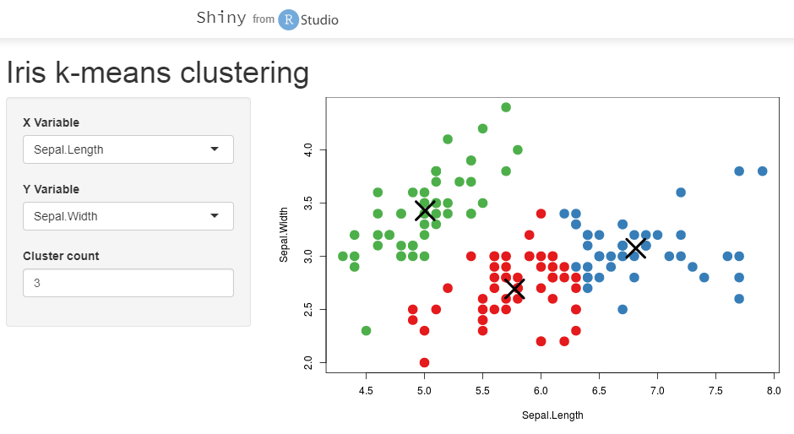
https://shiny.rstudio.com/gallery/kmeans-example.html

Slide 23
Concluding points - open data?
Also still the problem of easier access to charity register data - time for an open charity data campaign?
Charities receive public subsidy, and the charity commission is currently state funded, shouldn't access be completely open?

