Slide 1
Source dataset
Target dataset
Feature Extractor
OpenMax
Known
CORAL Regularization
Label Classifier
Data
Preprocessing
Unknown
Domain Discriminator
DANN

Slide 2
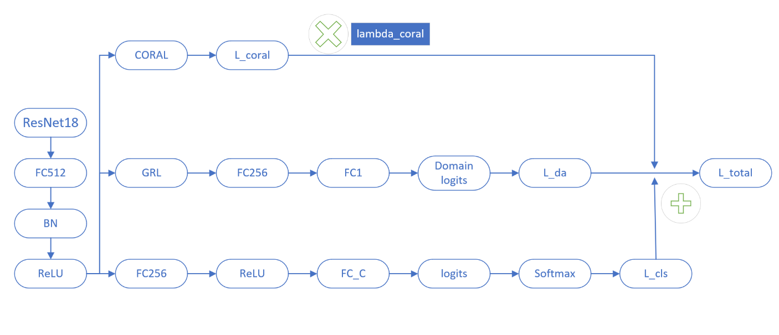
Feature Extractor
Domain Discriminator
Label Classifier

