Slide 1
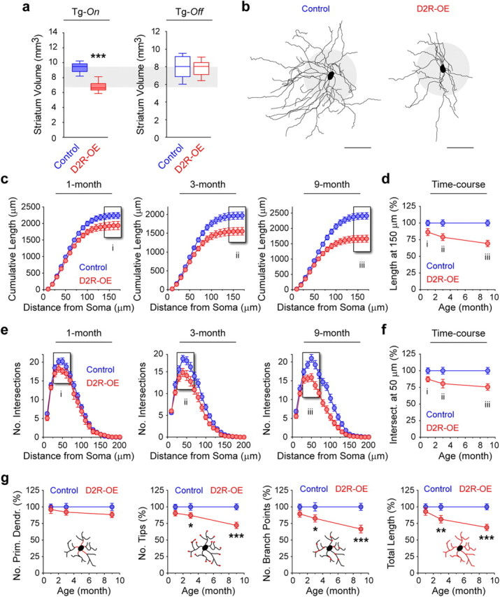
Progressive decrease in MSN dendritic arborization in the striatum of adult D2R-OE mice
Excessive dopamine D2 receptors activation has been associated with the positive (psychotic) symptoms of schizophrenia.
Striatal D2R upregulation decreases dendritic arborization of MSNs in mouse models of schizophrenia.
Cazorla et al. (2012) J Neurosci
DOI: 10.1523/JNEUROSCI.6056-11.2012
to be used
for validation
of the model
model
constraints

Slide 2
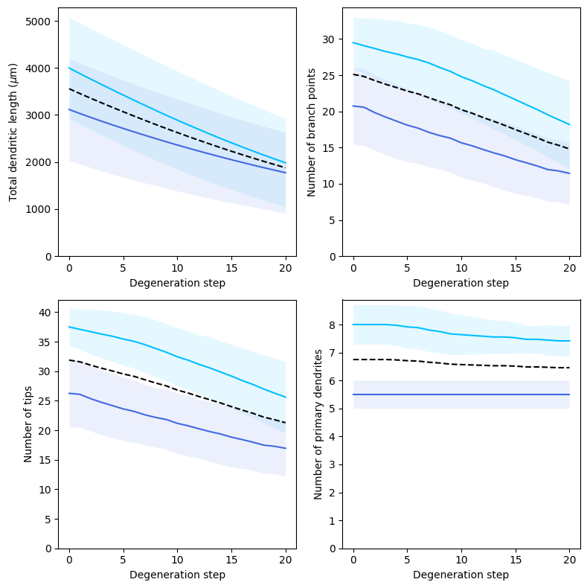
Modeling progressive dendritic degeneration in the striatal projection neurons
Dendritic branches are shortened by 3 μm in every terminal section at each degeneration step. This results in progressive decrease of the total dendritic length, the number of branching points and the number of dendritic tips but the number of dendritic stems.
Light blue for dSPN, dark blue for iSPN, dashed black lines for the means, shaded areas for STD.
The algorithm is described in
Carannante et al. (2024) Net Neuroscience
DOI: 10.1162/netn_a_00394

Slide 3
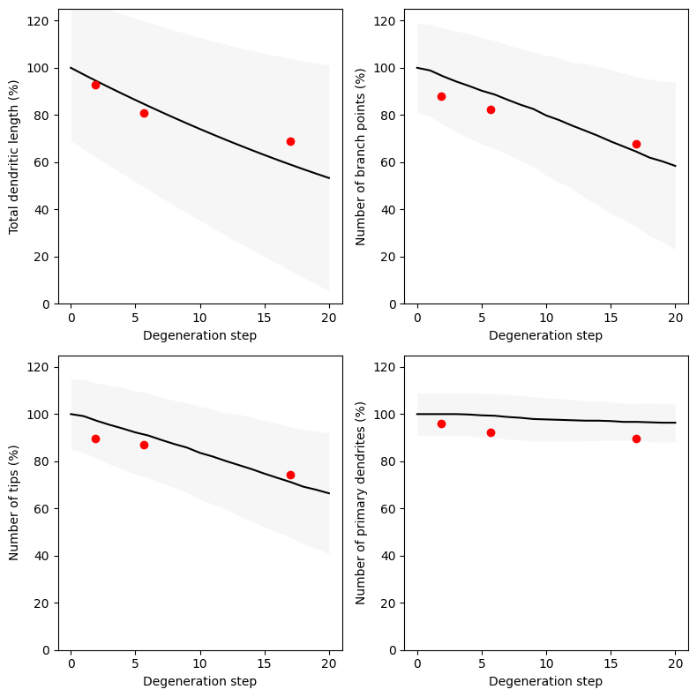
Modeling progressive dendritic degeneration in the striatal projection neurons
Experimental data from Cazorla et al., 2012 (red dots) for 1, 3 and 9 months old mice with D2R overexpression in striatum are mapped to the dendritic degeneration model (black). Shaded area for STD values in the model morphologies.

Slide 4
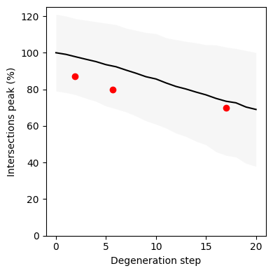
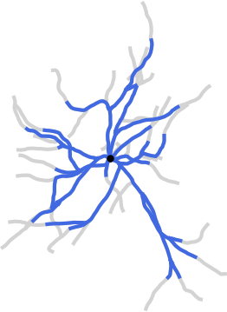
Modeling progressive dendritic degeneration in the striatal projection neurons
Validation of the model (black, mean; grey, STD) using the maximal number of Sholl intersections for 1, 3 and 9 months old mice with D2R overexpression in striatum (red dots).
Example of dSPN morphology at 17th degeneration stage corresponding to 9-month old mouse neuron with D2R overexpression. Lost dendritic branches are shown in grey.

