Slide 1
CS310
THIRD-YEAR PROJECT · VIVA
DEPT. OF COMPUTER SCIENCE · UNIVERSITY OF WARWICK
VIVA · 10-MINUTE PRESENTATION · LIVE DEMO
Implementing & empirically evaluating the Mixture-of-Superpositions -based protocol for classically verifiable quantum learning.
The first concrete, end-to-end instantiation of the protocol of Caro, Hinsche, Ioannou, Nietner & Sweke (2024) , whose Theorem 12 establishes existence only asymptotically. Also, the first empirical map of where it actually breaks.
CANDIDATE
SUPERVISOR
SECOND ASSESSOR
Alex Do · 5505454
Dr. Matthias Caro
Dr. Christian Ikenmeyer
May 2026

Slide 2
02 / 09
CONTENTS & FRAMING
Contents for today's Viva
WALKTHROUGH
7 slides · 10 min · + 5-min demo
WHERE THIS SITS
existence → instantiation
#
SECTION
WINDOW
Caro et al. (2024) prove that an honest BQP prover and a BPP verifier exist for the Fourier-sparse learning problem; an asymptotic statement. They provide a protocol for doing so, but not the implementation.
—
Intro & framing
0:00 – 1:00
03
What was built: the implementation
0:30 – 3:00
04
Completeness & soundness
3:00 – 4:00
05
The vanishing-margin finding
4:00 – 5:00
06
Robustness & the gate-noise cliff
5:00 – 6:30
This project supplies the missing artefact. Two Python packages, mos/ (state-level emulator) and ql/ (Thm. 12 interactive pair), with two equivalent backends, ~30k trials across seven experiments, and protobuf-aggregated results.
07
Sensitivity: bent functions, ϑ-boundary
6:30 – 7:30
08
Limitations & contributions
7:30 – 8:30
09
Future work
8:30 – 9:30
—
Live demo · sampling & verifier walkthrough
9:30 – 15:00
Implementing & Empirically Evaluating the MoS Protocol · Caro et al. (2024)
Headline: this is the implementation Caro et al. did not provide.

Slide 3
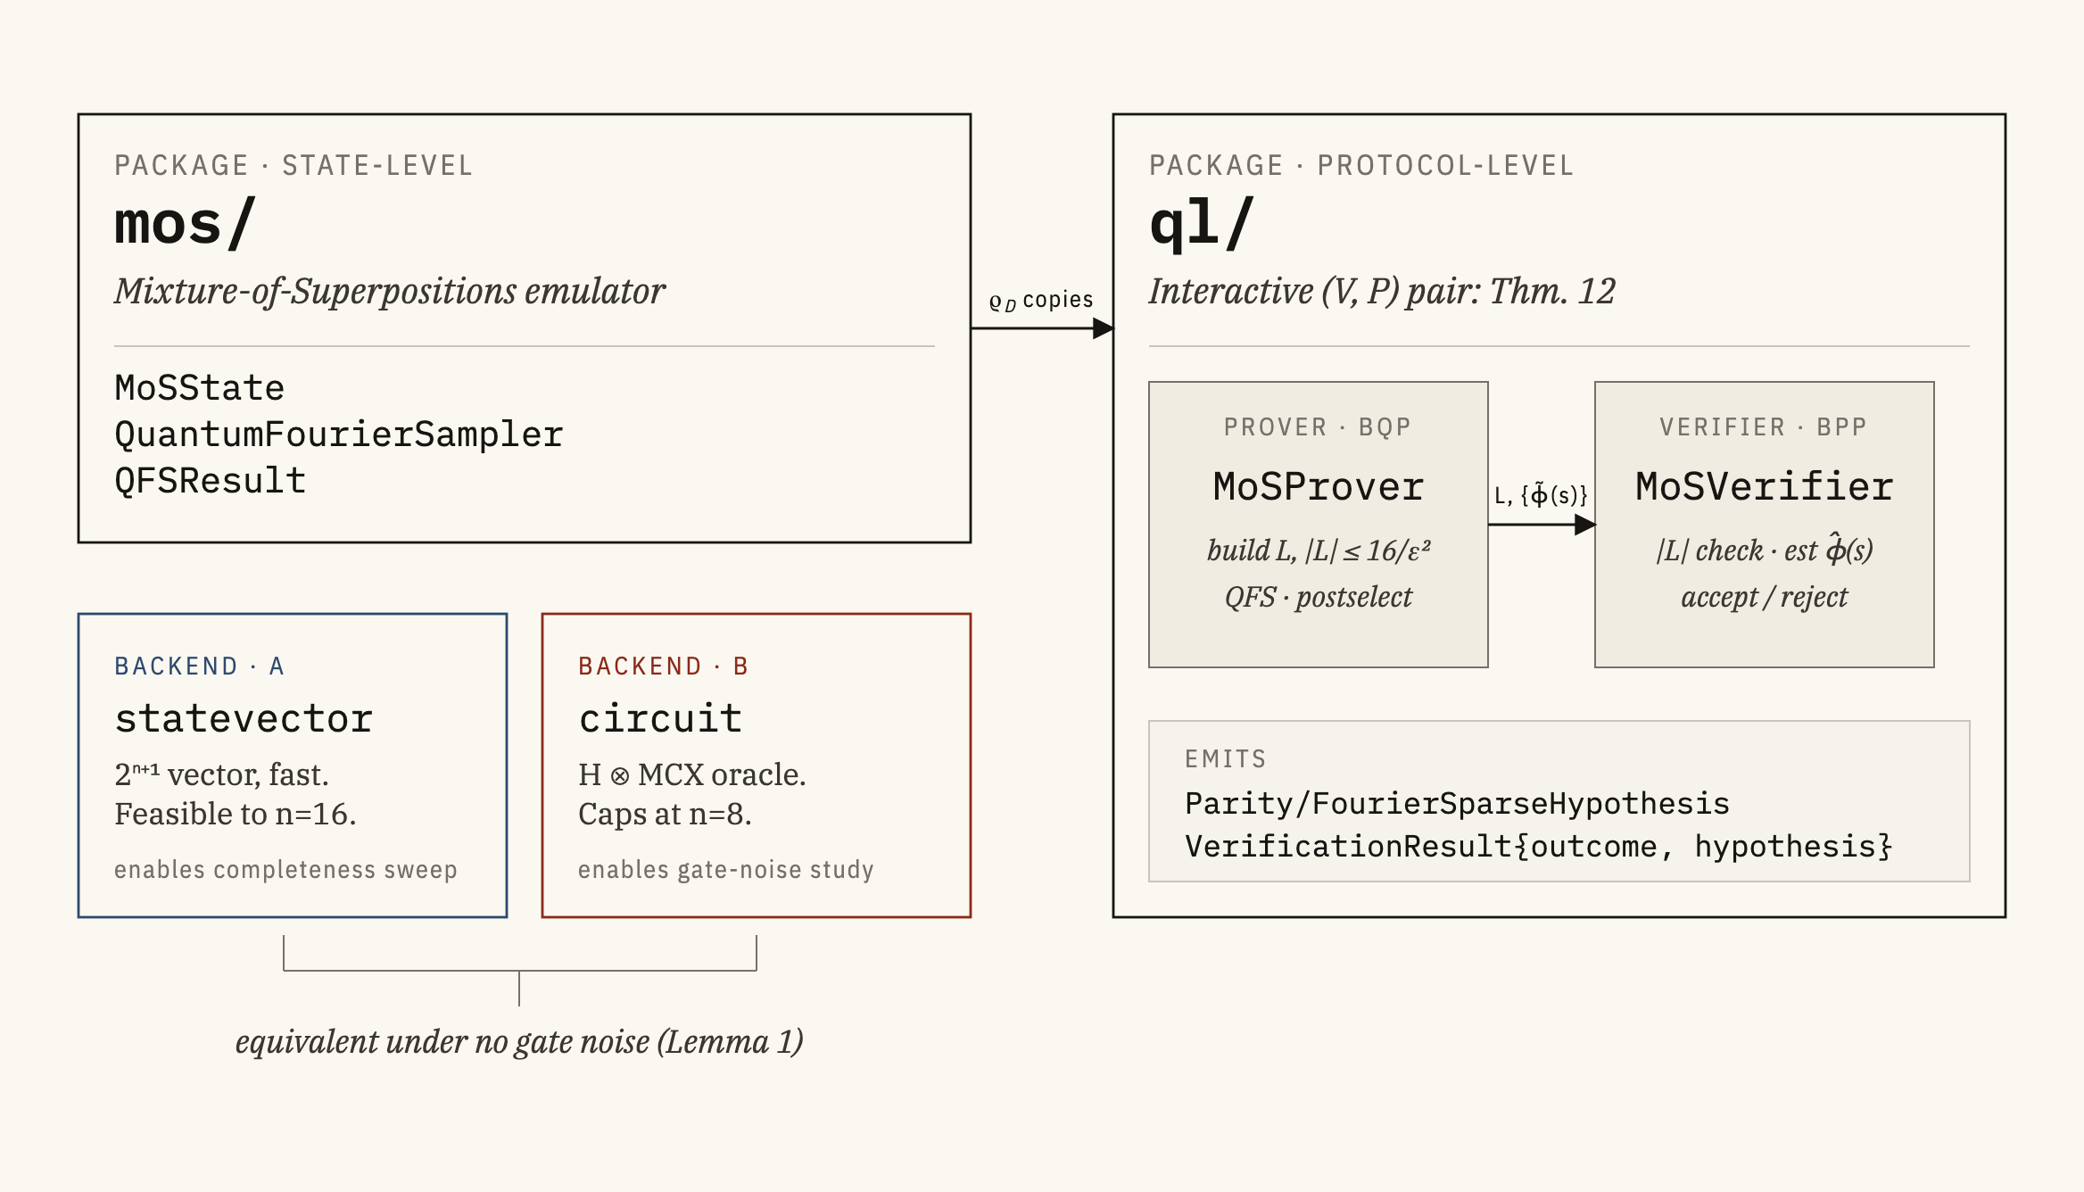
03 / 09
WHAT WAS BUILT
ENGINEERING SCALE
~30k
7
4
TRIALS
EXPERIMENTS
EMPIRICAL AXES
DCS · tiger
BATCH COMPUTE
Lemma 1. Statevector and circuit preparations of |ψ_{f}⟩ are identical under no gate noise; same |x, f (x)⟩ on every basis state.
AGGREGATION
Protobuf-aggregated results across distributed trials.
§4 Implementation · Thm. 12 (Caro et al.) · Lemma 1 (report)
Engineering credibility

Slide 4
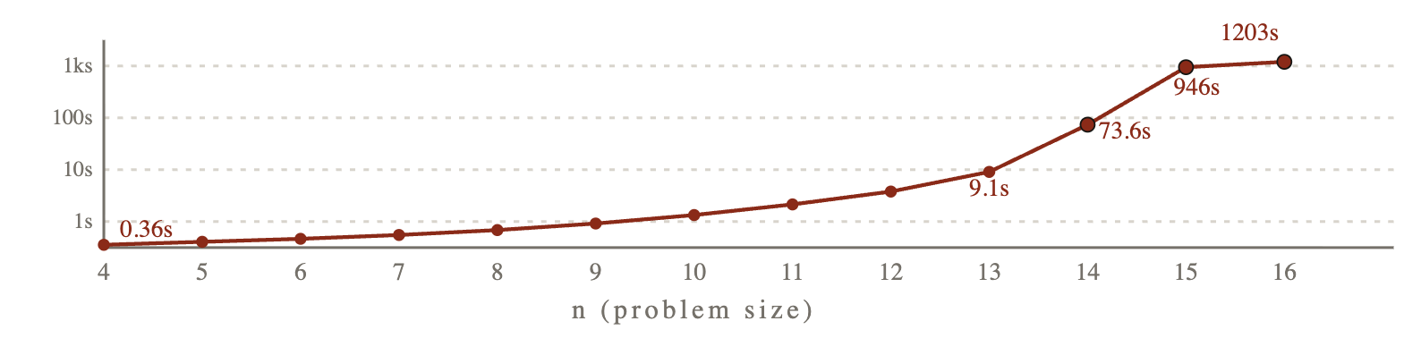
04 / 09
COMPLETENESS & SOUNDNESS
Honest (V, P) accepts at 100%. Dishonest (V, P) rejects where expected.
COMPLETENESS · SCALING BASELINE
n ∈ {4,…,16} · 100 trials each · 1300 total
SOUNDNESS · SINGLE-PARITY (4 CHEATS)
n ∈ {4,…,20} · 100 trials × 4 strategies · 6800 total
METRIC
OBSERVED
PREDICTED
CHEATING STRATEGY
N=4
N=8
N=12
N=16
N=20
ℙ[accept]
100%
≥ 1−δ = 0.9
random list (5 idx)
71%
97%
100%
100%
100%
ℙ[correct | accept]
100%
–
wrong parity
100%
100%
100%
100%
100%
post-selection rate
[0.496, 0.502]
½ (Thm. 2)
empty list
100%
100%
100%
100%
100%
wall-clock @ n=4
0.36 s
–
inflated list (10 idx)
100%
100%
100%
100%
100%
wall-clock @ n=16
1203 s
2ⁿ⁺¹ growth
Accidental accepts, not soundness violations. 5-element random lists hit s* with probability 5/2ⁿ. At n=4: predicted 31, observed 29 out of 100 trials.
Wall-clock growth is a simulator artefact: the 2ⁿ⁺¹-dim statevector dominates, not any protocol quantity.
Limitation: The list-size bound 64b²/ϑ² ≈ 711 never triggered: largest adversarial list submitted had |L| = 10. Future work.
FIG. 1 · WALL-CLOCK VS N · 13 POINTS, N=4…16 · FIXED 6000 COPIES/TRIAL
§5.1 Completeness · §5.2.1 Soundness

Slide 5
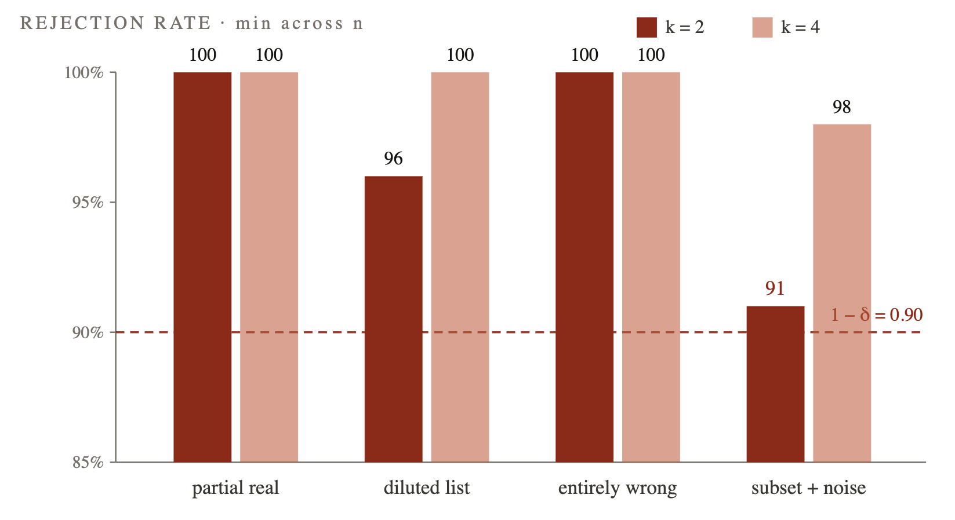
05 / 09
Multi-element soundness
MULTI-ELEMENT CHEATS · REJECTION RATE
k-sparse targets · per-cell minimum across n
MECHANISM & FRAMING
why the 91% floor sits there
The adversary submits the true heaviest Fourier coefficient alongside five fakes. The verifier’s weight check Σ ϕ̃(s)² < a² − ε²/8 is dominated by the real signal; only marginally tipped under threshold.
Definition 7 (Caro et al.) is universally quantified; these strategies are a spot-check, not a refutation.
STRATEGY
K=2 MEAN
K=2 MIN
K=4 MEAN
partial real
100%
100%
100%
diluted list
98.5%
96%
100%
entirely wrong
100%
100%
100%
subset + noise
95.1%
91%
99.8%
Attribution precision: separating structural from adversarial rejection.
§5.2.2 Multi-element dishonest provers · Table 4
Failure mode #1: vanishing-margin ceiling

Slide 6
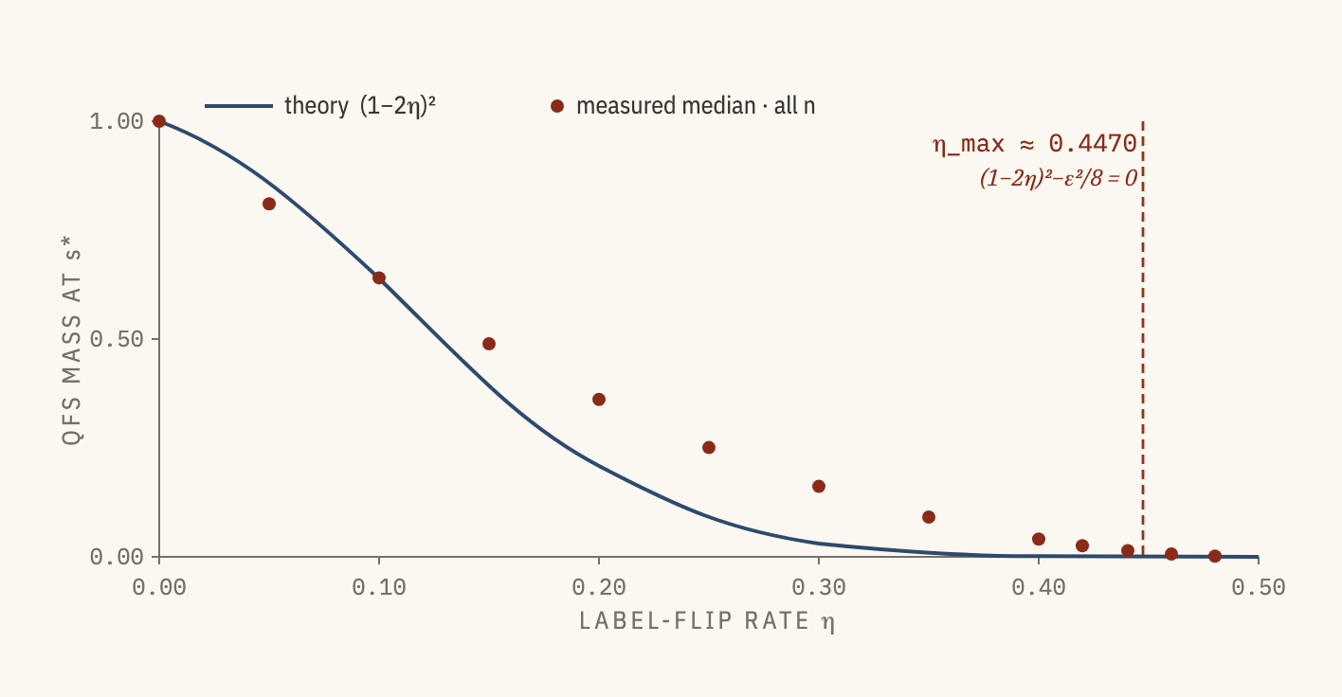
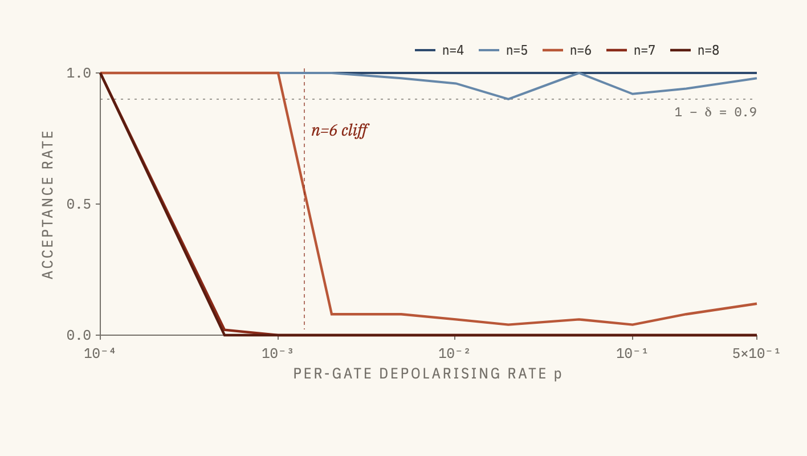
06 / 09
ROBUSTNESS: (1−2Η)² FIT AND THE GATE-NOISE CLIFF
The cleanest theory match; the only experiment outside Caro et al.’s promise universe.
LABEL-FLIP SWEEP
~17k trials · 13 noise rates
GATE-NOISE CLIFF
circuit backend · n ∈ {4,…,8}
< 1.8% relative error across all n ∈ {4,…,16}, all η ≤ 0.42. Sharp empty-list transition at η ≈ 0.447: exact root where margin (1−2η)² − ε²/8 goes negative. Lean on this.
Uniform noise floor 1/2ⁿ exceeds the extraction threshold ϑ²/4 for n ≤ 5 ; crosses below at n = 6 . Explains why n ≤ 5 looks robust and n ≥ 6 collapses. Ma–Su–Deng cover output-side noise, not per-gate depolarising. Genuine open question.
Failure mode #2: prover-side cliff

Slide 7
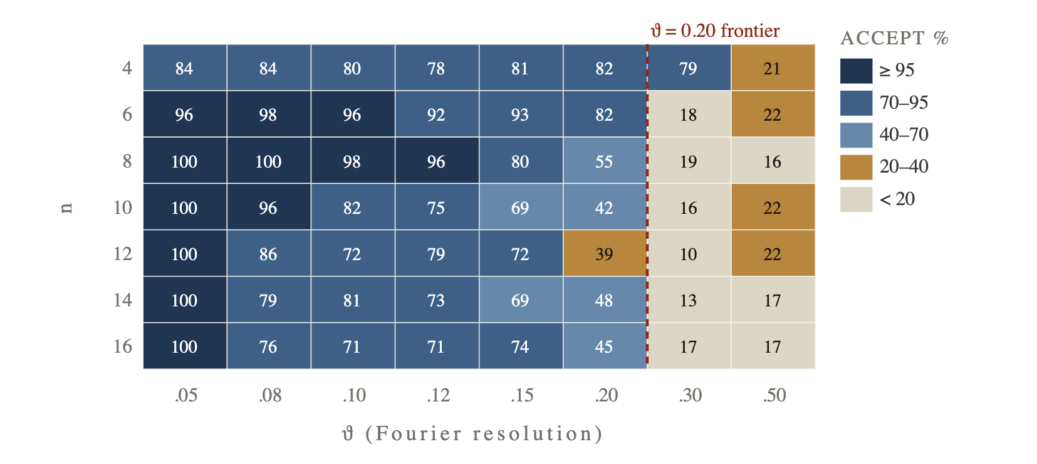
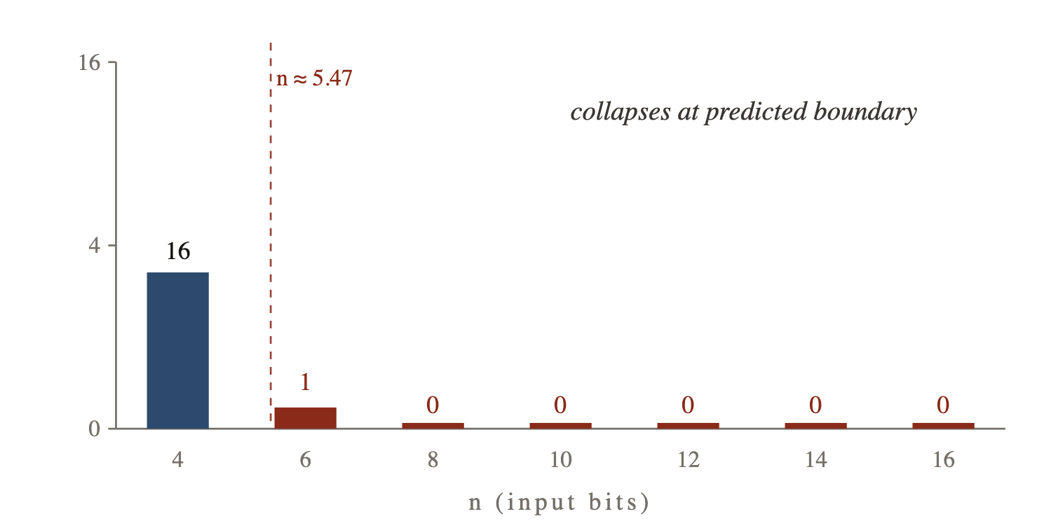
07 / 09
SENSITIVITY: BENT FUNCTIONS & THE Θ-BOUNDARY
Violating protocol preconditions
BENT FUNCTIONS · PERFECTLY FLAT SPECTRUM
Maiorana–McFarland · |ĝ(s)| = 2^{−n/2}
Θ-SENSITIVITY HEATMAP
target: dominant 0.7 + three secondaries 0.1
Corollary 5 (Caro et al.) excludes s whenever |ĝ(s)| < ε/2 . Flat bent coefficients 2^{−n/2} at ε = 0.3 hit that boundary at:
ϑ lower-bounds the magnitude of all non-zero Fourier coefficients. Sweep ϑ against n: acceptance collapses at the frontier ϑ = 2·c_{sec} = 0.2 : where the small-coefficient promise fails.
n = 2 log₂(2/ε) ≈ 5.47
FIG. 6 · ACCEPTANCE RATE · DARKER = HIGHER
FIG. 5 · RECOVERED LIST SIZE |L| VS N
§5.4.1 Bent functions · §5.4.2 ϑ-sensitivity

Slide 8
08 / 09
LIMITATIONS & CONTRIBUTIONS
Empirical mechanism study, not an asymptotic validation. Two failure modes characterised; one open question raised.
LIMITATIONS
CONTRIBUTIONS
Sample budgets three orders below analytic Hoeffding. For |L|=10, ε=0.3, δ=0.1 the requirement is ≈ 3.8×10⁷ ; experiments use ~10⁴. Maps mechanisms, not asymptotic complexity.
First faithful implementation of the MoS protocol
Two failure modes characterised. Vanishing-margin acceptance ceiling under mixed-coefficient cheats; prover-side cliff under per-gate depolarising noise.
No real quantum hardware. Every measurement is classical simulation. Cross-talk, decay, biased readout are unstressed.
One open theoretical question raised. Per-gate depolarising noise: Ma–Su–Deng treat output-side, not gate-side.
Brute-force circuit oracle caps gate-noise study at n=8. The MCX construction is exponential; the Statevector path avoids this but cannot carry per-gate noise.
§6 Discussion · §7.1 Summary of contributions

Slide 9
09 / 09
FUTURE WORK
Three directions in roughly decreasing impact on what this report can support.
01 · SAMPLE BUDGETS
02 · OPEN QUESTION
03 · HARDWARE
Analytic-budget validation.
Formal treatment of per-gate noise.
Real quantum hardware.
Re-run soundness at the full Hoeffding budget. Upgrades present empirical agreement from a “good-enough” state to an exact model.
Any IBM backend with effective per-gate error below 10⁻³ should admit honest acceptance at n=6: a concrete success criterion from the cliff.
Extend Ma–Su–Deng's output-side bounds (measurement noise, end-of-circuit depolarisation) to per-gate depolarisation inside the QFS circuit, and derive a closed-form (n, p) verifiability boundary that predicts the empirical cliff at n ≥ 6.
DEMO
DEMO
~5 min

