Slide 1
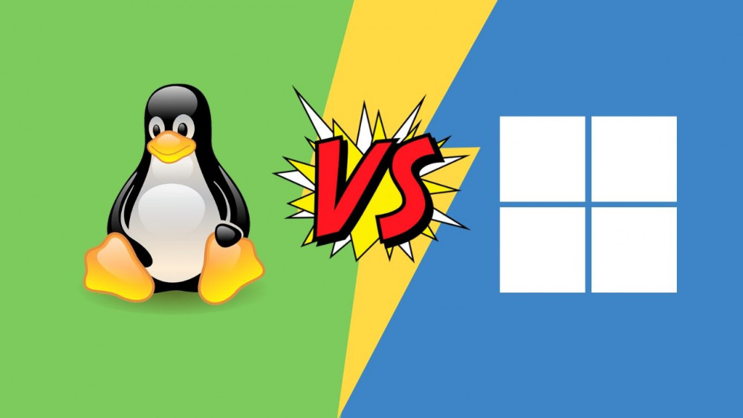
Linux Windows
Why does Windows win?
By Zhuravlev N.V., Mudrichenko M.N.

Slide 2


User friendly interface
- Tell me who your friend is and I'll tell you who you are - My friend is an interface!
Windows has a more user friendly interface.
To use Windows, not being able to use the terminal.
Easier to solve problems.

Slide 3

Popularity
Infinitely you can look at three things…
Cause popularity of Windows is its popularity!
This OS is the most common, because it is more profitable to deal with this market due to its size.

Slide 4

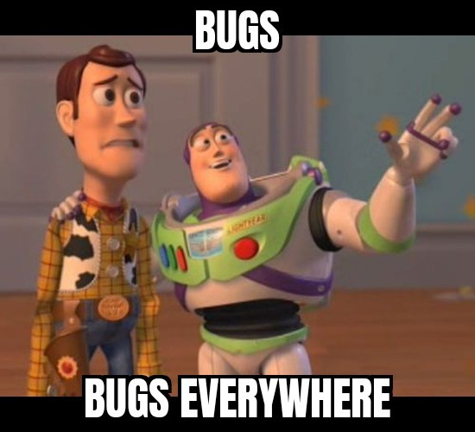
Stability
Stability is a attribute of a good OS
A large number of people work on Windows
Quickly fix errors

Slide 5

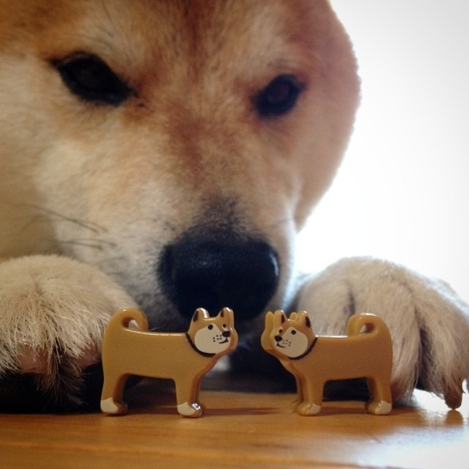
Compatible with many devices
If one key opens many locks, it is a good key…
- Easy setup and support
- It connects quickly and reliably

Slide 6
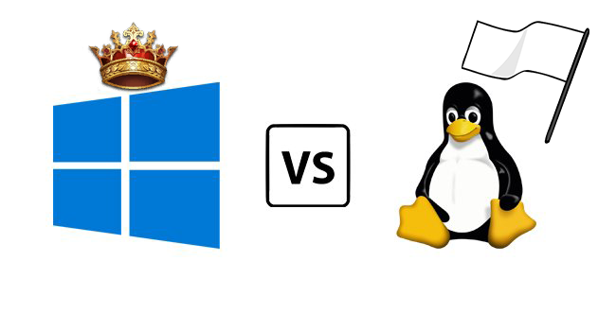

Conclusion

