Slide 1
tty/usb
20mA loop @ 110 baud, USB serial interface for ASR33 teletype
Duplex (separate transmit and receive loops)
Active (integrated current source, since ASR33 is passive)
Monitor activity with LEDs
Some translation and processing in Teensy firmware (switchable)
Uppercase → lowercase
ASCII-63 special characters to Unicode
Delay after CR, LF
https://github.com/hughpyle/ASR33

Slide 2
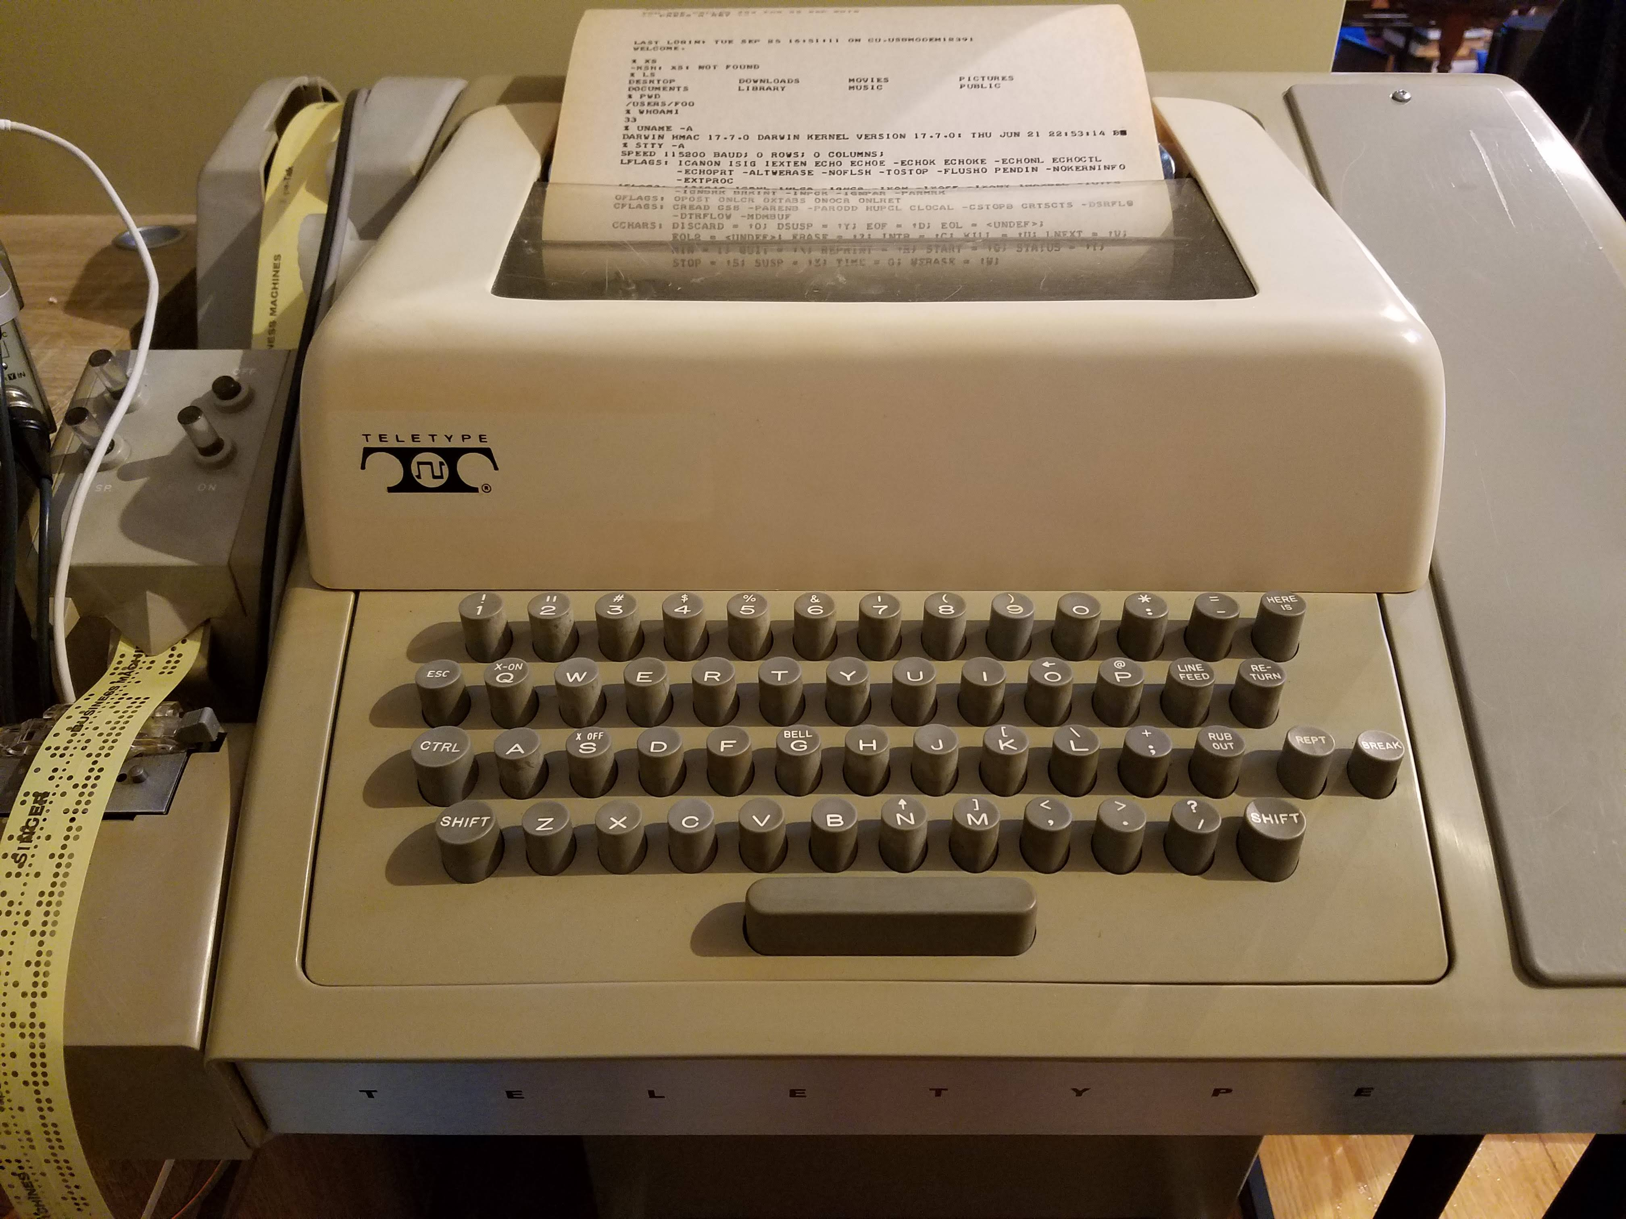

Slide 3
Teletype model 33 ASR (automatic send/receive)
On the “tty send” side is a paper-tape reader and keyboard.
On the “tty receive” side is a paper-tape punch and a printer with 72 characters per line.
The printer and keyboard use the ASCII 1963 character set (7-bit characters, no lowercase) with even parity. Parity is not checked. The papertape can read and write 8-bit bytes.
Escape characters include CR, LF and BEL (Return and line-feed are separate keys on the keyboard). Some models may handle more: WRU to trigger the “here is” answerback, DC1 to enable the tape reader, DC2 to enable the tape punch.
Serial-to-parallel conversion and timing is entirely mechanical, and runs at 110 baud (10 characters per second: 1 start bit, 8 data bits, 2 stop bits).
The interface is a 20mA current loop. The loop is normally closed (the SPACE value is current flowing). The keyboard includes a BREAK key that interrupts the loop to signal out-of-band.

Slide 4
Overall electronics
Teensy RX
USB
19.2 VDC
20mA
loop supply
Red LED
Loop To Teensy
tty “send”
(keyboard)
4
3
Teensy TX
USB
20mA
loop supply
Yellow LED
Teensy To Loop
tty “receive”
(printer)
7+
6-
Notes:
This interface is built as two independent 20mA current loops, including loop supply for each.
On the “tty send” side: the keyboard is a mechanical serial distributor that makes contact on “mark” (completing the loop) or break on each “space” bit. There’s no electronics in the teletype circuit, so polarity doesn’t matter. The components on the current loop are: a LED for monitoring; a LED opto-isolator to send signals to the Teensy serial received; and the teletype.
On the “tty receive” side, the teletype uses solenoids to drive the printer and tape punch. A driver amplifier is included in the teletype. The interface is polar, i.e. connector #7 on the teletype must be at positive voltage relative to connector #6. The components on this loop are: a LED for monitoring, a transistor switched via opto-isolator by the Teensy serial signal; and the teletype.

Slide 5
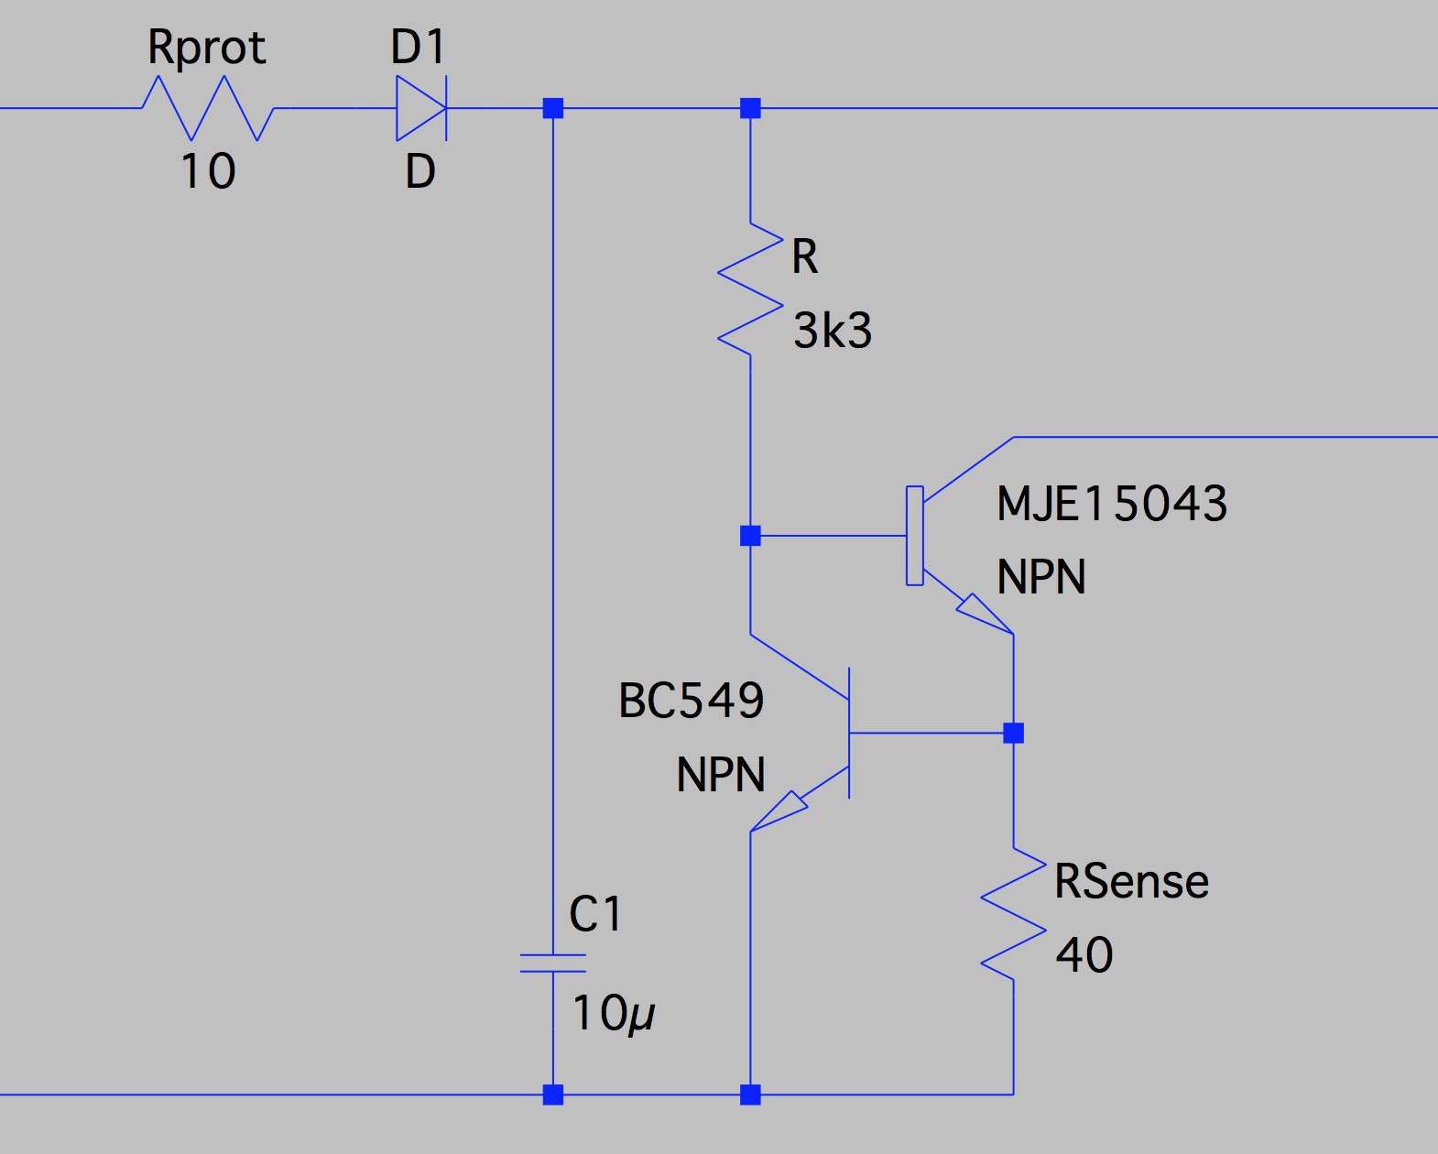
20mA loop supply
Current loop 20mA
19.2 VDC
Notes:
This is a current regulator that supplies max ~20mA into the loop.
This should survive short-circuit at the loop (since that’s how the loop works!) and also tolerate anything around ~12V to ~24V supply. In this build it’s driven by a 19.2V wall-wart.
NOTE: For this entire project, components are just what was to hand. The BC639 handles more current than BC549. The MJE15043 is a nice high-power transistor intended for audio, but really only needs to be able to dissipate 0.5W depending on the supply voltage.

Slide 6
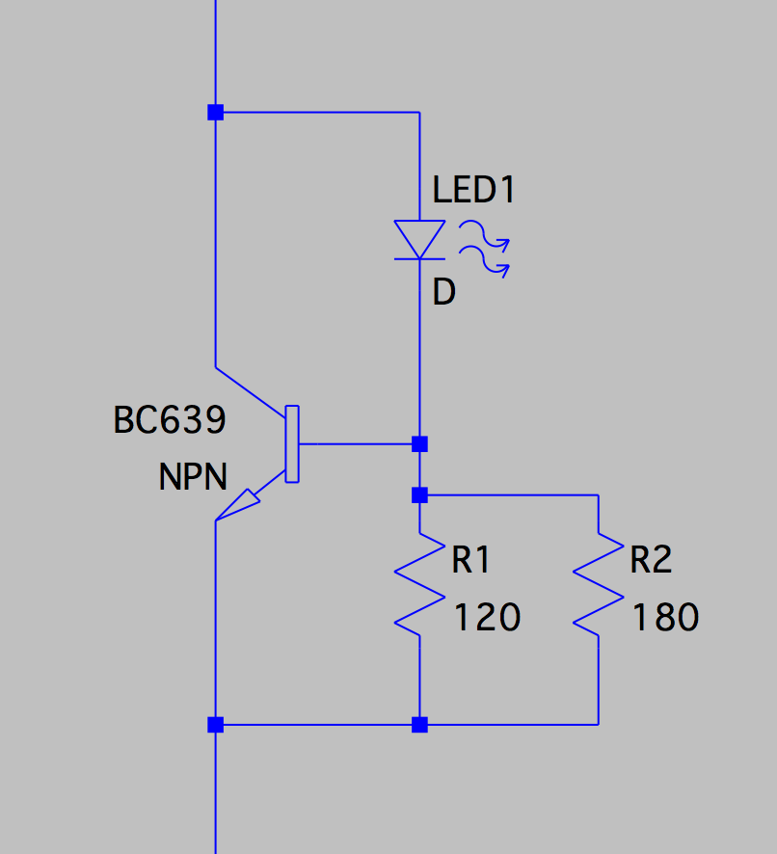
LED driver (~10mA)
Current loop
Notes:
I love this constant-current transistor circuit so much I’m using it everywhere. In this case as a LED current driver to supply ~10mA to standard 5mm red/yellow LEDs.

Slide 7
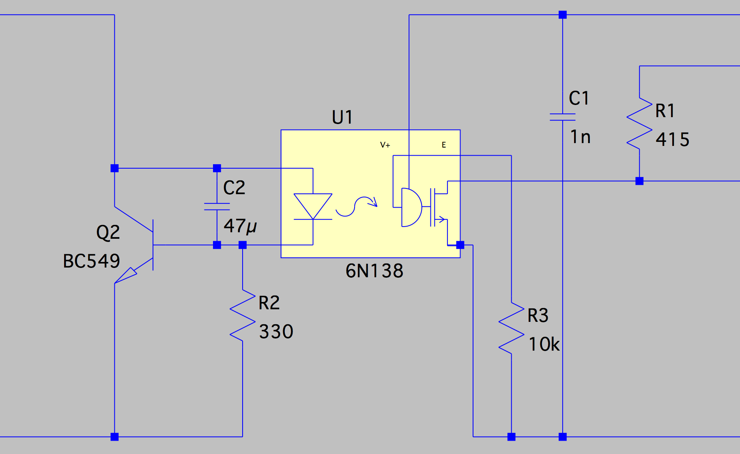
Loop to Teensy
Teensy 5V
Teensy 3.3V
Current loop
Teensy RX (pin 20)
Teensy GND
Notes:
LED current driver runs ~3mA into the opto-isolator. This is the same constant-current supply, but with larger R2 for lower load current.
The 47u capacitor filters out all the line noise, gives a slow rise-time for 110-baud operation. (Doesn’t need to be this big!).
On the other side, Teensy receives the serial signal. The 6N138 needs 5V power, from the Teensy. The RX pin has a pullup from the Teensy’s 3.3v supply.
NB the output is “inverted” (mark=low voltage, space=high, like RS232), and this needs to be handled in the receiver software.

Slide 8
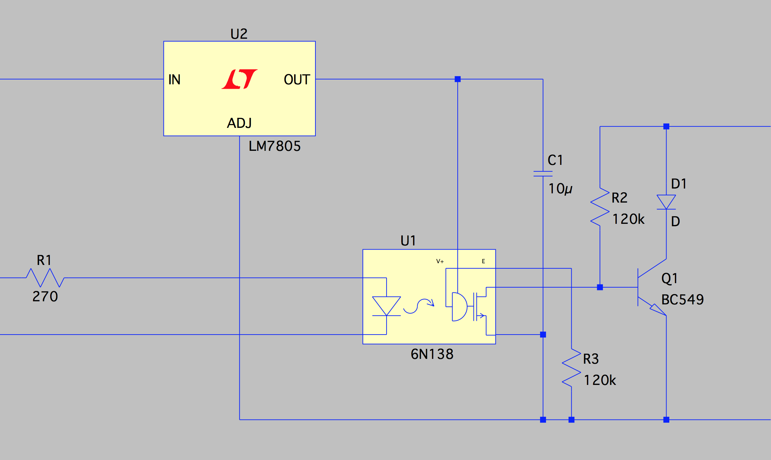
Teensy To Loop
19.2 VDC (@ loop supply)
Current
loop
Teensy TX (pin 21)
Teensy GND
Notes:
Teensy drives the opto-isolator LED through a small resistor.
On the loop side, the 6N138 output is buffered so that it can switch >20mA.
The 6N138 needs a 5V supply, which we get by regulating down the 19.2V source used for the loop (NOT from the Teensy!)
NB the output is “inverted” (high=mark, low=space low=mark=low, space=high), and this needs to be handled in the transmitter software.

Slide 9
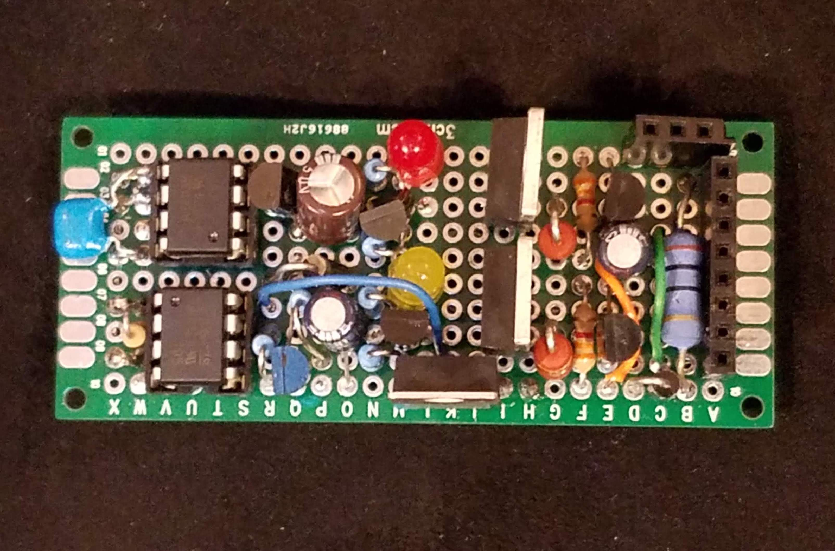
VIN +19.2
TTY 7 +RECEIVE
VIN GND
TTY 6 –RECEIVE
n/c
TTY 3 SEND
TTY 4 SEND
VIN GND
Notes:
The current loop electronics

Slide 10
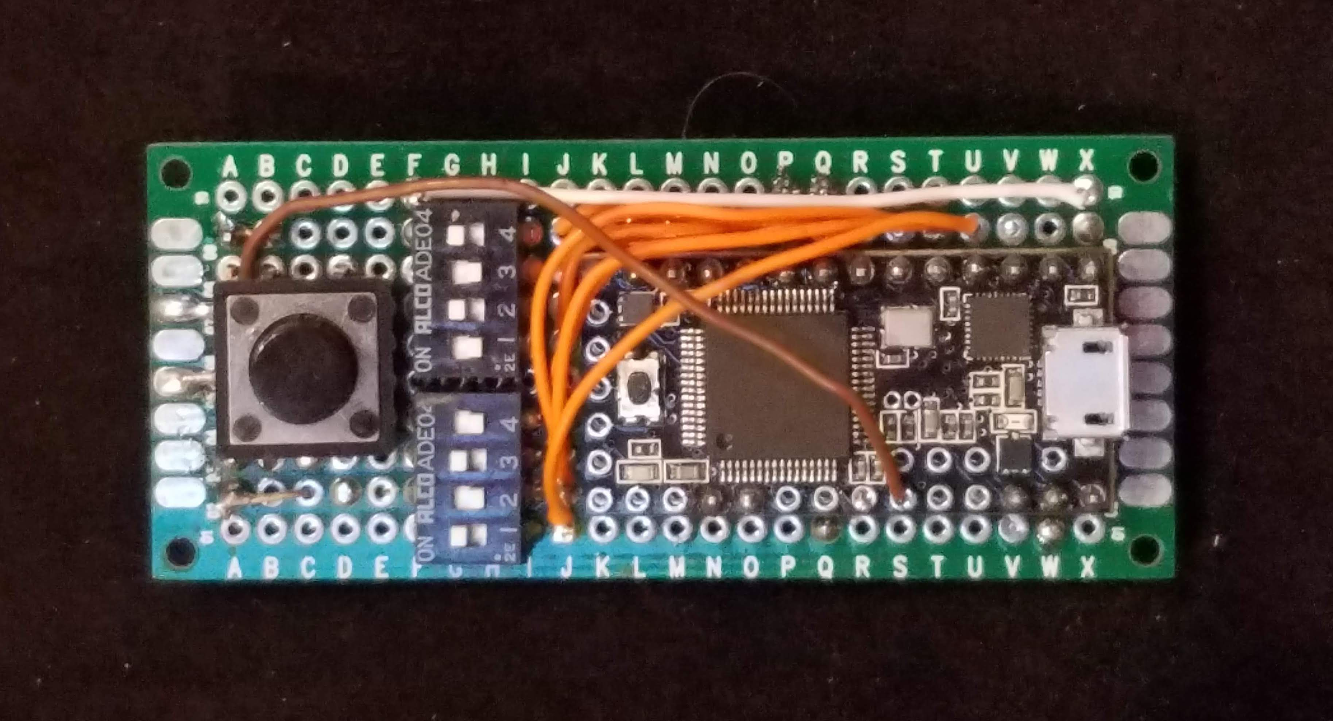
Notes:
The Teensy microcontroller

Slide 11
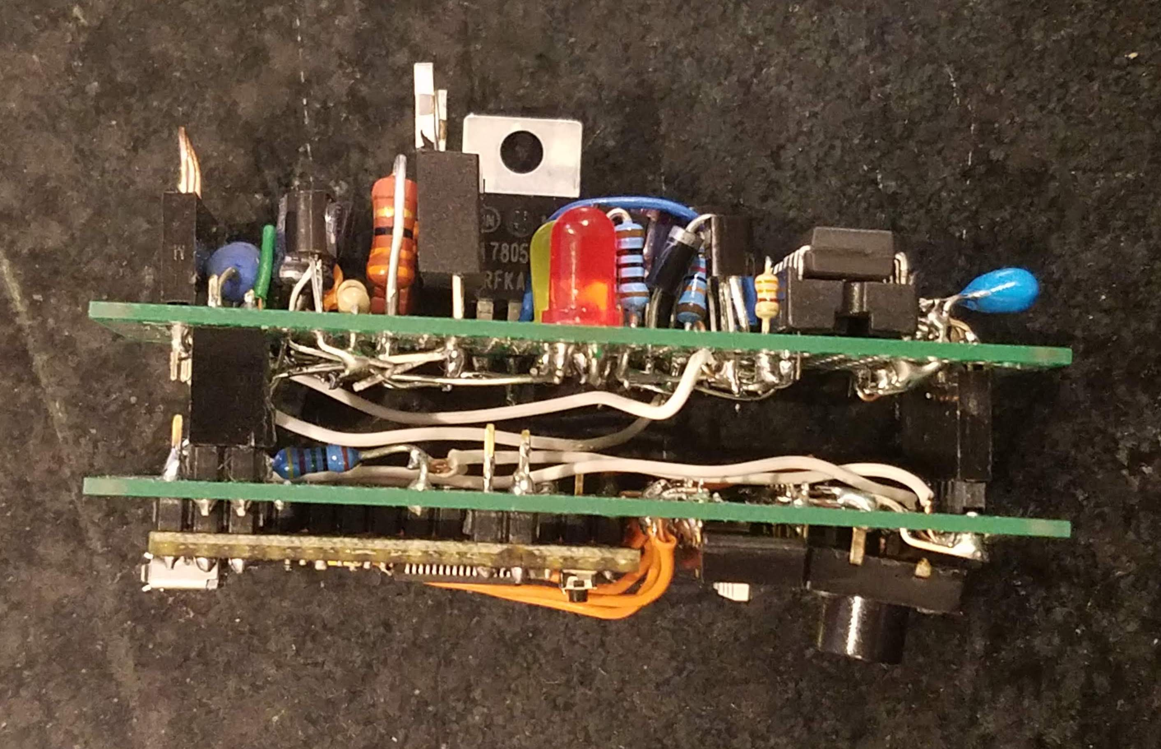
Notes:
The two boards stack together

Slide 12
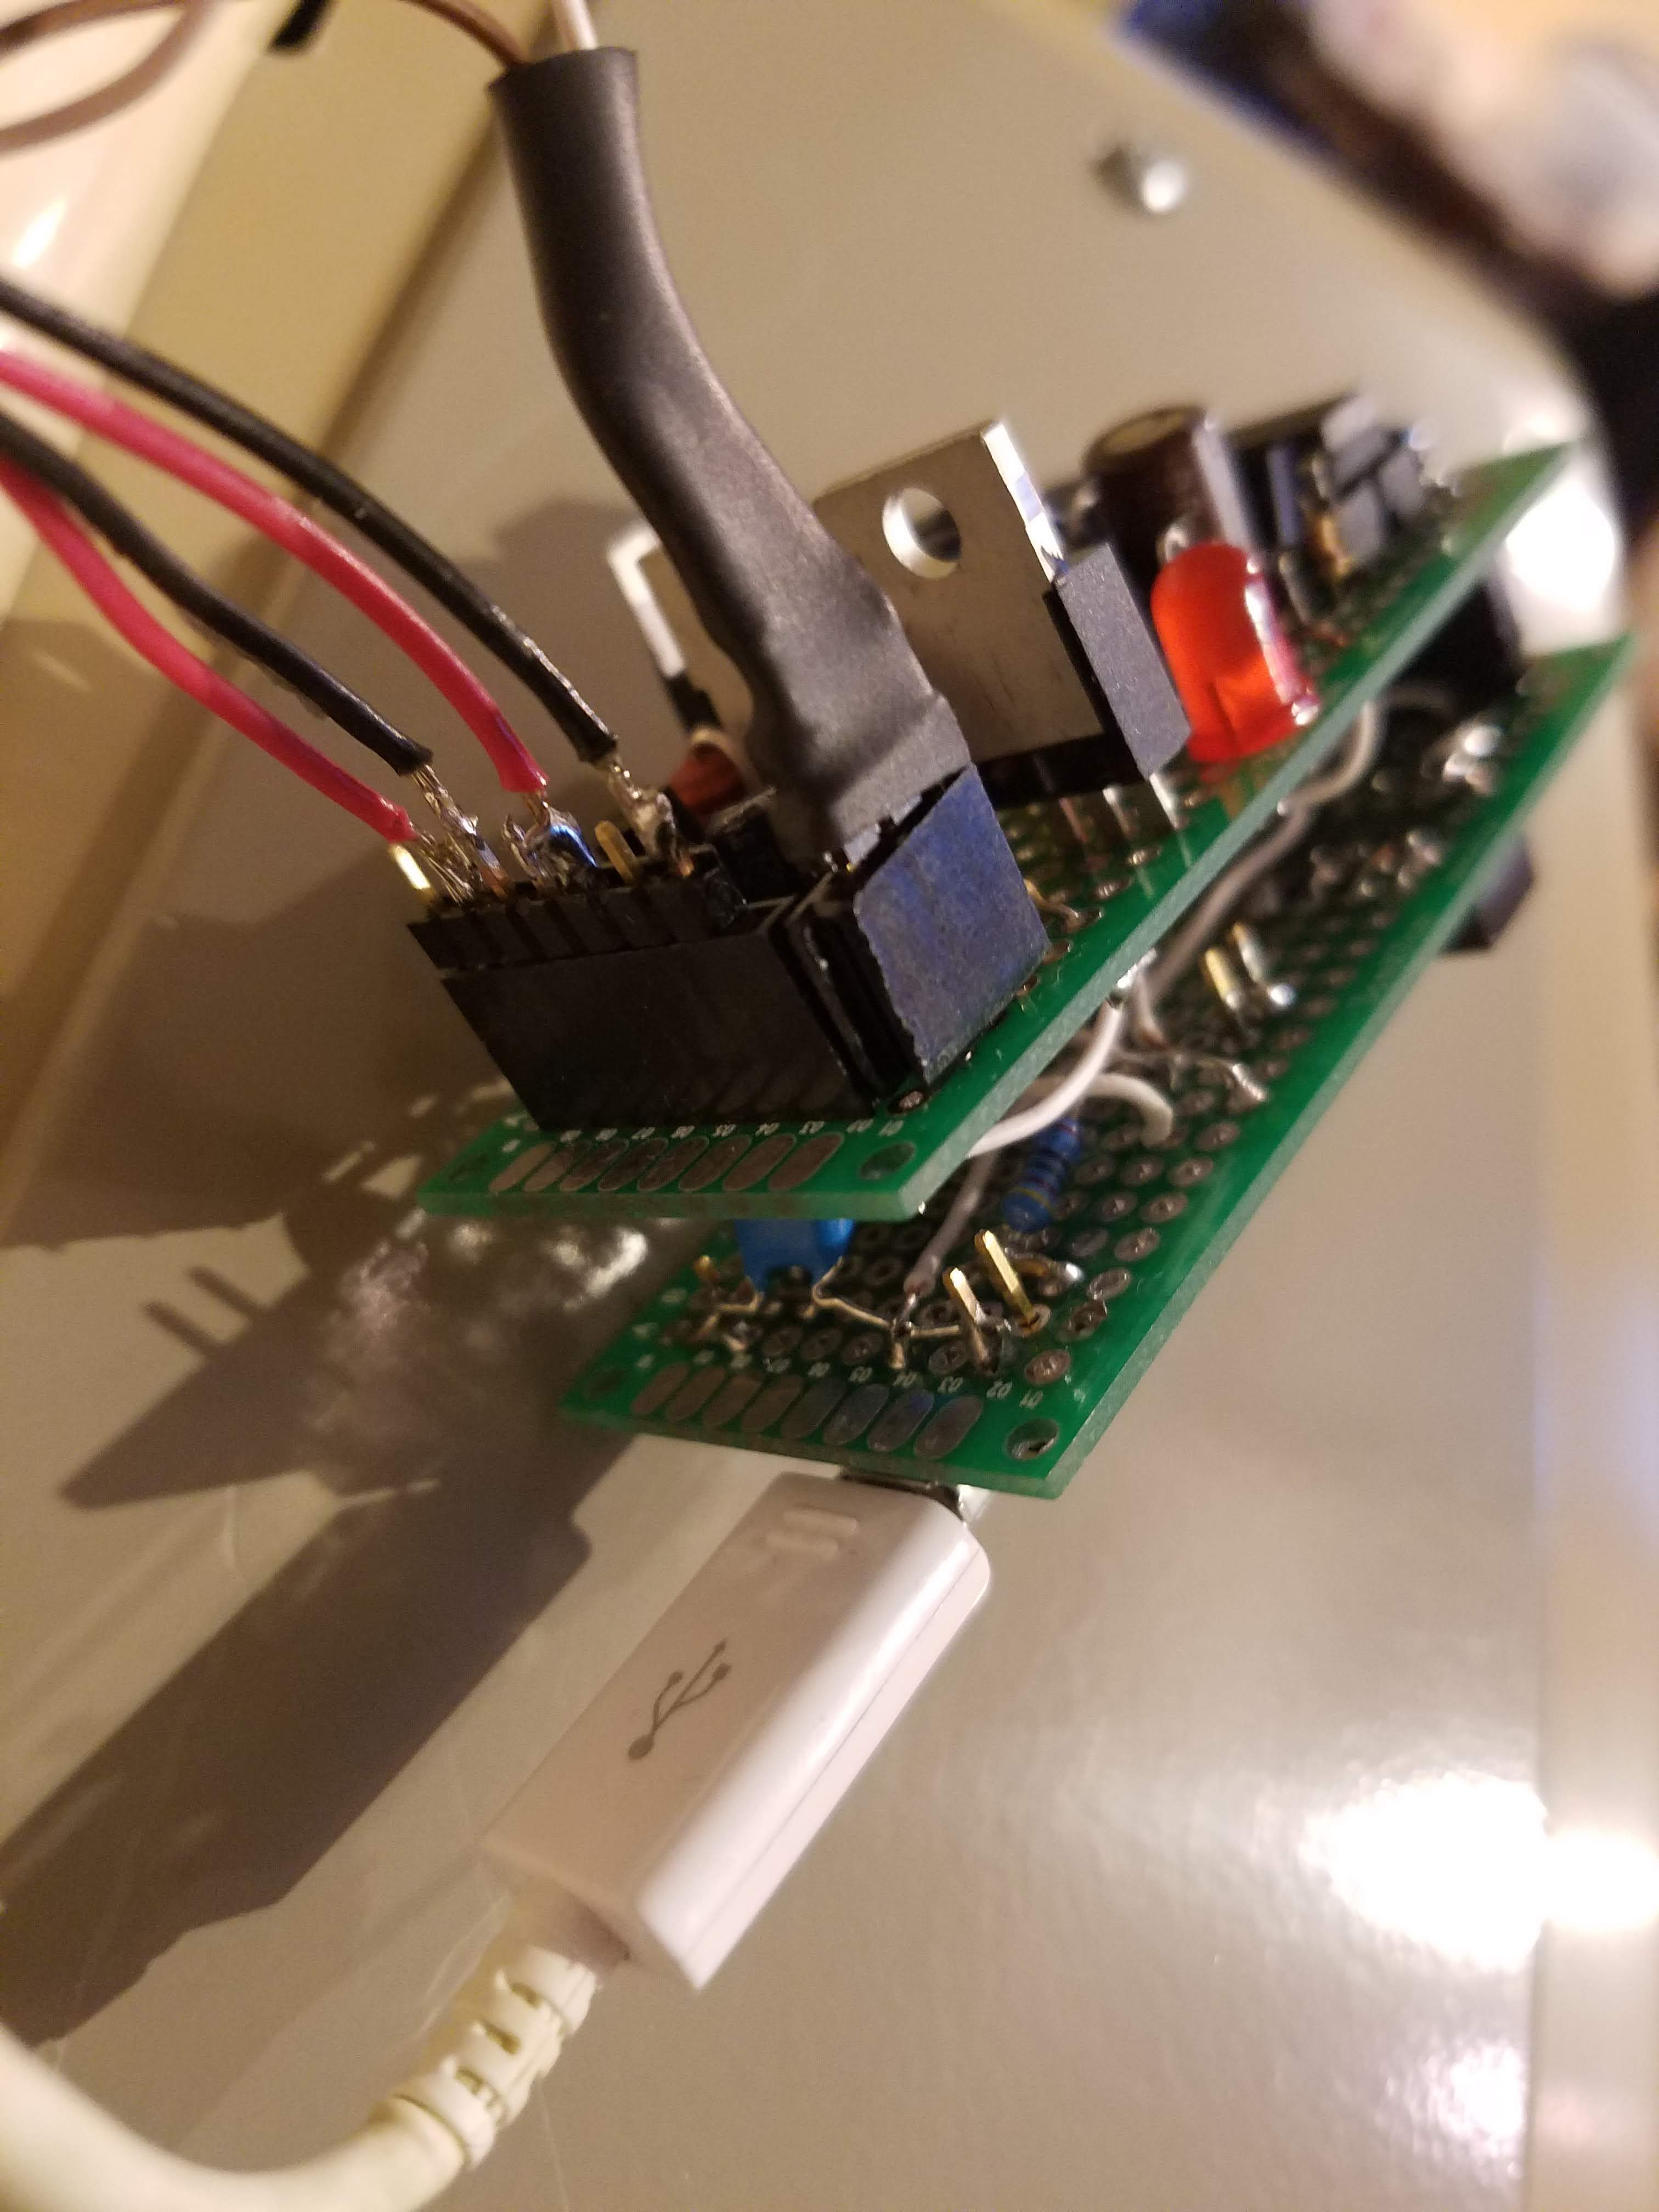
Notes:
Ready for action

Slide 13
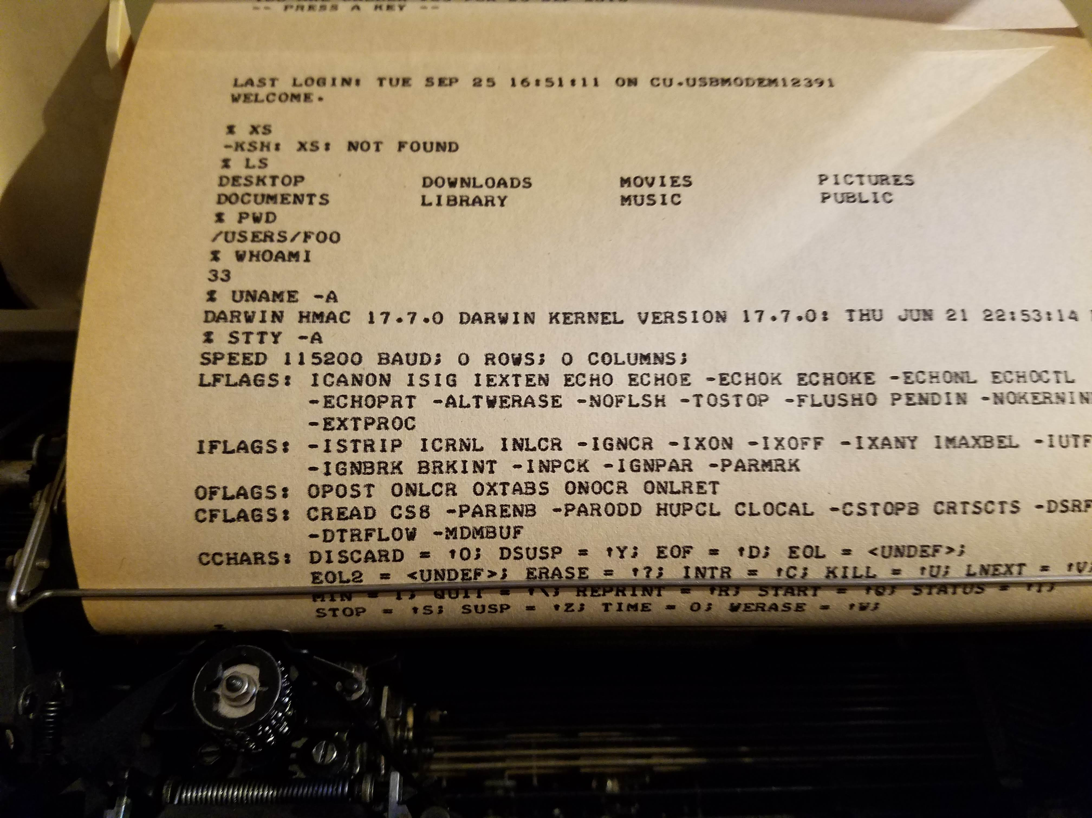
Notes:
Interfacing to OSX. Note that the host thinks this terminal runs at 115200 baud, because that’s the serial-USB speed that the Teensy microcontroller is running.

