Slide 1
tty/usb
20mA loop USB interface for ASR33 teletype
Duplex (separate transmit and receive loops)
Active (integrated current source, since ASR33 is passive)
Monitor activity with LEDs
110 baud loop data
Some translation and processing in Teensy firmware (switchable)
Uppercase → lowercase
ASCII-63 special characters to Unicode
Delay after CR, LF

Slide 2
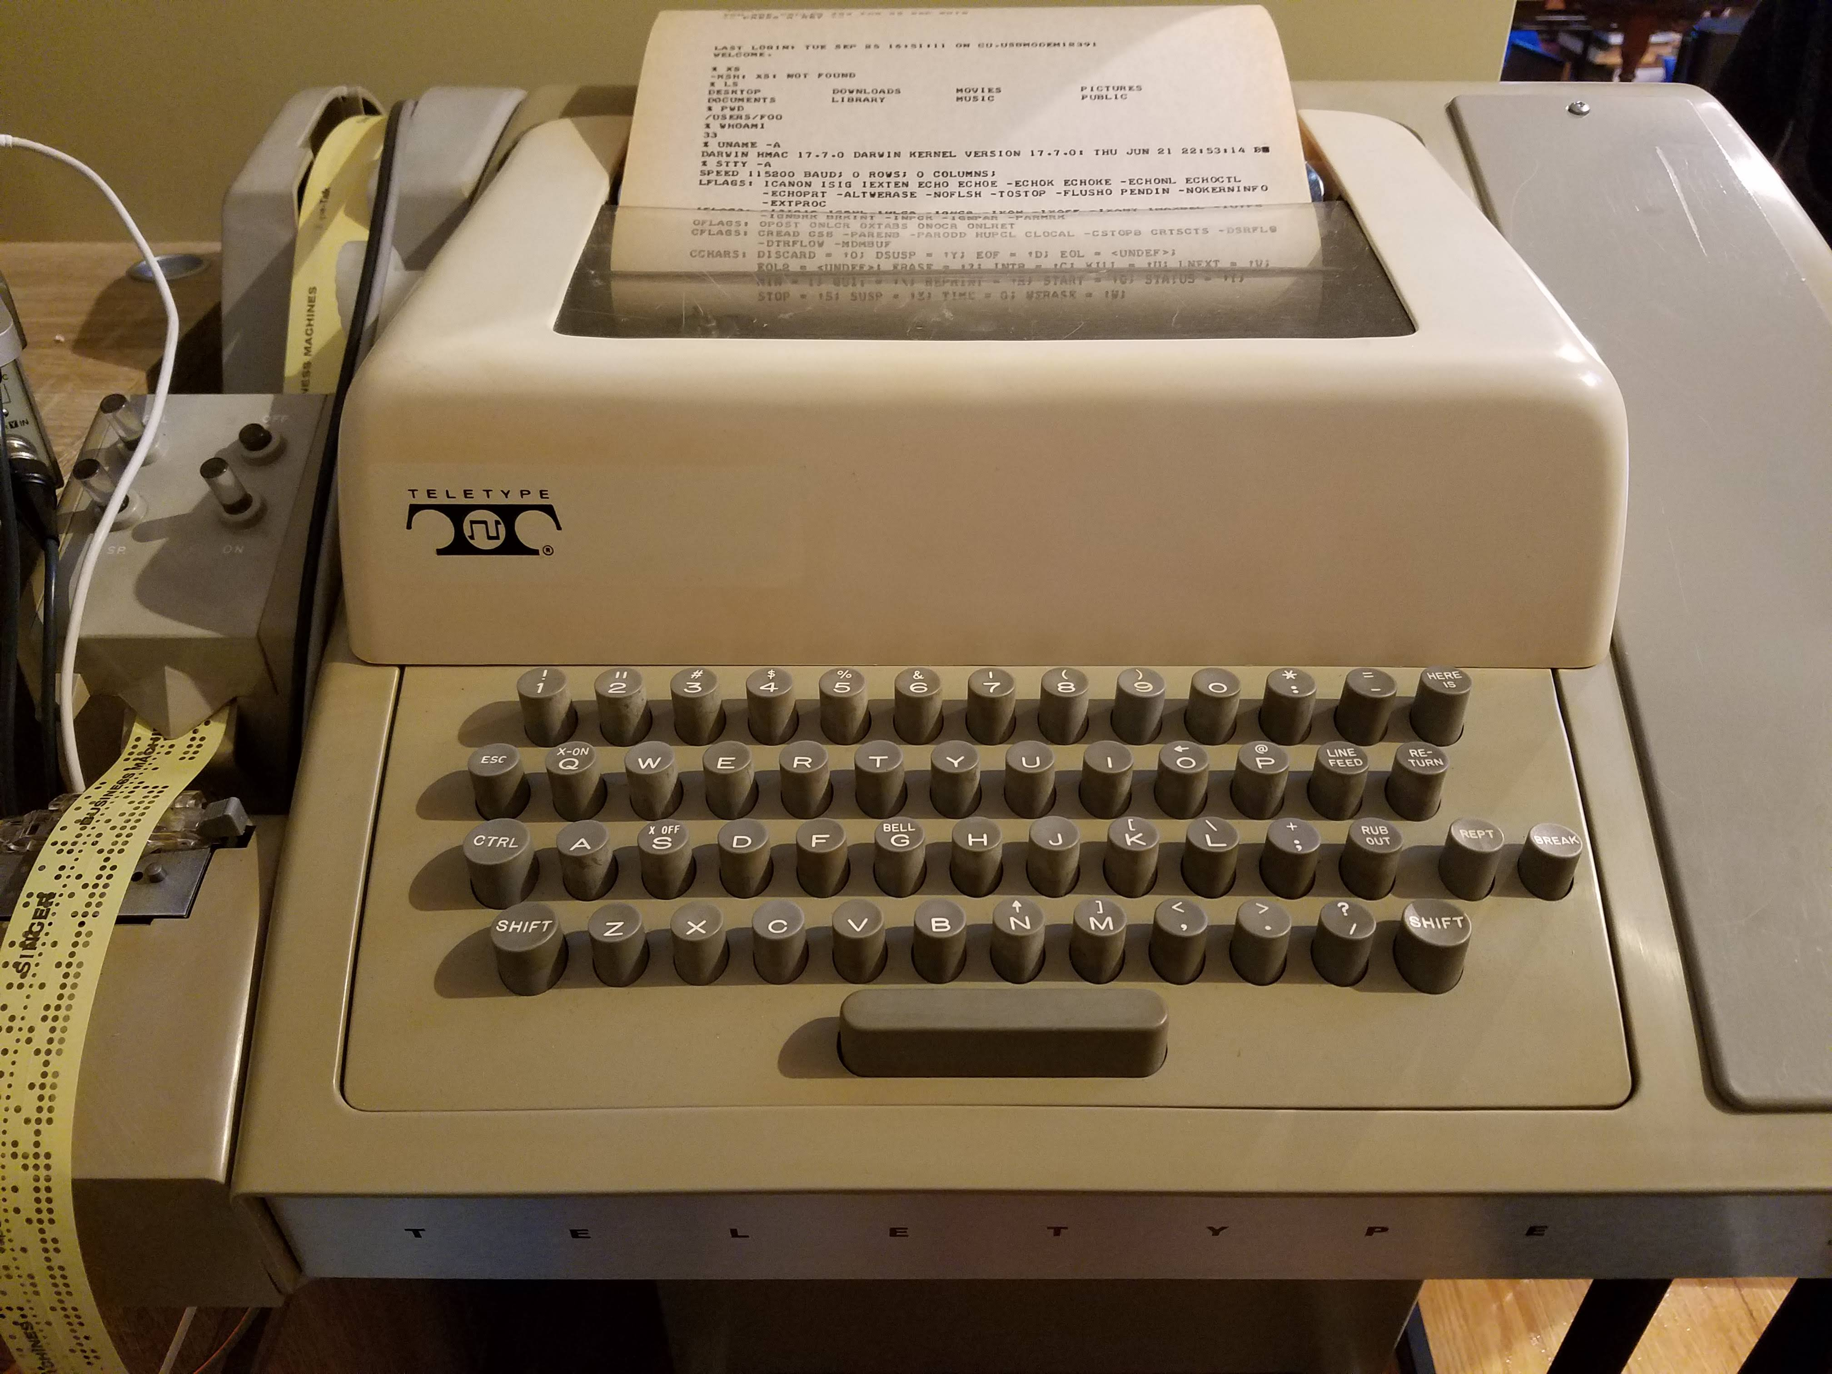

Slide 3
Overall electronics
Teensy RX
USB
19.2 VDC
20mA
loop supply
Red LED
Loop To Teensy
tty “send”
(keyboard)
4
3
Teensy TX
USB
20mA
loop supply
Yellow LED
Teensy To Loop
tty “receive”
(printer)
7+
6-

Slide 4
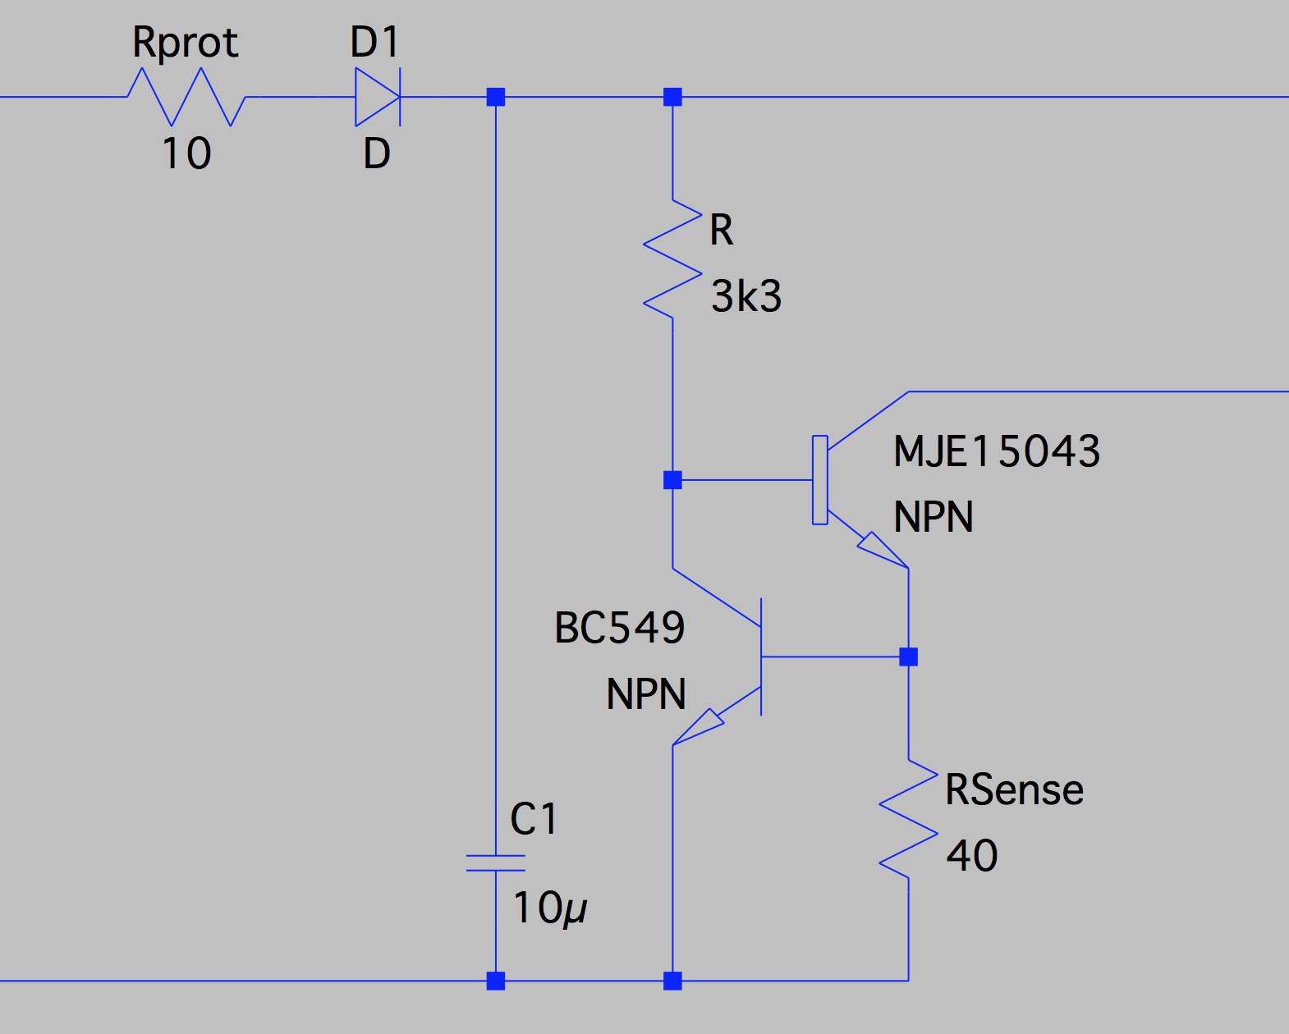
20mA loop supply
Current loop 20mA
19.2 VDC
Notes:
Current regulator pushes max ~20mA into the loop.
This should survive short-circuit at the loop (since that’s how the loop works!) and also tolerate anything around ~12V to ~24V supply.

Slide 5
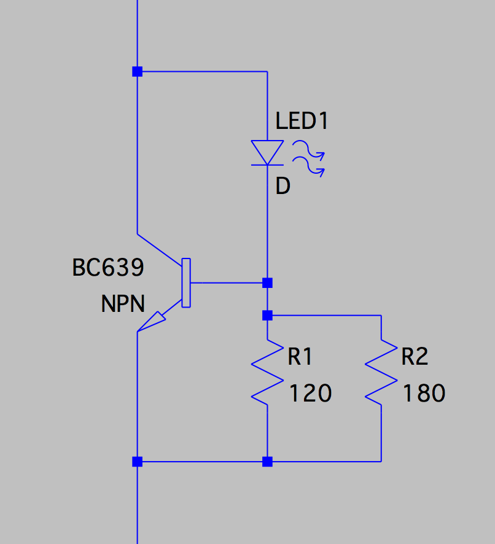
LED driver (~10mA)
Current loop
Notes:
LED current driver running ~10mA for standard 5mm red/yellow LEDs.

Slide 6
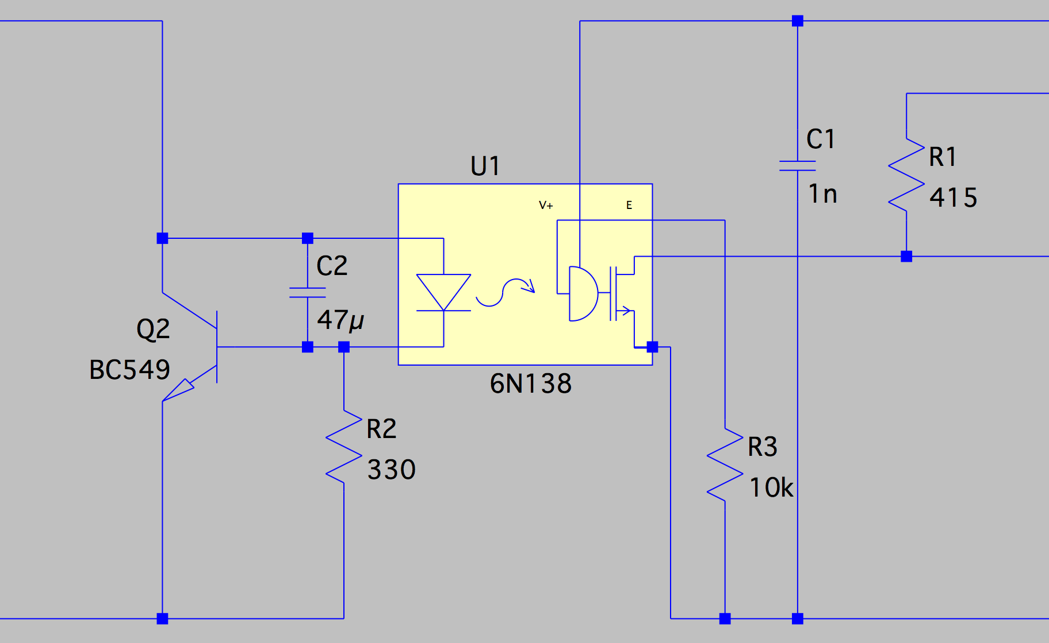
Loop to Teensy
Teensy 5V
Teensy 3.3V
Current loop
Teensy RX (pin 20)
Teensy GND
Notes:
LED current driver runs ~3mA into the opto-isolator.
The 47u capacitor filters out all the line noise, gives a slow rise-time for 110-baud operation. (Doesn’t need to be this big!).
On the other side, Teensy receives the serial signal. The 6N138 needs 5V power, from the Teensy.
NB the output is “inverted” (mark=low, space=high), and this needs to be handled in the receiver software.

Slide 7
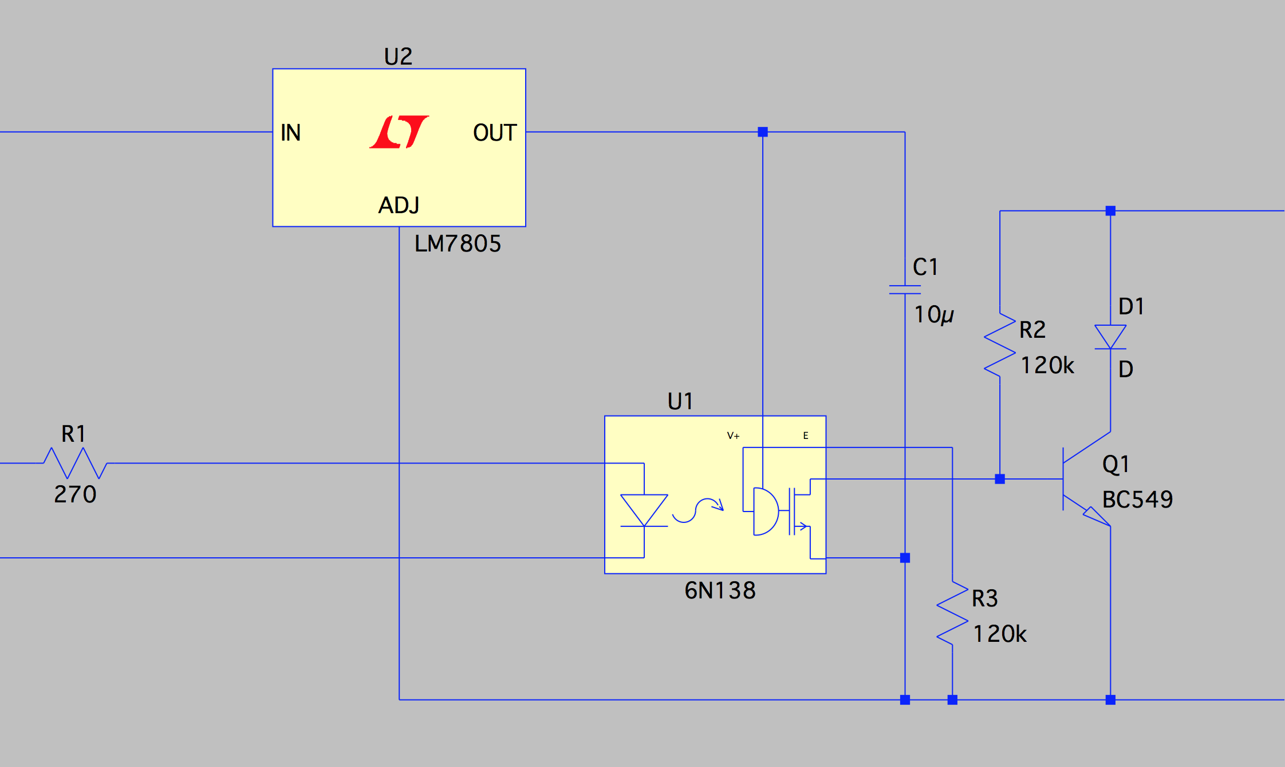
Teensy To Loop
19.2 VDC (@ loop supply)
Current
loop
Teensy TX (pin 21)
Teensy GND
Notes:
Teensy drives the opto-isolator LED through a small resistor.
The 6N138 needs a 5V supply, which we get by regulating down the 19.2V source used for the loop.
Output is a switched current that can handle ~20mA or more.
NB the output is “inverted” (high=mark, low=space low=mark=low, space=high), and this needs to be handled in the transmitter software.

Slide 8
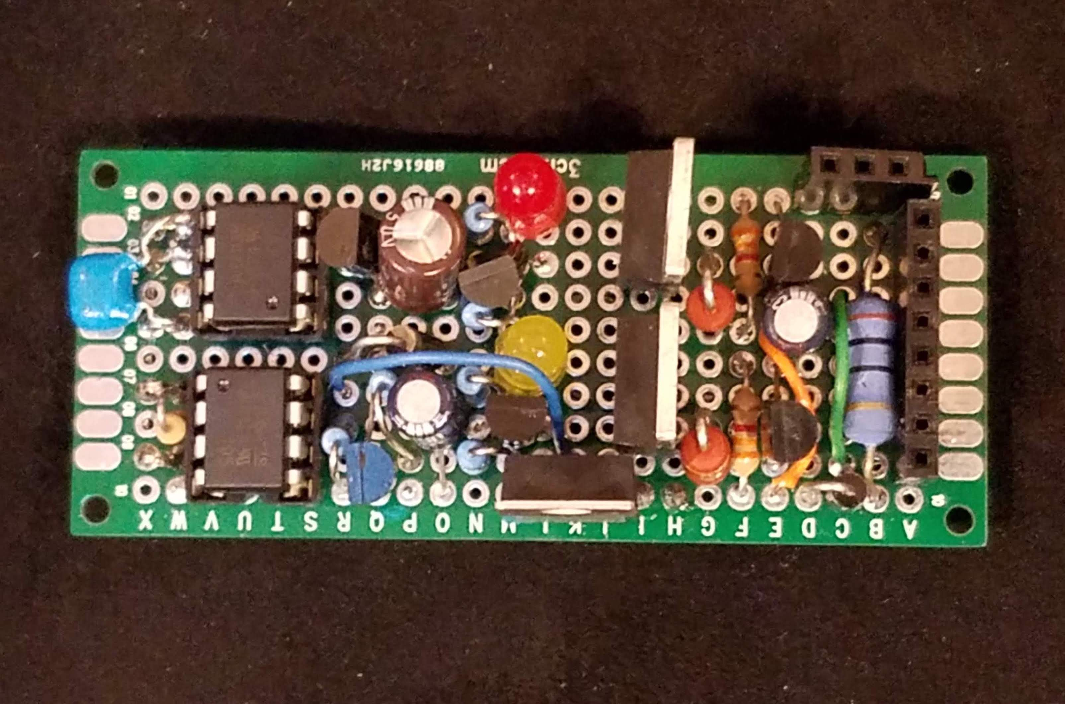
VIN +19.2
TTY 7 +RECEIVE
VIN GND
TTY 6 –RECEIVE
n/c
TTY 3 SEND
TTY 4 SEND
VIN GND

Slide 9
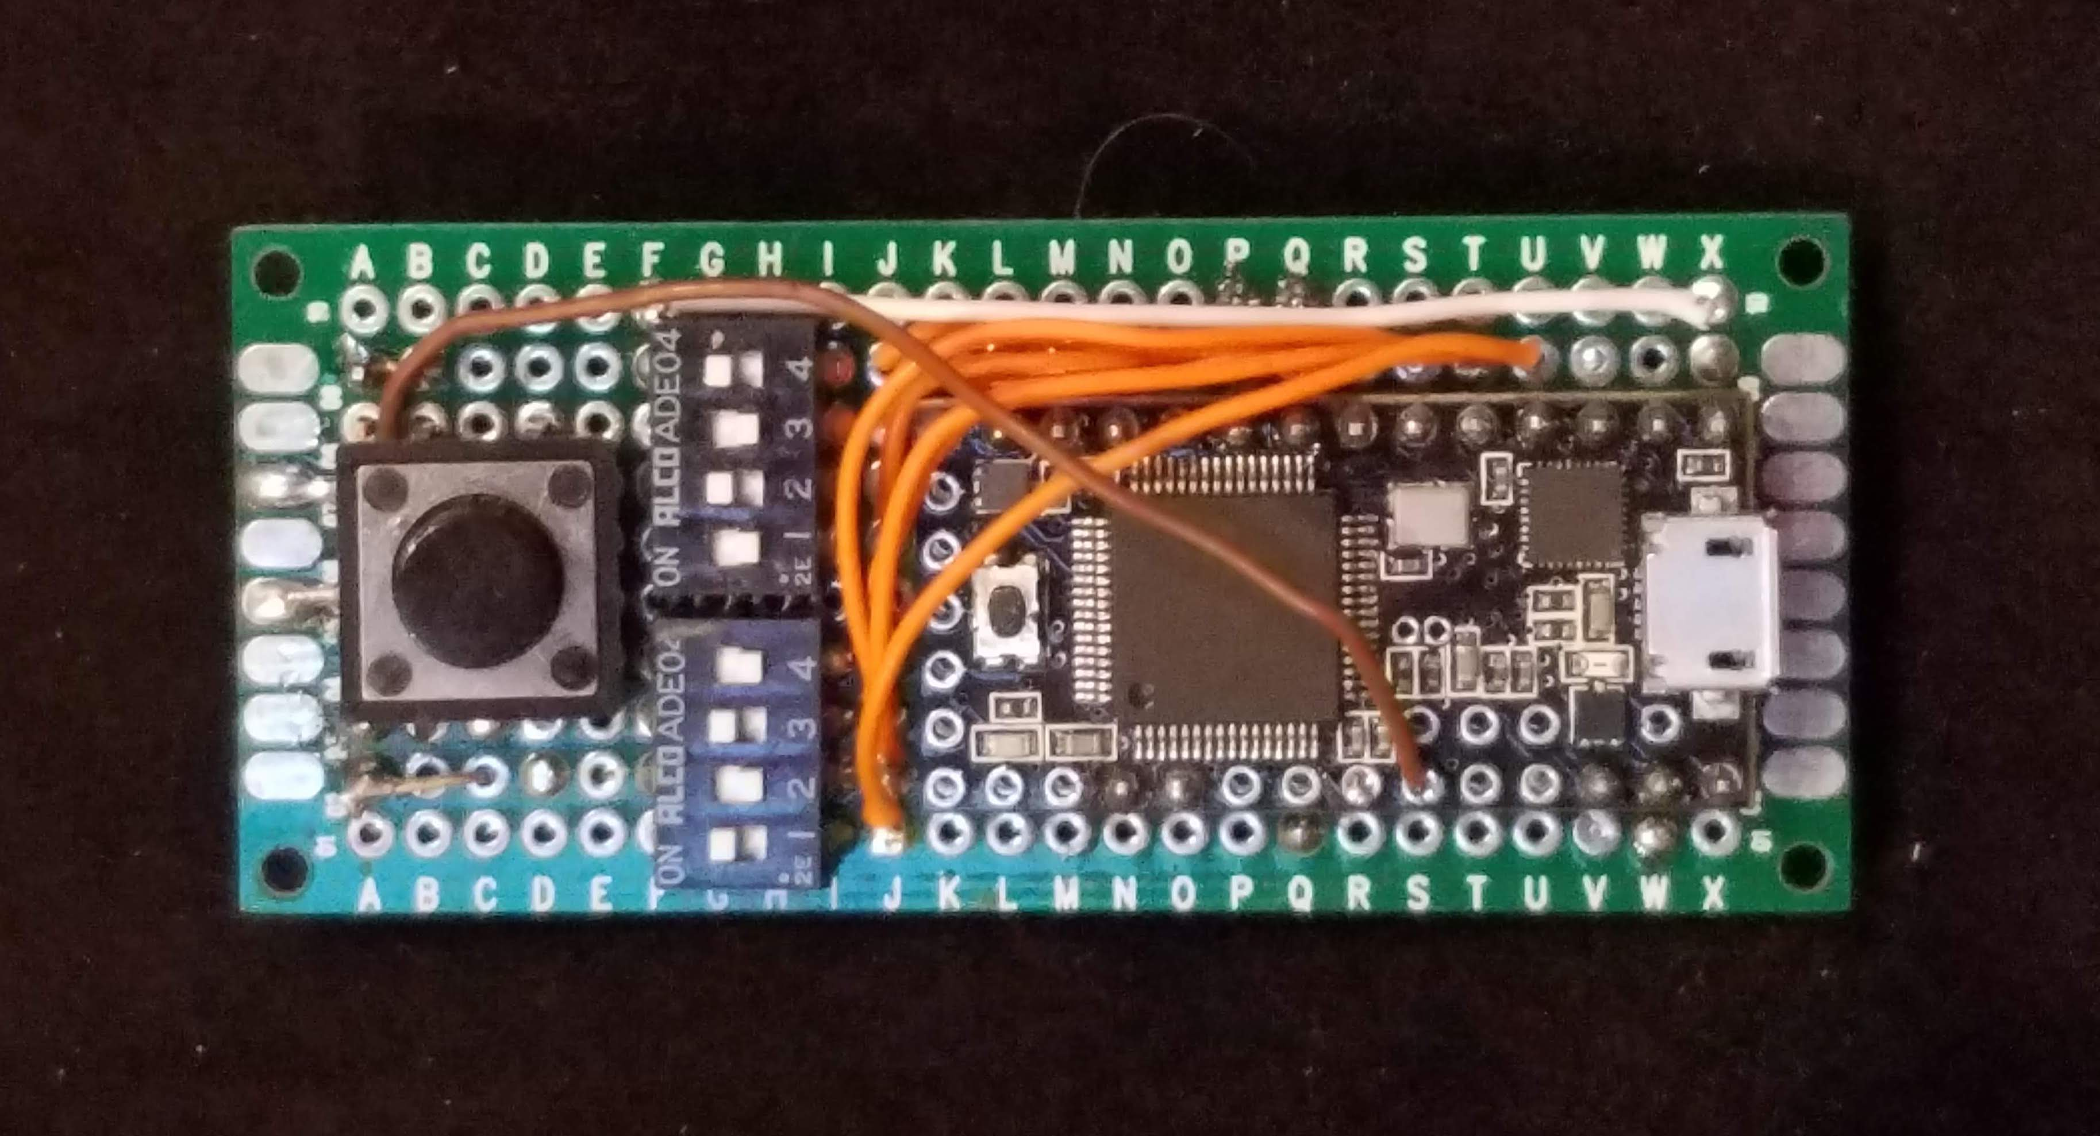

Slide 10
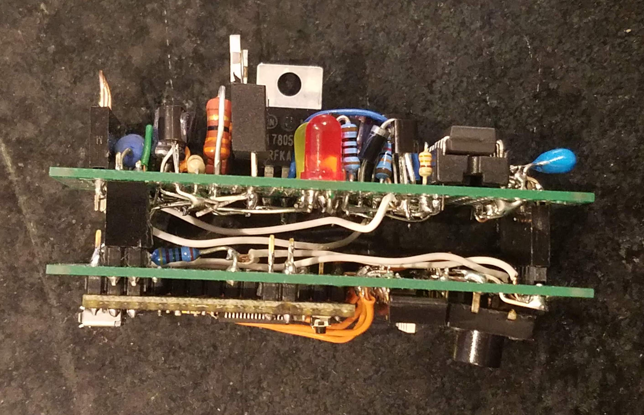

Slide 11
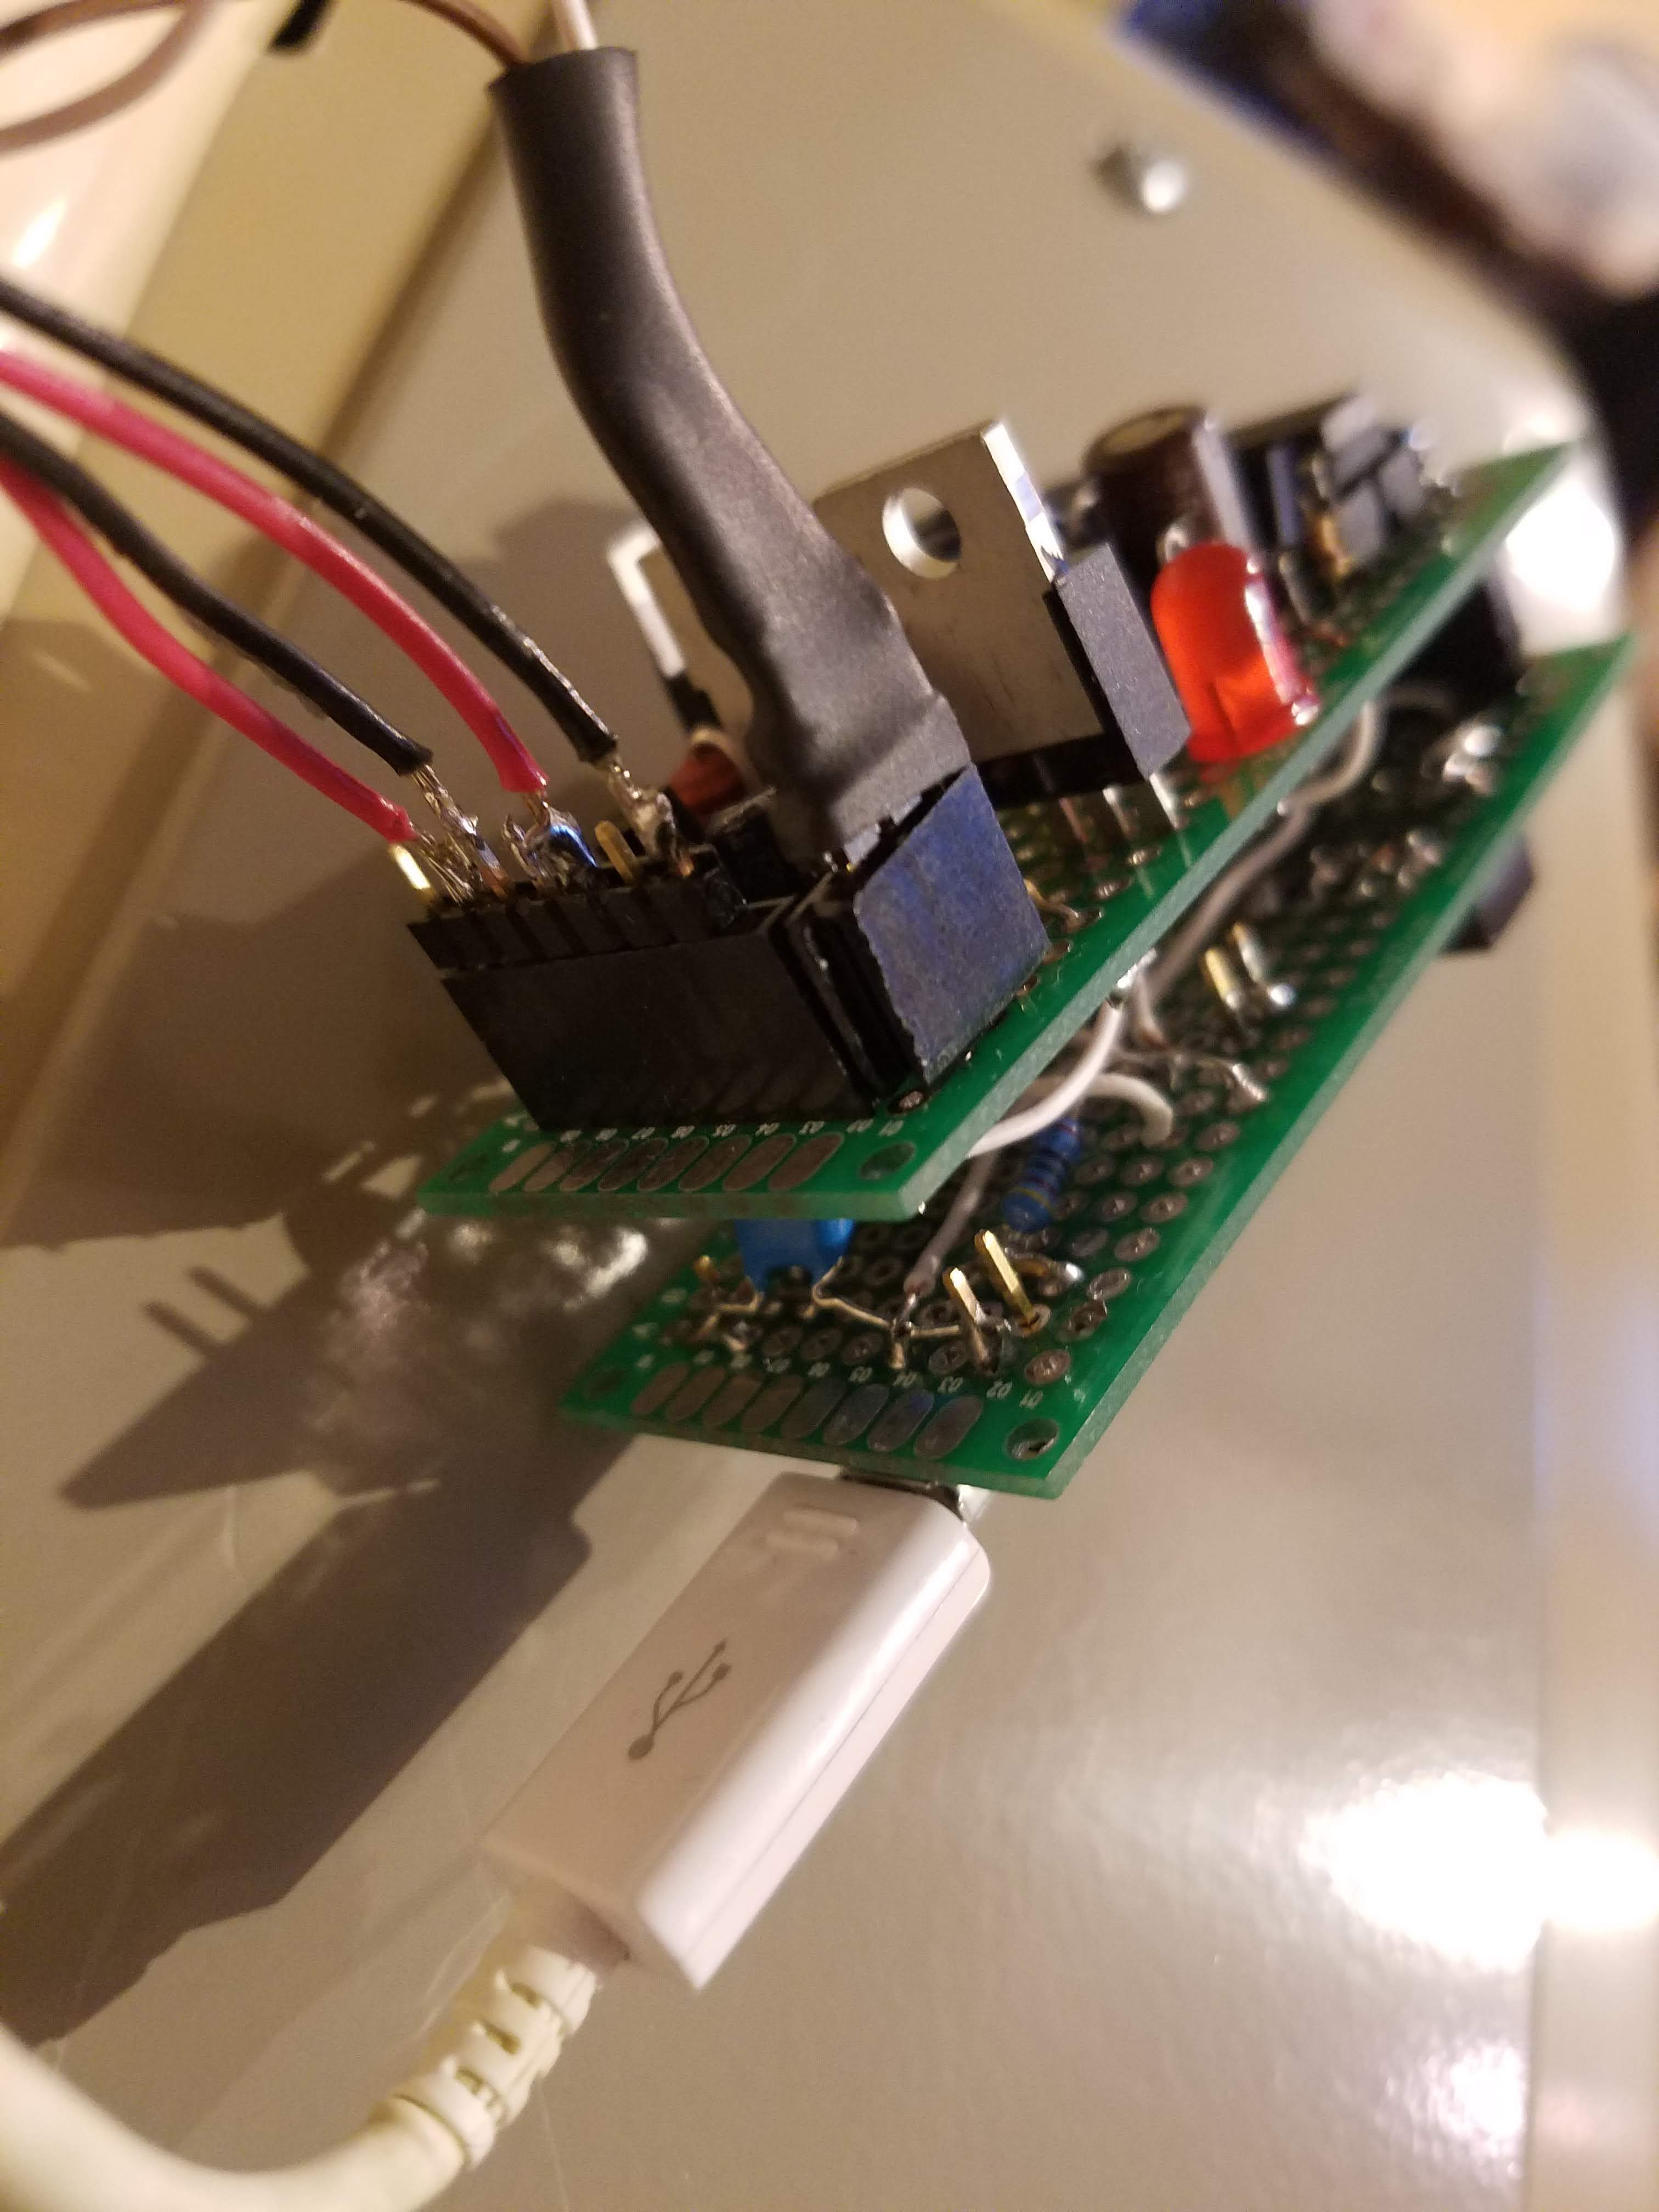

Slide 12
