Slide 1
Bash project: Movies
Linux script to get informed about the best movies
Sananikone Maud Vallée Eliot Vercier Hadrien
Wang Christian

Slide 2
Table of content
* Goal
* The steps
* What the scripts do

Slide 3
Goal
The Objectif is to do a script that gives you the 5 best movies of a month
The countries and the date can be precised (France and actual month by default)

Slide 4
The steps
Download the files that containts the informations
Clean the content of the files
Match the data between the 2 files
Do a graphical interface (create an html file)

Slide 5
Download the files with the data
2 data files from IMDB’s ftp :
Rating.list.gz
Release-dates.list.gz
Script to get the data :
Use of wget to download the files
Use of gunzip to decompress the files (with the flag –O)

Slide 6
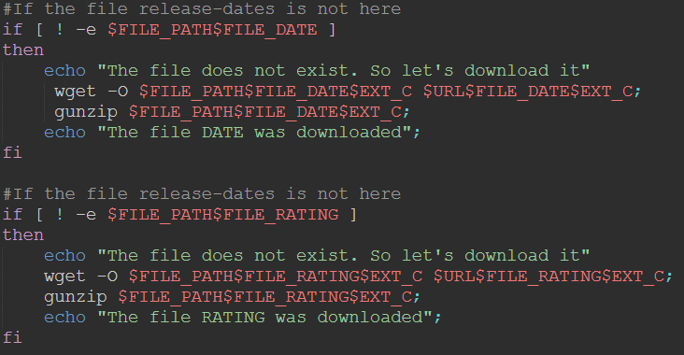
Download the files with the data
Use of the script open_files.sh :

Slide 7
Clean the content of the files (clean.sh)
The content was a little messy
Serie, video internet, video game
The date of all the country for the release date
Columns useless like « Distribution »
Script to clean it:
Use of sed for almost all the operations
Remove useless column
Get all the line from the date and the country requested
Remove the series with their particular pattern
Remove some particular case (i.e the release date of Festivals)

Slide 8
Clean.sh bash script sample
First, we affect the names of the files we will use for this script
We will clean the two following files
FILE_DATE="release-dates.list";
FILE_RATING="ratings.list";
These two files are temporary files, we delete them at the end of the script
FILE_DATE_TEMP="release-dates-temp.list";
FILE_RATING_TEMP="ratings-temp.list";
These two files are the files cleaned
FILE_DATE_PARSED="release-dates-parsed.list";
FILE_RATING_PARSED="ratings-parsed.list";
We check if the cleaned files exist, if so, we delete them
if [ -e $FILE_PATH$FILE_DATE_PARSED ]
then
rm $FILE_PATH$FILE_DATE_PARSED;
fi
if [ -e $FILE_PATH$FILE_RATING_PARSED ]
then
rm $FILE_PATH$FILE_RATING_PARSED;
fi

Slide 9
Clean.sh bash script sample
The first sed delete all lines between CRC and MOVIE RATINGS from the file rating.list
The second sed delete all lines between – and For further
The third sed get the lines having the word (2014), which correspond to films produced in 2014
The fourth sed replace all spaces, blanks, by one space
The cut divide the file into column with a space as the separator, and add all column except de 2 first one into the temporary file rating-temp
sed '/^CRC/,/^MOVIE RATINGS/d' $FILE_PATH$FILE_RATING |
sed '/^--/,/^For further/d' | sed -n "/($YEAR)/p" |
sed -e 's/\s\s*/ /g' |
cut -d' ' -f3- >$FILE_PATH$FILE_RATING_TEMP;

Slide 10
Clean.sh bash script sample
The following program check for each line of the temp file if the first column, containing the votes of persons, is less or equal than 1500. This was done because certain movie getting less than 1500 votes didn’t exist or weren’t out yet. We put the result into a temporary file temp.txt
exec<$FILE_PATH$FILE_RATING_TEMP;
while read line
do
login=$(echo $line | cut -d' ' -f1);
if [ $login -ge 1500 ]
then
echo $line >> temp.txt;
fi
done
We delete rating_temp, we don’t keep the first column of the temp.txt file, we recreate rating_temp and fill it. We delete temp.txt
rm $FILE_PATH$FILE_RATING_TEMP;
cut -d' ' -f2- temp.txt > $FILE_PATH$FILE_RATING_TEMP;
rm temp.txt;

Slide 11
Clean.sh bash script sample
The first sed delete all lines between CRC and ====from the file release_dates.list
The second sed get lines where the word France is present
The third sed get the word (2014)
The fourth sed get films released in May 2014
We convert the file into utf-8. We need to do so to be able to proceed with word containing special characters
We delete all lines containing a word after the release date, we add the result into the release –dates-temp file
sed '/^CRC/,/^====/d' $FILE_PATH$FILE_DATE |
sed -n "/$COUNTRY/p" |
sed -n "/($YEAR)/p" |
sed -n "/$MONTH $YEAR/p" |
iconv -f ISO-8859-1 -t utf-8 |
sed -e "/\(20[0-9][0-9]\)\t*(.*)/d" > $FILE_PATH$FILE_DATE_TEMP;

Slide 12
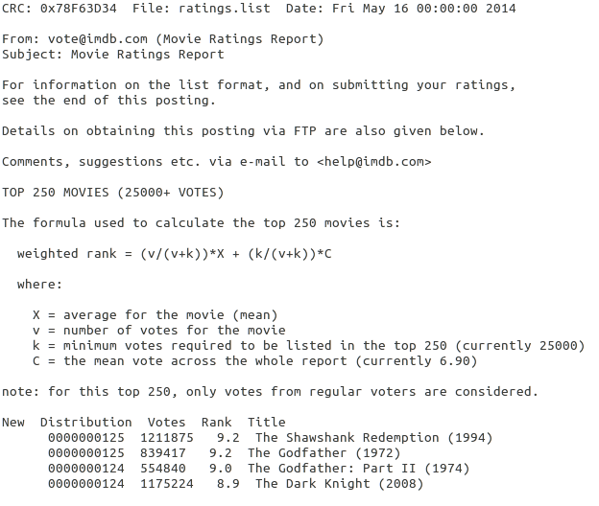
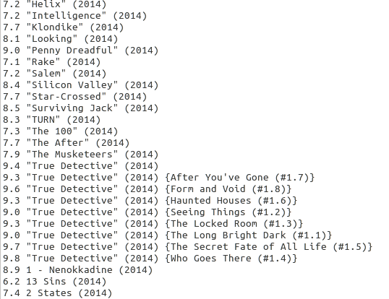
Clean.sh bash script sample
The ratings.list file at the beginning
The file after the first cleaning

Slide 13
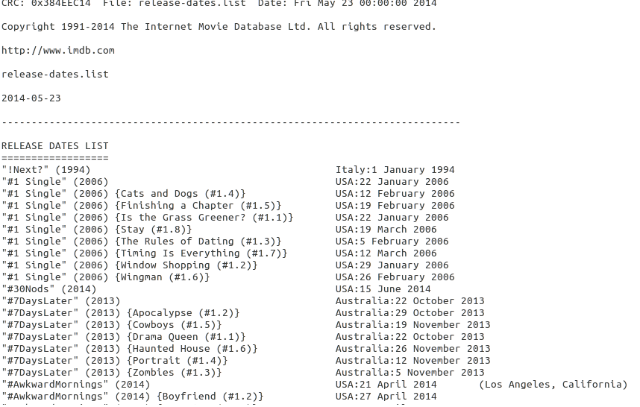
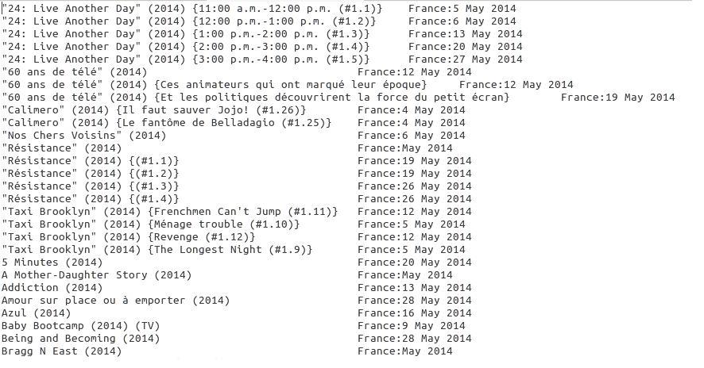
Clean.sh bash script sample
The release_dates.list
file at the beginning
The file after cleaning

Slide 14
Clean.sh bash script sample
In order to remove all the series, we delete every lines that containt {words} and the line before this pattern.
We store every line in a buffer. Whenever the pattern matches, we delete the content present in both, the pattern space which contains the current line, the buffer which contains the previous line.
The other sed is to remove the empty lines created by the first sed
sed -n '/{.*}/{s/.*//;x;d;};x;p;${x;p;}' $FILE_PATH$FILE_DATE_PARSED |
sed '/^$/d' > $FILE_PATH$FILE_DATE_TEMP;
sed -n '/{.*}/{s/.*//;x;d;};x;p;${x;p;}' $FILE_PATH$FILE_RATING_PARSED | sed '/^$/d' > $FILE_PATH$FILE_RATING_TEMP;

Slide 15
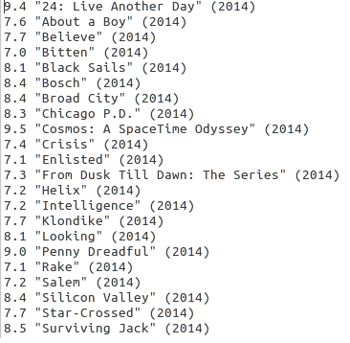
Clean.sh bash script sample
The file at the step before
The rating file at the end

Slide 16
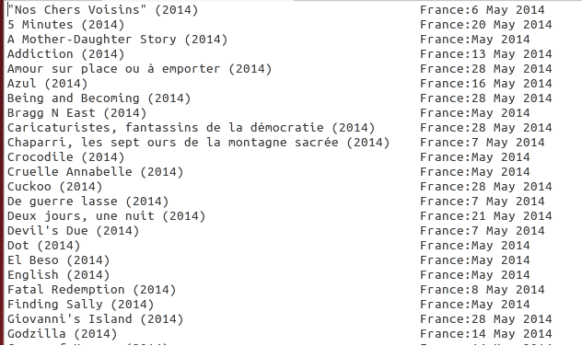
Clean.sh bash script sample
The file at the step before
The release_dates file at the end

Slide 17
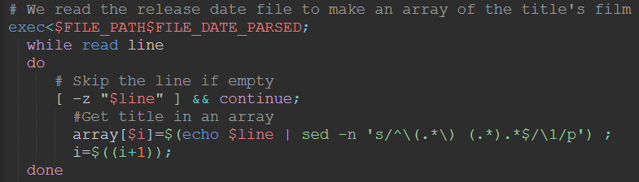
Match the files (match.sh)
Find the same film for the 2 files
Extract title from Release-date-parsed file:

Slide 18
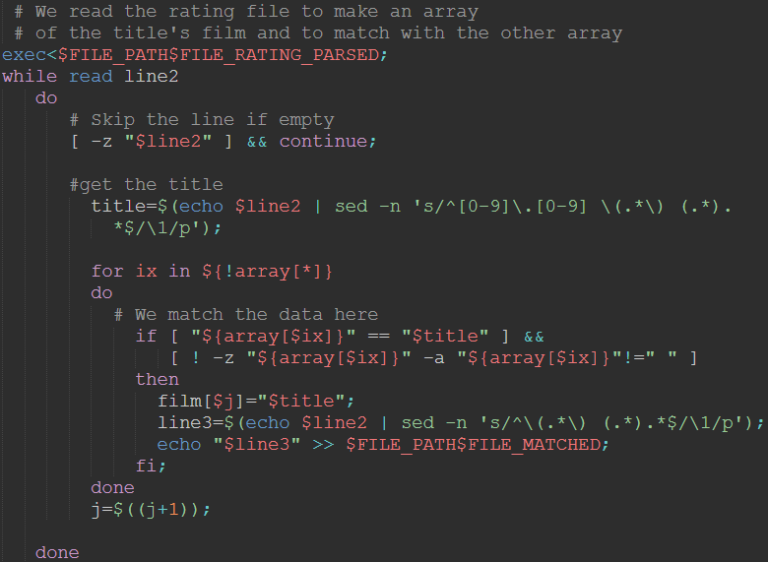
Match the files (match.sh)
Extract title from the ratings-parsed file and match in a file:

Slide 19
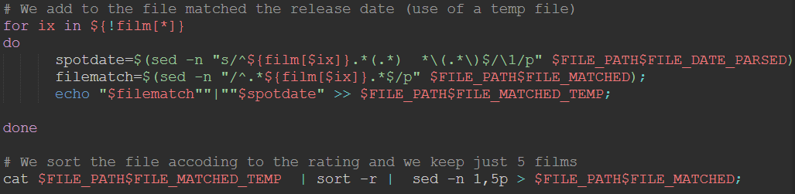
Match the files (match.sh)
Add missing informations in the matched file + sort it by score with only 5 films:

Slide 20
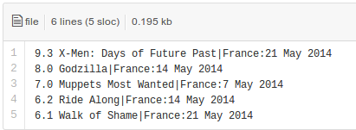
Match the files (match.sh)
Result data-to-html :

Slide 21
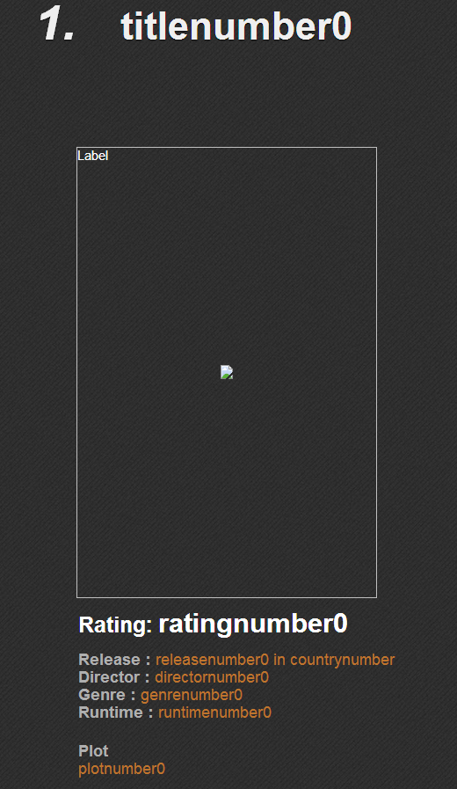
Graphical interface (html.sh)
Use of a html model :
The idea is to replace terms like ‘’ratingnumber0’’ by the value extrated from data-to-html.txt
Use of an API to get more information like the image and the plot

Slide 22
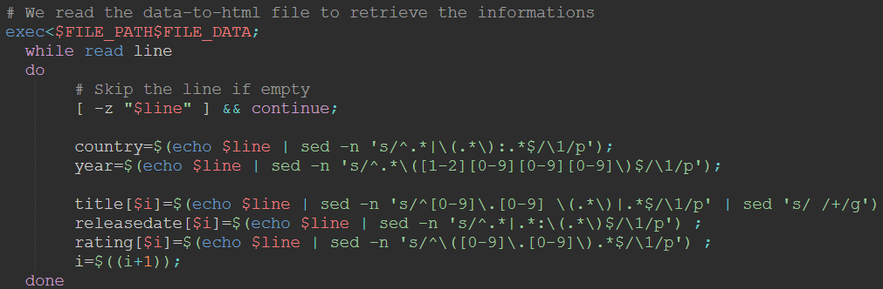
Graphical interface (html.sh)
Extract info from data-to-html.txt:
We also transform the title by replacing whitespace by + for the GET request of the API

Slide 23
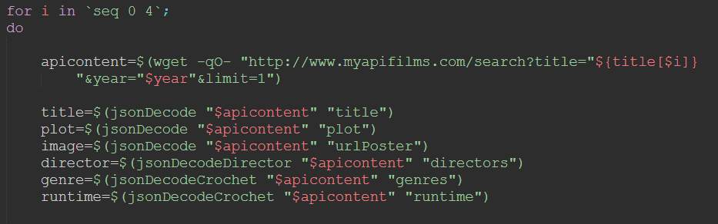
Graphical interface (html.sh)
Get API informations :
Use of functions for scrapping the json response

Slide 24
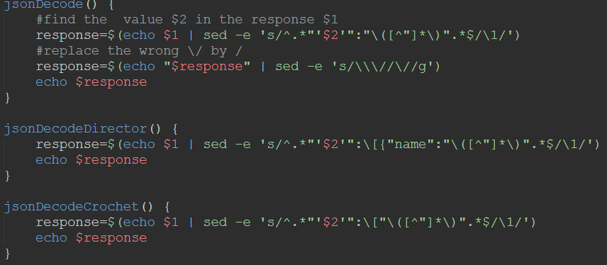
Graphical interface (html.sh)
Get API informations :
The functions for scrapping the json response :

Slide 25
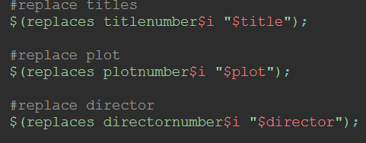
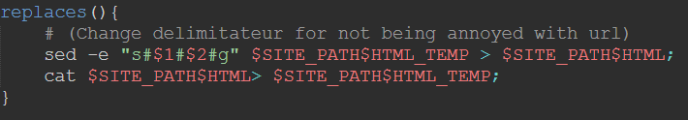
Graphical interface (html.sh)
Replace the all the informations in the html
The functions for scrapping the json response :

Slide 26
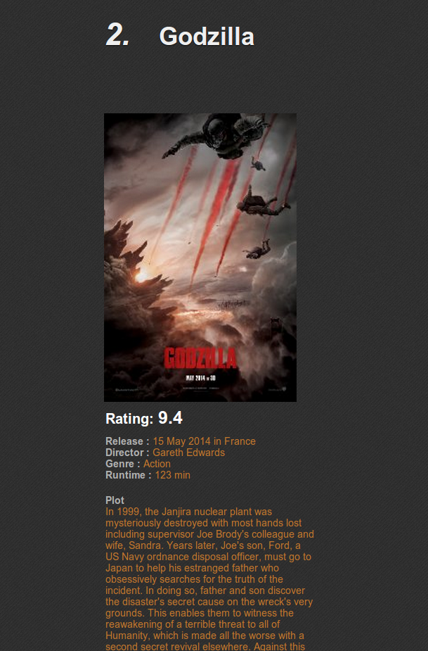
Final Result

Slide 27
Conclusion
To easily run the project : start.sh
Regroup all the sript in the right order
Give the possibility to use arguments for the date or country
Automaticly open the html file in the default browser

Slide 28
Conclusion
The parsing of the file was the most complicated thing because :
The files were messy
The patterns had to be analysed
Even after the last step we modified the cleaning of the file because not good enough (took the vote in count)
Interesting project
Learn a lot with these script
The final result is satisfying

