Slide 1
-~- IOSA PROJECT -~- SOUNDCLOUD ADVANCED SEARCH MODULE
William Tragnée
Julie Maslorz
Sarah Marcon

Slide 2
Summary
The project
What is Soundcloud?
Why this project?
Tools used
Soundcloud API
Putty / Bash / PHP script
Demonstration

Slide 3

WHAT IS SOUNDCLOUD ?
An audio platform where people can upload or record songs, promote them, create playlists and share their favorite songs.
Free account / premium account for professionals

Slide 4

SOUNDCLOUD TAG SEARCH PROJECT
Idea : search music by tags on Soundcloud
Why?
Search on Soundcloud : by artist, title, playlist, people, group
We wanted to search also by tags like we do on Tumblr, Instagram or Twitter
The user should be able the search by one or several tags : #rock #pop

Slide 5
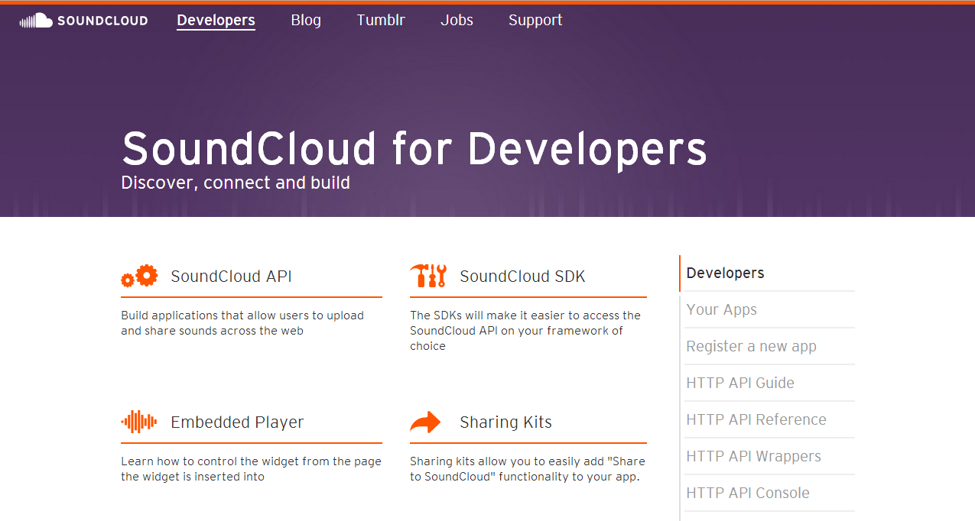
TOOLS USED : SOUNDCLOUD API

Slide 6
TOOLS USED : SOUNDCLOUD API
Connection to the API
Create an account
Create a new application : access tokens are given (clientID and clientPrivate)
Add the right lines in the code :

Slide 7

TOOLS USED : PUTTY / BASH / PHP
PUTTY
A SSH software : allow secured connection to a server
BASH / PHP
Using bash
Calling a PHP file using VIM
Notes:
À compléter, je sais pas trop quoi dire … =(

Slide 8
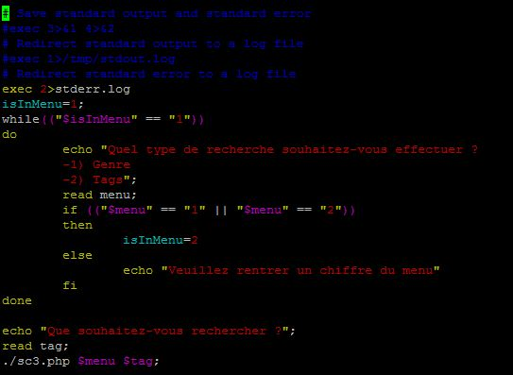
DEMONSTRATION : OUR CODE
In Bash, we have to execute the file scs.sh :
Notes:
Imprim écran du code, explication succincte.

Slide 9
DEMONSTRATION : OUR CODE
First, with the “menu”, the user is asked to select the kind of search he wants to do.
Second, we check if the user answer is a possible value. If not, the user is asked to select again.
Third, the file sc3.php is called.

Slide 10
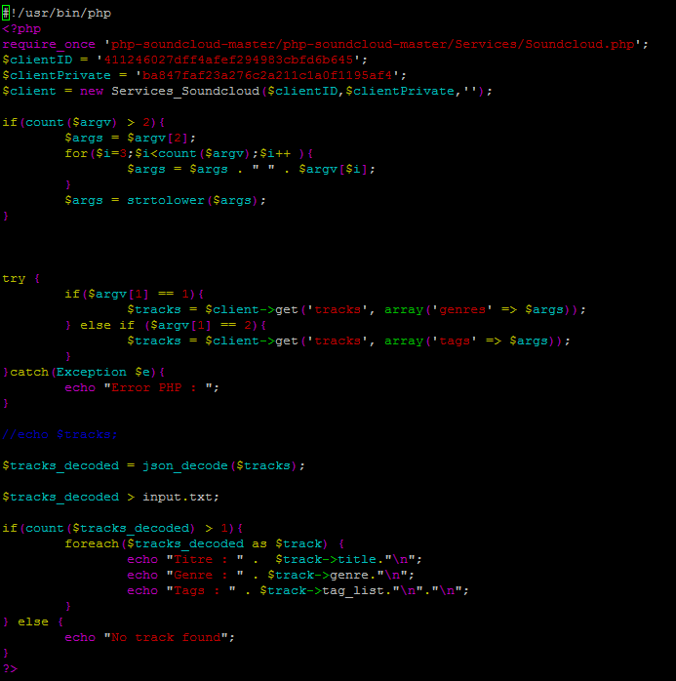
DEMONSTRATION : OUR CODE
The file sc3.php :
Notes:
Imprim écran du code, explication succincte.

Slide 11
DEMONSTRATION : OUR CODE
First, we connect our application to the Soundcloud API.
Second, the research of the user is analysed and concatenated in case of space use.
Third, according to the user’s choice (“genre” or “tag”), we catch informations from the Soundcloud API.
Finally, we decode the JSON file received and display the result.

Slide 12
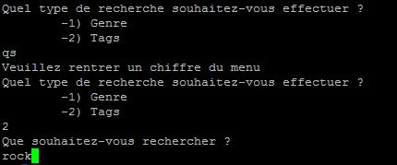
DEMONSTRATION : RESULT
If a bad information is entered, the user have to retry.

Slide 13
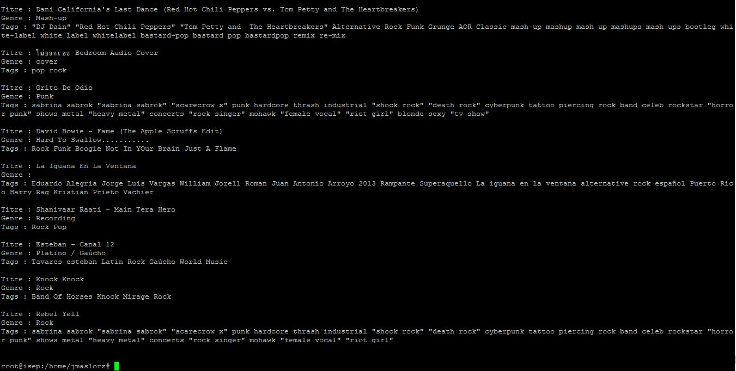
DEMONSTRATION : RESULT
Search for tag « rock »:

Slide 14
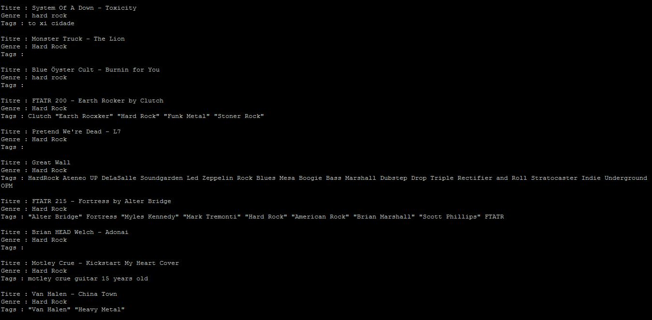
DEMONSTRATION : RESULT
Search for genre « Hard Rock » :

Slide 15
Conclusion
The purpose of this project was to find informations about songs from Soundcloud by entering a tag, what we can do now.
However, it would be interesting to be able to find informations by taping several tags. After some researches, it seems the Soundcloud API needs to fix some bugs about the “tag_list” attribute.

