Slide 1
CIS471/571, Fall 2018
Introduction to Artificial Intelligence
Instructor: Dejing Dou
Office hours: Mondays 4:00pm-5:00pm
Nov. 2, 2018

Slide 2
Chapter 13
Handling Uncertain Knowledge
Syntax for Probability
  Axioms of Probability
  Prior Probability
  Conditional Probability
Inference and Independence
Bayes’ Rule

Slide 3
Uncertainty
Let action A_{t} = leave for airport t minutes before flight
Will A_{t} get me there on time?
Problems:
  partial observability (road state, other drivers' plans, etc.)
  noisy sensors (traffic reports)
  uncertainty in action outcomes (flat tire, etc.)
  immense complexity of modeling and predicting traffic
Hence a purely logical approach either
  risks falsehood: “A₂₅ will get me there on time”, or
  leads to conclusions that are too weak for decision making:
“A₂₅ will get me there on time if there's no accident on the bridge and it doesn't rain and my tires remain intact etc etc.”
(A₁₄₄₀ might reasonably be said to get me there on time but I'd have to stay overnight in the airport …)

Slide 4
Methods for handling uncertainty
Default or nonmonotonic logic:
  Assume my car does not have a flat tire
  Assume A₂₅ works unless contradicted by evidence
Issues: What assumptions are reasonable? How to handle contradiction?
Rules with fudge factors:
  A₂₅ |→_{0.3} get there on time
  Sprinkler |→ _{0.99} WetGrass
  WetGrass |→ _{0.7} Rain
Issues: Problems with combination, e.g., Sprinkler causes Rain??
Probability
  Model agent's degree of belief
  Given the available evidence,
  A₂₅ will get me there on time with probability 0.03

Slide 5
Probability
Probabilistic assertions summarize effects of
  laziness: failure to enumerate exceptions, qualifications, etc.
  ignorance: lack of relevant facts, initial conditions, etc.
Subjective probability:
Probabilities relate propositions to agent's own state of knowledge
e.g., P(A₂₅ | no reported accidents) = 0.06
These are not assertions about the world
Probabilities of propositions change with new evidence:
e.g., P(A₂₅ | no reported accidents, 5 a.m.) = 0.15

Slide 6
Making decisions under uncertainty
Suppose we believe the following:
  P(A₂₅ gets me there on time | …) = 0.04
  P(A₉₀ gets me there on time | …) = 0.70
  P(A₁₂₀ gets me there on time | …) = 0.95
  P(A₁₄₄₀ gets me there on time | …) = 0.9999
Which action to choose?
Depends on my preferences for missing flight vs. time spent waiting, etc.
  Utility theory is used to represent and infer preferences
  Decision theory = probability theory + utility theory

Slide 7
Syntax
Basic element: random variable
Similar to propositional logic: possible worlds defined by assignment of values to random variables.
Boolean random variables
  e.g., Cavity (do I have a cavity?)
Discrete random variables
  e.g., Weather is one of <sunny,rainy,cloudy,snow>
Domain values must be exhaustive and mutually exclusive
Elementary proposition constructed by assignment of a value to a random variable: e.g., Weather = sunny, Cavity = false (abbreviated as ¬cavity)
Complex propositions formed from elementary propositions and standard logical connectives e.g., Weather = sunny ∨ Cavity = false
  Y/N

Slide 8
Syntax
Atomic event: A complete specification of the state of the world about which the agent is uncertain
  E.g., if the world consists of only two Boolean variables Cavity and Toothache, then there are 4 distinct atomic events:
    Cavity = false ∧Toothache = false
    Cavity = false ∧ Toothache = true
    Cavity = true ∧ Toothache = false
    Cavity = true ∧ Toothache = true
Atomic events are mutually exclusive and exhaustive

Slide 9
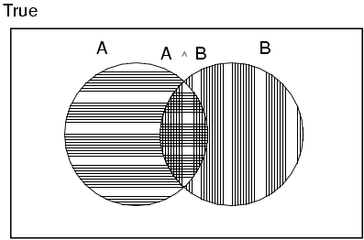
Axioms of probability
For any propositions A, B
  0 ≤ P(A) ≤ 1
  P(true) = 1 and P(false) = 0
  P(A ∨ B) = P(A) + P(B) - P(A ∧ B)

Slide 10
Prior probability
Prior or unconditional probabilities of propositions
  e.g., P(Cavity = true) = 0.1 and P(Weather = sunny) = 0.72 correspond to belief prior to arrival of any (new) evidence
Probability distribution gives values for all possible assignments:
  P(Weather) = <0.72,0.1,0.08,0.1> (normalized, i.e., sums to 1)
Joint probability distribution for a set of random variables gives the probability of every atomic event on those random variables
  P(Weather,Cavity) = a 4 × 2 matrix of values:
Weather = sunny rainy cloudy snow
Cavity = true 0.144 0.02 0.016 0.02
Cavity = false 0.576 0.08 0.064 0.08
Every question about a domain can be answered by the joint distribution

Slide 11
Conditional probability
Conditional or posterior probabilities
  e.g., P(cavity | toothache) = 0.8
  i.e., given that toothache is all I know
(Notation for conditional distributions:
  P(Cavity | Toothache) = 2-element vector of 2-element vectors)
If we know more, e.g., cavity is also given, then we have
  P(cavity | toothache,cavity) = 1
New evidence may be irrelevant, allowing simplification, e.g.,
  P(cavity | toothache, sunny) = P(cavity | toothache) = 0.8
This kind of inference, conducted by domain knowledge, is crucial

Slide 12
Conditional probability
Definition of conditional probability:
  P(a | b) = P(a ∧ b) / P(b) if P(b) > 0
Product rule gives an alternative formulation:
  P(a ∧ b) = P(a | b) P(b) = P(b | a) P(a)
A general version holds for whole distributions, e.g.,
  P(Weather,Cavity) = P(Weather | Cavity) P(Cavity)
(View as a set of 4 × 2 equations, not matrix mult.)
Chain rule is derived by successive application of product rule:
  P(X₁, …,X_{n}) = P(X₁,...,X_{n-1}) P(X_{n} | X₁,...,X_{n-1})
  = P(X₁,...,X_{n-2}) P(X_{n-1} | X₁,...,X_{n-2}) P(X_{n} | X₁,...,X_{n-1})
  = …
  = π_{i= 1} P(X_{i} | X₁, … ,X_{i-1})
n

Slide 13

Inference by enumeration
Start with the joint probability distribution:
For any proposition φ, sum the atomic events where it is true: P(φ) = Σ_{ω:ω╞φ} P(ω)
Notes:
Omega PHi

Slide 14

Inference by enumeration
Start with the joint probability distribution:
For any proposition φ, sum the atomic events where it is true: P(φ) = Σ_{ω:ω╞φ} P(ω)
P(toothache) = 0.108 + 0.012 + 0.016 + 0.064 = 0.2

Slide 15

Inference by enumeration
Start with the joint probability distribution:
Can also compute conditional probabilities:
P(¬cavity | toothache) = P(¬cavity ∧ toothache)
P(toothache)
= 0.016+0.064
0.108 + 0.012 + 0.016 + 0.064
= 0.4

Slide 16
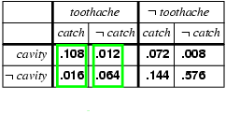
Normalization
Denominator can be viewed as a normalization constant α
P(Cavity | toothache) = α, P(Cavity,toothache)
  = α, [P(Cavity,toothache,catch) + P(Cavity,toothache,¬ catch)]
  = α, [<0.108,0.016> + <0.012,0.064>]
  = α, <0.12,0.08> = <0.6,0.4>
General idea: compute distribution on query variable by fixing evidence variables and summing over hidden variables

Slide 17
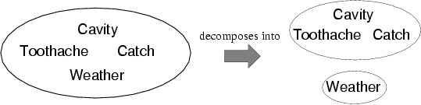
Independence
A and B are independent iff
P(A|B) = P(A) or P(B|A) = P(B) or P(A, B) = P(A) P(B)
  P(Toothache, Catch, Cavity, Weather)
  = P(Toothache, Catch, Cavity) P(Weather)
Absolute independence powerful but rare

Slide 18
Conditional independence
P(Toothache, Cavity, Catch) has 2³ – 1 = 7 independent entries
If I have a cavity, the probability that the probe catches in it doesn't depend on whether I have a toothache:
  (1) P(catch | toothache, cavity) = P(catch | cavity)
The same independence holds if I haven't got a cavity:
  (2) P(catch | toothache,¬cavity) = P(catch | ¬cavity)
Catch is conditionally independent of Toothache given Cavity:
  P(Catch | Toothache,Cavity) = P(Catch | Cavity)
Equivalent statements:
  P(Toothache | Catch, Cavity) = P(Toothache | Cavity)
  P(Toothache, Catch | Cavity) = P(Toothache | Cavity) P(Catch | Cavity)

Slide 19
Bayes' Rule
Product rule P(a∧b) = P(a | b) P(b) = P(b | a) P(a)
⇒ Bayes' rule: P(a | b) = P(b | a) P(a) / P(b)
or in distribution form
P(Y|X) = P(X|Y) P(Y) / P(X) = αP(X|Y) P(Y)
Useful for assessing diagnostic probability from causal probability:
  P(Cause|Effect) = P(Effect|Cause) P(Cause) / P(Effect)
  Note: posterior probability of meningitis still very small!

Slide 20
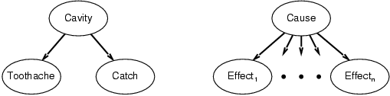
Bayes' Rule and conditional independence
P(Cavity | toothache ∧ catch)
  = αP(toothache ∧ catch | Cavity) P(Cavity)
  = αP(toothache | Cavity) P(catch | Cavity) P(Cavity)
This is an example of a naïve Bayes model:
  P(Cause,Effect₁, … ,Effect_{n}) = P(Cause) π_{i}P(Effect_{i}|Cause)
Total number of parameters is linear in n

Slide 21
Chapter 14: Bayesian Network
Syntax: Representing Knowledge in an uncertain domain
Semantics of Bayesian Network
Fuzzy Sets and Fuzzy Logic

Slide 22
Bayesian networks
A simple, graphical notation for conditional independence assertions and hence for compact specification of full joint distributions
Syntax:
  a set of nodes, one per variable
  a directed, acyclic graph (link ≈ "directly influences")
  a conditional distribution for each node given its parents:
    P (X_{i} | Parents (X_{i}))
In the simplest case, conditional distribution represented as a conditional probability table (CPT) giving the distribution over X_{i} for each combination of parent values

Slide 23

Example
Topology of Bayesian network encodes conditional independence assertions:
Weather is independent of the other variables
Toothache and Catch are conditionally independent given Cavity

Slide 24
Example
I'm at work, neighbor John calls to say my alarm is ringing, but neighbor Mary doesn't call. Sometimes it's set off by minor earthquakes. Is there a burglar?
Variables: Burglary, Earthquake, Alarm, JohnCalls, MaryCalls
Network topology reflects "causal" knowledge:
  A burglar can set the alarm off
  An earthquake can set the alarm off
  The alarm can cause Mary to call
  The alarm can cause John to call

Slide 25
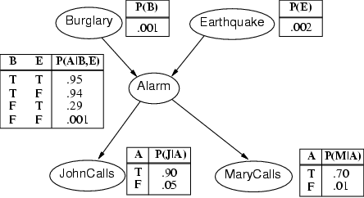
Example

Slide 26
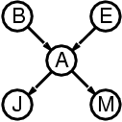
Compactness
A CPT for Boolean X_{i} with k Boolean parents has 2^{k} rows for the combinations of parent values
Each row requires one number p for X_{i} = true
(the number for X_{i} = false is just 1-p)
If each variable has no more than k parents, the complete network requires O(n · 2^{k}) numbers
  I.e., grows linearly with n, vs. O(2^{n}) for the full joint distribution
For burglary net, 1 + 1 + 4 + 2 + 2 = 10 numbers (vs. 2⁵-1 = 31)

Slide 27
Semantics
The full joint distribution is defined as the product of the local conditional distributions:
P (X₁, … ,X_{n}) = Π _{i = 1} P (X_{i} | Parents(X_{i}))
e.g., P(j ∧ m ∧ a ∧ ¬b ∧ ¬e)
= P (j | a) P (m | a) P (a | ¬b, ¬e) P (¬b) P (¬e)
n

Slide 28
Constructing Bayesian networks
1. Choose an ordering of variables X₁, … ,X_{n}
2. For i = 1 to n
  add X_{i} to the network
  select parents from X₁, … ,X_{i-1} such that
  P (X_{i} | X₁, ... X_{i-1}) = P (X_{i} | Parents(X_{i}))
This choice of parents guarantees:
P (X₁, … ,X_{n}) = Π_{i =1} P (X_{i} | X₁, … , X_{i-1})
= Π_{i =1}P (X_{i} | Parents(X_{i}))
(by construction)
(chain rule)
n
n

Slide 29
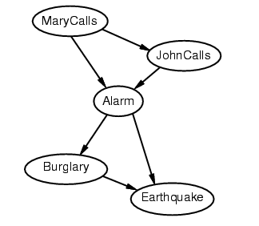
Example
Suppose we choose the ordering M, J, A, B, E
P(J | M) = P(J)?

Slide 30
Example
Suppose we choose the ordering M, J, A, B, E as diagnostic model
(symptoms to causes)
P(J | M) = P(J)?
P(A | J, M) = P(A | J)? P(A | J, M) = P(A)?
No

Slide 31
Example
Suppose we choose the ordering M, J, A, B, E
P(J | M) = P(J)?
P(A | J, M) = P(A | J)? P(A | J, M) = P(A)? No
P(B | A, J, M) = P(B | A)?
P(B | A, J, M) = P(B)?
No

Slide 32
Example
Suppose we choose the ordering M, J, A, B, E
P(J | M) = P(J)?
P(A | J, M) = P(A | J)? P(A | J, M) = P(A)? No
P(B | A, J, M) = P(B | A)? Yes
P(B | A, J, M) = P(B)? No
P(E | B, A ,J, M) = P(E | A)?
P(E | B, A, J, M) = P(E | A, B)?
No

Slide 33
Example
Suppose we choose the ordering M, J, A, B, E
P(J | M) = P(J)?
P(A | J, M) = P(A | J)? P(A | J, M) = P(A)? No
P(B | A, J, M) = P(B | A)? Yes
P(B | A, J, M) = P(B)? No
P(E | B, A ,J, M) = P(E | A)? No
P(E | B, A, J, M) = P(E | A, B)? Yes
No

Slide 34
Example
Deciding conditional independence is hard in noncausal (diagnostic) directions
(Causal models and conditional independence seem hardwired for humans!)
Network is less compact: 1 + 2 + 4 + 2 + 4 = 13 numbers needed

Slide 35
Fuzzy Sets
Fuzzy set theory: a means of specifying how well an object satisfies a vague description.
  Is Nate tall? (If we know Nate is 6’). People can say “Yes”, “No”, or “Sort of”
  “Tall” is a vague description in linguistics because it does not refer to a sharp demarcation of objects into two classes – there are degrees of tallness
Fuzzy set theory treat vague description as a fuzzy predicate and the truth value is a number in [0,1]
  The truth value of Tall(Nate) is a number in [0,1]
Fuzzy set is a set that does not have sharp boundaries

Slide 36
Fuzzy Logic
Fuzzy logic is method for reasoning with logical expressions describing membership in fuzzy sets.
  E.g.
Tall(Nate) ∧ Heavy(Nate) has a fuzzy truth value that is a function of the truth values of its components
Standard Rules:
T(A ∧ B) = min (T(A), T(B))
T(A ∨ B) = max (T(A), T(B))
T (¬ A) = 1 – T(A)
  E.g. T(Tall(Nate)) = 0.6, T(Heavy(Nate)) = 0.8
  T(Tall(Nate) ∧ ¬ Heavy(Nate)) = ?

Slide 37
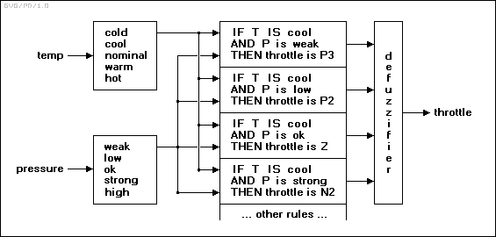
Fuzzy Control
Fuzzy Control: constructing control system in which the mappings between real-valued input and output parameters is represented by fuzzy rules.
n
N3: Large negative. N2: Medium negative. N1: Small negative. Z: Zero. P1: Small positive. P2: Medium positive. P3: Large positive.

Slide 38
Other approaches
Fuzzy logic can be explained in terms of probability theory and Bayesian Network.
  P(Observer says Nate is tall and heavy | Height, Weight)
Random sets: random variables whose values are set of objects.
  Tall is a random set whose values are set of people. The probability P(Tall = S₁), where S₁ is a particular set of people, is the probability that exactly that set would be identified as “tall” by an observer.
  P(Nate is tall) is the sum of the probability of all the sets of which Nate is a member. P(Tall = S₁) + P(Tall = S₂) …..

Slide 39
Learning
Learning agents
Inductive learning
Decision tree learning

Slide 40
Learning
Learning is essential for unknown environments,
  i.e., when designer lacks omniscience
Learning is useful as a system construction method,
  i.e., expose the agent to reality rather than trying to write it down
Learning modifies the agent's decision mechanisms to improve performance

Slide 41
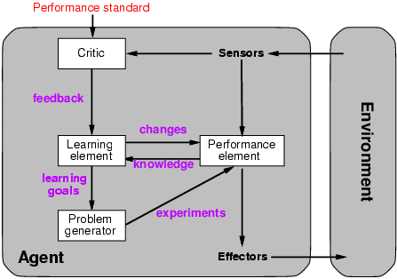
Learning agents
Notes:
Performance element: collection of knowledge and procedures.

Slide 42
Learning element
Design of a learning element is affected by
  Which components of the performance element are to be learned
  What feedback is available to learn these components
  What representation is used for the components
Type of feedback:
  Supervised learning: correct answers for each example
  Unsupervised learning: correct answers not given
  Reinforcement learning: occasional rewards

Slide 43
Inductive learning
Simplest form: learn a function from examples
f is the target function
An example is a pair (x, f(x))
Problem: find a hypothesis h
  such that h ≈ f
  given a training set of examples
(This is a highly simplified model of real learning:
  Ignores prior knowledge
  Assumes examples are given)

Slide 44
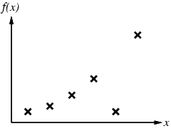
Inductive learning method
Construct/adjust h to agree with f on training set
  (h is consistent if it agrees with f on all examples)
  E.g., curve fitting:

Slide 45
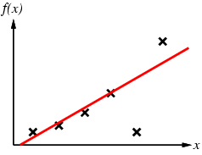
Inductive learning method
Construct/adjust h to agree with f on training set
  (h is consistent if it agrees with f on all examples)
  E.g., curve fitting:

Slide 46
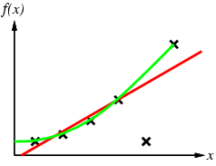
Inductive learning method
Construct/adjust h to agree with f on training set
  (h is consistent if it agrees with f on all examples)
  E.g., curve fitting:

Slide 47
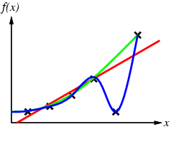
Inductive learning method
Construct/adjust h to agree with f on training set
  (h is consistent if it agrees with f on all examples)
  E.g., curve fitting:

Slide 48
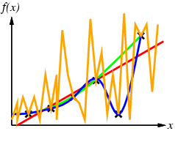
Inductive learning method
Construct/adjust h to agree with f on training set
  (h is consistent if it agrees with f on all examples)
  E.g., curve fitting:
Occam’s razor: prefer the simplest hypothesis consistent with data

Slide 49
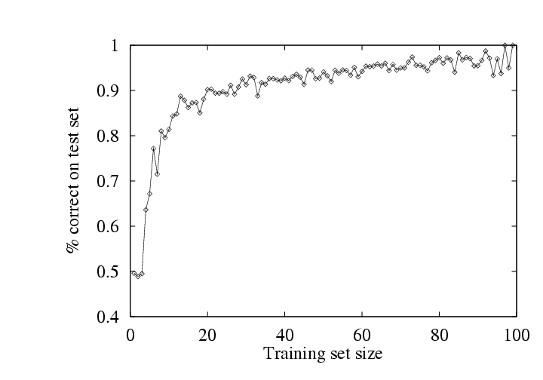
Performance measurement
How do we know that h ≈ f ?
  Use theorems of computational/statistical learning theory
  Try h on a new test set of examples
    (use same distribution over example space as training set)
Learning curve = % correct on test set as a function of training set size

