Slide 1
CIS471/571, Fall 2018
Introduction to Artificial Intelligence
Instructor: Dejing Dou
Office hours: Mondays 4:00pm-5:00pm
Nov. 7 and Nov. 9, 2018

Slide 2

Inference by enumeration
Start with the joint probability distribution:
For any proposition φ, sum the atomic events where it is true: P(φ) = Σ_{ω:ω╞φ} P(ω)
P(toothache) = 0.108 + 0.012 + 0.016 + 0.064 = 0.2

Slide 3

Inference by enumeration
Start with the joint probability distribution:
Can also compute conditional probabilities:
P(¬cavity | toothache) = P(¬cavity ∧ toothache)
P(toothache)
= 0.016+0.064
0.108 + 0.012 + 0.016 + 0.064
= 0.4

Slide 4
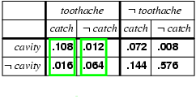
Normalization
Denominator can be viewed as a normalization constant α
P(Cavity | toothache) = α, P(Cavity,toothache)
  = α, [P(Cavity,toothache,catch) + P(Cavity,toothache,¬ catch)]
  = α, [<0.108,0.016> + <0.012,0.064>]
  = α, <0.12,0.08> = <0.6,0.4>
General idea: compute distribution on query variable by fixing evidence variables and summing over hidden variables

Slide 5
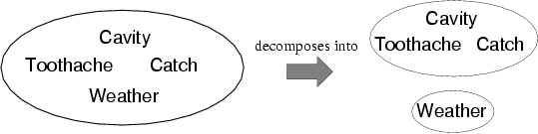
Independence
A and B are independent iff
P(A|B) = P(A) or P(B|A) = P(B) or P(A, B) = P(A) P(B)
  P(Toothache, Catch, Cavity, Weather)
  = P(Toothache, Catch, Cavity) P(Weather)
Absolute independence powerful but rare

Slide 6
Bayes' Rule
Product rule P(a∧b) = P(a | b) P(b) = P(b | a) P(a)
⇒ Bayes' rule: P(a | b) = P(b | a) P(a) / P(b)
or in distribution form
P(Y|X) = P(X|Y) P(Y) / P(X) = αP(X|Y) P(Y)
Useful for assessing diagnostic probability from causal probability:
  P(Cause|Effect) = P(Effect|Cause) P(Cause) / P(Effect)
  Note: posterior probability of meningitis still very small!

Slide 7
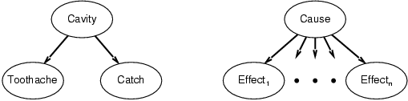
Bayes' Rule and conditional independence
P(Cavity | toothache ∧ catch)
  = αP(toothache ∧ catch | Cavity) P(Cavity)
  = αP(toothache | Cavity) P(catch | Cavity) P(Cavity)
  (Toothache and Catch are independent, given Cavity or ¬ Cavity)
This is an example of a naïve Bayes model:
  P(Cause,Effect₁, … ,Effect_{n}) = P(Cause) Π _{i}P(Effect_{i}|Cause)
Total number of parameters is linear in n

Slide 8
Chapter 14: Bayesian Network
Syntax: Representing Knowledge in an uncertain domain
Semantics of Bayesian Network
Fuzzy Sets and Fuzzy Logic

Slide 9
Bayesian networks
A simple, graphical notation for conditional independence assertions and hence for compact specification of full joint distributions
Syntax:
  a set of nodes, one per variable
  a directed, acyclic graph (link ≈ "directly influences")
  a conditional distribution for each node given its parents:
    P (X_{i} | Parents (X_{i}))
In the simplest case, conditional distribution represented as a conditional probability table (CPT) giving the distribution over X_{i} for each combination of parent values

Slide 10

Example
Topology of Bayesian network encodes conditional independence assertions:
Weather is independent of the other variables
Toothache and Catch are conditionally independent given Cavity

Slide 11
Example
I'm at work, neighbor John calls to say my alarm is ringing, but neighbor Mary doesn't call. Sometimes it's set off by minor earthquakes. Is there a burglar?
Variables: Burglary, Earthquake, Alarm, JohnCalls, MaryCalls
Network topology reflects "causal" knowledge:
  A burglar can set the alarm off
  An earthquake can set the alarm off
  The alarm can cause Mary to call
  The alarm can cause John to call

Slide 12
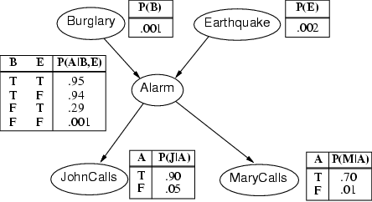
Example

Slide 13
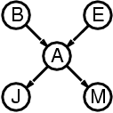
Compactness
A CPT for Boolean X_{i} with k Boolean parents has 2^{k} rows for the combinations of parent values
Each row requires one number p for X_{i} = true
(the number for X_{i} = false is just 1-p)
If each variable has no more than k parents, the complete network requires O(n · 2^{k}) numbers
  I.e., grows linearly with n, vs. O(2^{n}) for the full joint distribution
For burglary net, 1 + 1 + 4 + 2 + 2 = 10 numbers (vs. 2⁵-1 = 31)

Slide 14
Semantics
The full joint distribution is defined as the product of the local conditional distributions:
P (X₁, … ,X_{n}) = Π _{i = 1} P (X_{i} | Parents(X_{i}))
e.g., P(j ∧ m ∧ a ∧ ¬b ∧ ¬e)
= P (j | a) P (m | a) P (a | ¬b, ¬e) P (¬b) P (¬e)
n

Slide 15
Constructing Bayesian networks
1. Choose an ordering of variables X₁, … ,X_{n}
2. For i = 1 to n
  add X_{i} to the network
  select parents from X₁, … ,X_{i-1} such that
  P (X_{i} | X₁, ... X_{i-1}) = P (X_{i} | Parents(X_{i}))
This choice of parents guarantees:
P (X₁, … ,X_{n}) = Π_{i =1} P (X_{i} | X₁, … , X_{i-1})
= Π_{i =1}P (X_{i} | Parents(X_{i}))
(by construction)
(chain rule)
n
n

Slide 16
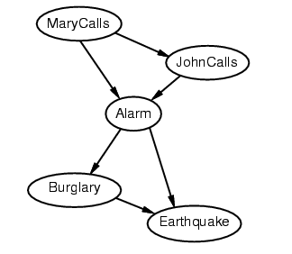
Example
Suppose we choose the ordering M, J, A, B, E
P(J | M) = P(J)?

Slide 17
Example
Suppose we choose the ordering M, J, A, B, E as diagnostic model
(symptoms to causes)
P(J | M) = P(J)?
P(A | J, M) = P(A | J)? P(A | J, M) = P(A)?
No

Slide 18
Example
Suppose we choose the ordering M, J, A, B, E
P(J | M) = P(J)?
P(A | J, M) = P(A | J)? P(A | J, M) = P(A)? No
P(B | A, J, M) = P(B | A)?
P(B | A, J, M) = P(B)?
No

Slide 19
Example
Suppose we choose the ordering M, J, A, B, E
P(J | M) = P(J)?
P(A | J, M) = P(A | J)? P(A | J, M) = P(A)? No
P(B | A, J, M) = P(B | A)? Yes
P(B | A, J, M) = P(B)? No
P(E | B, A ,J, M) = P(E | A)?
P(E | B, A, J, M) = P(E | A, B)?
No

Slide 20
Example
Suppose we choose the ordering M, J, A, B, E
P(J | M) = P(J)?
P(A | J, M) = P(A | J)? P(A | J, M) = P(A)? No
P(B | A, J, M) = P(B | A)? Yes
P(B | A, J, M) = P(B)? No
P(E | B, A ,J, M) = P(E | A)? No
P(E | B, A, J, M) = P(E | A, B)? Yes
No

Slide 21
Example
Deciding conditional independence is hard in noncausal (diagnostic) directions
(Causal models and conditional independence seem hardwired for humans!)
Network is less compact: 1 + 2 + 4 + 2 + 4 = 13 numbers needed

Slide 22
Fuzzy Sets
Fuzzy set theory: a means of specifying how well an object satisfies a vague description.
  Is Nate tall? (If we know Nate is 6’). People can say “Yes”, “No”, or “Sort of”
  “Tall” is a vague description in linguistics because it does not refer to a sharp demarcation of objects into two classes – there are degrees of tallness
Fuzzy set theory treat vague description as a fuzzy predicate and the truth value is a number in [0,1]
  The truth value of Tall(Nate) is a number in [0,1]
Fuzzy set is a set that does not have sharp boundaries

Slide 23
Fuzzy Logic
Fuzzy logic is method for reasoning with logical expressions describing membership in fuzzy sets.
  E.g.
Tall(Nate) ∧ Heavy(Nate) has a fuzzy truth value that is a function of the truth values of its components
Standard Rules:
T(A ∧ B) = min (T(A), T(B))
T(A ∨ B) = max (T(A), T(B))
T (¬ A) = 1 – T(A)
  E.g. T(Tall(Nate)) = 0.6, T(Heavy(Nate)) = 0.8
  T(Tall(Nate) ∧ ¬ Heavy(Nate)) = ?

Slide 24
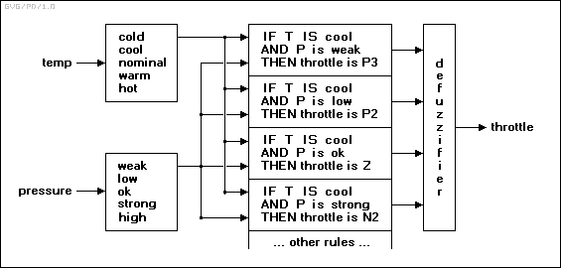
Fuzzy Control
Fuzzy Control: constructing control system in which the mappings between real-valued input and output parameters is represented by fuzzy rules.
n
N3: Large negative. N2: Medium negative. N1: Small negative. Z: Zero. P1: Small positive. P2: Medium positive. P3: Large positive.

Slide 25
Other approaches
Fuzzy logic can be explained in terms of probability theory and Bayesian Network.
  P(Observer says Nate is tall and heavy | Height, Weight)
Random sets: random variables whose values are set of objects.
  Tall is a random set whose values are set of people. The probability P(Tall = S₁), where S₁ is a particular set of people, is the probability that exactly that set would be identified as “tall” by an observer.
  P(Nate is tall) is the sum of the probability of all the sets of which Nate is a member. P(Tall = S₁) + P(Tall = S₂) …..

Slide 26
Learning
Learning agents
Inductive learning
Decision tree learning

Slide 27
Learning
Learning is essential for unknown environments,
  i.e., when designer lacks omniscience
Learning is useful as a system construction method,
  i.e., expose the agent to reality rather than trying to write it down
Learning modifies the agent's decision mechanisms to improve performance

Slide 28
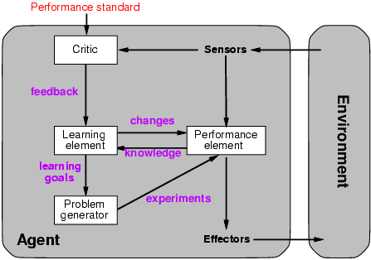
Learning agents
Notes:
Performance element: collection of knowledge and procedures.

Slide 29
Learning element
Design of a learning element is affected by
  Which components of the performance element are to be learned
  What feedback is available to learn these components
  What representation is used for the components
Type of feedback:
  Supervised learning: correct answers for each example
  Unsupervised learning: correct answers not given
  Reinforcement learning: occasional rewards

Slide 30
Inductive learning
Simplest form: learn a function from examples
f is the target function
An example is a pair (x, f(x))
Problem: find a hypothesis h
  such that h ≈ f
  given a training set of examples
(This is a highly simplified model of real learning:
  Ignores prior knowledge
  Assumes examples are given)

Slide 31
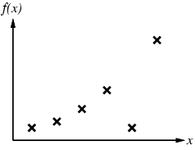
Inductive learning method
Construct/adjust h to agree with f on training set
  (h is consistent if it agrees with f on all examples)
  E.g., curve fitting:

Slide 32
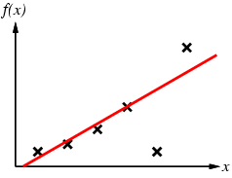
Inductive learning method
Construct/adjust h to agree with f on training set
  (h is consistent if it agrees with f on all examples)
  E.g., curve fitting:

Slide 33
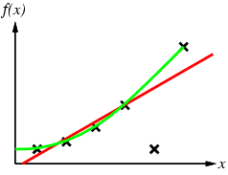
Inductive learning method
Construct/adjust h to agree with f on training set
  (h is consistent if it agrees with f on all examples)
  E.g., curve fitting:

Slide 34
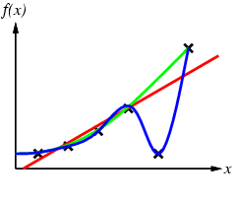
Inductive learning method
Construct/adjust h to agree with f on training set
  (h is consistent if it agrees with f on all examples)
  E.g., curve fitting:

Slide 35
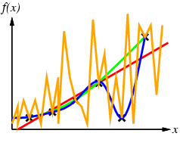
Inductive learning method
Construct/adjust h to agree with f on training set
  (h is consistent if it agrees with f on all examples)
  E.g., curve fitting:
Occam’s razor: prefer the simplest hypothesis consistent with data

Slide 36
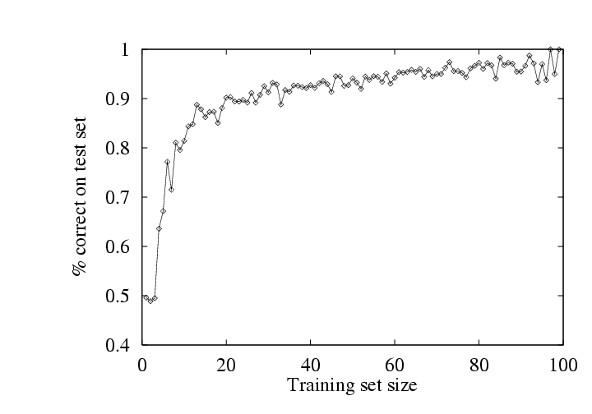
Performance measurement
How do we know that h ≈ f ?
  Use theorems of computational/statistical learning theory
  Try h on a new test set of examples
    (use same distribution over example space as training set)
Learning curve = % correct on test set as a function of training set size

Slide 37
Induction of Decision Tree
Attributes = {Outlook, Temperature, Humidity, Wind}
PlayTennis = {yes, no}
Outlook
sunny
rain
cloudy
Humidity
Wind
yes
high
normal
strong
weak
no
yes
no
yes
Note: the temperature attribute is not necessary in this decision tree.

Slide 38
Learning decision trees
Problem: decide whether to wait for a table at a restaurant, based on the following attributes:
  Alternate: is there an alternative restaurant nearby?
  Bar: is there a comfortable bar area to wait in?
  Fri/Sat: is today Friday or Saturday?
  Hungry: are we hungry?
  Patrons: number of people in the restaurant (None, Some, Full)
  Price: price range ($, $$, $$$)
  Raining: is it raining outside?
  Reservation: have we made a reservation?
  Type: kind of restaurant (French, Italian, Thai, Burger)
  WaitEstimate: estimated waiting time (0-10, 10-30, 30-60, >60)

Slide 39
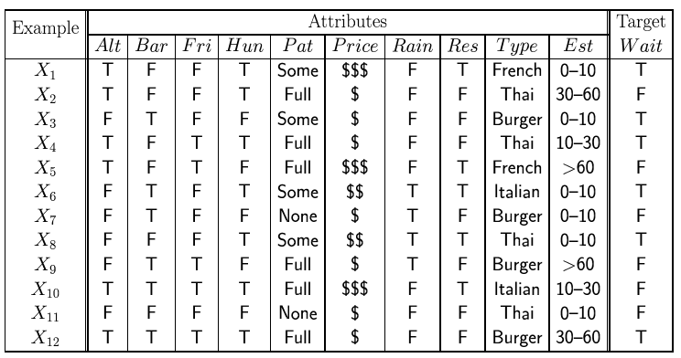
Attribute-based representations
Examples described by attribute values (Boolean, discrete, continuous)
  E.g., situations where I will/won't wait for a table:
Classification of examples is positive (T) or negative (F)

Slide 40
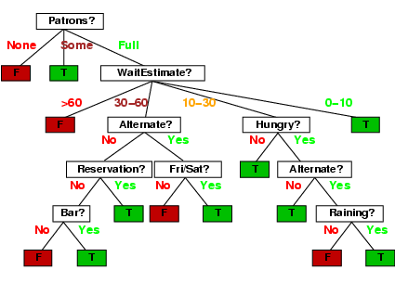
Decision trees
One possible representation for hypotheses
  E.g., here is the “true” tree for deciding whether to wait:

Slide 41
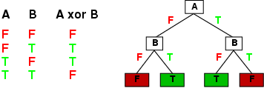
Expressiveness
Decision trees can express any function of the input attributes.
  E.g., for Boolean functions, truth table row → path to leaf:
Trivially, there is a consistent decision tree for any training set with one path to leaf for each example (unless f nondeterministic in x) but it probably won't generalize to new examples
Prefer to find more compact decision trees

Slide 42
Hypothesis spaces
How many distinct decision trees with n Boolean attributes?
= number of Boolean functions
= number of distinct truth tables with 2^{n} rows = 2^{2n}
E.g., with 6 Boolean attributes, there are 18,446,744,073,709,551,616 trees

Slide 43
Hypothesis spaces
How many distinct decision trees with n Boolean attributes?
= number of Boolean functions
= number of distinct truth tables with 2^{n} rows = 2^{2n}
E.g., with 6 Boolean attributes, there are 18,446,744,073,709,551,616 trees
More expressive hypothesis space
  increases chance that target function can be expressed
  increases number of hypotheses consistent with training set
  ⇒ may get worse predictions

Slide 44
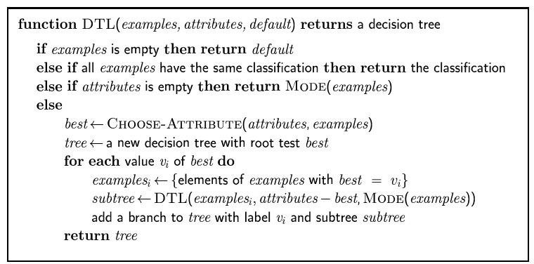
Decision tree learning
Aim: find a small tree consistent with the training examples
Idea: (recursively) choose "most significant" attribute as root of (sub)tree

Slide 45
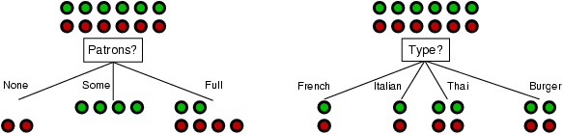
Choosing an attribute
Idea: a good attribute splits the examples into subsets that are (ideally) "all positive" or "all negative"
Patrons? is a better choice

Slide 46
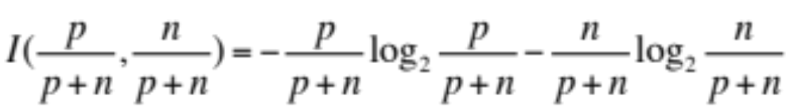
Using information theory
To implement Choose-Attribute in the DTL algorithm
Information Content (Entropy):
I(P(v₁), … , P(v_{n})) = Σ_{i=1} -P(v_{i}) log₂ P(v_{i})
For a training set containing p positive examples and n negative examples:

Slide 47
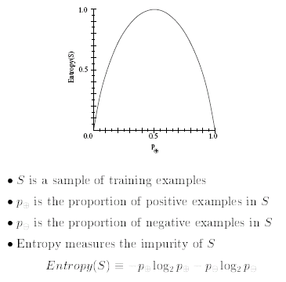
Entropy (Impurity)
P+
P-
-
P+
P+
-
P-
P-
Notes:
"är-kE-'ä-l&-jE/

Slide 48
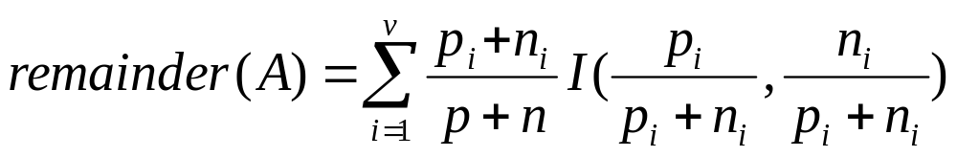
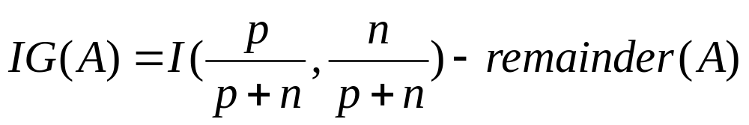
Information gain
A chosen attribute A divides the training set E into subsets E₁, … , E_{v} according to their values for A, where A has v distinct values.
Information Gain (IG) or reduction in entropy from the attribute test:
Choose the attribute with the largest IG

Slide 49
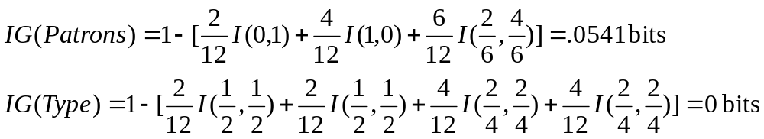
Information gain
For the training set, p = n = 6, I(6/12, 6/12) = 1 bit
Consider the attributes Patrons and Type (and others too):
Patrons has the highest IG of all attributes and so is chosen by the DTL algorithm as the root

Slide 50
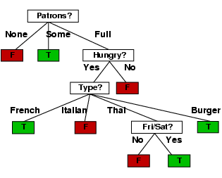
Example (cont’d)
Decision tree learned from the 12 examples:
e.g Patrons(Full) ∧ Hungry ∧ Type(French) ⇒ WillWait
Substantially simpler than “true” tree---a more complex hypothesis isn’t justified by small amount of data

Slide 51
Decision tree learning
Aim: find a small tree consistent with the training examples
Idea: (recursively) choose "most significant" attribute as root of (sub)tree

Slide 52
Examples and Hypotheses
∀r WillWait(r) ⇔ Patrons(r, Some)
∨ Patrons(r, Full) ∧ Hungry (r) ∧ Type(r, French)
∨ Patrons(r, Full) ∧ Hungry (r) ∧ Type(r, Thai) ∧ Fri/Sat (r)
∨ Patrons(r, Full) ∧ Hungry (r) ∧ Type(r, Burger)

Slide 53
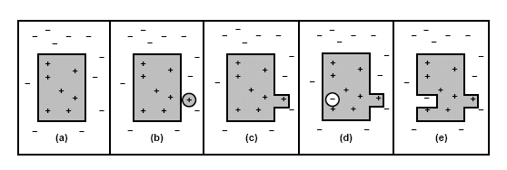
Current-best-hypothesis search
To maintain a single hypothesis, and to adjust it as new examples arrive in order to maintain consistency.
(a) a consistent hypothesis (b) a false negative (c) the hypothesis is (increased) generalized. (d) a false positive (e ) the hypothesis is (decreased) specialized

Slide 54
Neural Network
Basic Concepts and Units
Single Layer NN Learning
Multilayer NN Learning
  Back-propagation
Deep Learning

Slide 55
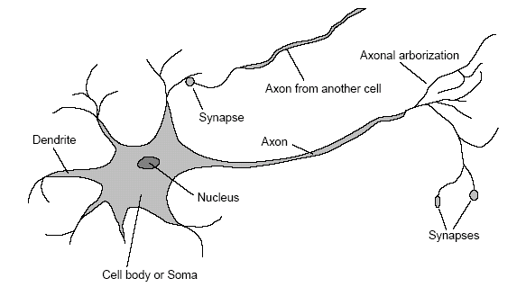
A Neuron
A cell in brain which can collect, process and disseminate electrical signals

Slide 56
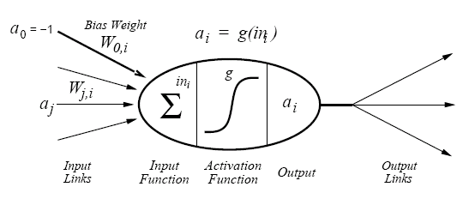
A Simple Mathematical Model
a_{i} = g(Σ_{j}^{n}₌₀ W_{j,i}a_{j})

Slide 57
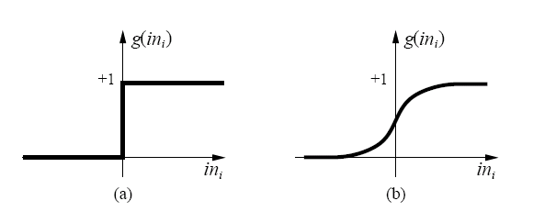
Two activation functions
(a) Threshold function: outputs 1 when the input is positive and 0 otherwise
(b) Sigmoid function: 1/(1 + e^{-x}), which is differentiable
The bias weight W_{0,i} sets the actual threshold for the unit.

Slide 58
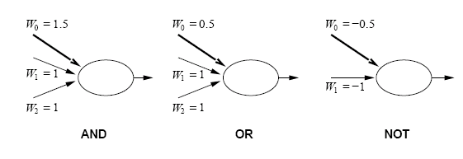
Acting as Logic Gates
a₁ + a₂ – 1.5 a₁ + a₂ – 0.5 -a₁ + 0.5

Slide 59
Neural Network Structures
Feed-forward networks (acyclic)
  A function of current input and it has no internal state other than the weights themselves
Recurrent networks (cyclic)
  A function of current input and the feedback from previous output. It can support short-term memory.
  The activation levels of the network form a dynamical system that may reach a stable state or exhibit oscillations or even chaotic behavior.

Slide 60
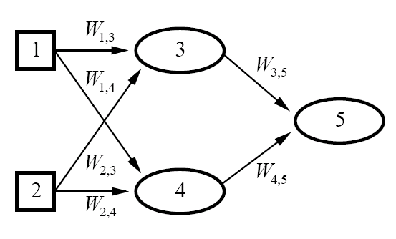
A simple neural network
Two inputs, one hidden layer of two units, and one output.
It is a feed-forward network.

Slide 61
A simple neural network
W1,5
Three inputs (one is the feedback from output), one hidden layer of two units, and one output.
It is a recurrent network.

Slide 62
Perceptron vs. decision tree
a0= -1
a1
W0
.
.
.
an
Wj
A majority function (outputs 1 only if more than half of its n inputs are 1) can be a perceptron network with some W_{j} and W₀, what they are?
A decision tree need O(2^{n}) nodes to represent this function

Slide 63
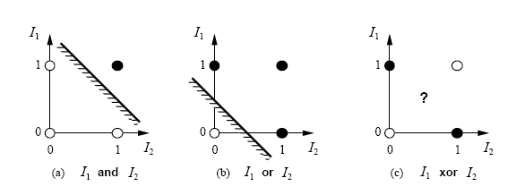
Hyperplane
Σ_{j}^{n}₌₀ W_{j}x_{j} > 0 then g(Σ_{j}^{n}₌₀ W_{j}x_{j}) = 1
W•X = 0 defines a hyperplane in the input space, so the perceptron with threshold function returns 1 if and only if the input is on one side of that hyperplane.
(a) and (b) is linearly separable but (c) is not.

Slide 64
Neural Network Learning
General idea: adjust the weights of the network to minimize some measure of the error on the training set.
So neural network learning can be formulated as an optimization search in weight space.
The “classical” measure of error is the sum of squared errors.

Slide 65
The squared error vs. weights
The Squared Error:
E = ½ Err² ⁼ ½ (y - g(Σ_{j}^{n}₌₀ W_{j}x_{j}))²
We can use gradient descent to reduce the squared error by calculating the partial derivative of E respect to each weight:
∂E/∂W_{j} = Err × ∂Err/∂W_{j}
= Err × ∂(y – g(Σ_{j}^{n}₌₀ W_{j}x_{j}))/ ∂W_{j}
= - Err × g’(in) × x_{j}
where g’ is the derivative of the activation function. For sigmoid, g’ = g(1-g)

Slide 66
Weights updating
If we want to reduce E, we can update the weights:
W_{j} <= W_{j} + α × Err × g’(in) × x_{j}
α is the learning rate. If the Err is positive, it means that output is too small. Then the weights are increased for the positive inputs and decreased for the negative inputs. The opposite happens when the error is negative.

Slide 67
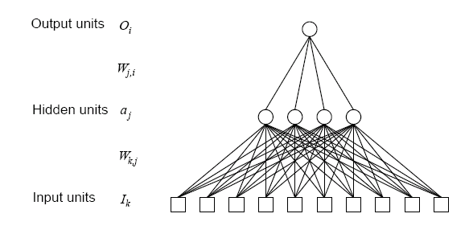
Multilayer feed-forward NN

Slide 68
Advantages of Multilayer NN
It enlarges the space of hypotheses that network can represent.
With one single, sufficiently large hidden layer, it is possible to represent any continuous function of the inputs with arbitrary accuracy.
With two hidden layers, even discontinuous functions can be represented.
However, it is hard to characterize exactly which functions can be represented for any particular network structure.

Slide 69
Restaurant Problem ?
Examples described by attribute values (Boolean, discrete, continuous)
  E.g., situations where I will/won't wait for a table:
Classification of examples is positive (T) or negative (F)

Slide 70
Multilayer feed-forward NN
It is a good NN (with four hidden unit) for restaurant problem. But the problem choosing the right number of hidden units in advance is still not well understood.

Slide 71
Learning by Multilayer NN
It may have several outputs, so we need an output vector h_{w}(x) and a true value output vector y (gold standard).
The error y - h_{w}(x) at output layer is clear, but the error at the hidden layers seems mysterious.
However, we can back-propagate the error from the output layer to the hidden layer.

Slide 72
Back Propagation
Let Err_{i} be ith component of the error vector y - h_{w}(x) . Define Δ_{i} = Err × g’(in), so the weight update rule for output layer is:
W_{j,i} <= W_{j,i} + α × Δ_{i} × a_{j}
The hidden node j is “responsible” for some faction of the error Δ_{i} in each of the output nodes to which it connects.

Slide 73
Back Propagation
The Δ_{i} values are divided according to the strength of connection between the hidden node and the output node and are propagated back to provide Δ_{j} values for the hidden layer:
Δ_{j} = g’(in) Σ W_{j,i} Δ_{i}
W_{k,j} <= W_{k,j} + α × Δ_{j} × I_{k}
By using math, we know:
∂E/∂W_{j,i} = - a_{j} Δ_{i} ∂E/∂W_{k,j} = - I_{k} Δ_{j}

Slide 74
Back Propagation
It can be summarized as follows:
Compute the Δ values for the output units, using the observed errors.
Starting with the output layer, repeat the following for each layer in the network, until the earliest hidden layer is reached
    Propagate the Δ values back to the previous layer
    Update the weights between the two layers

