Slide 1
Novel Contribution
We did the time-series analysis using ARIMA (Autoregressive integrated moving average) model. ARIMA is a generalization of an autoregressive moving average (ARMA) model, both of these models are fitted to time series data either to better understand the data or to predict future points in the series (forecasting). ARIMA models are applied in some cases where data show evidence of non-stationarity, where an initial differencing step can be applied one or more times to eliminate the non-stationarity.
We predicted the next 5 hours (data points) for the time-series using ARIMA and compared them with the actual.

Slide 2
Description of the Contribution
Conduct supervised learning as well as time series analyses to predict future traffic congestion based on historical data
Cross validate the models created using accuracy metrics and visualize results to find the model that performs the best

Slide 3
Contribution of Competitor’s Article
Competitor’s Article: “Short-Term Trafﬁc Flow Forecasting: An Experimental Comparison of Time-Series Analysis and Supervised Learning”
The authors first reviewed existing approaches to traffic flow forecasting the common view of probabilistic graphical models, presenting an extensive experimental comparison, which proposes a common baseline for their performance analysis and provides the infrastructure to operate on a publicly available data set.
Then the authors provide two new support vector regression models, which are speciﬁcally devised to beneﬁt from typical trafﬁc ﬂow seasonality and are shown to represent an interesting compromise between prediction accuracy and computational efﬁciency.

Slide 4
Contribution of Competitor’s Article
Competitor’s Article: “Short-Term Trafﬁc Flow Forecasting: An Experimental Comparison of Time-Series Analysis and Supervised Learning”
The authors first reviewed existing approaches to traffic flow forecasting the common view of probabilistic graphical models, presenting an extensive experimental comparison, which proposes a common baseline for their performance analysis and provides the infrastructure to operate on a publicly available data set.
Then the authors provide two new support vector regression models, which are speciﬁcally devised to beneﬁt from typical trafﬁc ﬂow seasonality and are shown to represent an interesting compromise between prediction accuracy and computational efﬁciency.

Slide 5
Data Source and Content
This dataset consists of data from traffic in a city called Aarhus in Denmark. This dataset is collection of traffic data between two points for certain duration of time in CSV format for different durations. A CSV metadata file is also available that provides additional information regarding the different two points.
Below were the fields in the dataset
status,
avgMeasuredTime,
avgSpeed,
extID,
medianMeasuredTime,
TIMESTAMP,
vehicleCount,
_id, and
REPORT_ID.

Slide 6
Method
Using Spark, load and combine all the datasets
Using SQL and R, look at the descriptive statistics of the dataset. Split the dataset into training and test data sets for cross validation and evaluation of the models to be created

Slide 7
Method (Cont’d)
Build different supervised learning models based on training datasets using different packages in R
Decision Trees
Time Series Analysis – Order (4,1,4)
Seasonal Time Series Analysis – Order (0, 2, 7) & Seasonality (0, 0, 18)
Evaluate the models with different performance metrics to pick the best model that can be used for prediction
Select the final model

Slide 8
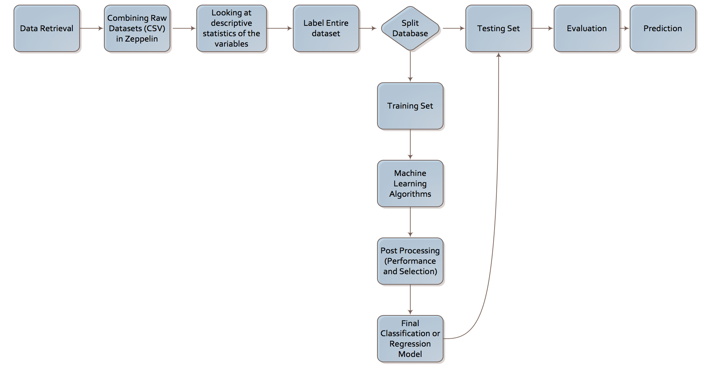
Method (Cont’d)

Slide 9
Model
Learning Algorithm
Training DataSet
Learn Model
Model
Test Data Set
Apply Model

Slide 10
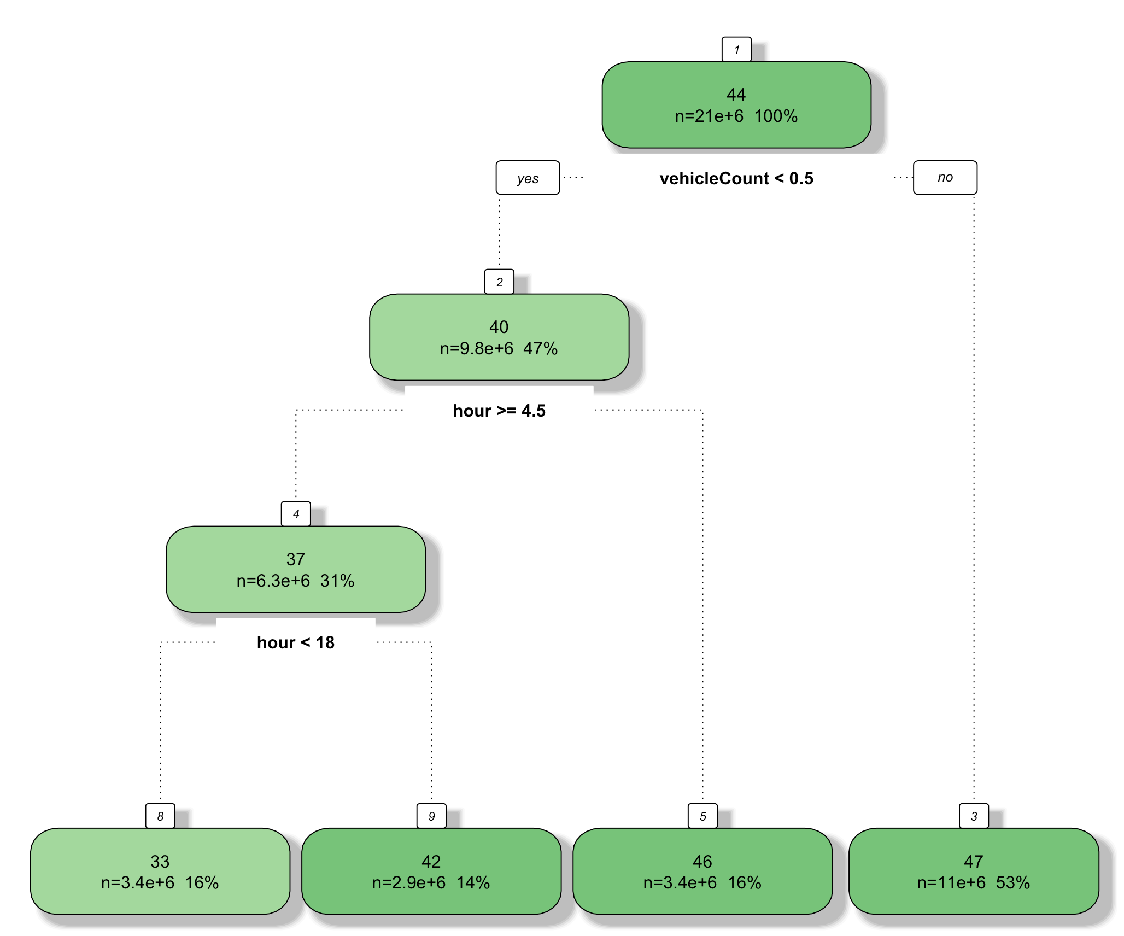
Quantitative Results

Slide 11
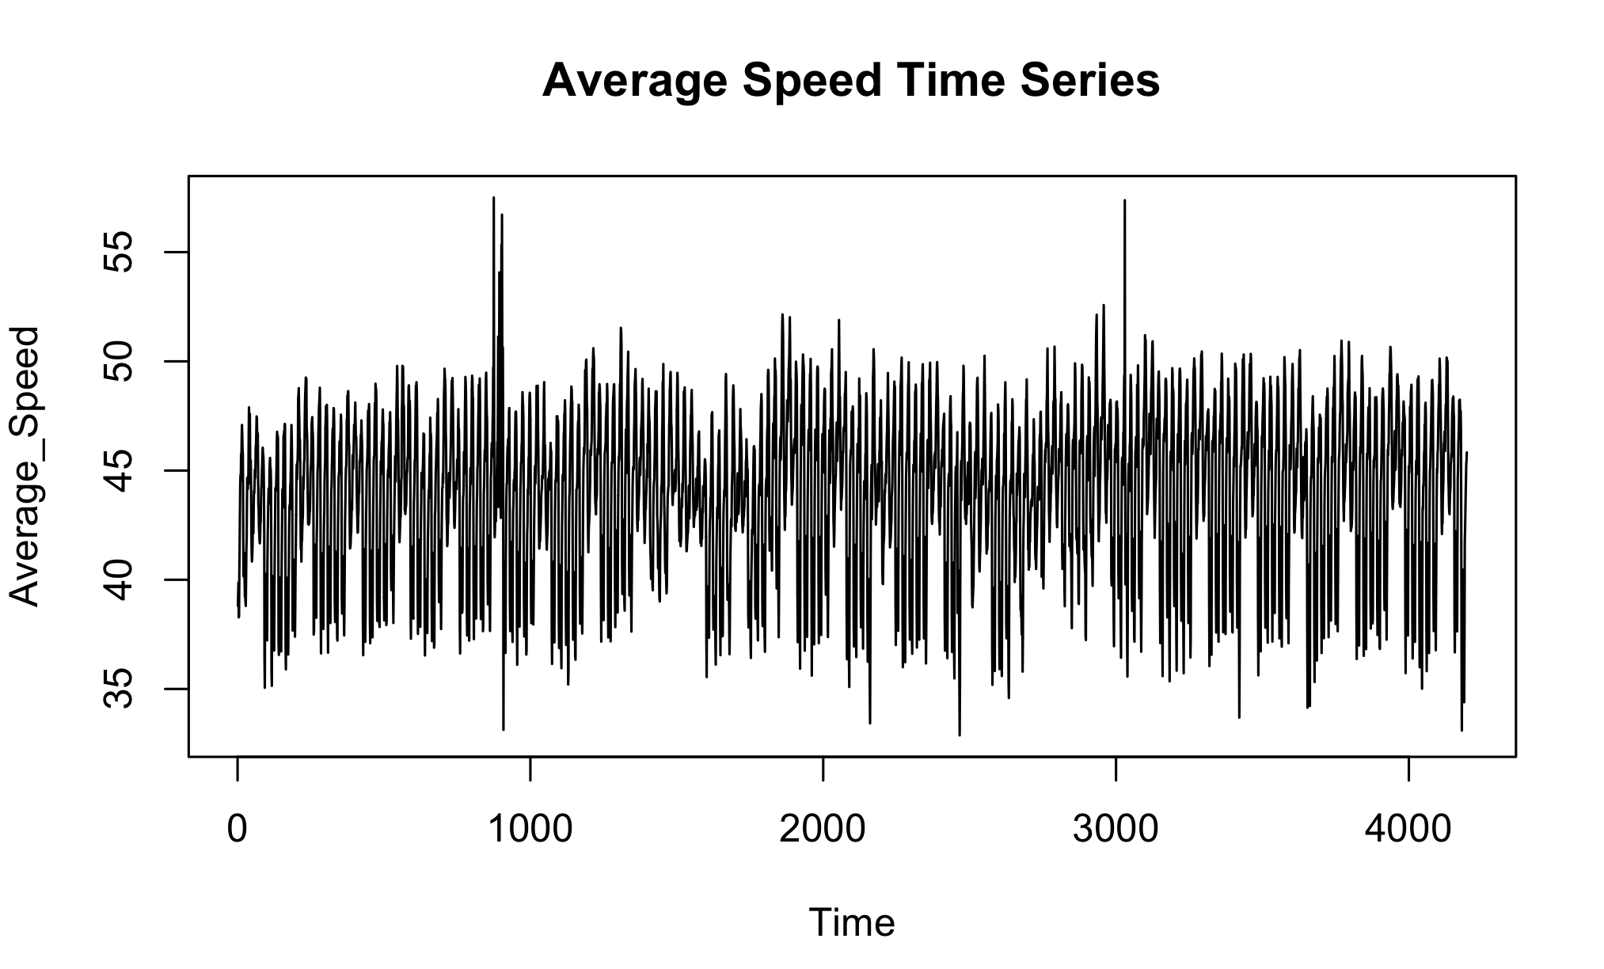
Quantitative Results (Cont’d)

Slide 12
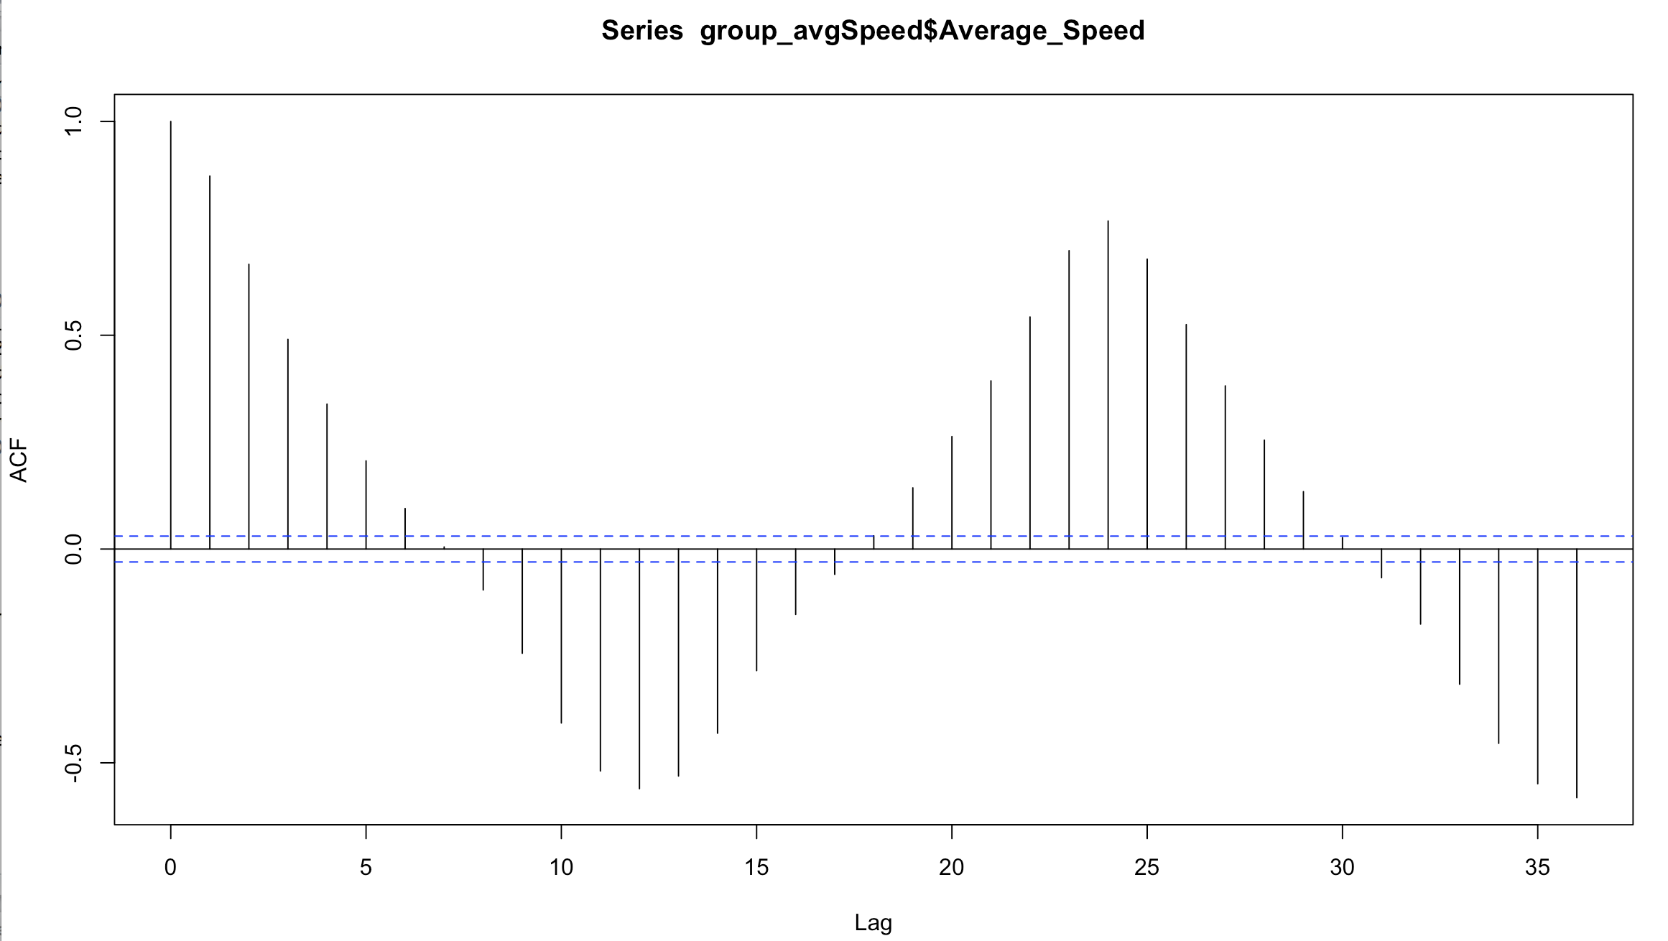
Quantitative Results (Cont’d)

Slide 13
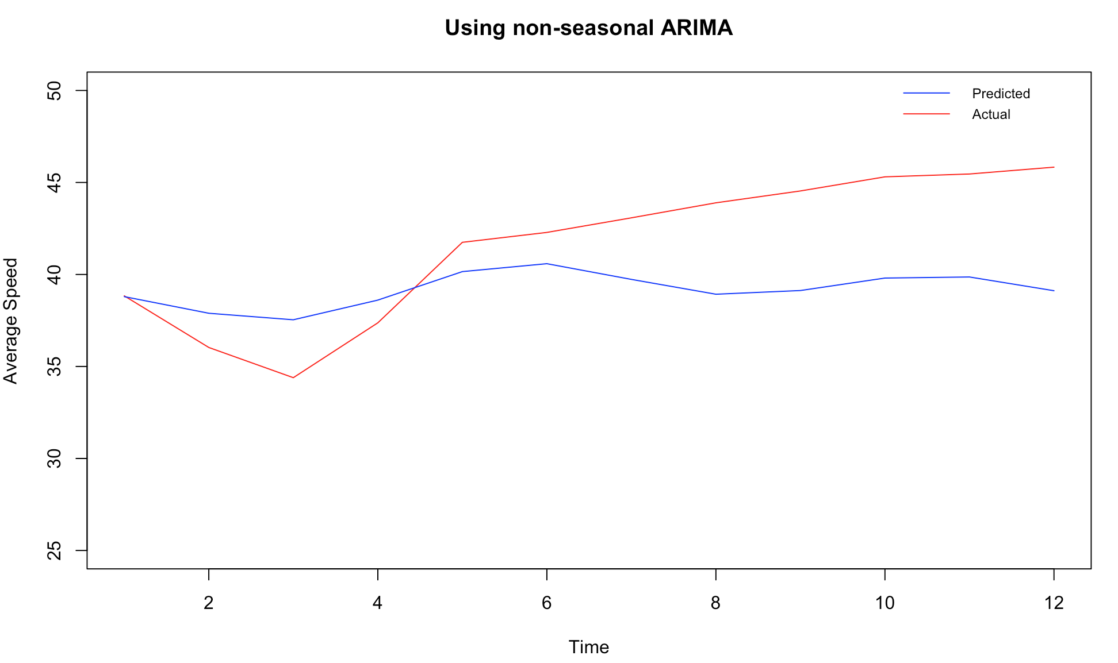
Quantitative Results (Cont’d)
MAPE = 2.51

Slide 14
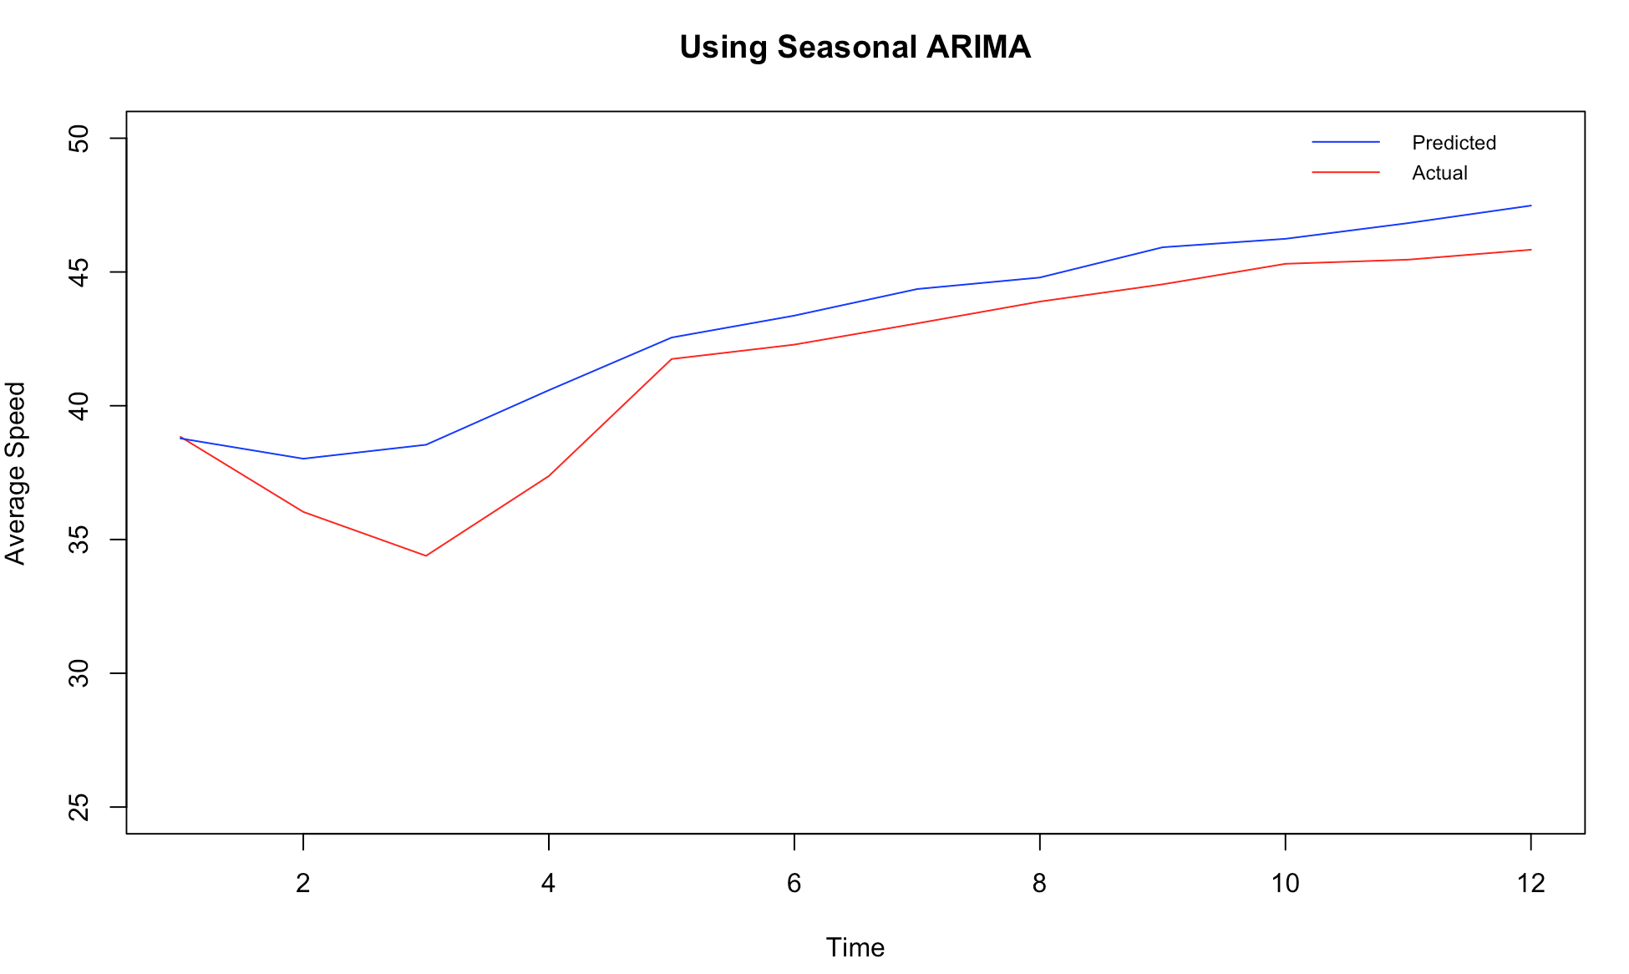
Quantitative Results (Cont’d)
MAPE = 2.19

Slide 15
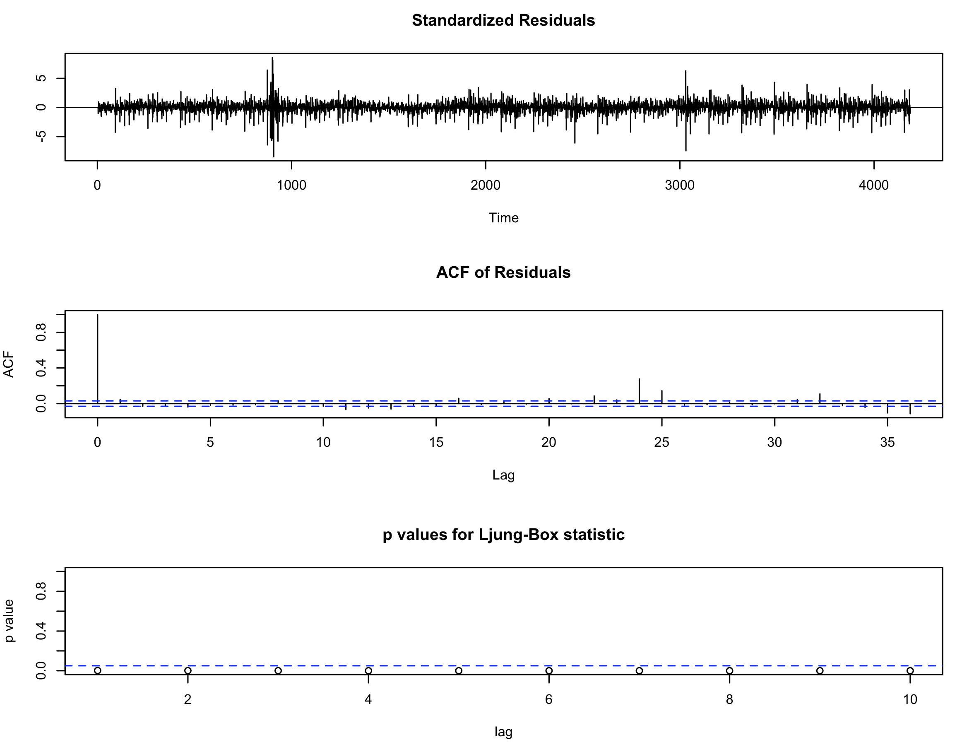
Quantitative Results (Cont’d)

Slide 16
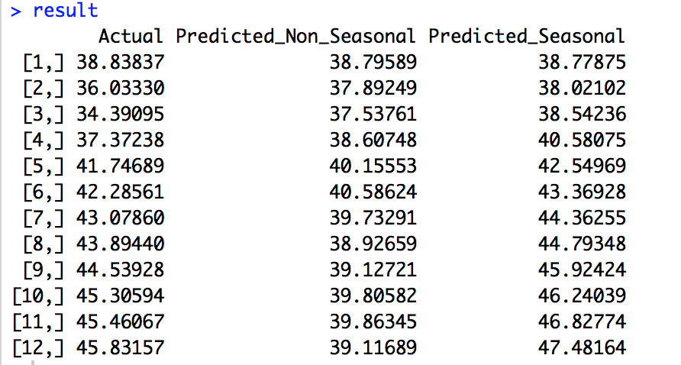
Quantitative Results (Cont’d)

Slide 17
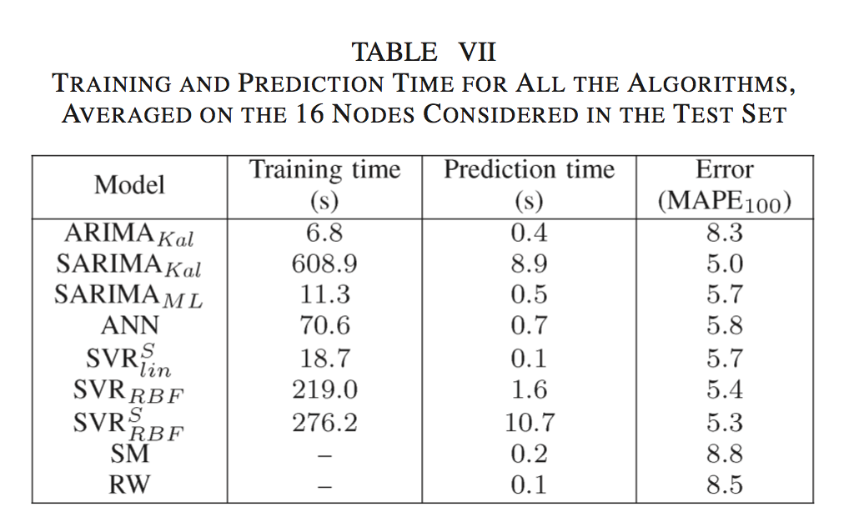
Comparison With Your Competitor
Competitor’s Results
The set of tested models by competitors consists of the following algorithms:
The table from the competitor article shows that the lowest mean absolute percentage error they got as for a Seasonal ARIMA or SARIMA model with MAPE of 5.0.

Slide 18
Comparison With Your Competitor (Cont’d)
Your Results
First we performed supervised learning with decision tree with two variables. The errors were high.
Next we let forecast package in R select the best order for ARIMA model and it selected order of (4, 1, 4) with no seasonality. We got a Mean Absolute Percentage Error of 2.52.
Looking at the ACF and PACF we see that there is some seasonality in the data and decided to add a seasonality component to the ARIMA and performed an ARIMA order of (0, 2, 7) with a seasonality of (0, 0, 18). For this model we got an MAPE of 2.19
Both MAPE of models that we created were better than the best MAPE of the competitor’s model.

Slide 19
Performance on Big Data: Time Measurements
# | Operation | Time Measured
1 | Load raw dataset in Spark | 52 sec for 20 million records
2 | Load dataset in R | 1 min 31 sec
3 | Aggregate (Group by) data by hour | 4 min 18 sec
4 | Look at descriptive statistics | 4 seconds
5 | Decision Tree (20 million Records) | 3 min 5 sec
6 | Time Series Non-Seasonal | 32 sec
7 | Time Series Seasonal | 4 min 1 sec
8 | Count using SQL | 18 sec
9 | Plot non-seasonal TS result | <1 sec
10 | Plot seasonal TS result | 2 sec

Slide 20
Conclusion
As the competitor we also found that SARIMA model is best model to predict traffic flow as we observed the least amount of MAPE using this model.
The seasonal ARIMA and ARIMA model that we built had a much lower MAPE compared to the competitor.
Since the dataset the competitor’s article used and we used are different, it may be difficult to compare the two results but only looking at how the model we built predicted the results compared to the actual values, we can say that SARIMA is the best predictor of traffic flow.

