Slide 1

Vehicle Traffic, Provided by City of Aarhus in Denmark
Presented by: Amit Pandey
Guided by: Professor Sylvain Jaume
Course: DS670 - Capstone

Slide 2
Outline
Summary
Action plan
Introduction
Data description/structure
Data processing
Article compared
Article abstract
Methodology of the article
Knowledge workflow
Comparative work/improvement
Conclusion

Slide 3
Summary:
The urban traffic congestion is transforming into an epidemic all over the world. The brisk increase in vehicle traffic has become one of the critical problems faced by cities all over the world. As a result of the constant traffic congestion, transportation cost has increased significantly due to all the time wasted on the road and the corresponding fuel cost.

Slide 4
Action plan:
I plan to analyze how the Vehicle Traffic data collected can be used in making Aarhus a smart city in terms of traffic guidance and management. Also, I plan to compare the work done by other and try to improve those models.

Slide 5
Introduction
The dataset assigned for the capstone project is the “Vehicle Traffic, Provided by City of Aarhus in Denmark” from CityPulse dataset collection. A collection of datasets of vehicle traffic, observed between two points for a set duration of time over a period of 6 months (449 observation points in total). The data is available in raw (CSV) and semantically annotated format using the citypulse information model. This proposal looks at how the Vehicle Traffic data collected can be used in making Aarhus a smart city in terms of traffic guidance and management

Slide 6
Data description/structure:
A collection of datasets of vehicle traffic in the city called Aarhus in Denmark, observed between two points for a set duration of time over a period certain months (449 observation points in total). The data is available in raw (CSV) and semantically annotated format using the Citypulse information model.

Slide 7
Data Processing
The data is available in raw (CSV) and semantically annotated format. For this project, I’m going to use the “.csv” format only as it’s easy to manipulate and analyze the data. The data analysis will be done in Apache Zeppelin environment that is being taught in the class.

Slide 8
Classification of Road Traffic Congestion Levels from GPS Data using a Decision Tree Algorithm and Sliding Windows
Article compared:
T. Thianniwet, S. Phosaard and Wasan Pattara‐ Atikom, ʺClassification of Road Traffic Congestion Levels from GPS Data using a Decision Tree Algorithm and Sliding Windows,ʺ Proc. of the World Congress on Engineering WCE 2009, Vol I, ISBN: 978‐ 988‐17012‐5‐1, July, 2009, London, U.K.

Slide 9
Abstract:
In this article, the authors explored an option to recognize the traffic activity from the mobile sensor data that was in-line with the motorist judgment. The data for the study was collected from three sources: GPS (through mobile data), webcams and a survey. The article looks at a way to identify traffic congestion from the velocity of mobile sensors.

Slide 10
Methodology of the Experiment
In the experiment, they used a model that will be able to classify the traffic congestion level from traffic reports.
They used a smart-device with a GPS device to collected date, time, latitude, longitude, and vehicle velocity from the GPS.
They gathered the congestion levels from 11 subjects with driving experience of up to 10 years.
They watched a 3-hour video clip of road survey and rated the congestion levels into three levels, light, heavy, and jam

Slide 11
Data Preparation
Minimized the attributes by concentrating only on the vehicle velocity and the moving pattern of a vehicle. This way they can interpret the level of the traffic congestion.

Slide 12
Knowledge flow of experiment
Arff Loader
Model Performance Chart
Classifier Performance Evaluator
Text Viewer
Visualization error
Text
Data Set
Batch Classifier
Training Set
Class Assigner
Cross Validation Fold Marker
J48
Graph Viewer
Data Set
Test Set
Graph
Note: MS Word was used to create the flow-chart

Slide 13
Comparison
In this experiment, I plan to classify the Road data into three different categories: Red, Yellow, and Green refereeing to “High Traffic”, “Medium Traffic”, and “Low Traffic”, respectively.
The article has looked at only 11 subjects to predict the model. However, our data-set is much larger and going to be looking at a much larger data-set.
The plan is to get higher accuracy of prediction

Slide 14
Comparison
As shown in Figure 1 , 2, and 3 in the next slides, I will try to find the co-relation between average speed , vehicle count, or average measured time and vehicle passed to see what is the best cause for the traffic congestion.

Slide 15
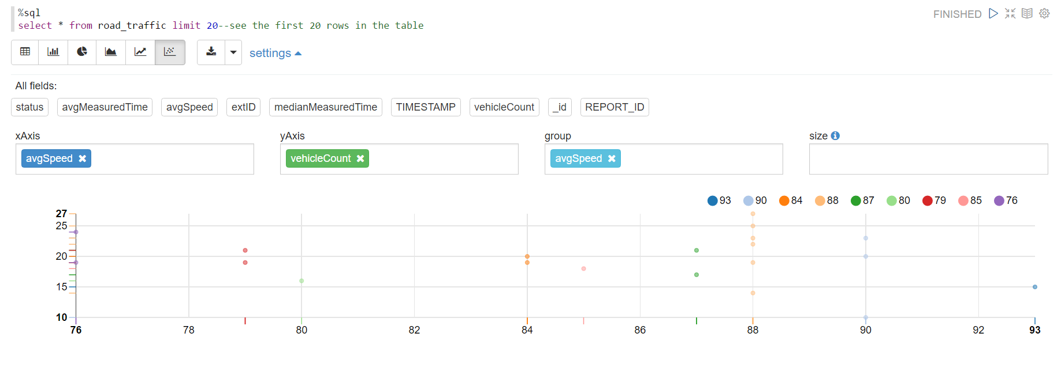
Figure 1 Comparison between AvgSpeed and Vehicle Count
Note: Chart created in Zeppelin

Slide 16
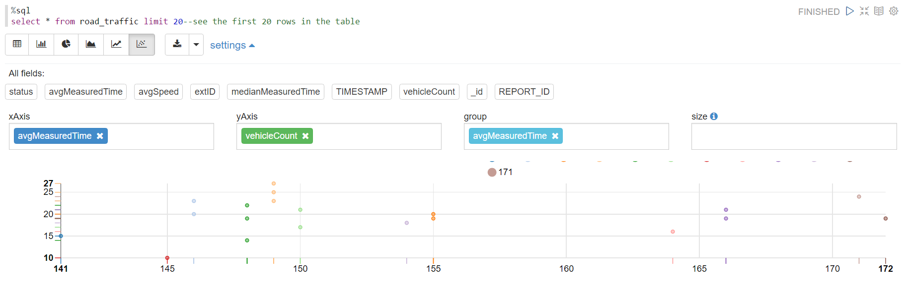
Figure 2 Comparison between AvgMeasuredTime and Vehicle Count
Note: Chart created in Zeppelin

Slide 17
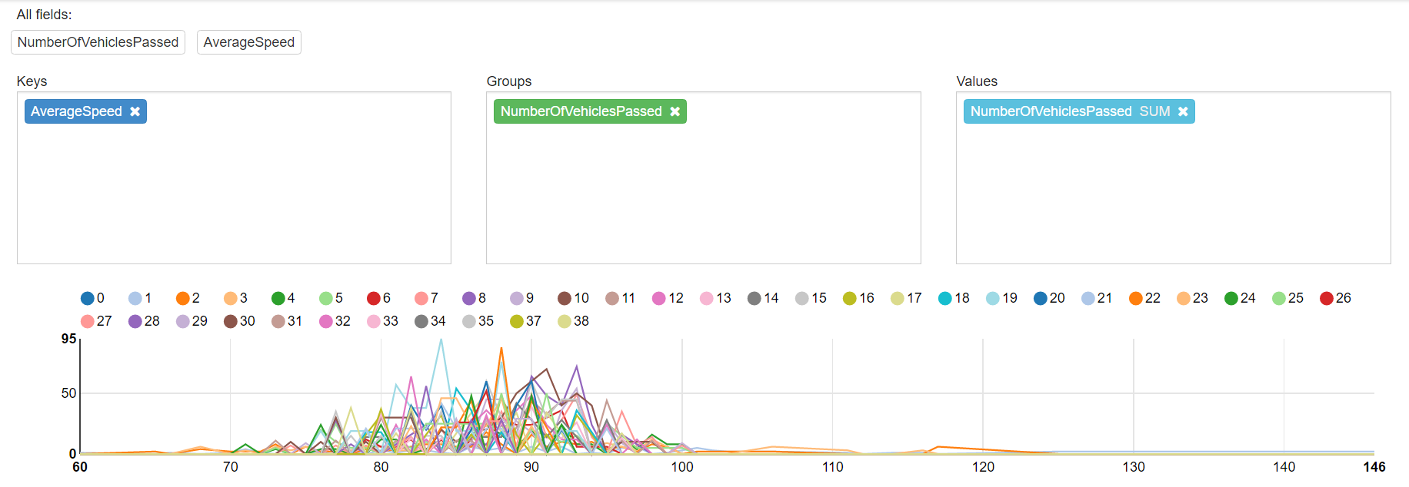
Figure 3 Comparison between AvgSpeed and Number of Vehicles Passed
Note: Chart created in Zeppelin

Slide 18
Prediction
The road data provided for this project seems to be much larger than the one used by the authors of the comparative article. We would be able to better predict the model and accuracy of the traffic congestion through our data.

Slide 19
Conclusion
I need to compare the data for the Road closely and use the larger number of variables to come up with a better prediction than the one used by the article’s authors.

Slide 20
Thank you

