Slide 1

#LifeKoKaroLift
Natural Language Processing

Slide 2



Course : Machine Learning
Lecture On : NLP and Text Analytics
Instructor : Aditya Bhattacharya

Slide 3
Today’s Agenda
1
Text Pre-processing
2
Text Feature Engineering and EDA
3
Text Modeling
4
Code Walkthrough – Sentiment Analysis

Slide 4
Text Pre-processing
Noise Removal & Normalization
Special character cleaning: special characters such as “\n” double quotes must be removed from the text since we aren’t expecting any predicting power from them.
Upcase/downcase: we would expect, for example, “Book” and “book” to be the same word and have the same predicting power. For that reason we have downcased every word.
Punctuation signs: characters such as “?”, “!”, “;” have been removed.
Possessive pronouns: in addition, we would expect that “Trump” and “Trump’s” had the same predicting power.
Stop words: words such as “what” or “the” won’t have any predicting power since they will presumably be common to all the documents. For this reason, they may represent noise that can be eliminated. We have downloaded a list of English stop words from the nltk package and then deleted them from the corpus.
Notes:
Text data are mostly available in an unstructured format, various types of noise are present in it and the data is not readily analyzable without any pre-processing. The entire process of cleaning and standardization of text, making it noise-free and ready for analysis comes under text preprocessing.

Slide 5
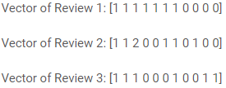
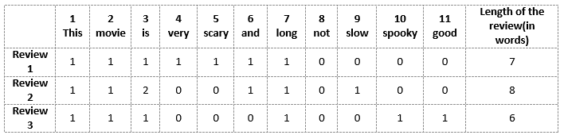
BAG OF WORDS
A bag-of-words model, or BOW for short, is a way of extracting features from text for use in modeling, such as with machine learning algorithms.
The approach is very simple and flexible, and can be used in a myriad of ways for extracting features from documents.
A bag-of-words is a representation of text that describes the occurrence of words within a document.
Example
We will first build a vocabulary from all the unique words in the above three reviews. The vocabulary consists of these 11 words: ‘This’, ‘movie’, ‘is’, ‘very’, ‘scary’, ‘and’, ‘long’, ‘not’, ‘slow’, ‘spooky’, ‘good’.
We can now take each of these words and mark their occurrence in the three movie reviews above with 1s and 0s. This will give us 3 vectors for 3 reviews:
Lets se the three movie reviews:
Review 1: This movie is very scary and long
Review 2: This movie is not scary and is slow
Review 3: This movie is spooky and good

Slide 6
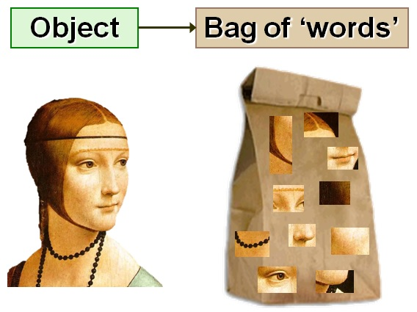
Drawbacks of BOW
In the above example, we can have vectors of length 11. However, we start facing issues when we come across new sentences:
If the new sentences contain new words, then our vocabulary size would increase and thereby, the length of the vectors would increase too.
Additionally, the vectors would also contain many 0s, thereby resulting in a sparse matrix (which is what we would like to avoid)
We are retaining no information on the grammar of the sentences nor on the ordering of the words in the text.

Slide 7
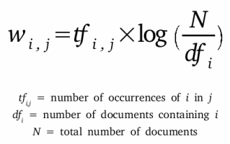
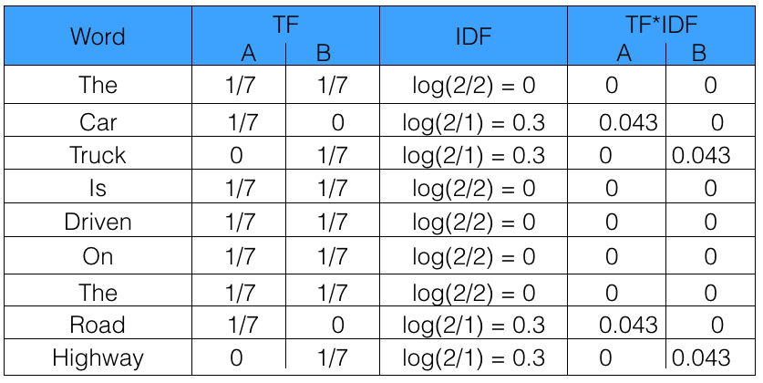
TFIDF
TF-IDF stands for “Term Frequency — Inverse Document Frequency”
It gives us the frequency of the word in each document in the corpus.
It is the ratio of number of times the word appears in a document compared to the total number of words in that document.
It increases as the number of occurrences of that word within the document increases.
Each document has its own term frequency.
Sentence 1 : The car is driven on the road.
Sentence 2 : The truck is driven on the highway.
Example

Slide 8
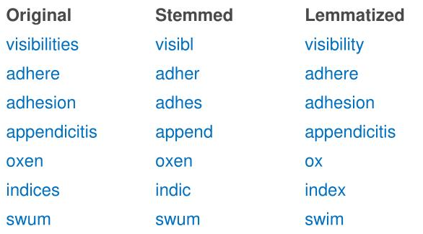
LEMMATIZATION
Lemmatization is closely related to stemming.
In linguistics, it is the process of grouping together the different inflected forms of a word so they can be analyzed as a single item.
Lemmatization changes the verb form, while keeping the meaning of the word the same.
Stemming will reduce “Worker” and “Speaker” to “Work” and “Speak” respectively while lemmatization will reduce them to “Worker” and “Speaker” because “Worker” is not an inflected form of “Work“, neither is “Speaker” an inflected form of “Speak”.

Slide 9
STEMMING
Stemming, in literal terms, is the process of cutting down the branches of a tree to its stem.
Language dependent
e.g., automate(s), automatic, automation all reduced to automat.
Stemmer operates on a single word without knowledge of the context, and therefore cannot discriminate between words which have different meanings depending on part of speech.
However, stemmers are typically easier to implement and run faster, and the reduced accuracy may not matter for some applications.
Porter’s Algorithm
rule based stemmer
produces stems, makes a number of mistakes
Krovetz Algorithm
algorithm + dictionary
if not found → strip suffix, lookup again
produces “words” not stems

Slide 10
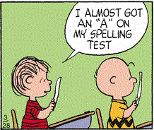
Why Phonetic Hashing ?
There are some cases that can’t be handled either by stemming nor lemmatization. You need another preprocessing method in order to stem or lemmatize the words efficiently.
Example,
‘disappearing’ : ‘dissappearng’ & ’dissapearing’.
After you stem these words, you’ll have two different stems
‘dissappear’ and ‘dissapear’.
You still have the problem of redundant tokens.
lemmatization won’t even work because it only works on correct dictionary spelling

Slide 11
Phonetic Hashing
Phonetic hashing buckets all the similar phonemes (words with similar sound or pronunciation) into a single bucket and gives all these variations a single hash code. Hence, the word ‘Dilli’ and ‘Delhi’ will have the same code.
A commonly used conversion results in a 4-character code, with the first character being a letter of the alphabet and the other three being digits between 0 and 9.
Retain the first letter of the term.
Change all occurrences of the following letters to '0' (zero): 'A', E', 'I', 'O', 'U', 'H', 'W', 'Y'.
Change letters to digits as follows:
B, F, P, V to 1.
C, G, J, K, Q, S, X, Z to 2.
D,T to 3.
L to 4.
M, N to 5.
R to 6.
H,W,Y to unencoded
Repeatedly remove one out of each pair of consecutive identical digits.
Remove all zeros from the resulting string. Pad the resulting string with trailing zeros and return the first four positions, which will consist of a letter followed by three digits.

Slide 12
Example
Let’s try encoding the word “ Hermann ”
Notes:
Answer H655

Slide 13
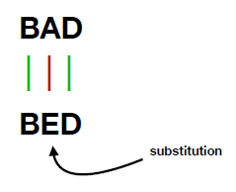

Edit Distance
This method was invented by Vladimir Levenshtein in 1965. The value refer to the minimum number of action (deletion, insertion and substitution) required to transform from one word to another word.
Simply put, edit distance is a measurement of how many changes we must do to one string to transform it into the string we are comparing it to.
As an illustration, the difference between “Frederic” and “Fred” is four, as we can change “Frederic” into “Fred” with the deletion of the letters “e” , “r”, “i” and ”c”.
To calculate the Levenshtein Distance, we have to go through every single word and using the minimum + 1 from
(i-1, j): It means left box (deletion)
(i, j-1): It means upper box (insertion)
(i-1, j-1): It means left upper box (substitution)
https://en.wikipedia.org/wiki/Levenshtein_distance

Slide 14
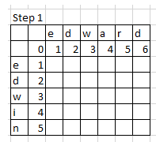
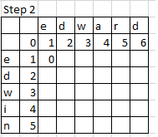
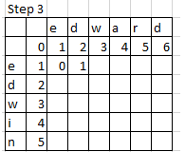
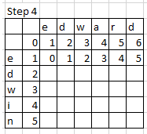
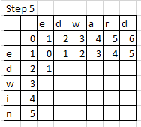
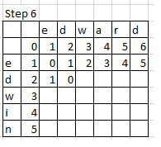
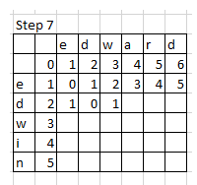
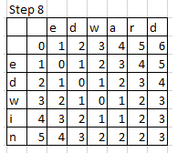
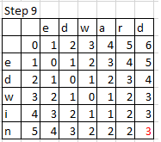
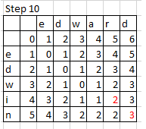
Example
Substitute “n” by “d”
2.Substitute “i” by “r”
3.Delete “a”

Slide 15
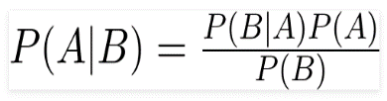


Naive Bayes
What is Naive Bayes?
A Naive Bayes classifier is a probabilistic machine learning model that is based on the Bayes theorem
Bayes Theorem
Using Bayes theorem, we can find the probability of A happening, given that B has occurred. Here, B is the evidence and A is the hypothesis. The assumption made here is that the predictors/features are independent. That is presence of one particular feature does not affect the other. Hence it is called naive.
There could be cases where the classification could be multiclass. Therefore, we need to find the class y with maximum probability.
Naive Bayes algorithms are mostly used in sentiment analysis, spam filtering, recommendation systems etc. They are fast and easy to implement but their biggest disadvantage is that the requirement of predictors to be independent. In most of the real life cases, the predictors are dependent, this hinders the performance of the classifier.
https://web.stanford.edu/class/cs124/lec/naivebayes.pdf

Slide 16
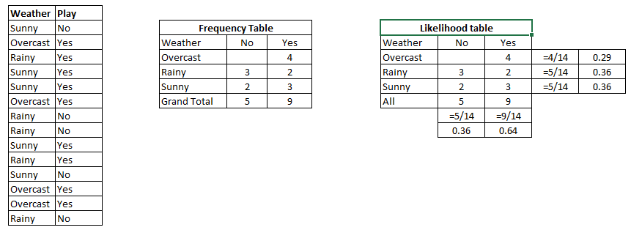
Naive Bayes
Below We have a training data set of weather and corresponding target variable ‘Play’ (suggesting possibilities of playing). Now, we need to classify whether players will play or not based on weather condition. Let’s follow the below steps to perform it.
Will the players play if weather is sunny?
Notes:
P(Yes | Sunny) = P( Sunny | Yes) * P(Yes) / P (Sunny)
Here we have P (Sunny |Yes) = 3/9 = 0.33, P(Sunny) = 5/14 = 0.36, P( Yes)= 9/14 = 0.64
Now, P (Yes | Sunny) = 0.33 * 0.64 / 0.36 = 0.60, which has higher probability.

Slide 17
Let’s see the code walkthrough now !

Slide 18
Thank You !

