Slide 1
爐內破片 map
Represent by:
115/11/07
Notes:
115/11/07
Confidential

Slide 2
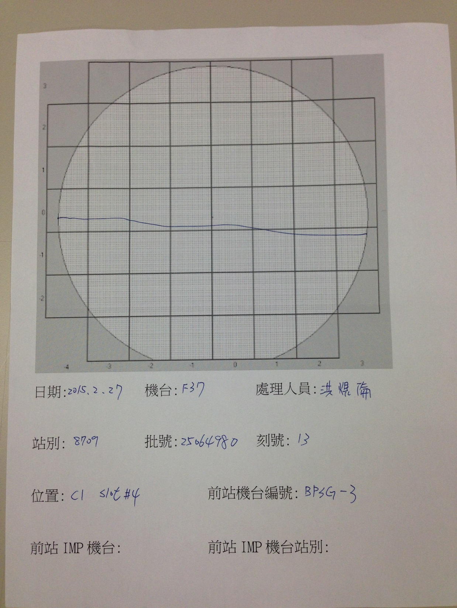

Slide 3
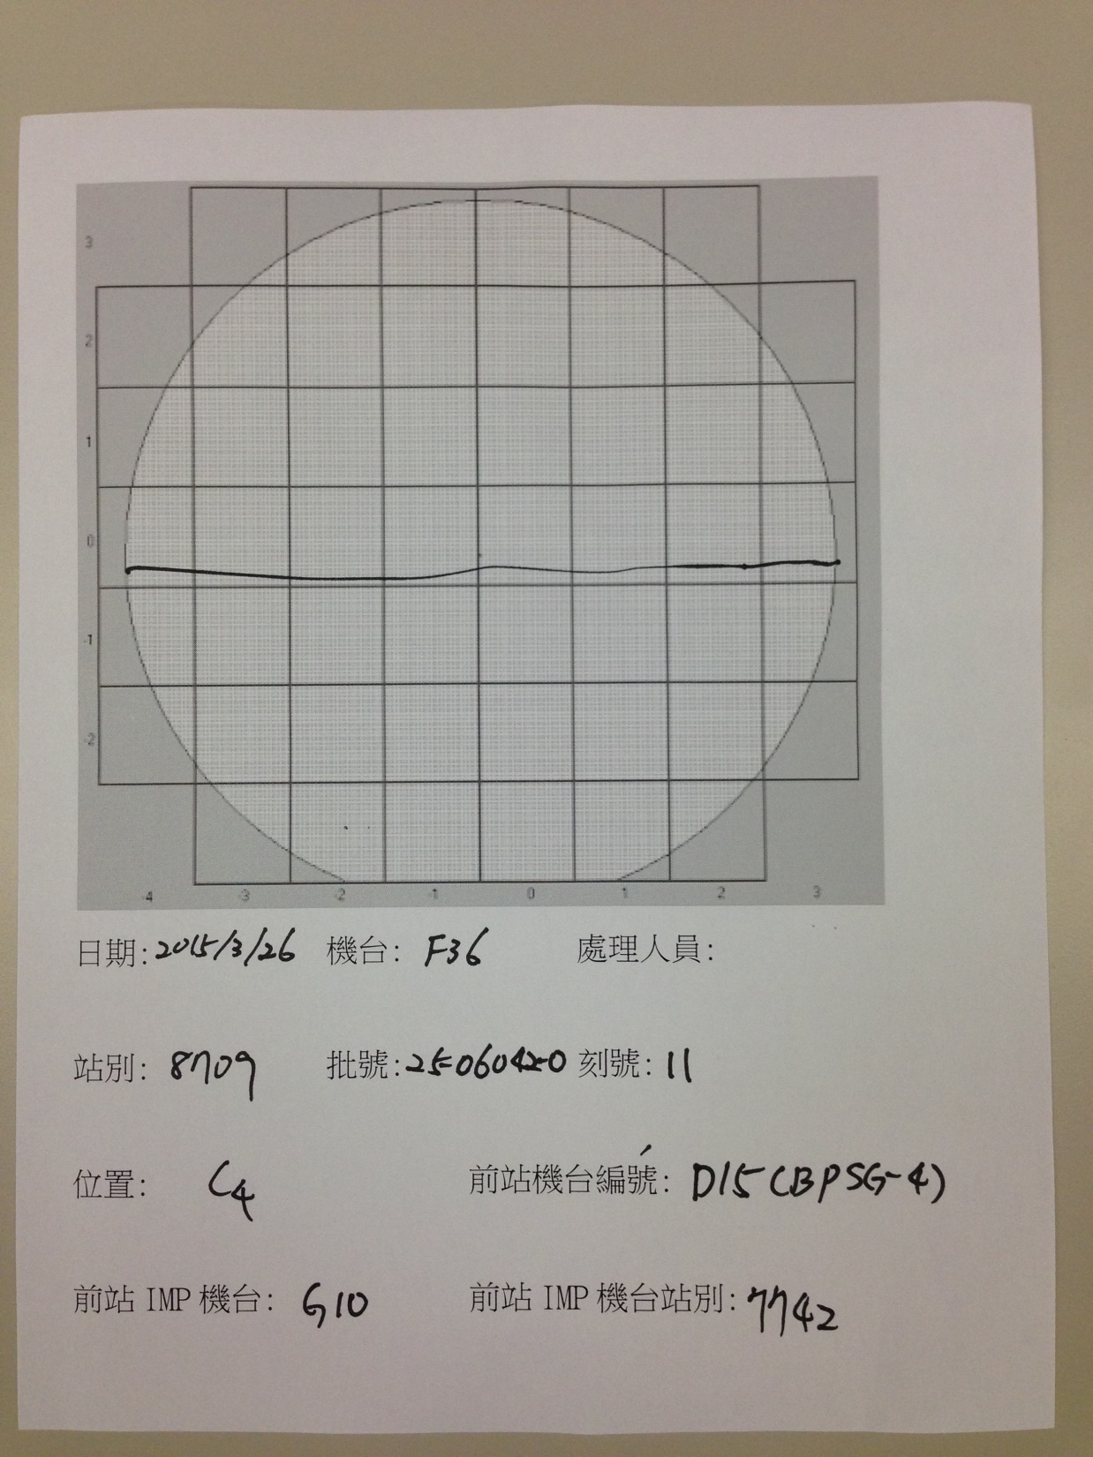

Slide 4
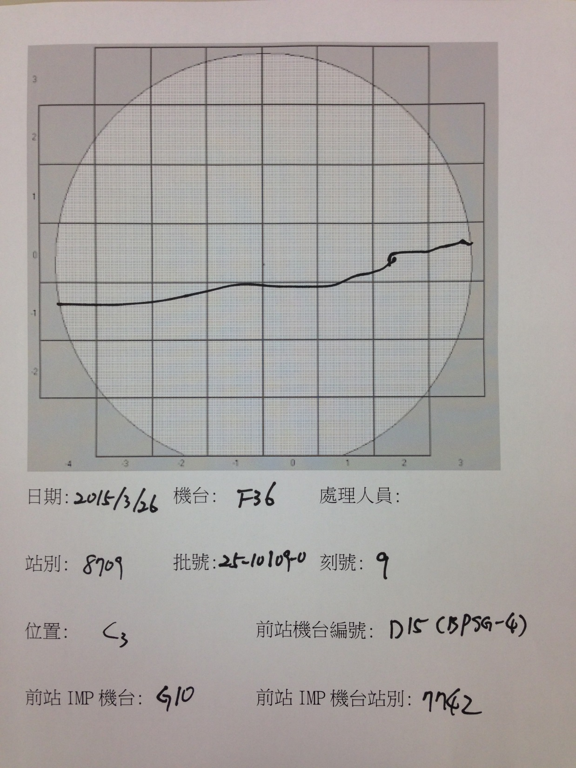

Slide 5
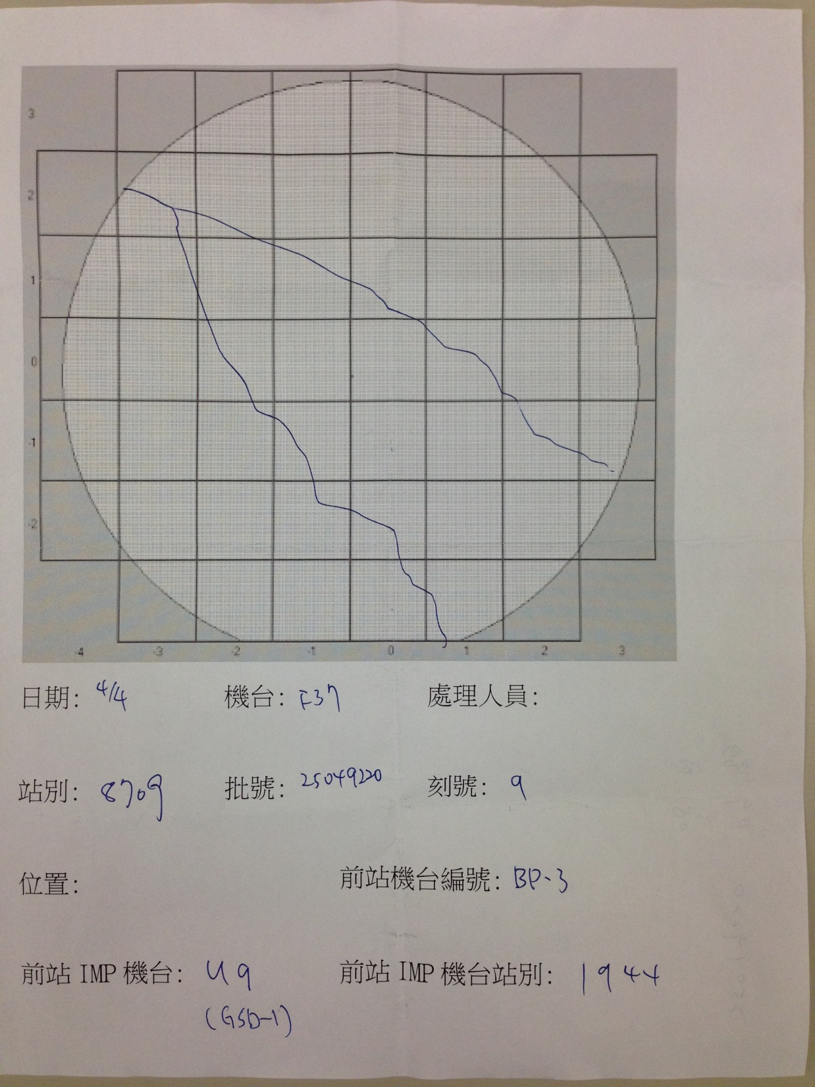

Slide 6
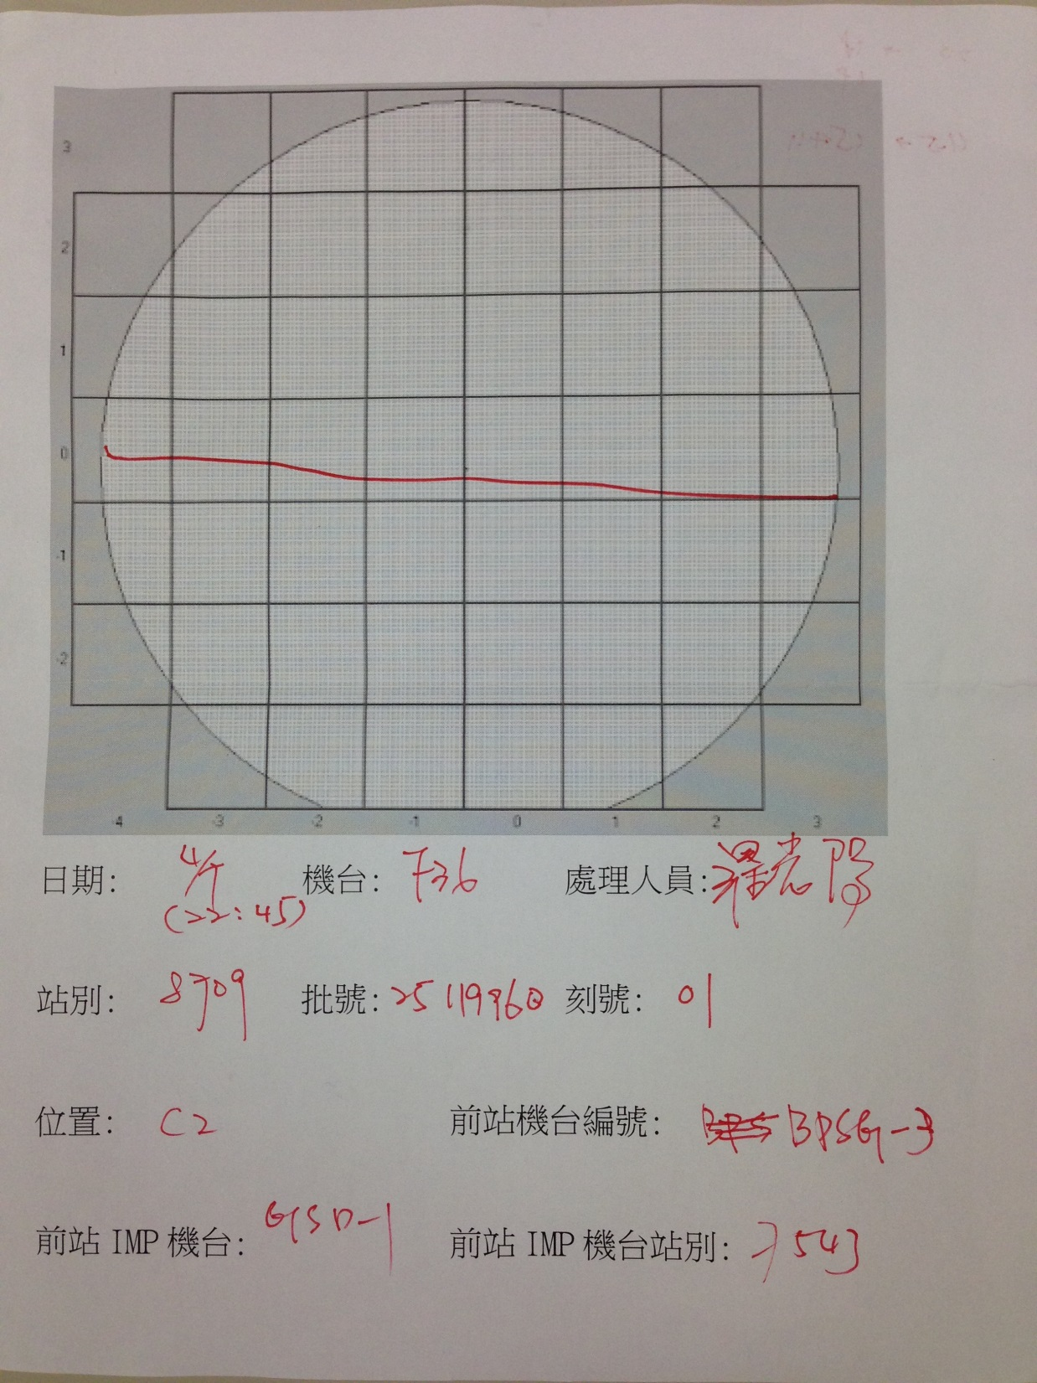

Slide 7
