Slide 1
爐管新人學習進度報告
2024.06.03 ~ 2024.06.14
林峻毅
Notes:
115/11/07
Confidential

Slide 2
日期 | 機台 | 學習內容
6/03 |  | 報到 | 雲端課程
6/04 |  | FAB環境認識 | 雲端課程
6/05 | P2 | 5PM | 雲端課程
6/06 | T5 | 3PM | 雲端課程
6/07 | P6 | 2PM
6/10 |  | 放假
6/11 | T1 | 2PM
6/12 | P4 | 1PM
6/13 | N5 | SPM | 化學品教育訓練
6/14 | N4 | 1PM
2024.06.03 ~ 2024.06.14

Slide 3

機台主流分類

Slide 4
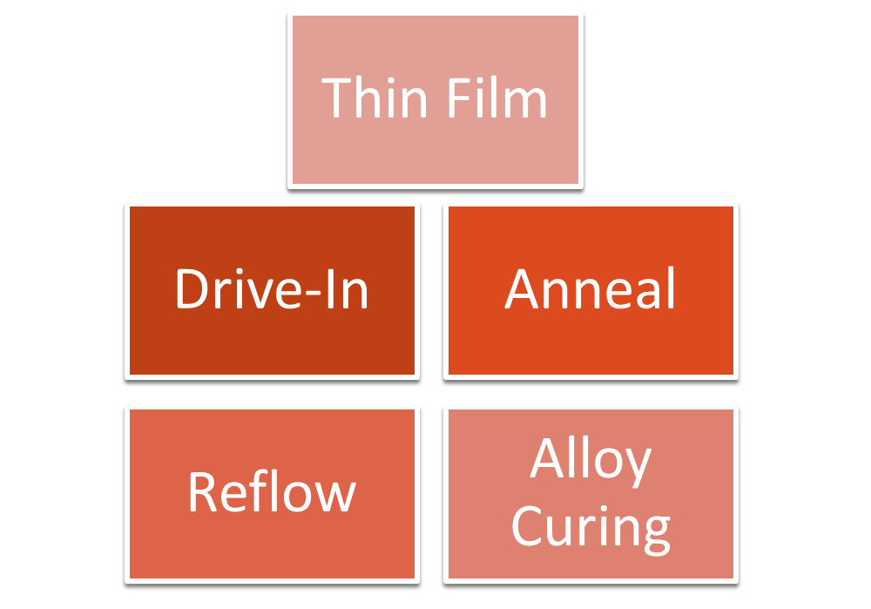
爐管製程分類

Slide 5
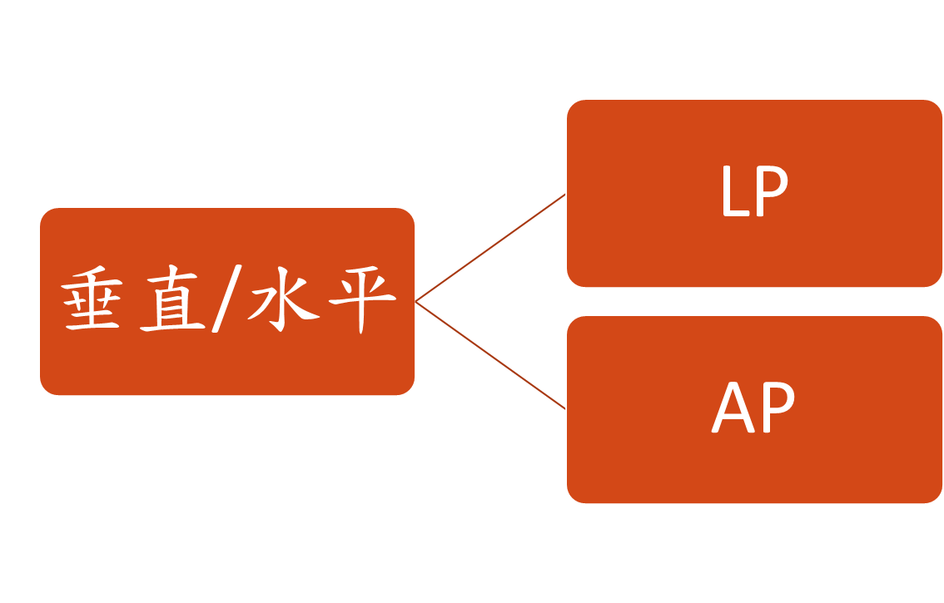
爐管類型

Slide 6
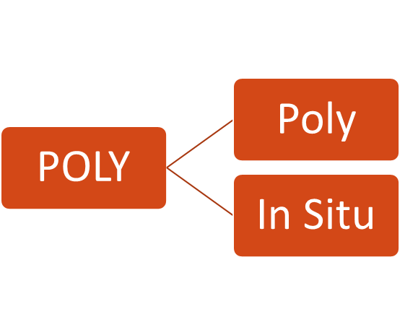
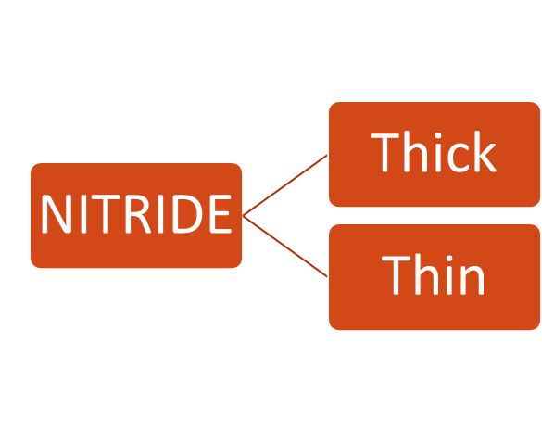
LP
6 x
7 x
8 x
TEOS
HTO

Slide 7
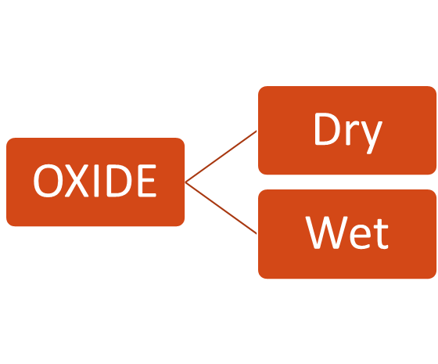
AP
3 x
POCL3
field
gate
pad
sac
poly
oxide
oxide
40 x
oxide
oxide
oxide
2 x
KOYO
bpsg reflow
alloy curing
drive-in
...

Slide 8
其他機台
2 x
WSIX-2
4 x
RTP
2 x
GRD
3 x
EM

Slide 9
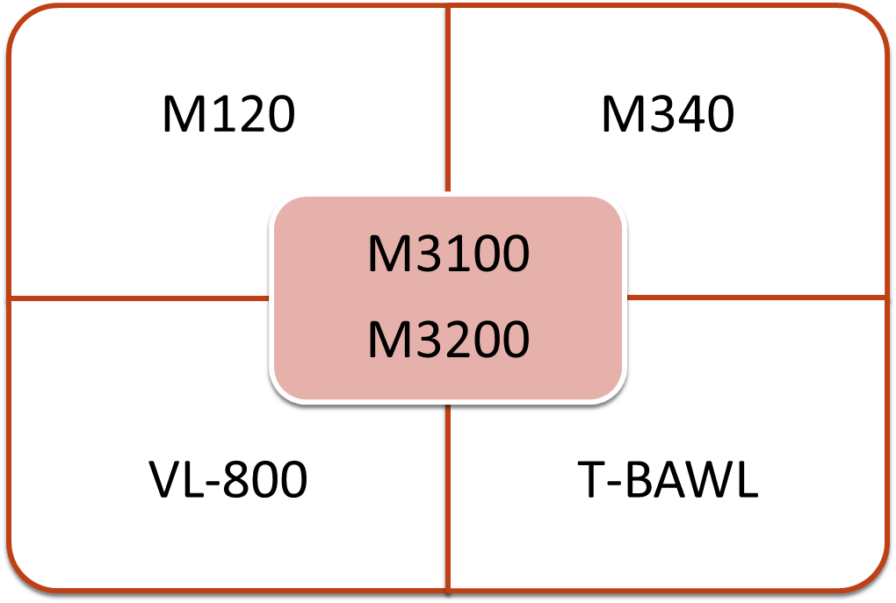
控制介面

Slide 10
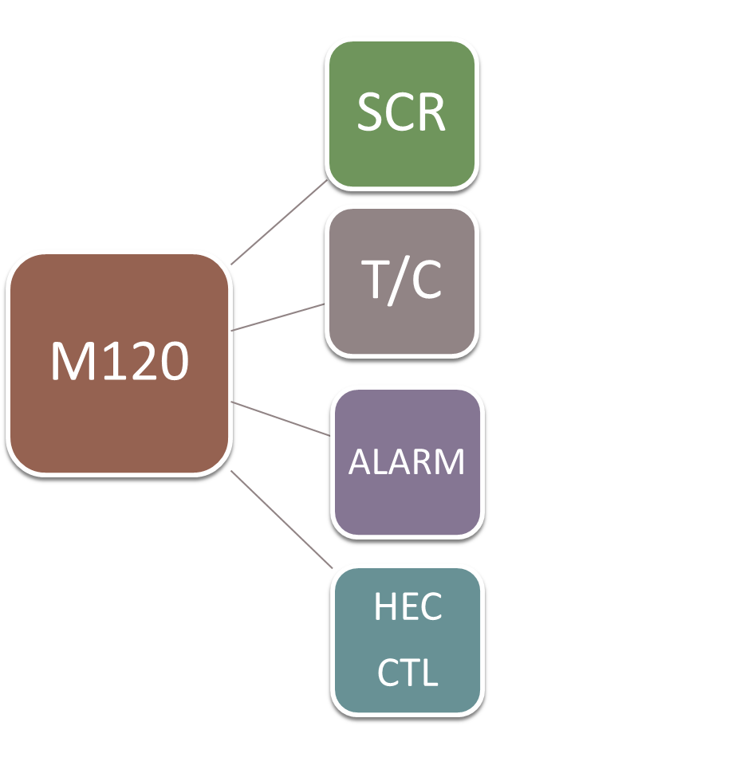
電流控制
測溫元件
異常監控
溫度控制(AP)

Slide 11
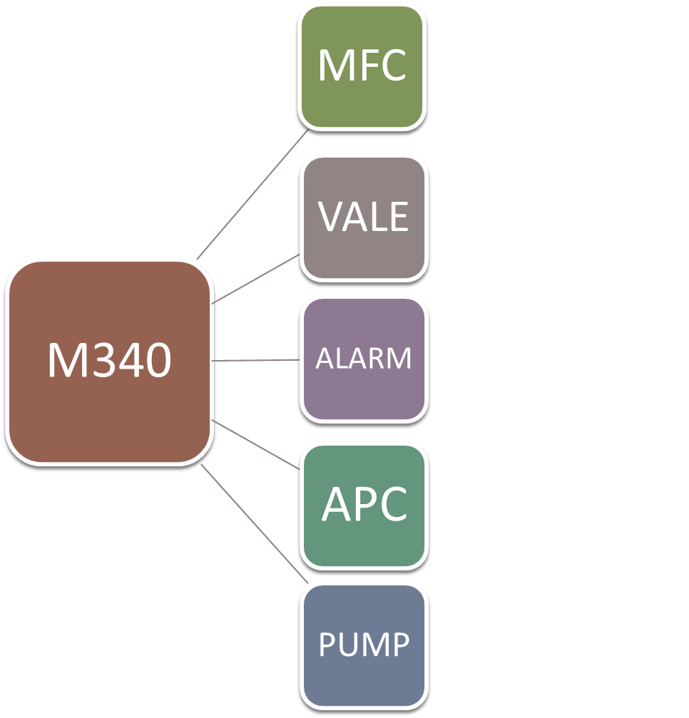
流量控制
閥門控制
異常監控
壓力控制(LP)
抽真空(LP)

Slide 12
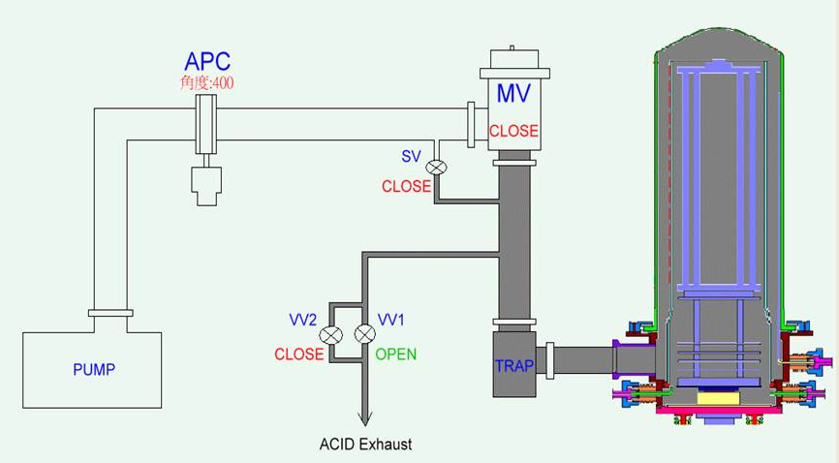

LP機台架構
Boat
Paddle TC
Top
CTR-2
CTR-1
BTM-2
BTM-1
Tube
QSV
Pedestal
Boost Pump
&
Dry Pump
Manifold
vent
Shutter
Injector

Slide 13
LP機台架構
Furnace
Single TC
Top
CTR-2
CTR-1
BTM-2
BTM-1
Double TC
(Spike)

Slide 14
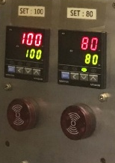
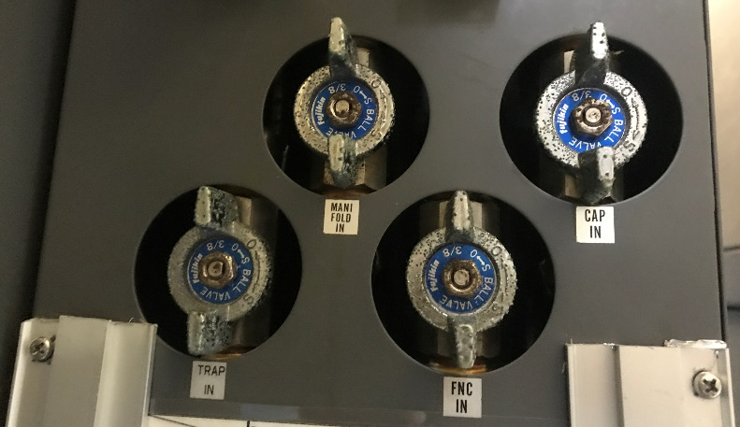
LP機台架構
Manifold
Spindle Cap
Cold Trap
Furnace
MV
Vacuum Pipe

Slide 15
用語縮寫
PCRB
TECN
EMS
RMS
SPC
QIT
(Process Change Review Board)
(Temporary Engineering Change Notice)
(Equipment Management System)
(Recipe Management System)
(Statistical Process Control)
(Quality Improvement Team)

Slide 16
用語縮寫
UT
SU
LT
PM
MD
PD
FD
(Up Time)
(Setup Time)
(Loss Time)
(Preventive Maintenance)
(Machine Down)
(Process Down)
(Fab Down)

