Slide 1
爐管新人學習進度報告
2024.06.17 ~ 2024.06.28
林峻毅
Notes:
115/11/07
Confidential

Slide 2
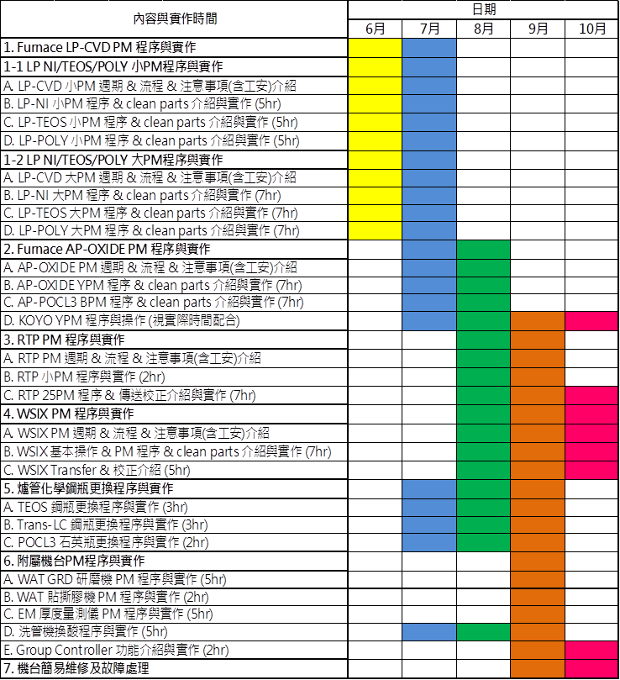

Slide 3
種類 | 進度
LP-P SPM | 100%
LP-T SPM | 100%
LP-N SPM | 100%
LP-P BPM | 90%
LP-T BPM | 80%
LP-N BPM | 70%
AP QPM | 0%
AP YPM | 10%
POCL3 BPM | 0%
WSIX BPM | 0%
WSIX MPM | 0%
GRD MPM | 40%
RTP 25PM | 10%

Slide 4
日期 | 機台 | 實作內容
6/17 | P3 | 4PM | 刮管/承接/傳送
6/18 | T3 | 1PM | Trap/Shutter/刮管/承接/傳送
6/19 | N7 | 轉子更換
6/20 | N1 | SPM | 全部
6/21 | P1 | 5PM | 前段
6/24 | T5 | SPM | 全部
6/25 |  | 急救實體課程
6/26 | RTP4 | 25PM
6/27 | GRD3 | MPM
6/28 | P2 | 1PM | 全部

Slide 5


T-BAWL
INIT
DIAG
EVAL
RUN
<MORE>
EDIT
MDFY
STATUS
TIME
f1
f2
f3
f4
f5

Slide 6


T-BAWL
EVAL
DIAG
INIT
EDIT
MDFY
STATUS
TIME
RUN
<MORE>
f1
f2
f3
f4
f5

Slide 7


T-BAWL
EDIT
<MORE>
TIME
DIAG
MDFY
INIT
EVAL
RUN
STATUS
f1
f2
f3
f4
f5

Slide 8
INITIALIZE SEQUENCE START? (Y/N)
BP. ADJUST START? (Y/N) Y COMPLETE
HP. RESET START? (Y/N) Y COMPLETE
各軸初始化
<EXIT>
f1
f2
f3
f4
f5

Slide 9
DIAG MENU
01 ONE MOTION
02 ONE INITIALIZE
03 ORG.MOTION
04 WELL PITCH SLIDE
<NEXT>
<PREV>
<EXIT>
f1
f2
f3
f4
f5

Slide 10
DIAG MENU
05 SENSOR CHECK
06 ALARM LOG COUNTER
<NEXT>
<PREV>
<EXIT>
f1
f2
f3
f4
f5

Slide 11
01 ONE MOTION
MOTION NO. =03
單軸作動
<EXIT>
f1
f2
f3
f4
f5

Slide 12
03 CPOT LR POS:XXXXXXXX
P01:XXXXXXXX P02:XXXXXXXX P03:XXXXXXXX
<EXIT>
f1
f2
f3
f4
f5

Slide 13
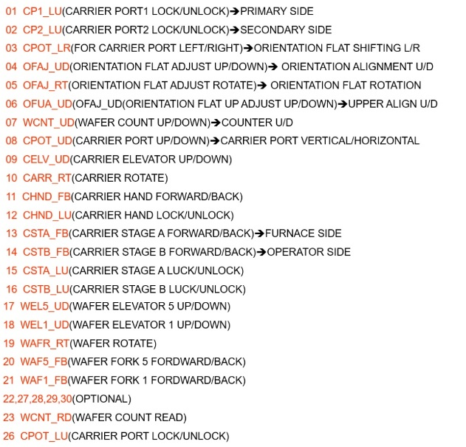


Slide 14
01. CPT1_LU
02. CPT2_LU
03. CPOT_LR
04. OFAJ_UD
05. OFAJ_UD
06. OFUA_UD
07. WCNT_UD
08. CPOD_UD
09. CELV_UD
10. CARR_RT
11. CHND_FB
12. CHND_LU
13. CSTA_FB
14. CSTB_FB
15. CSTA_LU
16. CSTB_LU
CARRIER PORT 內側LOCK
CARRIER PORT 外側LOCK
轉平邊平台 左右移
轉平邊平台 上下移
轉平邊滾軸 旋轉
轉平邊平台中心 上下移
計數器平台 上下移
CARRIER PORT 垂直轉
ROBOT 上下移
ROBOT 左右轉(CARRIER)
ROBOT 前後移
ROBOT LOCK
內CARRIER STAGE 前後移
外CARRIER STAGE 前後移
內CARRIER STAGE LOCK
外CARRIER STAGE LOCK
17.
18.
19. WAFR_RT
20. WAF5_FB
21. WAF1_FB
22.
23. WCNT_RD
24.
25.
26. CPOT_LU
27.
28.
29.
30.
ROBOT 左右轉(FORK)
FORK-5 前後移
FORK-1 前後移
COUNTER 讀值
CARRIER PORT 下方LOCK

Slide 15
02 ONE INITIALIZE
MOTION NO. =01
單軸初始化
<EXIT>
f1
f2
f3
f4
f5

Slide 16
03 ORG.MOTION(1)
01 FORK-5 BOAT
02 FORK-1 BOAT
FORK基準點對齊
TOP、BOTTOM
03 FORK-5 CARRIER
04 FORK-1 CARRIER
<EXIT>
f1
f2
f3
f4
f5

Slide 17
01 FORK-5 BOAT ORG.MOTION
BOAT TOP :XXXXXXXX ACT:XXXXXXXX
BTM:XXXXXXXX
<EXIT>
f1
f2
f3
f4
f5

Slide 18
03 FORK-5 CARRIER ORG. MOTION
C1:XXXXXXXX C5:XXXXXXXX
C2:XXXXXXXX C6:XXXXXXXX ACT:XXXXXXXX
C3:XXXXXXXX C7:XXXXXXXX
C4:XXXXXXXX C8:XXXXXXXX
<EXIT>
f1
f2
f3
f4
f5

Slide 19
04 WELL PITCH SLIDE
AXIS =FORK-1
TARGET=CARRIER-1
PITCH =01
FORK移動至
特定SLOT位置
<EXIT>
f1
f2
f3
f4
f5

Slide 20
05 SENSOR CHECK(1)
CPT1 :XX CPT2:XX OFAJ : XX WCNT:XX
OFUA:XX CPOT:XX CHND:XX WPUT:XX
CSTA :XXXX CSTB:XXXX CARRIA:XXXXXXXX
WSET:XX ORAJ:X WAFZ:X PORT:X
感應器數值
<NEXT>
<PREV>
<EXIT>
f1
f2
f3
f4
f5

Slide 21
05 SENSOR CHECK(2)
CPOT :OFF CELV:OFF CARR : OFF WAF1:OFF
WAF5:OFF CHND: OFF CRT: XX
I/L-1:X I/L-2:2 I/L-3:X PAUSE:X
AC SERVO:XXX
<NEXT>
<PREV>
<EXIT>
f1
f2
f3
f4
f5

Slide 22
05 SENSOR CHECK(3)
CMOV-LU:XX CHV2-UD:XX CMV1-UD:XX
CMOV-LR:XX CARR-IN :XX CMV1-EX :XX
DORR-LR :XX CARR-HN:XX
AC SERVO:XXX
<NEXT>
<PREV>
<EXIT>
f1
f2
f3
f4
f5

Slide 23
06 ALARM LOG. COUNTER (XXX-XXX)
00 00 00 00 00 00 00 00 00 00 00 00
00 00 00 00 00 00 00 00 00 00 00 00
00 00 00 00 00 00 00 00 00 00 00 00
00 00 00 00 00 00 00 00 00 00 00 00
ALARM數量紀錄
<EXIT>
f1
f2
f3
f4
f5

Slide 24
EVAL MENU
01 CARRIER LOAD
02 CARRIER UNLOAD
03 EVALUATION LOAD
04 EVALUATION UNLOAD
<NEXT>
<PREV>
<EXIT>
f1
f2
f3
f4
f5

Slide 25
EVAL MENU
05 WAFER TRANSFER
06 WAFER WITHDRAW
<NEXT>
<PREV>
<EXIT>
f1
f2
f3
f4
f5

Slide 26
01 CARRIER LOAD
C2:OFF C1:OFF
C4:OFF C3:OFF
C6:OFF C5:OFF
C8:OFF C7:OFF
CARRIER NO. =01
WAFER COUNT 25
CARRIER傳送
<EXIT>
f1
f2
f3
f4
f5

Slide 27
02 CARRIER UNLOAD
C2:OFF C1:OFF
C4:OFF C3:OFF
C6:OFF C5:OFF
C8:OFF C7:OFF
CARRIER NO. =01
<EXIT>
f1
f2
f3
f4
f5

Slide 28
03 EVALUATION LOAD
C2:00 C1:00
C4:00 C3:00
C6:00 C5:00
C8:00 C7:00
SELECT MAP NO. =MAP-1
MAP傳送
<EXIT>
f1
f2
f3
f4
f5

Slide 29
04 EVALUATION UNLOAD
C2:00 C1:00
C4:00 C3:00
C6:00 C5:00
C8:00 C7:00
SELECT MAP NO. =MAP-1
<EXIT>
f1
f2
f3
f4
f5

Slide 30
05 WAFER TRANSFER
SEQ. =FORK5-LOAD
CARRIER NO. =1
CARRIER PITCH=01
BOAT PITCH =021
BOAT傳送
<EXIT>
f1
f2
f3
f4
f5

Slide 31
06 WAFER WITHDRAW
C2:00 C1:00
C4:00 C3:00
C6:00 C5:00
C8:00 C7:00
收回上一個傳送
<EXIT>
f1
f2
f3
f4
f5

Slide 32
RUN (HOST-LOCAL) MENU (1)
01 LOAD
T/C:
E/L:
TR :
02 UNLOAD
03 MONITOR CARRIER SET
04 MONITOR CARRIER RELEASE
TUBE CONTROLLER(M3100 ONLINE)
BOAT ELEVATOR(VL800 REMOTE)
BOAT POSITION(VL800)
<NEXT>
<PREV>
<EXIT>
f1
f2
f3
f4
f5

Slide 33
RUN (HOST-LOCAL) MENU (2)
05 DUMMY LOAD
T/C:
E/L:
TR :
06 DUMMY UNLOAD
07 EXTRA DUMMY LOAD
08 EXTRA DUMMY UNLOAD
<NEXT>
<PREV>
<EXIT>
f1
f2
f3
f4
f5

Slide 34
RUN (HOST-LOCAL) MENU (3)
09 DUMMY EXCHANGE
T/C:
E/L:
TR :
<NEXT>
<PREV>
<EXIT>
f1
f2
f3
f4
f5

Slide 35
EDIT MENU
01 MODE SELECT
02 EVALUATION WAFER MAP
03 DUMMY PITCH OF BOAT
04 MONITOR SET OF BOAT
<NEXT>
<PREV>
<EXIT>
f1
f2
f3
f4
f5

Slide 36
EDIT MENU
05 DUMMY USABLE TIME
06 SHORT BATCH REACTION
07 BOAT WAFER POSITION
08 WAFER PUT OFFSET
<NEXT>
<PREV>
<EXIT>
f1
f2
f3
f4
f5

Slide 37
EDIT MENU
09 SPEED OF MOTOR
10 POSITION OF MOTOR
11 ORG. POSITION
12 OAJ TIME
<NEXT>
<PREV>
<EXIT>
f1
f2
f3
f4
f5

Slide 38
MODE SELECT
HOST=REMOTE
TUBE=ON-LINE
AGV =NOT USE
CONTROLLER INTERLOCK
<EXIT>
f1
f2
f3
f4
f5

Slide 39
MAP-1
C1
01=XXX 06=XXX 11=XXX 16=XXX 21=XXX
02=XXX 07=XXX 12=XXX 17=XXX 22=XXX
03=XXX 08=XXX 13=XXX 18=XXX 23=XXX
04=XXX 09=XXX 14=XXX 19=XXX 24=XXX
05=XXX 10=XXX 15=XXX 20=XXX 25=XXX
MAP設定
<EXIT>
f1
f2
f3
f4
f5

Slide 40
03 DUMMY PITCH OF BOAT
TOP =04 1111
BTM=13 11111 11111 111
D/W設定
<EXIT>
f1
f2
f3
f4
f5

Slide 41
04 MONITOR SET OF BOAT
TOP 1001001 BTM
M/W設定
<EXIT>
f1
f2
f3
f4
f5

Slide 42
05 DUMMY USABLE TIME
DUMMY WAFER =05 00
EXTRA DUMMY WAFER=05 00
D/W使用次數設定
<EXIT>
f1
f2
f3
f4
f5

Slide 43
06 SHORT BATCH REACTION
REACTION=PRESS ON
WAFER擺放方式
ALARM :滿批
PRESS ON :中間集中
CONTINUE: 不限
<EXIT>
f1
f2
f3
f4
f5

Slide 44
07 BOAT WAFER POSITION
1CARR. =E 4CARR. =B
2CARR. =D 5CARR. =A
3CARR. =C
A
B
C
D
E
傳送優先順序
<EXIT>
f1
f2
f3
f4
f5

Slide 45
08 WAFER PUT OFFSET
BOAT OFFSET=2200
CARRIER OFFSET=2200
WAFER間距
<EXIT>
f1
f2
f3
f4
f5

Slide 46
09 SPEED OF MOTOR
(03, 09, 10, 11, 17, 18, 19, 20, 21)
MOTION NO. =03
MOTOR速度設定
<EXIT>
f1
f2
f3
f4
f5

Slide 47
10 POSITION OF MOTOR
01 CARRIER TRANSFER
02 WAFER TRANSFER FORK-5
03 WAFER TRANSFER FORK-1
MOTOR傳送調整
04 CARRIER PORT
<EXIT>
f1
f2
f3
f4
f5

Slide 48
01 CARRIER TRANSFER
PART=CARRIER-1
<EXIT>
f1
f2
f3
f4
f5

Slide 49
CARRIER-1 ACT:XXXXXXXX
M09 CELV -UD C1L=XXXXXXXX C1H=XXXXXXXX
M10 CARR RT CR1=XXXXXXXX
M11 CHND FB C1L=XXXXXXXX C1U=XXXXXXXX
M12 CHND-LU
<EXIT>
f1
f2
f3
f4
f5

Slide 50
02 WAFER TRANSFER FORK-1
PART=CARRIER-1
<EXIT>
f1
f2
f3
f4
f5

Slide 51
CARRIER-1 (FORK-1) ACT:XXXXXXXX
M18 WEL1-UP CR1=XXXXXXXX
M19 WAFR-RT CR1=XXXXXXXX
M21 WAF1-FB CRL=XXXXXXXX
<EXIT>
f1
f2
f3
f4
f5

Slide 52
04 CARRIER PORT
PART=M03 CPOT-LR
<EXIT>
f1
f2
f3
f4
f5

Slide 53
M03 CPOT-LR ACT:XXXXXXXX
HP. =XXXXXXXX OAJ=XXXXXXXX WCT=XXXXXXXX
<EXIT>
f1
f2
f3
f4
f5

Slide 54
11 ORG. POSITION
01 FORK-5 BOAT
02 FORK-1 BOAT
03 FORK-5 CARRIER
04 FORK-1 CARRIER
FORK基準點對齊
TOP、BOTTOM
<EXIT>
f1
f2
f3
f4
f5

Slide 55
01 FORK-5 BOAT ORG. POSITION
BOAT TOP =XXXXXXXX ZCT:XXXXXXXX
BTM=XXXXXXXX
<EXIT>
f1
f2
f3
f4
f5

Slide 56
12 OAJ TIME
LOWER ALIGN TIME = 060 (*0.1 SEC)
UPPER ALIGN TIME = 022 (*0.1 SEC)
WAFER轉平邊時間
<EXIT>
f1
f2
f3
f4
f5

Slide 57
MDFY MENU
01 LOT ATTRIBUTE
02 BOAT WAFER STATUS
03 CARRIER STATUS
<EXIT>
f1
f2
f3
f4
f5

Slide 58
01 LOT ATTRIBUTE
  NOT USED
未使用
<EXIT>
f1
f2
f3
f4
f5

Slide 59
02 BOAT WAFER STATUS(1)
001-025 - - - - - - - - - - - - - - - - - - - - PREDT
025-050 - - - - - - - - - - - - - - - - - - - - - - - - -
051-075 - - - - - - - - - - - - - - - - - - - - - - - - -
076-100 - - - - - - - - - - - - - - - - - - - - - - - - -
BOAT傳送紀錄
P: PRODCT WAFER
E: EXTRA DUMMY
D: RESIDENT DUMMY
T: TEST WAFER
R: REFERENCE WAFER
(MONITOR)
<NEXT>
<PREV>
<EXIT>
f1
f2
f3
f4
f5

Slide 60
02 BOAT WAFER STATUS(2)
101-125 --
125-150 --
151-175 --
176-200 --
<NEXT>
<PREV>
<EXIT>
f1
f2
f3
f4
f5

Slide 61
03 CARRIER STATUS(1)
C1 : 05 - - - - - - - - - - - - - - - - - - - - PREDT
C2 : 00 - - - - - - - - - - - - - - - - - - - - - - - - -
C3 : 00 - - - - - - - - - - - - - - - - - - - - - - - - -
C4 : 00 - - - - - - - - - - - - - - - - - - - - - - - - -
CARRIER傳送紀錄
P: PRODCT WAFER
E: EXTRA DUMMY
D: RESIDENT DUMMY
T: TEST WAFER
R: REFERENCE WAFER
(MONITOR)
<NEXT>
<PREV>
<EXIT>
f1
f2
f3
f4
f5

Slide 62
03 CARRIER STATUS(1)
C5 : --
C6 : --
C7 : --
C8 : --
<NEXT>
<PREV>
<EXIT>
f1
f2
f3
f4
f5

Slide 63
STATUS MENU
01 BOAT WAFER STATUS
02 CARRIER STATUS
傳送紀錄(唯讀)
<EXIT>
f1
f2
f3
f4
f5

Slide 64
02 BOAT WAFER STATUS(1)
001-025 - - - - - - - - - - - - - - - - - - - - PREDT
025-050 - - - - - - - - - - - - - - - - - - - - - - - - -
051-075 - - - - - - - - - - - - - - - - - - - - - - - - -
076-100 - - - - - - - - - - - - - - - - - - - - - - - - -
BOAT傳送紀錄
P: PRODCT WAFER
E: EXTRA DUMMY
D: RESIDENT DUMMY
T: TEST WAFER
R: REFERENCE WAFER
(MONITOR)
<NEXT>
<PREV>
<EXIT>
f1
f2
f3
f4
f5

Slide 65
02 BOAT WAFER STATUS(2)
101-125 --
125-150 --
151-175 --
176-200 --
<NEXT>
<PREV>
<EXIT>
f1
f2
f3
f4
f5

Slide 66
03 CARRIER STATUS(1)
C1 : 05 - - - - - - - - - - - - - - - - - - - - PREDT
C2 : 00 - - - - - - - - - - - - - - - - - - - - - - - - -
C3 : 00 - - - - - - - - - - - - - - - - - - - - - - - - -
C4 : 00 - - - - - - - - - - - - - - - - - - - - - - - - -
CARRIER傳送紀錄
P: PRODCT WAFER
E: EXTRA DUMMY
D: RESIDENT DUMMY
T: TEST WAFER
R: REFERENCE WAFER
(MONITOR)
<NEXT>
<PREV>
<EXIT>
f1
f2
f3
f4
f5

Slide 67
03 CARRIER STATUS(2)
C5 : --
C6 : --
C7 : --
C8 : --
<NEXT>
<PREV>
<EXIT>
f1
f2
f3
f4
f5

Slide 68
TIMER SET&DISPLAY DISPLAY MODE
DATE(YY/MM/DD) = 26/11/07
TIME(HH:MM:SS) = 22:07:23
T-BAWL時間
<EXIT>
f1
f2
f3
f4
f5

Slide 69
PASS WORD PLEASE
系統DEBUG
<EXIT>
f1
f2
f3
f4
f5

Slide 70
PASS WORD PLEASE
系統參數
<EXIT>
f1
f2
f3
f4
f5

